Slide 1


akka.net
By Taswar Bhatti
System Architect for Gemalto
Microsoft MVP
http://taswar.zeytinsoft.com
@taswarbhatti
taswar@gmail.com
24 March 2016

Slide 2
Agenda
What are we trying to solve?
What is Akka.Net
How does it work?
Demo
Additional Resources

Slide 3
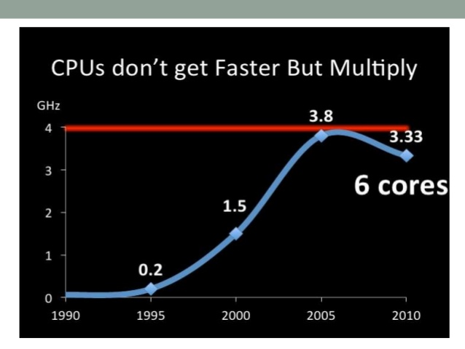
Free Lunch or Pizza is Over

Slide 4
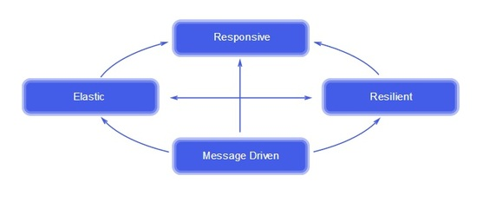
Reactive Manifesto
Message Driven (async, loose coupling, location independent)
Elastic (Scalable)
Responsive (in timely manner)
Resilient (Recovery)

Slide 5
Classic .NET applications
Scale up | Scale out | Elasticity
Parallel Linq | WCF | ?
TPL (Task Parallel Library) | Webapi
async await | MSMQ
Threads | Azure Service Bus

Slide 6
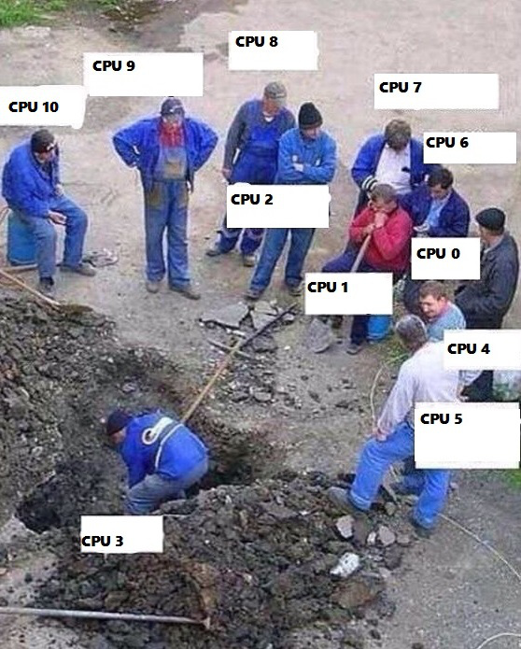
Multicore with your app

Slide 7
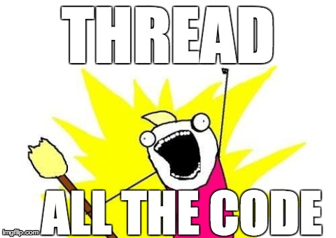
Write more threads

Slide 8
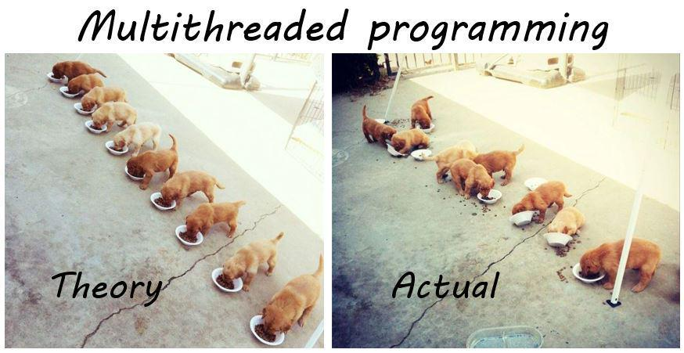
Multi Threading

Slide 9

Fixing multithreading is no fun

Slide 10
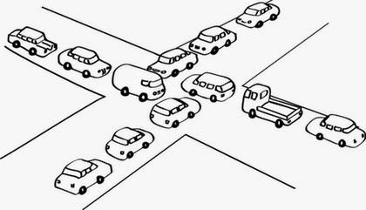
Deadlock

Slide 11

Concurrency is HARD
Complexities of concurrency, parallelism, and multi-threading is no piece of cake, poor babies…………

Slide 12
Akka.Net
Scale up | Scale out | Elasticity
Akka Actor | Akka Remote | Akka Cluster
Simplify the building of scalable, concurrent,
high -throughput and low latency systems

Slide 13
Classes of Applications
Transactional applications (Financial, gambling/betting, social media, telecom)
Batch (Divide workloads between actors)
General Service (REST, SOAP, System integration)
Communications (Chat app, Real time notification
Gaming (Multiplayer interactions)
Traffic Management (Road traffic flow, asset management)
Numerical Processing (Biz intelligence, data mining)
IoT (Incoming stream of data sensor)

Slide 14
The Actor Model
1973 Actor model Carl Hewitt
The actor model is a conceptual model
It deal with concurrent computation
It defines general rules for how the system’s components should behave and interact with each other
Commonly used in Erlang

Slide 15

Actors not these one

Slide 16
What is an Actor?
Everything is an Actor
Actors are inherently lazy
Fundamental primitive computational unit
Small well defined task
Actor code is the same whether it’s local or distributed
Every actor instance has an address
Actors communicate via messages

Slide 17
Four things an Actor can do
Receive and React to messages
Create more actors
Send messages to other actors
Change Behavior for next message

Slide 18
Actors
Incoming Mailbox
State
Children Actors Hierarchy
Supervision Strategy (in case of some failure in children)
Behavior
Actors always processes one message at a time

Slide 19
Messages
POCO class
Message instances should be immutable
Passing of messages is asynchronous

Slide 20
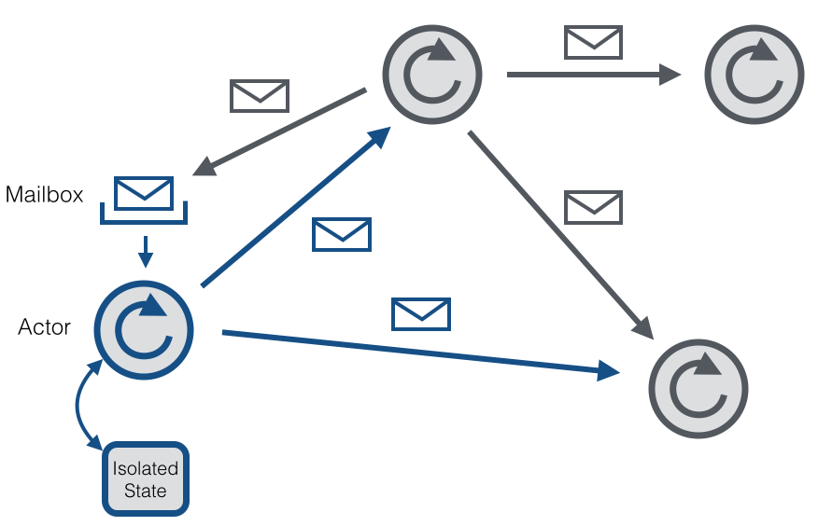
Actors and Messages

Slide 21
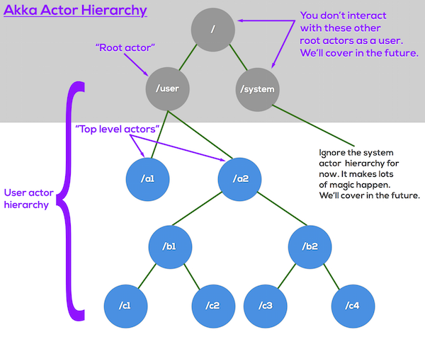
Actors Hierarchy

Slide 22
When Children do bad things
Parent actors have a supervision strategy for children actor
Default could be restart the child actor
Or if it does not know what do let its parent know
A child actor cannot notify a grand parent of misbehavior it is up to the parent actor to propagate the message up, such that failures can be isolated

Slide 23
Supervisors
A supervisor can decide to:
Force a restart
Terminate
Ignore and resume
Escalate up to it’s own supervisor

Slide 24
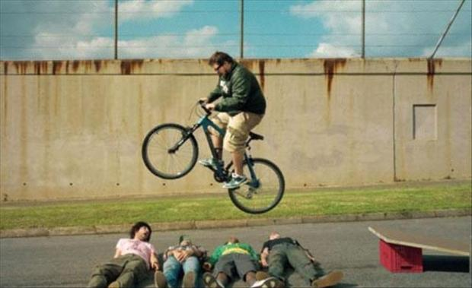
Error handling in Java, C# and C

Slide 25
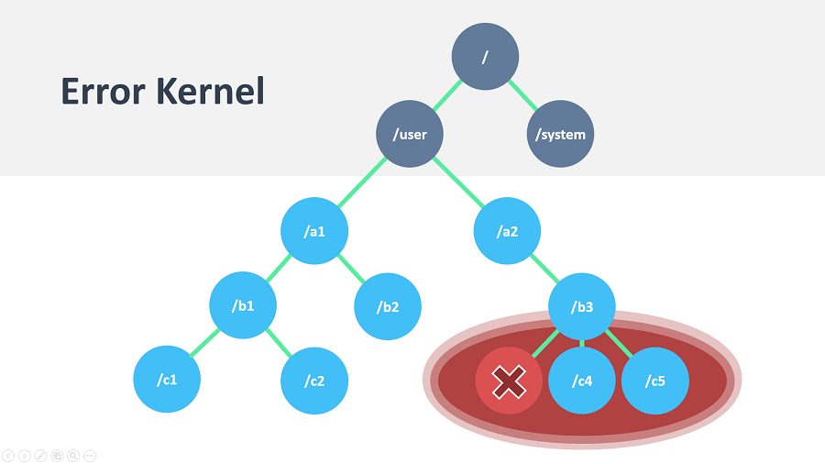
Error

Slide 26
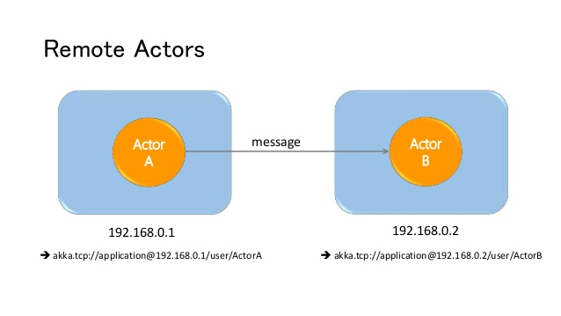
Akka Remoting

Slide 27
Akka .Net Packages
Akka
Akka Remote
Akka Cluster
Akka DI (Dependency Injection)
Akka Test (TestKit)
Akka Persistence
Akka Logger

Slide 28
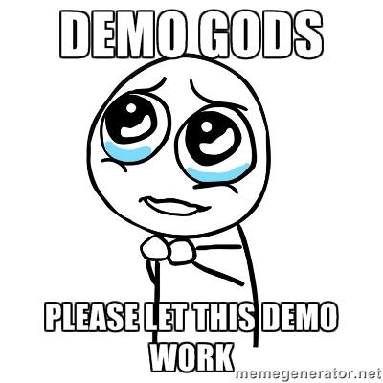
Demo

Slide 29
Resources
Akka .NET (http://getakka.net/)
Akka Bootcamp (https://github.com/petabridge/akka-bootcamp)
Petabridge Training (https://petabridge.com/)
Manning Book (Reactive Applications with Akka.NET)
https://www.manning.com/books/reactive-applications-with-akka-net
Project Orleans (another Actor Model)
Pluralsight Courses

