Slide 1

Conceptual Architecture of PostgreSQL
Team C-Lion:
Yonis Abokar, Qasim Ahmed, Chirag Sardana, Sarwat Shaheen, Chandler Cabrera, Taswar Karim

Slide 2
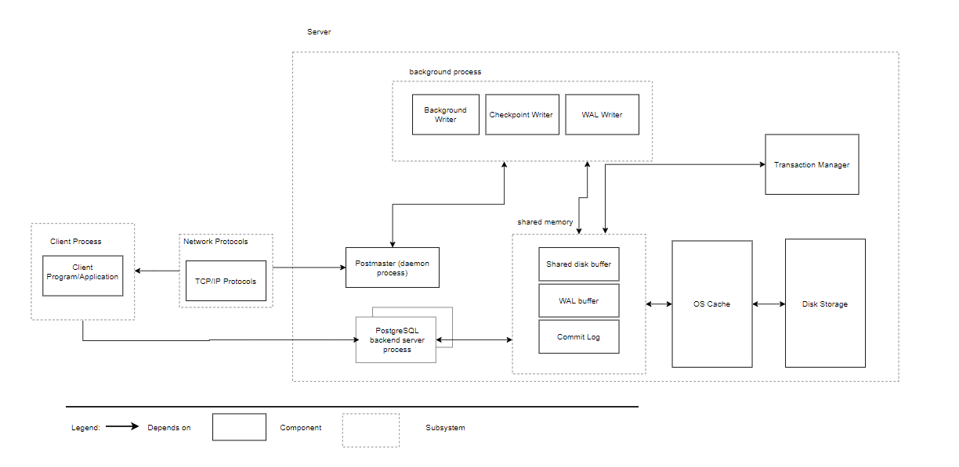
Introduction
PostGreSQL is an object relational database management system.
Developed in 1996
Uses variety of architecture styles(client-server, pipe and filter, layered and repository style)
Figure 2: Conceptual architecture - high level view of postgreSQL [3]
Notes:
If the client and server don’t reside on the same computer a TCP/IP network connection needs to be established

Slide 3
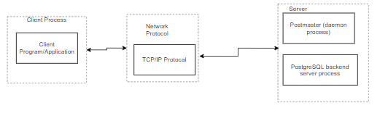
Subsystems: Client
The client’s application uses an INTERFACE LIBRARY to communicate with the postgreSQL server
Transforms the client application command into an SQL query
Common Examples:
Libpq for C
Psycopg2 for Python
PostgreSQL JDBC Driver for Java
Figure 3: Conceptual architecture - high level view of postgreSQL

Slide 4
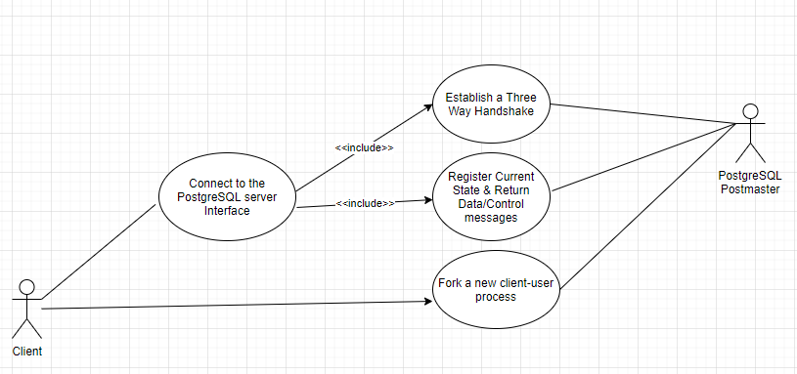
Use Case
Figure 4: Use Case Explained

Slide 5
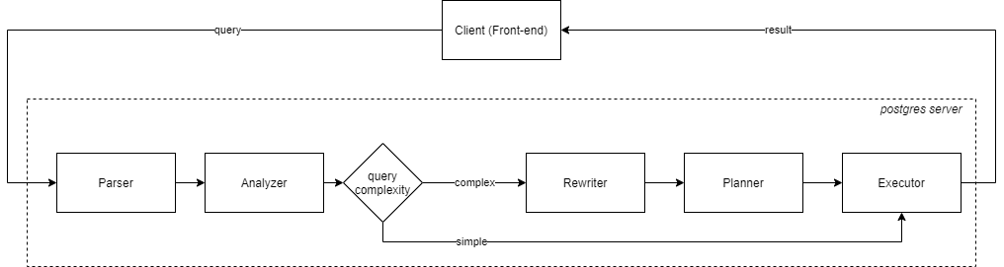
Subsystems: Server
The server uses a PIPE AND FILTER architecture
Processes the plaintext query and transforms it into various query trees
The executor recursively indexes the tree to determine what operations to perform Data is returned to the client
Figure 5: PostgreSQL server architecture - Query Processing [4]

Slide 6
Subsystems: Database Control
The server interacts with the database in two ways:
ACCESS
Used when the server must retrieve data (tables, rules, etc)
Common operations: index, scan, search, compile, return data
STORAGE
The subsystem in which data is stored
Stored data is accessed

Slide 7
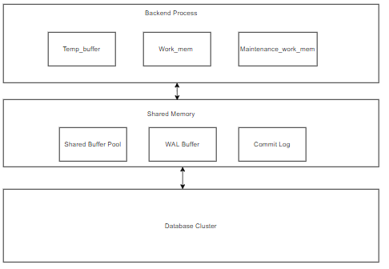
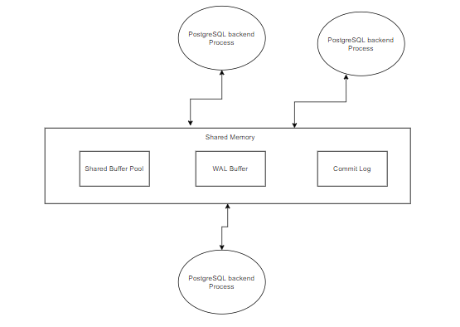
Memory Architecture
Shared memory uses both layered and repository style
Two types of memory areas local memory and shared memory
Local memory has sub areas like work memory, maintenance memory and temporary memory
Local memory is basically used for doing operations in query for tables
Shared memory has shared buffer pool for retrieving different tables needed in the query for operation
Figure 6: High level view of layered memory architecture [5] [6]
Notes:
-Shared memory does the operations in order to maintain concurrency so that the data in database cluster is consistent
-Shared memory makes use of database cluster which has the consistent data cluster which has the consistent data .
ter

Slide 8

DBMS System Evolution
Performance Optimization
Caching and connection pooling
More Object Oriented features
Restrictions on defining methods on data types
Potential Support for future Query Languages
Graph Query Language (GQL)
Figure 7 [2]

Slide 9
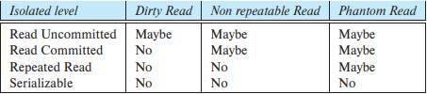
Concurrency
Multiversion Concurrency Control (MVCC)
Reading data doesn’t conflict with locks acquired for writing data
Read Committed
Repeatable Read Isolation
Serializable
Figure 8: Standard SQL isolation levels [3]

Slide 10
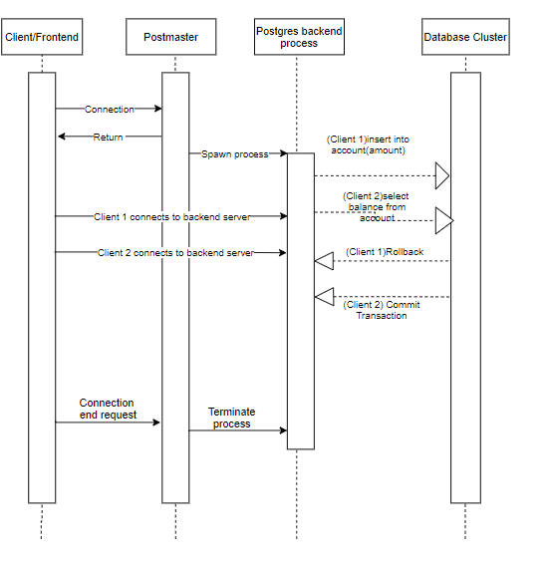
Figure 9: Sequence diagram for transaction isolation level

Slide 11
References
[1] https://digitalthinkerhelp.com/what-is-client-server-architecture-diagram-types-examples-components/
[2]https://cdn.britannica.com/84/203584-050-57D326E5/speed-internet-technology-background.jpg
[3]https://www.db-book.com/db7/online-chapters-dir/32.pdf
[4]https://www.google.com/url?q=https://www.interdb.jp/pg/pgsql03.html&sa=D&source=editors&ust=1633358946868000&usg=AOvVaw1c7-OePgB55ARmaryRgh8g
[5] https://media.oiipdf.com/pdf/e20b3491-488b-466d-86d6-24659ff0594a.pdf

Slide 12


