Slide 1

Concrete Architecture
PostgreSQL
Shared Memory
Team C-Lion
Yonis, Qasim, Chirag, Sarwat, Chandler, Taswar, Amir, Kai

Slide 2
Introduction
We chose Shared memory subsystem to talk about in our presentation
We will touch on different architecture subsystems within shared memory and do a live demo
Furthermore we will show sequence diagrams of shared memory and use cases.

Slide 3
Process of deriving Concrete Architecture
Checked the postgres source code
Understood the dependencies and created scripts to extract dependencies
Looked at the Postgres_Understand_FileDependency.csv file
Created the subsystems in containment files
Generated clean high level architecture diagrams via Lsedit tool

Slide 4
Top level Subsystems
Describe the functionality of the top level subsystems
Present the rationale for the interactions between these subsystems
Client Interface Library(pibpq, ecpg)
Backend (postmaster, query processing, tcop etc)
Include (contains .h header files)

Slide 5
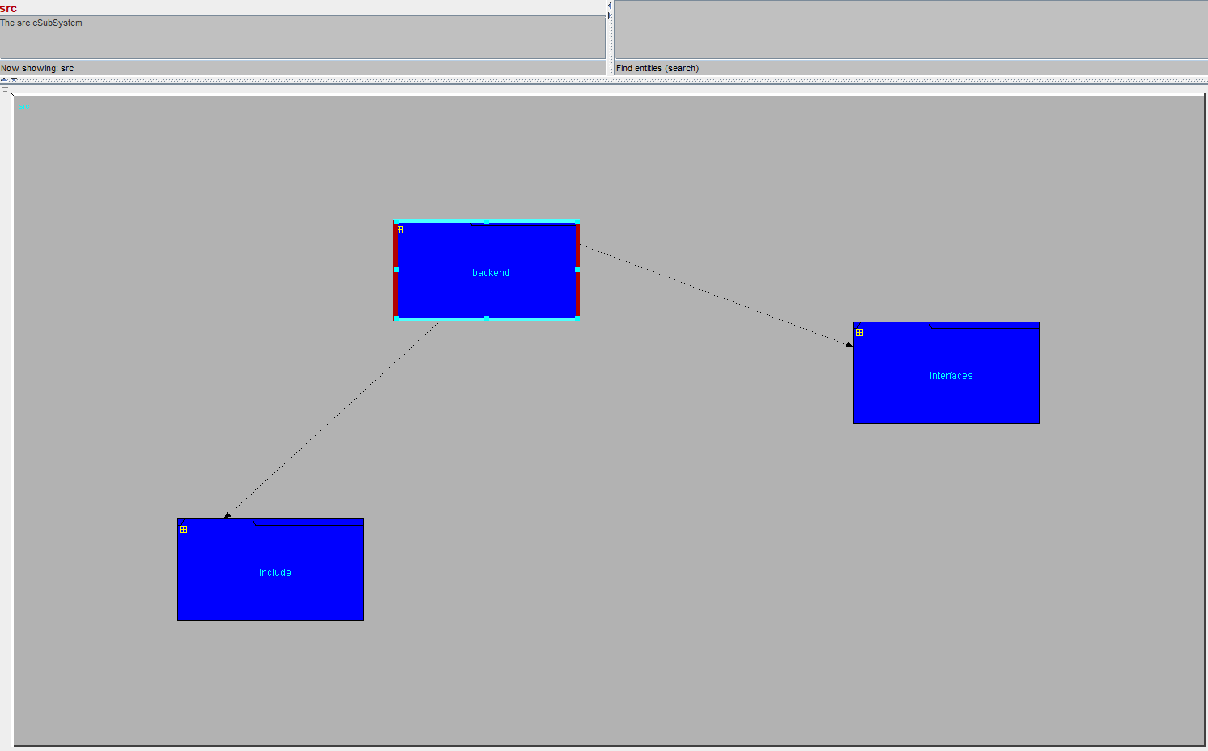
Figure 1: High Level Concrete Architecture

Slide 6
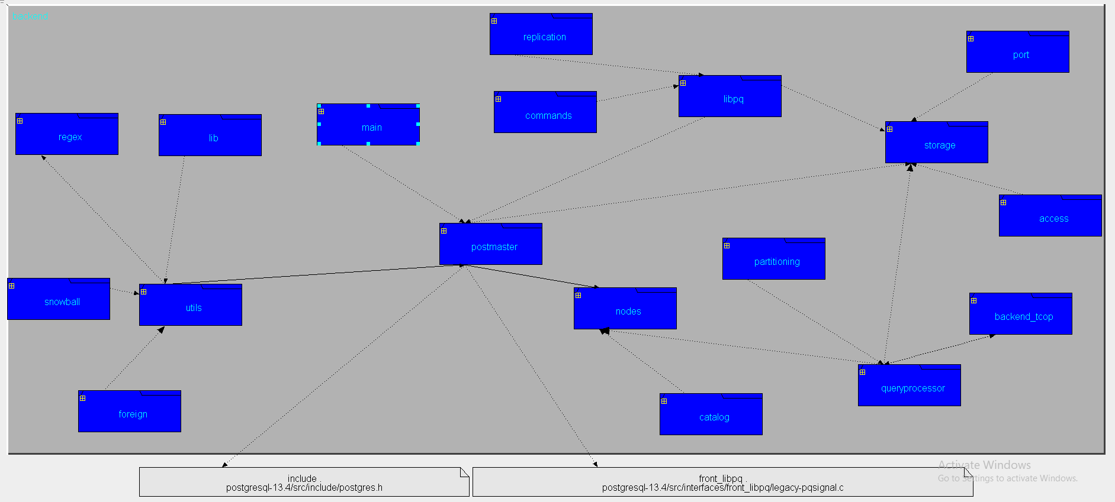
Figure 2: Concrete Architecture of Backend Subsystem

Slide 7
Architectural Style of PostgreSQL
Relational database sub-systems use a combination of architectural styles (Client-Server, Pipe-Filter, & Master-Slave models)
PostgreSQL makes use of the database-centric architecture
This architecture allows for stored procedures which can run on the database server itself
Allows for ease of sharing of memory between many clients in distributed computing applications
Architecture makes use of table driven logic instead of commonly used compiler logic

Slide 8
Design Patterns in Shared Memory
Lots of design pattern exists for the purposes of shared memory
Usage of these patterns depends on their respective application domain
Some notably used design patterns used in shared memory:
Static Allocation Pattern: Used for predictable shared memory systems
Pool Allocation Pattern: Used for dynamically shared memory systems
Garbage Collection Pattern: Used for clearing up pointer defects and memory leaks with the shared memory
Layered Pattern: Used by the Buffer Manager to transfer data between storage and shared memory

Slide 9
Live Demo of the Extracted Architecture
Provide a live demo of the extracted architecture and explain its subcomponents and their interactions using LSEdit

Slide 10
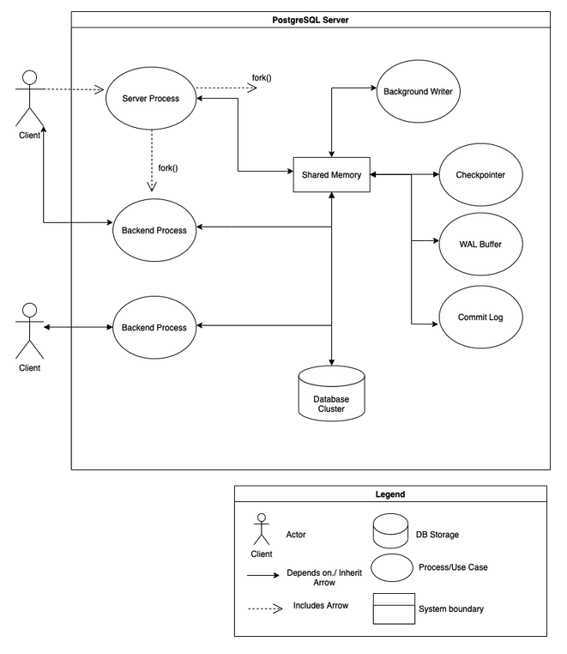
Use Case
Postmaster
Notes:
Kai

Slide 11
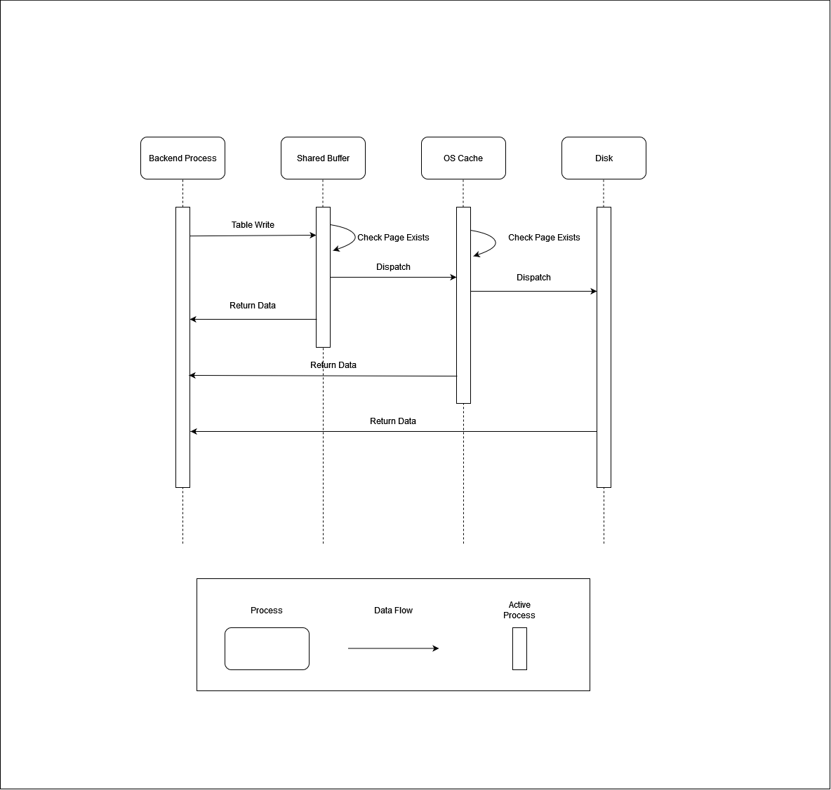
Sequence Diagram
Shared buffer mechanism:
- Backend process requests
To update table x
- Each memory unit checks if table x
exists before passing the request
forward
Notes:
Kai

Slide 12
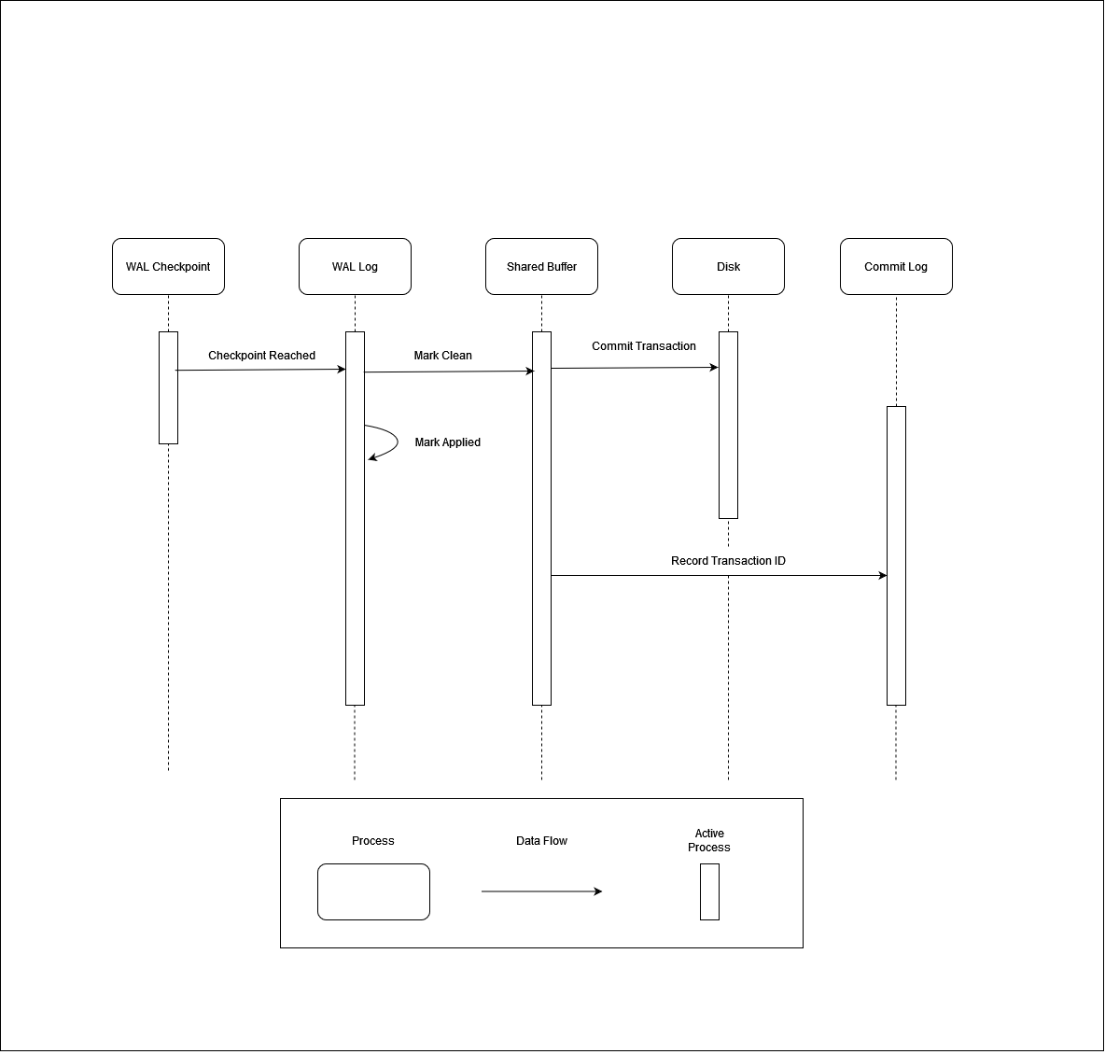
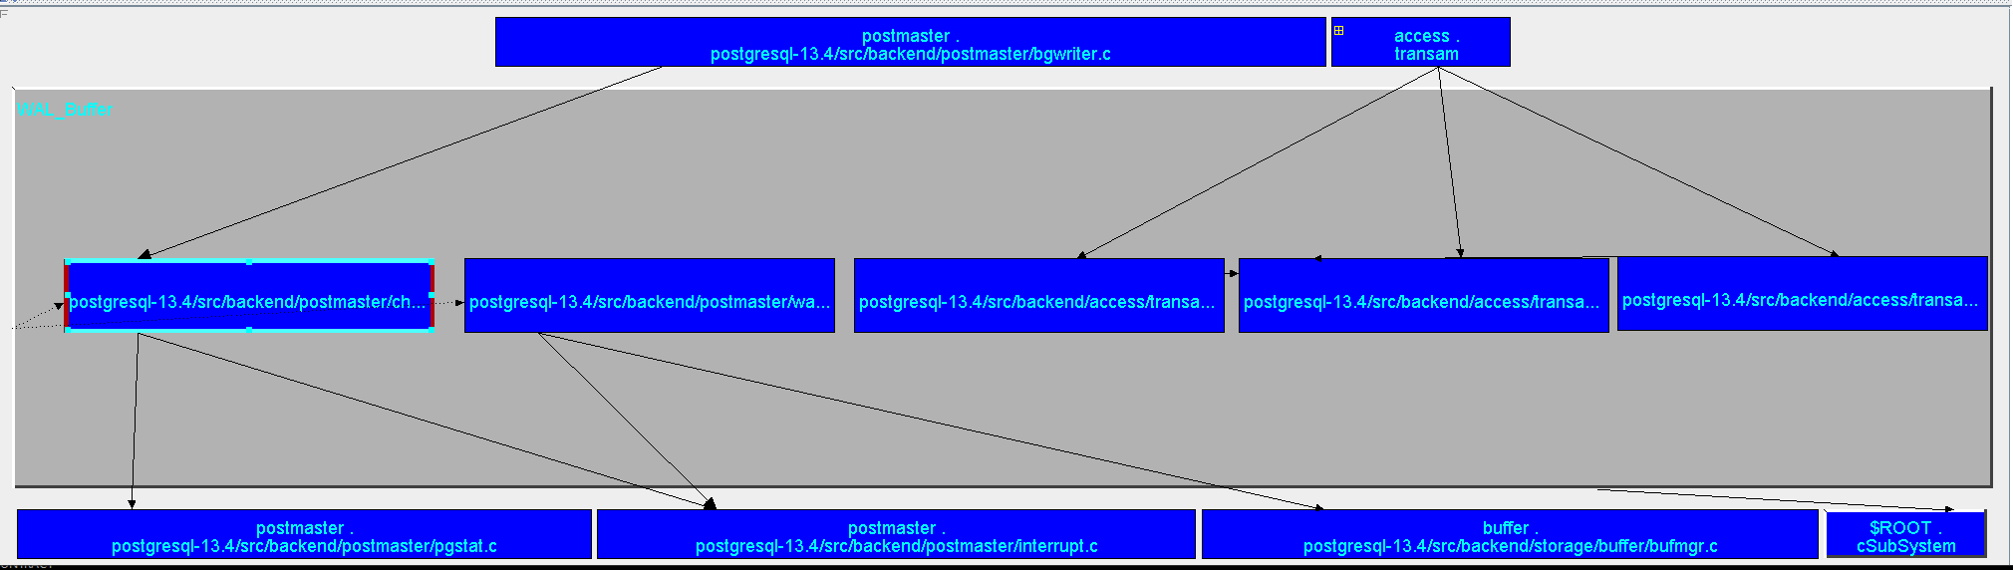
Sequence Diagram
Wal Buffer Sequence:
-Checkpointer sends signal when either:
-Checkpoint time expired
-WAL Buffer size limit reached
Notes:
Kai

Slide 13
Reflection Analysis
During conceptual analysis, components of the Assigned Subsystem presumed to be located in the same folder. This was not the case during concrete analysis.
During conceptual analysis, the interface library subsystem was overlooked. This subsystem played a big role in the concrete analysis.
Notes:
Kai

Slide 14
Reflection Analysis (Cont’d)
Memory (especially Shared Memory) was viewed as a black-box subsystem within our conceptual architecture
The role of the shared memory subsystem was explored in further detail during the synthesis of our concrete architecture
Importance of the use of design patterns to solve common shared memory subsystem problems
The transactional nature of the shared memory interactions have been investigated in our concrete architecture
Extensions to Write Ahead Logging (WAL) Shared Buffer Pool from our conceptual architecture
Notes:
Chandler

Slide 15
Limitations of report findings
The architecture diagrams that are produced in LSEdit still don’t show all the dependencies of files as there are thousands of files overall.
It might not be evident from the report as how to combine the least important subsystems together.
Due to many dependencies we had to pick and choose very important relevant subsystems only.

Slide 16
Lesson Learned
Good commenting in the source code made the task of understanding subsystems much easier.
important lesson is that a system's concrete architecture will not always strictly follow a particular architecture style.
Because of the way that open source projects evolve, there are legacy interactions that should have been updated, but haven't looked into yet.

Slide 17
Conclusion
There were many unexpected dependencies, some which were logical and some that were not.
There were many unexpected dependencies, some which were not logical. It was learned that unjustified dependencies were usually the effect of convenience or legacy reasons.
The pqsignal protocol could be rewritten and moved to minimize repeated code and add additional cohesiveness to the subsystems.

