Slide 1
Dependency Extraction Assignment 3 Presentation
Team C-Lion
Yonis, Qasim, Chirag, Sarwat, Chandler, Taswar, Amir, Kai
Notes:
Amir

Slide 2
Overview of Presentation
Introduction
Dependency Extraction Techniques
Understand
Include
srcML
Comparison Metrics Process
Quantitative and Qualitative Analysis
Sequence Diagram
Risk/Limitations and Lessons Learned
Live Demo
Notes:
Amir

Slide 3
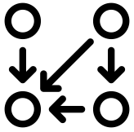
Introduction
This presentation is focused on process of extracting the dependencies between files and demonstrates the effectiveness of each technique.
Dependency Extraction is a process in Architecture recovery which focuses on the extraction of file dependencies from a given source directory.
We will be talking about these three techniques in detail in the following slides.
Notes:
Amir

Slide 4

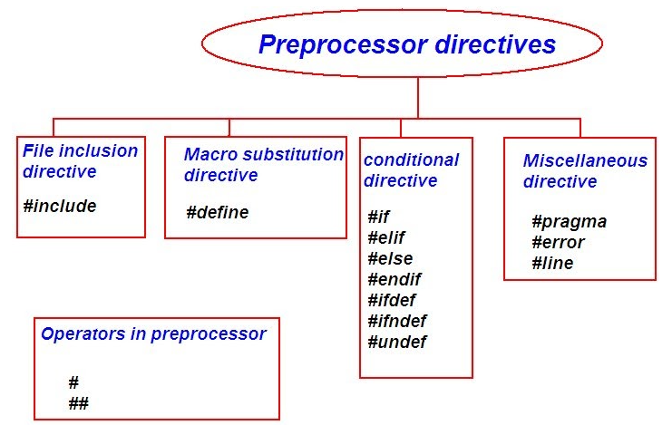

Dependency Extraction Techniques
Understand
Include Method
srcML Method
Notes:
Kai

Slide 5
Understand
Comprehensive software with many dependency-recognizing methods:
Creates database of references between the various parts of the code
Each reference serves as a connection between two entities
Example: void foo(){...} -> void bar(){...}
Notes:
Kai

Slide 6
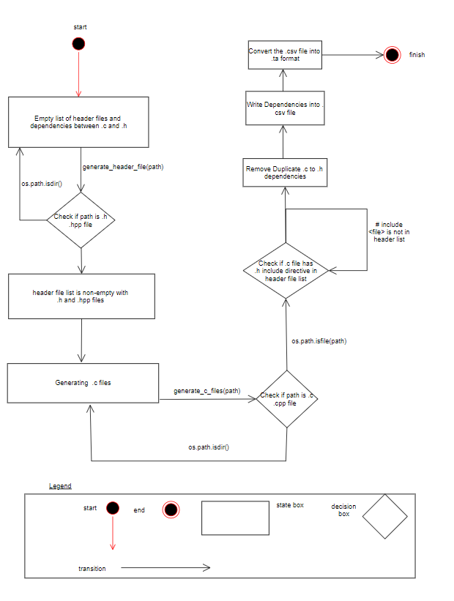
Include
Notes:
Chirag
- It went through all the source code files to see the inheritance pattern for pulling out the dependencies between the current file name and the include header files.
-Wrote scripts in python which leveraged the functionality of the os library
-First the script ran through all the source files for Postgres to extract all the header files ie. (#include *.h) files and the .c files (#include *.c).

Slide 7
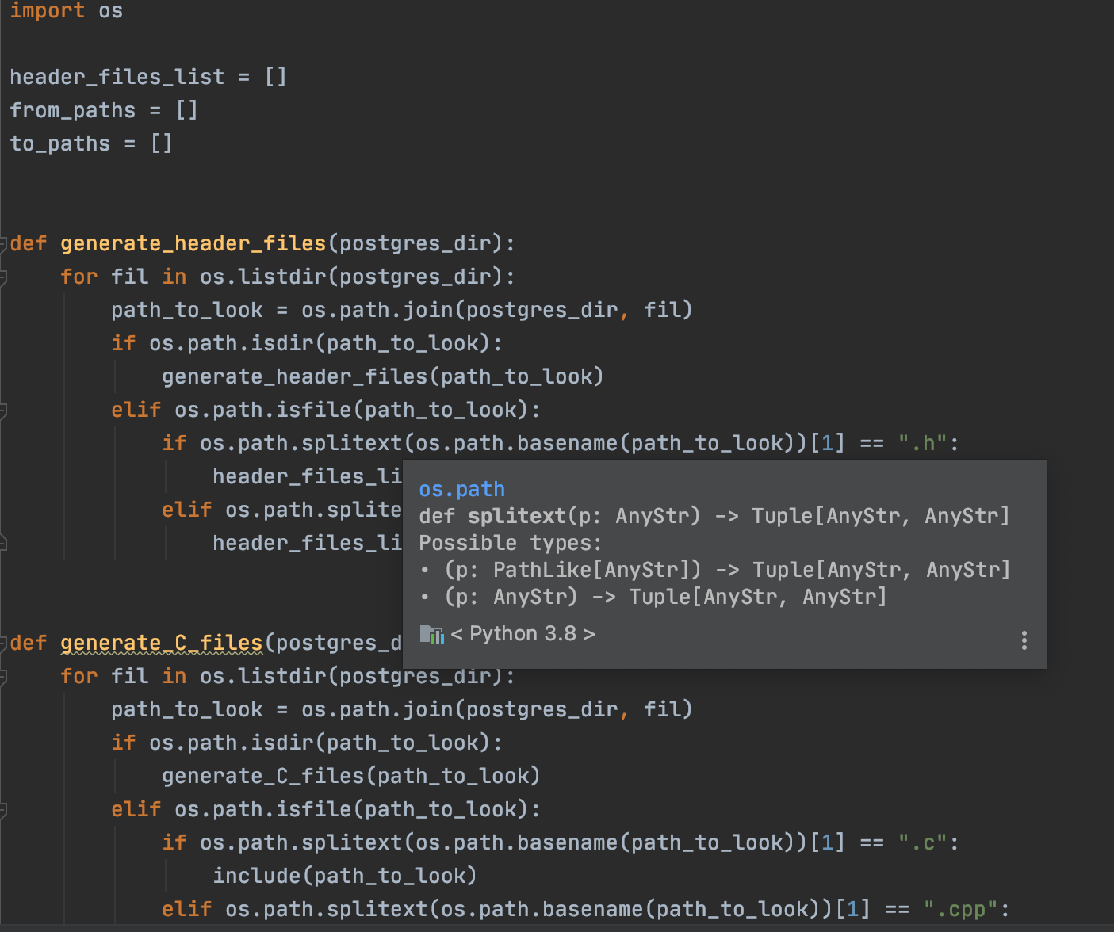
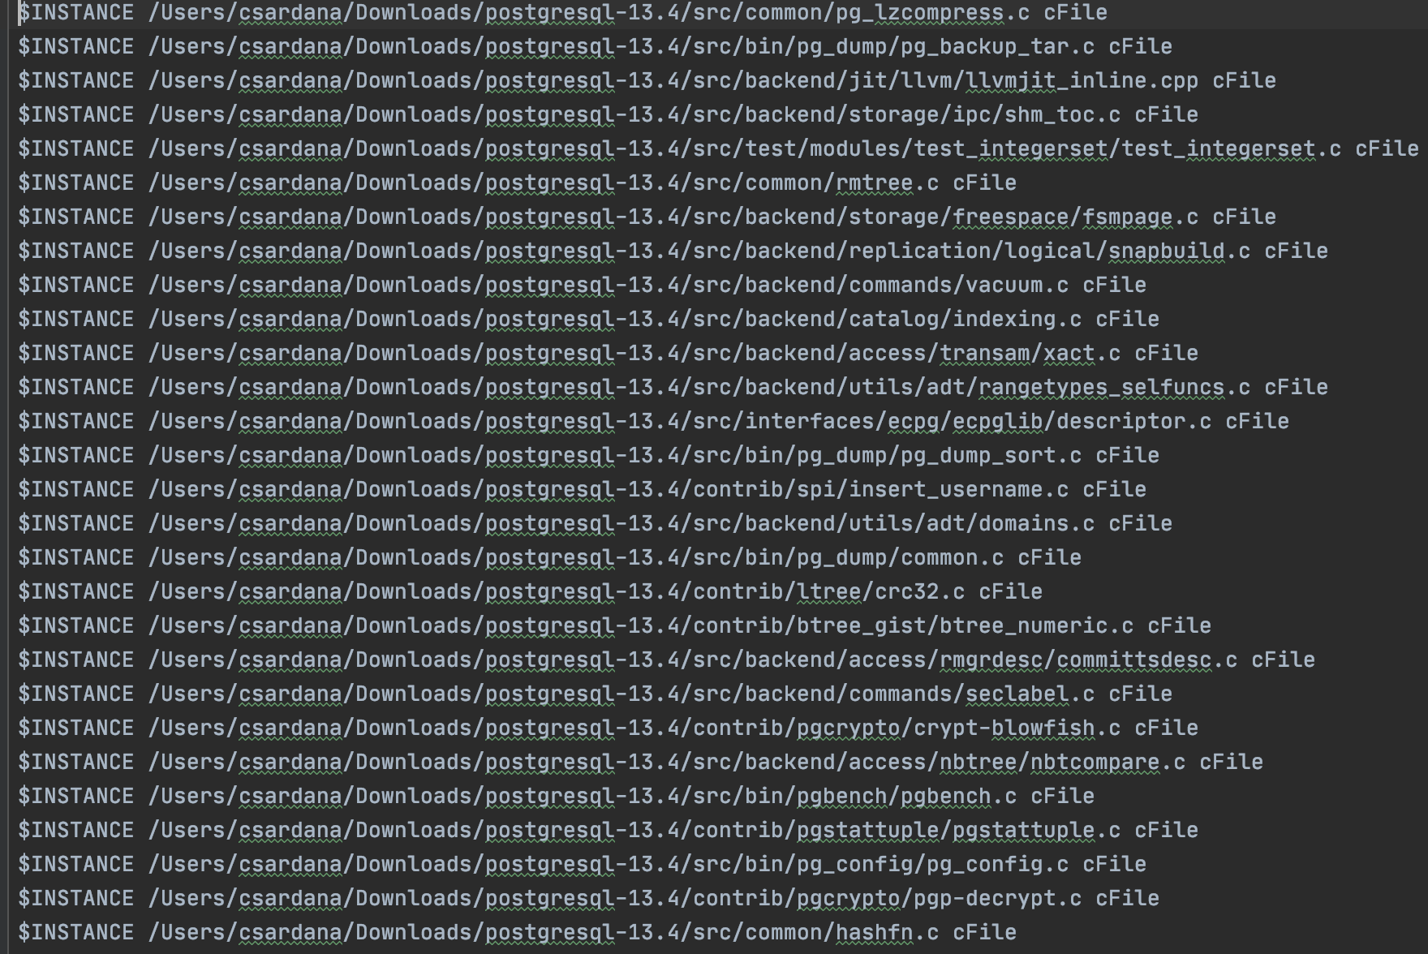
Include Cont’d
Python script to produce include_dependencies.raw.ta
include_dependencies.raw.ta
Notes:
Chirag

Slide 8
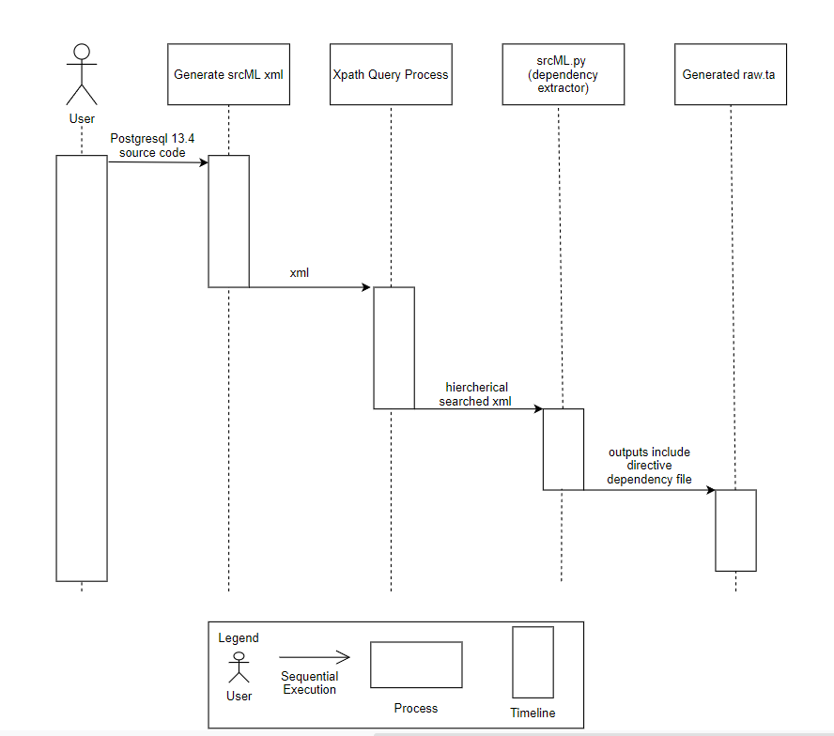
srcML
The source directory given to srcML as input is postgresql-13.4.
Query processing language such as XPath is used to query the XML and select particular nodes from the XML file.
Takes directories/files as input.
Query processing language such as XPath
is used to query the XML and select
particular nodes from the XML file.
Notes:
Qasim
All the original information from the source code stays intact(i.e comments, whitespaces).
This application is a command line application that can take directories/files as input
Query processing language such as XPath is used to query the XML and select particular nodes from the XML file.
srcML is a free software application that transforms C, C#,C++, Java source code into XML format representation.

Slide 9
srcML Cont’d
Below are the steps we took to generate the raw.ta.
We used the below command to generate the XML file. The postgresql-13.4 is given as input
srcml --verbose postgresql-13.4 -o dependencies_srcML.xml
Once the XML was created we used the XML query language to select particular nodes from the XML file. We used the following command. The // selects everything after the slash in the entire document
srcml --xpath "//cpp:include//cpp:file" dependencies_srcML.xml
> extracted_dependencies_srcML.xml
Notes:
Qasim

Slide 10
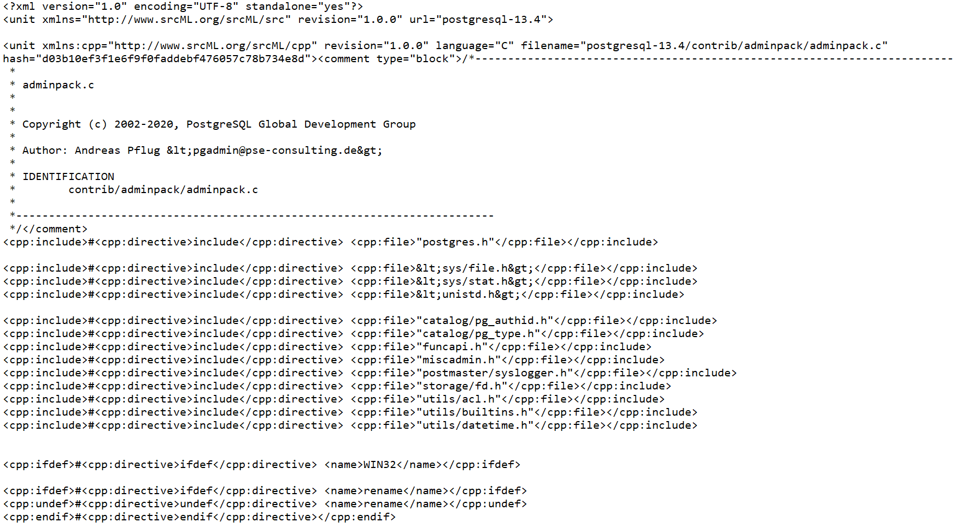
srcML XML file
Notes:
Qasim

Slide 11
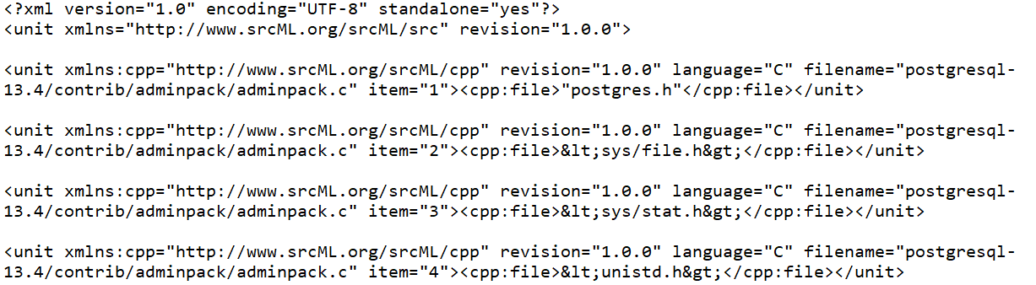
srcML Cont’d
Below shows how the extracted_dependencies_srcML.xml looks like after using XPath.
Furthermore the dependencies_from_srcML_.xml file was converted to raw.ta format using a python script
Notes:
Qasim

Slide 12
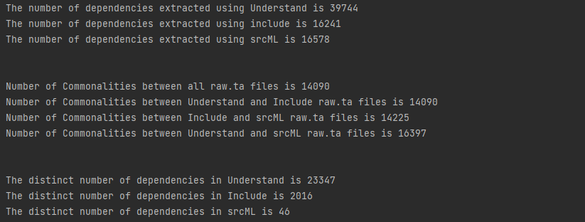
Comparison Metrics Process
To compare the dependencies in raw.ta files we wrote a python program ‘Statistics.py’ that reads all the raw.ta files and produces the details that are needed to do analysis
Script reports total number of dependencies, commonalities and distinct files
Notes:
Amir

Slide 13
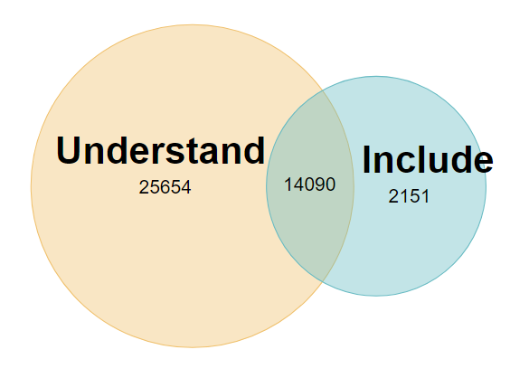
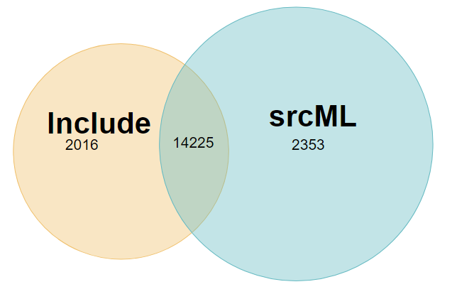
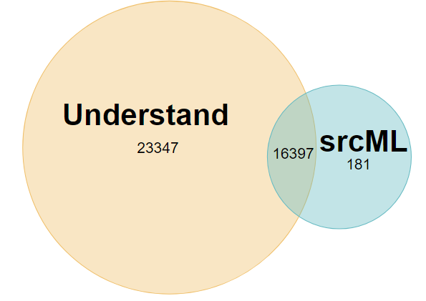
Quantitative Analysis
Understand Vs Include
Include Vs srcML
Understand Vs srcML
Notes:
Amir

Slide 14
Qualitative Analysis
Understand
Most comprehensive in finding dependencies.
Recognizes dependencies from various references:
Function calls
Type reference
Variable reference
Recognizes transitive dependencies
Does not recognize dynamic dependencies:
#ifdef… #else… etc.
Notes:
Kai

Slide 15

Qualitative Analysis
Include
Largest number of incorrect results
Recognized transitive dependencies that were on a new line
The include script did recognize some transitive dependencies
postgresql-13.4/contrib/auth_delay/auth_delay.c → postgresql-13.4/src/include/port/win32_port.h
Notes:
Chandler

Slide 16
Qualitative Analysis
srcML
Found the second highest number of dependencies
Recognizes transitive dependencies
Recognizes the #include directives that are included inside the directives such #ifdef, #else etc.
Out of 39 distinct dependencies in srcML, 30 of them were correct and 9 of them were incorrect.
Notes:
Chandler

Slide 17
Qualitative Analysis
Distinct dependencies - Understand
postgresql-13.4/contrib/pg_buffercache/pg_buffercache_pages.c→postgresql-13.4/src/include/utils/elog.h
elog() is a function from “elog.h”
ERROR is a macro defined in “elog.h”
Function call and variable reference - no #include directive
Notes:
Kai

Slide 18
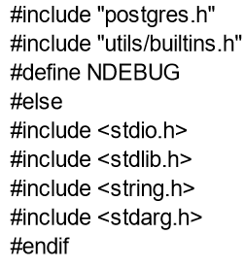
Qualitative Analysis Cont’d
Distinct dependencies - srcML
postgresql-13.4/contrib/fuzzystrmatch/dmetaphone.c→ postgresql-13.4/src/include/common/string.h is an example of dependency only found by srcML.
The dependency is not found by Understand as Understand method doesn’t recognize the dependencies inside the conditional directives(example screenshot).
The dependency is also not found by Include due to same reason mentioned above.
Notes:
Qasim

Slide 19
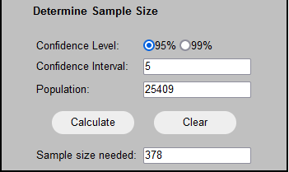
Precision and Recall
 | Understand
Precision | TP=256 FP=91 256/(91+256)=72 %
Recall | TP=256 FN=358.7 256/(256+358.7) = 41.6%
Notes:
For all the distinct dependencies between the different techniques we tried to classify True Positive and False positive based on the transitive property with the mapping of .c to .h header files. Using the total distinct total of 25409, the same size of the uniques file dependencies is 378 and with further investigation using a script to find all the .h through the transitive property corresponding to the .c file.

Slide 20
Precision and Recall Cont’d
 | Include
Precision | TP=16 FP=14 16/(16+14) = 53 %
Recall | TP=16 FN=358.7 16/(16+358.7) = 4.27%

Slide 21
Precision and Recall Cont’d
 | srcML
Precision | TP=1 FP=0 1/(1+0) = 100 %
Recall | TP=1 FN=358.7 1/(1+358.7) = 0.287%

Slide 22
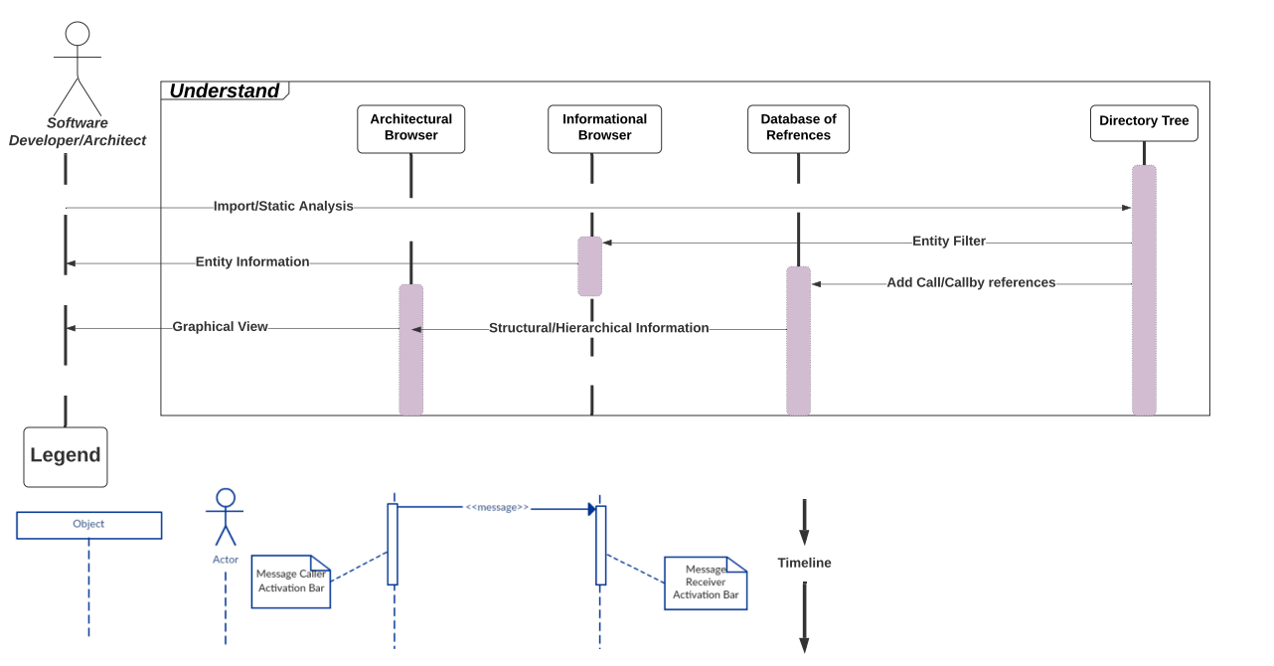
Sequence Diagram for Understand
Notes:
Sarwat

Slide 23
Risk/Limitations
Dependencies exist outside of the include directive - affects comparison results
Found in function and method level, as well as inheritance
Qualitative Analysis uses randomly generated dependencies which uses a normal distribution. However dependencies may be distributed differently.
Lessons Learned
There are multiple techniques of dependency extraction & each approach will produce different solutions depending on variant extraction processes
Function calls
Inheritance (for OOP only)
Include/import statements
Understand provides multiple relations and is more inclusive
Include provides a firm list but may skip important dependencies by not analyzing function calls
Notes:
Taswar

Slide 24
Live Demo
Notes:
Yonis

Slide 25
References
[Sample Size Calculator] https://www.surveysystem.com/sscalc.htm
[Understand User Guide and Documentation] https://documentation.scitools.com/pdf/understand.pdf
[Understand User Support] https://support.scitools.com/support/solutions/articles/70000582792-understanding-understand-dependencies
[srcML Website] https://www.srcml.org/

Slide 26
The End
Thank you for listening!
Any Questions?

