Slide 1
NETWORK PROTOCOL STRUCTURES
Tasya Kurnia Zaleha
2121700003
Rekayasa Perangkat Lunak /A
Notes:
This template can be used as a starter file for presenting training materials in a group setting.
Sections
Right-click on a slide to add sections. Sections can help to organize your slides or facilitate collaboration between multiple authors.
Notes
Use the Notes section for delivery notes or to provide additional details for the audience. View these notes in Presentation View during your presentation.
Keep in mind the font size (important for accessibility, visibility, videotaping, and online production)
Coordinated colors
Pay particular attention to the graphs, charts, and text boxes.
Consider that attendees will print in black and white or grayscale. Run a test print to make sure your colors work when printed in pure black and white and grayscale.
Graphics, tables, and graphs
Keep it simple: If possible, use consistent, non-distracting styles and colors.
Label all graphs and tables.

Slide 2
NETWORK PROTOCOL STRUCTURES
The old adage “There is nothing new under the sun” holds true when it comes to the way protocols are structured. Binary and text protocols follow common patterns and structures and, once understood, can easily be applied to any new protocol.
This chapter details some of these structures and formalizes the way I’ll represent them throughout the rest of this book. In this chapter, I discuss many of the common types of protocol structures. Each is described in detail along with how it is represented in binary- or text-based protocols. By the end of the chapter, you should be able to easily identify these common types in any unknown protocol you analyze.
Once you understand how protocols are structured, you’ll also see patterns of exploitable behavior—ways of attacking the network protocol itself. Chapter 10 will provide more detail on finding network protocol issues, but for now we’ll just concern ourselves with structure.
Notes:
Give a brief overview of the presentation. Describe the major focus of the presentation and why it is important.
Introduce each of the major topics.
To provide a road map for the audience, you can repeat this Overview slide throughout the presentation, highlighting the particular topic you will discuss next.

Slide 3

Binary Protocol Structures
Binary protocols work at the binary level; the smallest unit of data is a single binary digit. Dealing with single bits is difficult, so we’ll use 8-bit units called octets, commonly called bytes. The octet is the de facto unit of network protocols. Although octets can be broken down into individual bits (for example, to represent a set of flags), we’ll treat all network data in 8-bit units, as shown in Figure 3-1.
When showing individual bits, I’ll use the bit format, which shows bit 7, the most significant bit (MSB), on the left. Bit 0, or the least significant bit (LSB), is on the right. (Some architectures, such as PowerPC, define the bit numbering in the opposite direction.)
Numeric Data
Booleans
Bit Flags
Binary Endian
Text and Human-Readable Data
Variable Binary Length Data

Slide 4
1.
Data values representing numbers are usually at the core of a binary protocol. These values can be integers or decimal values. Numbers can be used to represent the length of data, to identify tag values, or simply to represent a number. In binary, numeric values can be represented in a few different ways, and a protocol’s method of choice depends on the value it’s representing. The following sections describe some of the more common formats.
Numeric Data

Slide 5
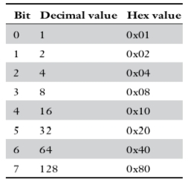
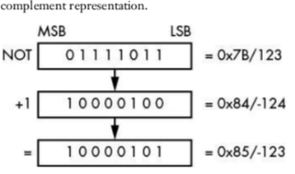
Numeric data
a. Unsigned Integers
b. Signed Integers
Unsigned integers are the most obvious representation of a binary number. Each bit has a specific value based on its position, and these values are added together to represent the integer. Table 3-1 shows the decimal and hexadecimal values for an 8-bit integer.
While encoding an unsigned integer seems obvious, the CPU can only work with the same set of bits. Therefore, the CPU requires a way of interpreting the unsigned integer value as signed; the most common signed interpretation is two’s complement. The term two’s complement refers to the way in which the signed integer is represented within a native integer value in the CPU.

Slide 6
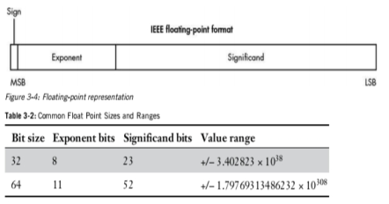
Numeric data
c. Variable-Length Integers
d. Floating-Point Data
Efficient transfer of network data has historically been very important. Even though today’s high-speed networks might make efficiency concerns unnecessary, there are still advantages to reducing a protocol’s bandwidth. It can be beneficial to use variable-length integers when the most common integer values being represented are within a very limited range. For example, consider length fields: when sending blocks of data between 0 and 127 bytes in size, you could use a 7-bit variable integer representation. Figure 3-3 shows a few different encodings for 32-bit words. At most, five octets are required to represent the entire range. But if your protocol tends to assign values between 0 and 127, it will only use one octet, which saves a considerable amount of space.
Sometimes, integers aren’t enough to represent the range of decimal values needed for a protocol. For example, a protocol for a multiplayer computer game might require sending the coordinates of players or objects in the game’s virtual world. If this world is large, it would be easy to run up against the limited range of a 32- or even 64-bit fixed-point value.

Slide 7
2.
Because Booleans are very important to computers, it’s no surprise to see them reflected in a protocol. Each protocol determines how to represent whether a Boolean value is true or false, but there are some common conventions.
The basic way to represent a Boolean is with a single-bit value. A 0 bit means false and a 1 means true. This is certainly space efficient but not necessarily the simplest way to interface with an underlying application. It’s more common to use a single byte for a Boolean value because it’s far easier to manipulate. It’s also common to use zero to represent false and non-zero to represent true.
Booleans

Slide 8
3.
Bit flags are one way to represent specific Boolean states in a protocol. For example, in TCP a set of bit flags is used to determine the current state of a connection. When making a connection, the client sends a packet with the synchronize flag (SYN) set to indicate that the connections should synchronize their timers. The server can then respond with an acknowledgment (ACK) flag to indicate it has received the client request as well as the SYN flag to establish the synchronization with the client. If this handshake used single enumerated values, this dual state would be impossible without a distinct SYN/ACK state.
Bit Flags

Slide 9
4.
The endianness of data is a very important part of interpreting binary protocols correctly. It comes into play whenever a multi-octet value, such as a 32-bit word, is transferred. The endian is an artifact of how computers store data in memory.
Because octets are transmitted sequentially on the network, it’s possible to send the most significant octet of a value as the first part of the transmission, as well as the reverse —send the least significant octet first. The order in which octets are sent determines the endianness of the data. Failure to correctly handle the endian format can lead to subtle bugs in the parsing of protocols.
Modern platforms use two main endian formats: big and little. Big endian stores the most significant byte at the lowest address, whereas little endian stores the least significant byte in that location. Figure 3-5 shows how the 32-bit integer 0x01020304 is stored in both forms.
Binary Endian

Slide 10
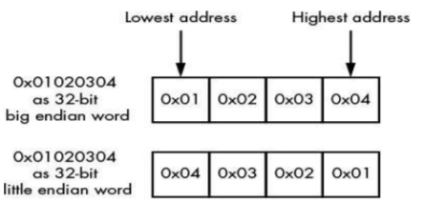
Binary Endian
The endianness of a value is commonly referred to as either network order or host order. Because the Internet RFCs invariably use big endian as the preferred type for all network protocols they specify (unless there are legacy reasons for doing otherwise), big endian is referred as network order. But your computer could be either big or little endian. Processor architectures such as x86 use little endian; others such as SPARC use big endian.

Slide 11
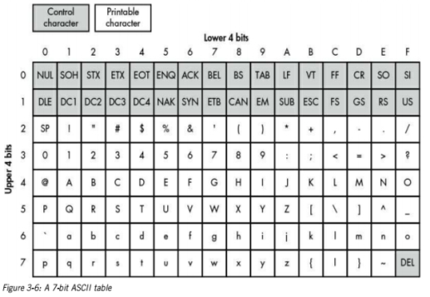
5.
Along with numeric data, strings are the value type you’ll most commonly encounter, whether they’re being used for passing authentication credentials or resource paths. When inspecting a protocol designed to send only English characters, the text will probably be encoded using ASCII. The original ASCII standard defined a 7-bit character set from 0 to 0x7F, which includes most of the characters needed to represent the English language
Text and Human-Readable Data

Slide 12
Text and Human-Readable Data
The ASCII standard was originally developed for text terminals (physical devices with a moving printing head). Control characters were used to send messages to the terminal to move the printing head or to synchronize serial communications between the computer and the terminal. The ASCII character set contains two types of characters: control and printable. Most of the control characters are relics of those devices and are virtually unused. But some still provide information on modern computers, such as CR and LF, which are used to end lines of text. The printable characters are the ones you can see. This set of characters consists of many familiar symbols and alphanumeric characters; however, they won’t be of much use if you want to represent international characters, of which there are thousands. It’s unachievable to represent even a fraction of the possible characters in all the world’s languages in a 7-bit number. Three strategies are commonly employed to counter this limitation: code pages, multibyte character sets, and Unicode. A protocol will either require that you use one of these three ways to represent text, or it will offer an option that an application can select.
Code Pages
Multibyte Character Sets
Unicode
UCS-2/UTF-16
UCS-4/UTF-32
UTF-8

Slide 13
6.
If the protocol developer knows in advance exactly what data must be transmitted, they can ensure that all values within the protocol are of a fixed length. In reality this is quite rare, although even simple authentication credentials would benefit from the ability to specify variable username and password string lengths. Protocols use several strategies to produce variable-length data values: I discuss the most common—terminated data, length-prefixed data, implicit-length data, and padded data—in the following sections.
Variable Binary Length Data

Slide 14
Variable Binary Length Data
Terminated Data
You saw an example of variable-length data when variable-length integers were discussed earlier in this chapter. The variable-length integer value was terminated when the octet’s MSB was 0. We can extend the concept of terminating values further to elements like strings or data arrays. A terminated data value has a terminal symbol defined that tells the data parser that the end of the data value has been reached. The terminal symbol is used because it’s unlikely to be present in typical data, ensuring that the value isn’t terminated prematurely. With string data, the terminating value can be a NUL value (represented by 0) or one of the other control characters in the ASCII set. If the terminal symbol chosen occurs during normal data transfer, you need to use a mechanism to escape these symbols. With strings, it’s common to see the terminating character either prefixed with a backslash (\) or repeated twice to prevent it from being identified as the terminal symbol. This approach is especially useful when a protocol doesn’t know ahead of time how long a value is—for example, if it’s generated dynamically. Figure 3-9 shows an example of a string terminated by a NUL value.

Slide 15
Variable Binary Length Data
Length-Prefixed
Data If a data value is known in advance, it’s possible to insert its length into the protocol directly. The protocol’s parser can read this value and then read the appropriate number of units (say characters or octets) to extract the original value. This is a very common way to specify variable-length data. The actual size of the length prefix is usually not that important, although it should be reasonably representative of the types of data being transmitted. Most protocols won’t need to specify the full range of a 32-bit integer; however, you’ll often see that size used as a length field, if only because it fits well with most processor architectures and platforms.

Slide 16
Variable Binary Length Data
Implicit-Length
Data Sometimes the length of the data value is implicit in the values around it. For example, think of a protocol that is sending data back to a client using a connection-oriented protocol such as TCP. Rather than specifying the size of the data up front, the server could close the TCP connection, thus implicitly signifying the end of the data. This is how data is returned in an HTTP version 1.0 response. Another example would be a higher-level protocol or structure that has already specified the length of a set of values. The parser might extract that higher-level structure first and then read the values contained within it. The protocol could use the fact that this structure has a finite length associated with it to implicitly calculate the length of a value in a similar fashion to close the connection (without closing it, of course). For example, Figure 3-12 shows a trivial example where a 7-bit variable integer and string are contained within a single block. (Of course, in practice, this can be considerably more complex.)

Slide 17
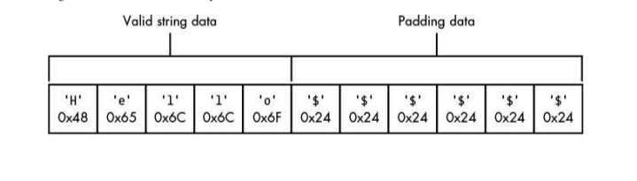
Variable Binary Length Data
Padded data
Padded data is used when there is a maximum upper bound on the length of a value, such as a 32-octet limit. For the sake of simplicity, rather than prefixing the value with a length or having an explicit terminating value, the protocol could instead send the entire fixedlength string but terminate the value by padding the unused data with a known value. Figure 3-13 shows an example.

Slide 18
B. Dates and Times
Dates and Times It can be very important for a protocol to get the correct date and time. Both can be used as metadata, such as file modification timestamps in a network file protocol, as well as to determine the expiration of authentication credentials. Failure to correctly implement the timestamp might cause serious security issues. The method of date and time representation depends on usage requirements, the platform the applications are running on, and the protocol’s space requirements. I discuss two common representations, POSIX/Unix Time and Windows FILETIME, in the following sections.

Slide 19
C. POSIX/Unix Time
Currently, POSIX/Unix time is stored as a 32-bit signed integer value representing the number of seconds that have elapsed since the Unix epoch, which is usually specified as 00:00:00 (UTC), 1 January 1970. Although this isn’t a high-definition timer, it’s sufficient for most scenarios. As a 32-bit integer, this value is limited to 03:14:07 (UTC) 19 January 2038, at which point the representation will overflow. Some modern operating systems now use a 64-bit representation to address this problem.

Slide 20
D. Windows FILETIME
The Windows FILETIME is the date and time format used by Microsoft Windows for its filesystem timestamps. As the only format on Windows with simple binary representation, it also appears in a few different protocols.
The FILETIME format is a 64-bit unsigned integer. One unit of the integer represents a 100 ns interval. The epoch of the format is 00:00:00 (UTC), 1 January 1601. This gives the FILETIME format a larger range than the POSIX/Unix time format.

Slide 21
E. Tag, Length, Value Pattern
Tag, Length, Value Pattern It’s easy to imagine how one might send unimportant data using simple protocols, but sending more complex and important data takes some explaining. For example, a protocol that can send different types of structures must have a way to represent the bounds of a structure and its type.
One way to represent data is with a Tag, Length, Value (TLV) pattern. The Tag value represents the type of data being sent by the protocol, which is commonly a numeric value (usually an enumerated list of possible values). But the Tag can be anything that provides the data structures with a unique pattern. The Length and Value are variable-length values. The order in which the values appear isn’t important; in fact, the Tag might be part of the Value. Figure 3-14 show a couple of ways these values could be arranged.
The Tag value sent can be used to determine how to further process the data. For example, given two types of Tags, one that indicates the authentication credentials to the application and another that represents a message being transmitted to the parser, we must be able to distinguish between the two types of data. One big advantage to this pattern is that it allows us to extend a protocol without breaking applications that have not been updated to support the updated protocol. Because each structure is sent with an associated Tag and Length, a protocol parser could ignore the structures that it doesn’t understand.

Slide 22
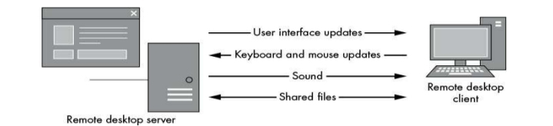
F. Multiplexing and Fragmentation
Multiplexing and Fragmentation Often in computer communication, multiple tasks must happen at once. For example, consider the Microsoft Remote Desktop Protocol (RDP): a user could be moving the mouse cursor, typing on the keyboard, and transferring files to a remote computer while changes in the display and audio are being transmitted back to the user (see Figure 3-15).
This complex data transfer would not result in a very rich experience if display updates had to wait for a 10-minute audio file to finish before updating the display. Of course, a workaround would be opening multiple connections to the remote computer, but those would use more resources. Instead, many protocols use multiplexing, which allows multiple connections to share the same underlying network connection.

Slide 23
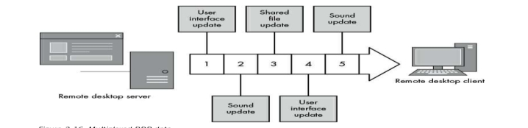
Multiplexing and Fragmentation
Multiplexing (shown in Figure 3-16) defines an internal channel mechanism that allows a single connection to host multiple types of traffic by fragmenting large transmissions into smaller chunks. Multiplexing then combines these chunks into a single connection. When analyzing a protocol, you may need to demultiplex these channels to get the original data back out.
Unfortunately, some network protocols restrict the type of data that can be transmitted and how large each packet of data can be—a problem commonly encountered when layering protocols. For example, Ethernet defines the maximum size of traffic frames as 1500 octets, and running IP on top of that causes problems because the maximum size of IP packets can be 65536 bytes. Fragmentation is designed to solve this problem: it uses a mechanism that allows the network stack to convert large packets into smaller fragments when the application or OS knows that the entire packet cannot be handled by the next layer.

Slide 24
G. Network Address
Network Address Information The representation of network address information in a protocol usually follows a fairly standard format. Because we’re almost certainly dealing with TCP or UDP protocols, the most common binary representation is the IP address as either a 4- or 16-octet value (for IPv4 or IPv6) along with a 2-octet port. By convention, these values are typically stored as big endian integer values. You might also see hostnames sent instead of raw addresses. Because hostnames are just strings, they follow the patterns used for sending variable-length strings, which was discussed earlier in “Variable Binary Length Data” on page 47. Figure 3-17 shows how some of these formats might appear.

Slide 25
H. Structured Binary Formats
Structured Binary Formats Although custom network protocols have a habit of reinventing the wheel, sometimes it makes more sense to repurpose existing designs when describing a new protocol. For example, one common format encountered in binary protocols is Abstract Syntax Notation 1 (ASN.1). ASN.1 is the basis for protocols such as the Simple Network Management Protocol (SNMP), and it is the encoding mechanism for all manner of cryptographic values, such as X.509 certificates. ASN.1 is standardized by the ISO, IEC, and ITU in the X.680 series. It defines an abstract syntax to represent structured data. Data is represented in the protocol depending on the encoding rules, and numerous encodings exist. But you’re most likely to encounter the Distinguished Encoding Rules (DER), which is designed to represent ASN.1 structures in a way that cannot be misinterpreted—a useful property for cryptographic protocols. The DER representation is a good example of a TLV protocol. Rather than going into great detail about ASN.1 (which would take up a fair amount of this book), I give you Listing 3-1, which shows the ASN.1 for X.509 certificates.

Slide 26
Text Protocol Structures Text protocols are a good choice when the main purpose is to transfer text, which is why mail transfer protocols, instant messaging, and news aggregation protocols are usually text based. Text protocols must have structures similar to binary protocols. The reason is that, although their main content differs, both share the goal of transferring data from one place to another. The following section details some common text protocol structures that you’ll likely encounter in the real world.
Numeric Data Over the millennia, science and written languages have invented ways to represent numeric values in textual format. Of course, computer protocols don’t need to be human readable, but why go out of your way just to prevent a protocol from being readable (unless your goal is deliberate obfuscation).
Integers It’s easy to represent integer values using the current character set’s representation of the characters 0 through 9 (or A through F if hexadecimal). In this simple representation, size limitations are no concern, and if a number needs to be larger than a binary word size, you can add digits. Of course, you’d better hope that the protocol parser can handle the extra digits or security issues will inevitably occur. To make a signed number, you add the minus (–) character to the front of the number; the plus (+) symbol for positive numbers is implied.
Decimal Numbers Decimal numbers are usually defined using human-readable forms. For example, you might write a number as 1.234, using the dot character to separate the integer and fractional components of the number; however, you’ll still need to consider the requirement of parsing a value afterward. Binary representations, such as floating point, can’t represent all decimal values precisely with finite precision (just as decimals can’t represent numbers like 1/3). This fact can make some values difficult to represent in text format and can cause security issues, especially when values are compared to one another.
Text Booleans Booleans are easy to represent in text protocols. Usually, they’re represented using the words true or false. But just to be difficult, some protocols might require that words be capitalized exactly to be valid. And sometimes integer values will be used instead of words, such as 0 for false and 1 for true, but not very often.
Dates and Times At a simple level, it’s easy to encode dates and times: just represent them as they would be written in a human-readable language. As long as all applications agree on the representation, that should suffice. Unfortunately, not everyone can agree on a standard format, so typically many competing date representations are in use. This can be a particularly acute issue in applications such as mail clients, which need to process all manner of international date formats.

Slide 27
Variable-Length Data All but the most trivial protocols must have a way to separate important text fields so they can be easily interpreted. When a text field is separated out of the original protocol, it’s commonly referred to as a token. Some protocols specify a fixed length for tokens, but it’s far more common to require some type of variable-length data.
Delimited Text Separating tokens with delimiting characters is a very common way to separate tokens and fields that’s simple to understand and easy to construct and parse. Any character can be used as the delimiter (depending on the type of data being transferred), but whitespace is encountered most in human-readable formats. That said, the delimiter doesn’t have to be whitespace. For example, the Financial Information Exchange (FIX) protocol delimits tokens using the ASCII Start of Header (SOH) character with a value of 1.
Terminated Text Protocols that specify a way to separate individual tokens must also have a way to define an End of Command condition. If a protocol is broken into separate lines, the lines must be terminated in some way. Most well-known, text-based Internet protocols are line oriented, such as HTTP and IRC; lines typically delimit entire structures, such as the end of a command. What constitutes the end-of-line character? That depends on whom you ask. OS developers usually define the end-of-line character as either the ASCII Line Feed (LF), which has the value 10; the Carriage Return (CR) with the value 13; or the combination CR LF. Protocols such as HTTP and Simple Mail Transfer Protocol (SMTP) specify CR LF as the official end-of-line combination. However, so many incorrect implementations occur that most parsers will also accept a bare LF as the end-of-line indication.

Slide 28
Structured Text Formats
As with structured binary formats such ASN.1, there is normally no reason to reinvent the wheel when you want to represent structured data in a text protocol. You might think of structured text formats as delimited text on steroids, and as such, rules must be in place for how values are represented and hierarchies constructed. With this in mind, I’ll describe three formats in common use within real-world text protocols.
J. Multipurpose Internet Mail Extensions Originally developed for sending multipart email messages, Multipurpose Internet Mail Extensions (MIME) found its way into a number of protocols, such as HTTP. The specification in RFCs 2045, 2046 and 2047, along with numerous other related RFCs, defines a way of encoding multiple discrete attachments in a single MIME-encoded message. MIME messages separate the body parts by defining a common separator line prefixed with two dashes (--). The message is terminated by following this separator with the same two dashes. Listing 3-3 shows an example of a text message combined with a binary version of the same message.

Slide 29
K. Final Words
Final Words In this chapter, I defined many ways to represent data values in binary and text protocols and discussed how to represent numeric data, such as integers, in binary. Understanding how octets are transmitted in a protocol is crucial to successfully decoding values. At the same time, it’s also important to identify the many ways that variable-length data values can be represented because they are perhaps the most important structure you will encounter within a network protocol. As you analyze more network protocols, you’ll see the same structures used repeatedly. Being able to quickly identify the structures is key to easily processing unknown protocols. In Chapter 4, we’ll look at a few real-world protocols and dissect them to see how they match up with the descriptions presented in this chapter.

Slide 30
Today’s Overview
1
2
Explore your new environment
3
Meet your new colleagues
Familiarize yourself with your new assignment
Notes:
This is another option for an Overview slide.

Slide 31

Learning Objectives
Technology
Procedure
Policies
Benefits
Notes:
What will the audience be able to do after this training is complete? Briefly describe each objective how the audience will benefit from this presentation.

Slide 32
THANK YOU
Notes:
Use a section header for each of the topics, so there is a clear transition to the audience.

