Slide 1
MIPS add/subtract processor
By: David Zhang

Slide 2
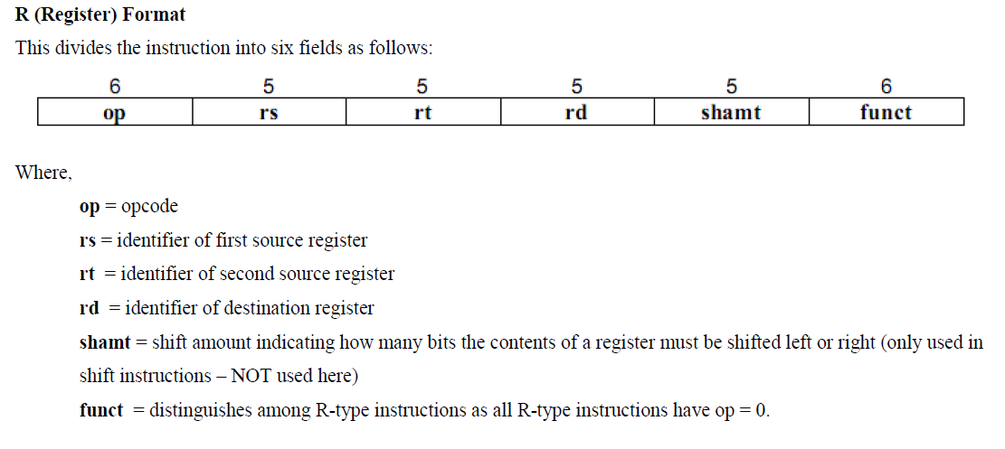
Objective
Make a processor in VHDL to simulate MIPS r-type instruction add, addu, sub, and subu using a 3-ported 32 32-bit register file.

Slide 3
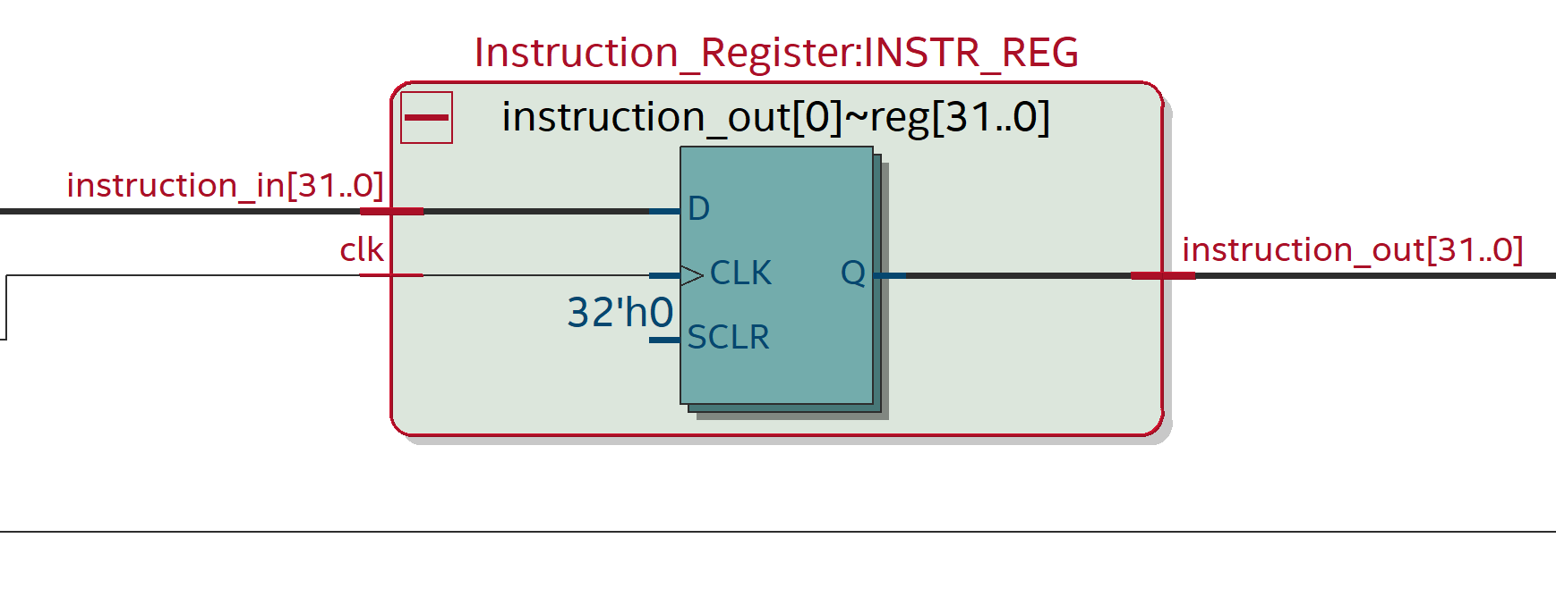
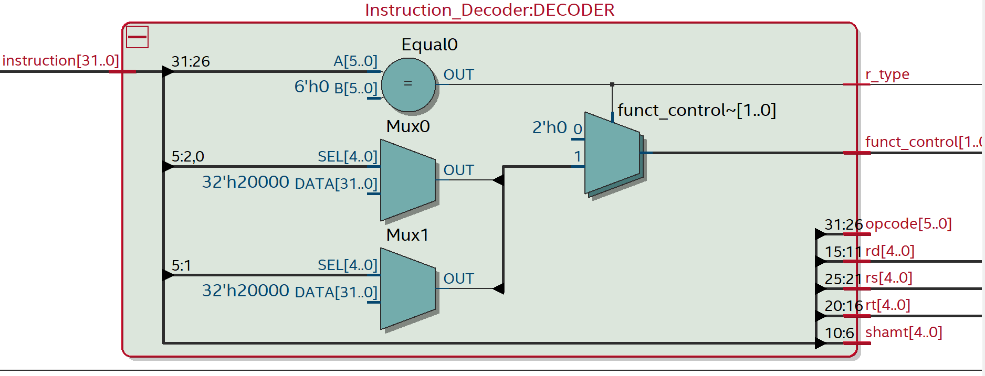
Main Components
Instruction register
Instruction Decoder
32-bit Register Files
32-bit Adder/subtractor
The IR takes a 32-bit vector input that is then passed to the decoder to send out the parsed instructions to the register files and adder/subtractor.

Slide 4
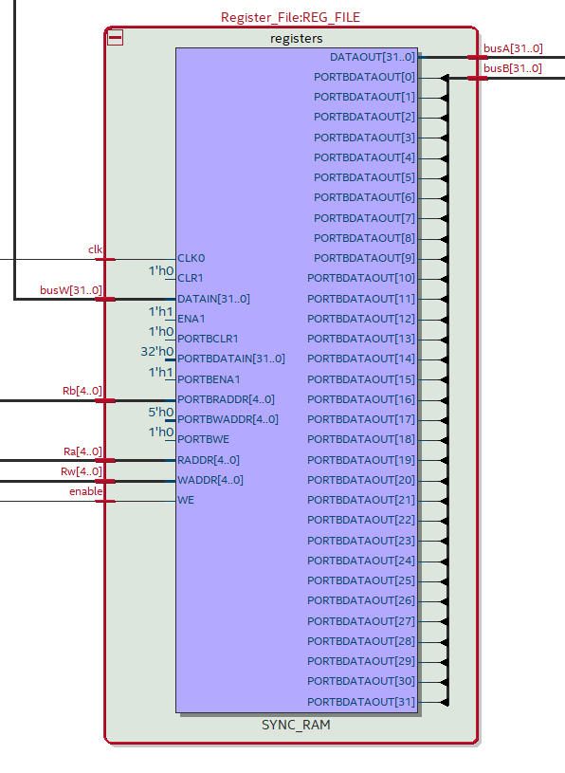
Main Components
The 32 32-bit register file is constructed using an array of 32-bit vectors rather than 32 flip-flops for every singular register
This saves a lot of processing time and power but doesn’t stay true to the reality of the hardware of an actual register.
type register_array is array(0 to 31) of STD_LOGIC_VECTOR(31 downto 0);

Slide 5
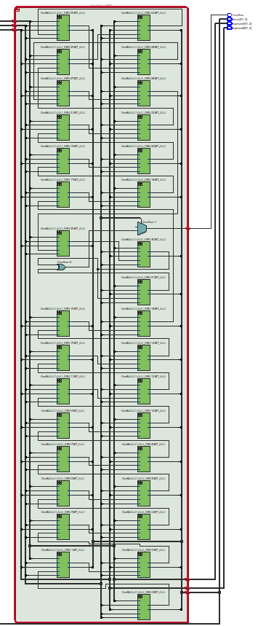
Main Components
The 32-bit adder/subtractor was designed using a loop to make a collection of 32 modified full adders.
This method is usually discouraged in hardware because of its inefficient implementation in real life and the longer path time that may bottleneck the program’s speed.

Slide 6
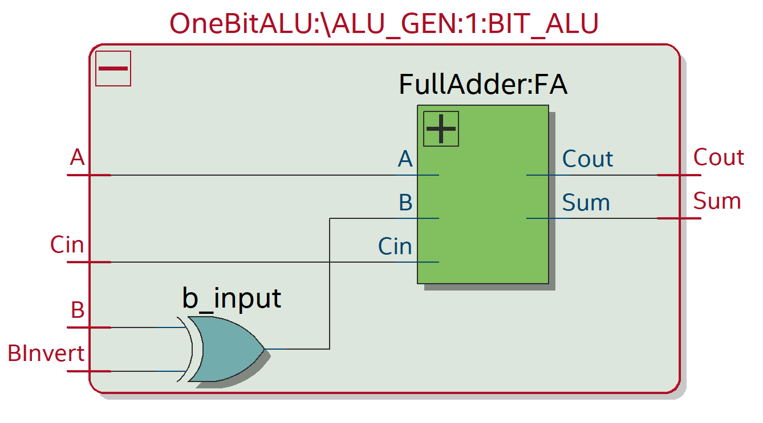
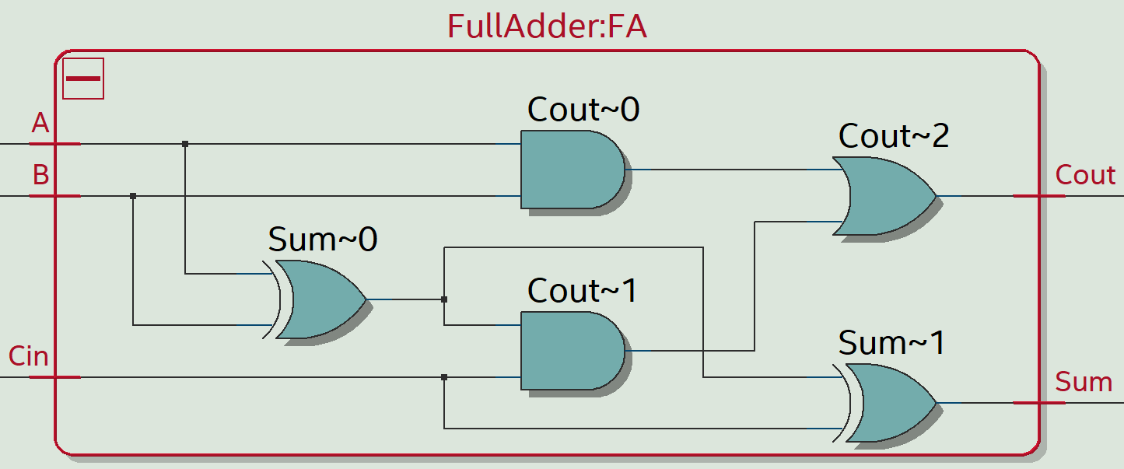
Sub-Components
The 32-bit Adder/subtractor is comprised of 32 1-bit adder/subtractors that are a modified version of a full adder to take an extra value for bit inversion in 2’s complement

Slide 7
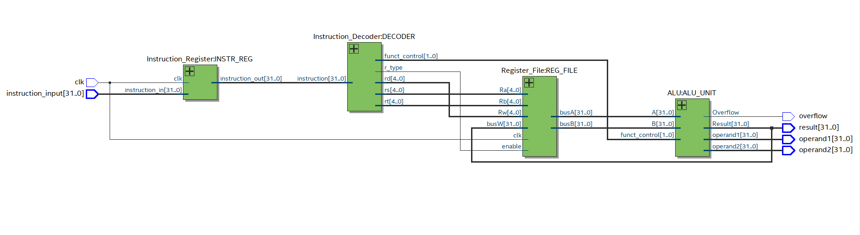
Full RTL view of processor

Slide 8
Waveform Testing
-- Case 1: add $9, $1, $2 (1 + 2 = 3, NO OVERFLOW)
-- Case 2: add $10, $4, $1 (MAX_INT + 1, OVERFLOW)
-- 000000 00100 00001 01010 00000 100000
-- This will overflow because 0x7FFFFFFF + 1 = 0x80000000 (positive + positive = negative)
-- Case 3: addu $11, $1, $2 (1 + 2 = 3, NO OVERFLOW IN UNSIGNED)
-- Case 4: addu $12, $3, $1 (MAX_INT + 1, would OVERFLOW in unsigned operations)
-- Case 5: sub $13, $8, $6 (10 - 5 = 5, NO OVERFLOW)
-- Case 6: sub $14, $5, $1 (MIN_INT - 1, OVERFLOW)
-- This will overflow because 0x80000000 - 1 = 0x7FFFFFFF (negative - positive = positive)
-- Case 7: subu $15, $8, $6 (10 - 5 = 5, NO OVERFLOW IN UNSIGNED)
-- Note: subu does not detect overflow, but this operation wouldn't overflow anyway
-- Case 8: subu $16, $7, $1 (MIN_INT - 1, would OVERFLOW in signed operation)

Slide 9
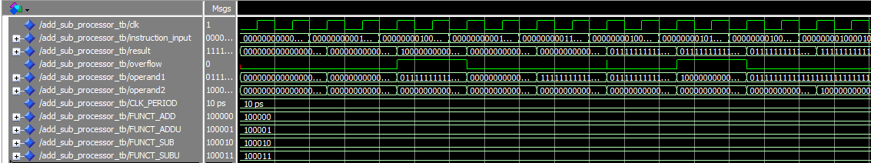
Waveform Testing

Slide 10
FIN
Thank you for your time

