Slide 1
Multimodal RAG for Integrating Tabular, Text and Image Data
CSE 496
First Presentation
Taha Alparslan Atabey
Advisor: Asst. Prof. Dr. Salih Sarp
September 2025

Slide 2
Contents
Project Definition
Project Design
Project Requirements
Success Criteria (There will be at least 3)
Project Timeline (with monthly granularity)
References

Slide 3
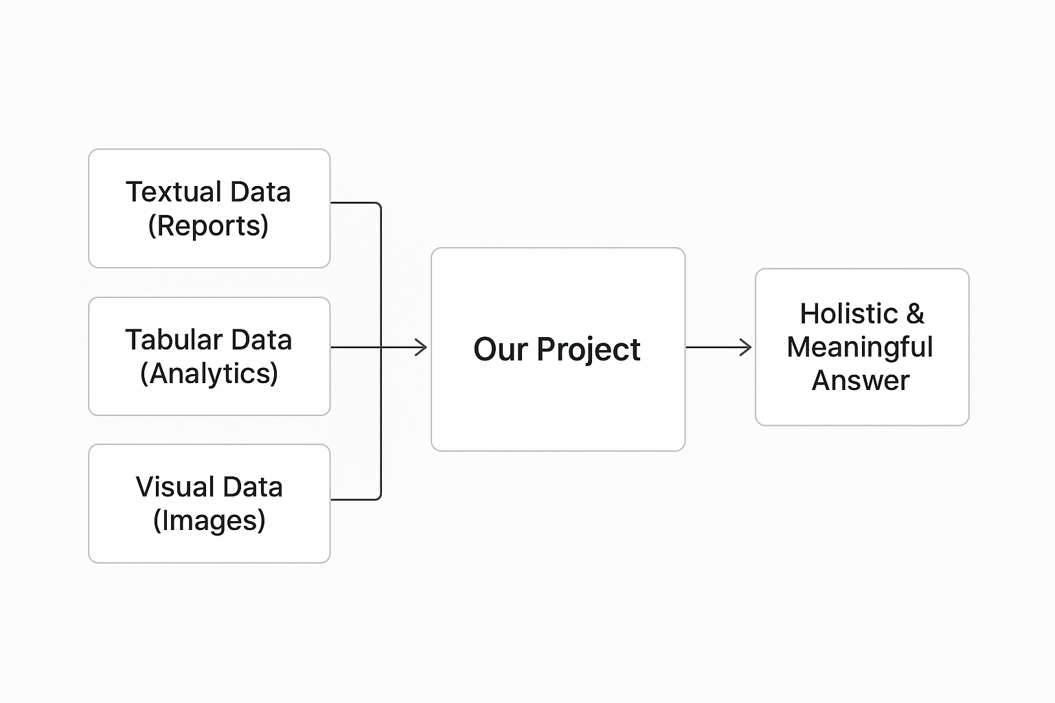
Project Definition
Problem: Currently, vital information is fragmented across disconnected and diverse formats, such as reports (text), analytical tables (tabular), and graphics/images (visual).
Objective: This project aims to develop an intelligent system capable of generating holistic and meaningul answers to complex, natural language queries by integrating this fragmented, multi-format data.

Slide 4
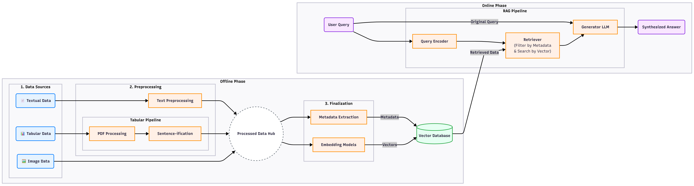
Project Design

Slide 5
Project Requirements
Software
Programming Language: Python
Core Libraries & Frameworks:
For Machine Learning: PyTorch or TensorFlow
For RAG & LLMs: Hugging Face (Transformers, Datasets), LangChain or LlamaIndex
For Data Processing: Pandas (for tables), PyMuPDF/Camelot (for PDF parsing), Pillow (for images)
Vector Database: ChromaDB or FAISS + Metadata
For OCR: Tesseract & pytesseract (for scanned PDFs)

Slide 6
Project Requirements
Hardware
Development Machine: A modern PC or laptop.
GPU (Graphics Processing Unit): A CUDA-enabled NVIDIA GPU with at least 8-12 GB of VRAM (e.g., RTX 3060 or higher) is highly recommended for running embedding models and experimenting with LLMs (especially local models).
Other Resources
Dataset: A dataset suitable for the project's objectives, containing documents (such as PDFs) that include text, images, and tables.
API Keys (Optional): If benchmark results show that no available open-source model meets the required performance for the project's objectives, API keys may be required to utilize proprietary models such as GPT-4.

Slide 7
Success Criteria
Criterion 1 (Quantitative - Answer Relevance):For a pre-defined test set of 30 questions with known answers, the system's generated responses must achieve a relevance and correctness score of ≥ 80% (at least 24 out of 30), as evaluated by a human reviewer.
Criterion 2 (Qualitative - Multimodal Capability):The system must successfully generate a correct answer for a query that requires the synthesis of information from at least two different data modalities.
Criterion 3 (Qualitative - Source Citation):When an answer is generated using information retrieved from a source document (e.g., a PDF), the system must correctly and automatically cite the source of the information (e.g., document name, page number) within its response.

Slide 8
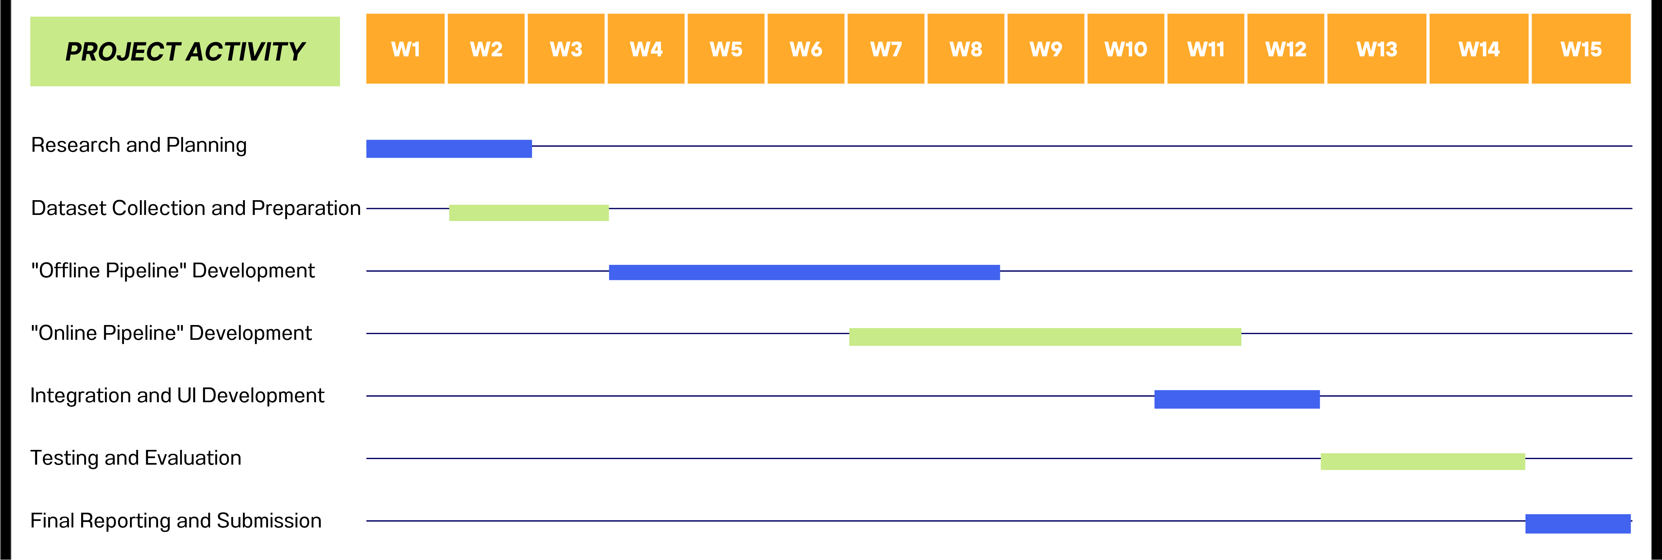
Project Timeline

Slide 9
References
Radford, A., et al. (2021). "Learning Transferable Visual Models From Natural Language Supervision". Proceedings of the 38th International Conference on Machine Learning.
Herzig, J., et al. (2020). "TAPAS: Weakly Supervised Table Parsing via Pre-training". Proceedings of the 58th Annual Meeting of the Association for Computational Linguistics.
Lewis, P., et al. (2020). "Retrieval-Augmented Generation for Knowledge-Intensive NLP Tasks". Advances in Neural Information Processing Systems 33.
LangChain Documentation. LangChain. Retrieved October 15, 2025, from https://docs.langchain.com/
Hugging Face Documentation. Hugging Face. Retrieved October 15, 2025, from https://huggingface.co/docs

