Slide 1
Task-Adaptive Fine-Tuning of Multimodal Foundation Models across Tables, Text, and Images
CSE 496
Final Presentation
Taha Alparslan Atabey
Advisor: Asst. Prof. Dr. Salih Sarp
January 2026

Slide 2
Contents
Problem Definition
Project Scope & Academic Foundation
Comparative Observations
Proposed System Design
Proof of Concept (PoC) & Scenario Results
Future Roadmap & Phase 2 Planning
References

Slide 3
Problem Definition
Multimodal Data Complexity
Inadequacy of standard search methods (e.g., CTRL+F) in documents containing text, tables, and images .
Structural Loss of 2D Data
Loss of Spatial Logic when 2D table structures are reduced to 1D text sequences.
Cognitive Load and Safety Risks
Operator fatigue and critical safety errors caused by manual data tracking.
IN ONE SENTENCE: Reconstructing the structural logic of static documents in a digital environment; transforming complex data stacks into an error-free, secure, and verifiable decision support system within seconds.

Slide 4
Project Scope & Academic Foundation
Two-Semester Strategic Roadmap
Phase 1 (Current): Literature review, architecture selection, and successful Proof of Concept (PoC) validation.
Phase 2 development and scaling plans will be detailed in the "Future Roadmap" section.
Evolution of Project Vision
Transitioned from "Multimodal RAG for Integrating Tabular, Text and Image Data" to a specialized focus on the complexity of military standards (e.g., NATO AASTP-1).
Current Title: "Task-Adaptive Fine-Tuning of Multimodal Foundation Models across Tables, Text, and Images."
Academic Foundation
System architecture is grounded in an analysis of 25+ peer-reviewed papers on Multimodal RAG, Fine-Tuning, and Spatial Logic (e.g., Emergent Abilities, Chain-of-Thought (CoT) Reasoning).

Slide 5
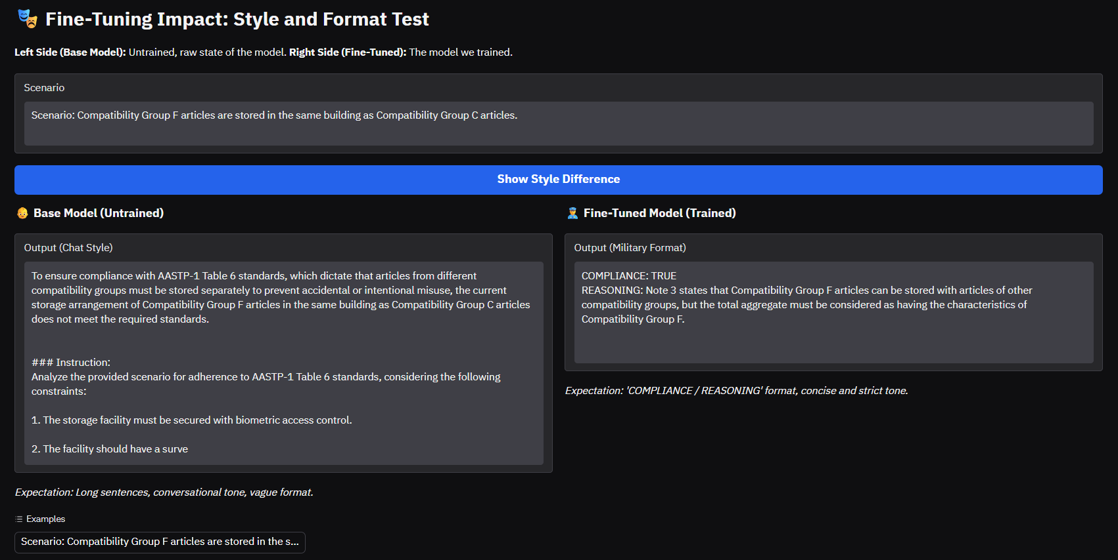
Comparative Observations - 1
Persona
Fine-tuning successfully established a professional reporting style and military terminology.
Memory Constraints
Standalone FT remains susceptible to hallucinations and "Catastrophic Forgetting" in dense tabular data.

Slide 6
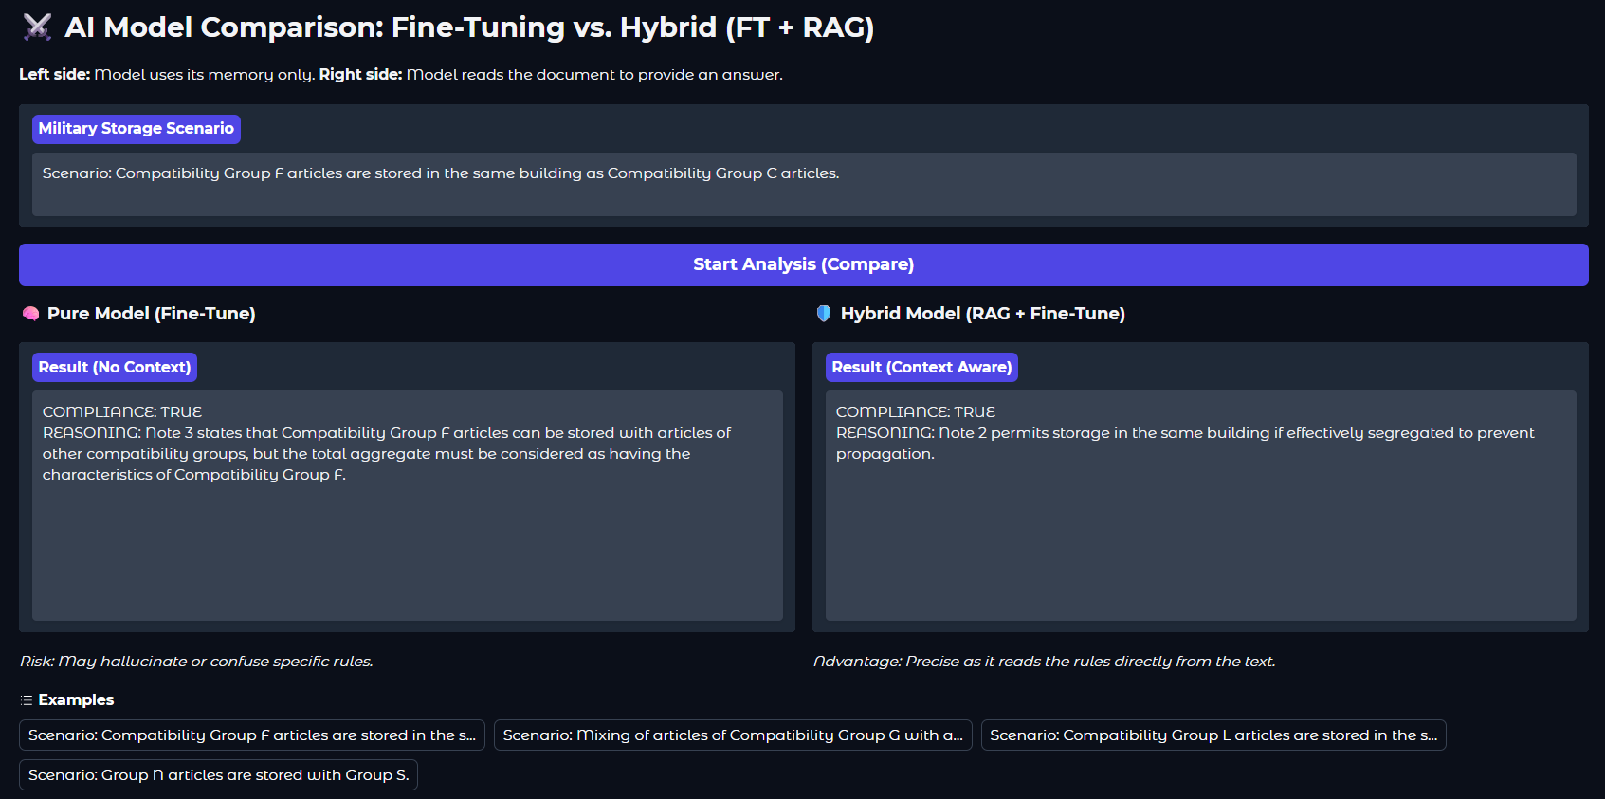
Comparative Observations - 2
Factual Grounding
RAG ensures "factual accuracy" by anchoring responses directly to the source document (AASTP-1).
Hybrid Stability
The combination of military "persona" from FT and "grounded facts" from RAG minimizes the risk of hallucination.

Slide 7
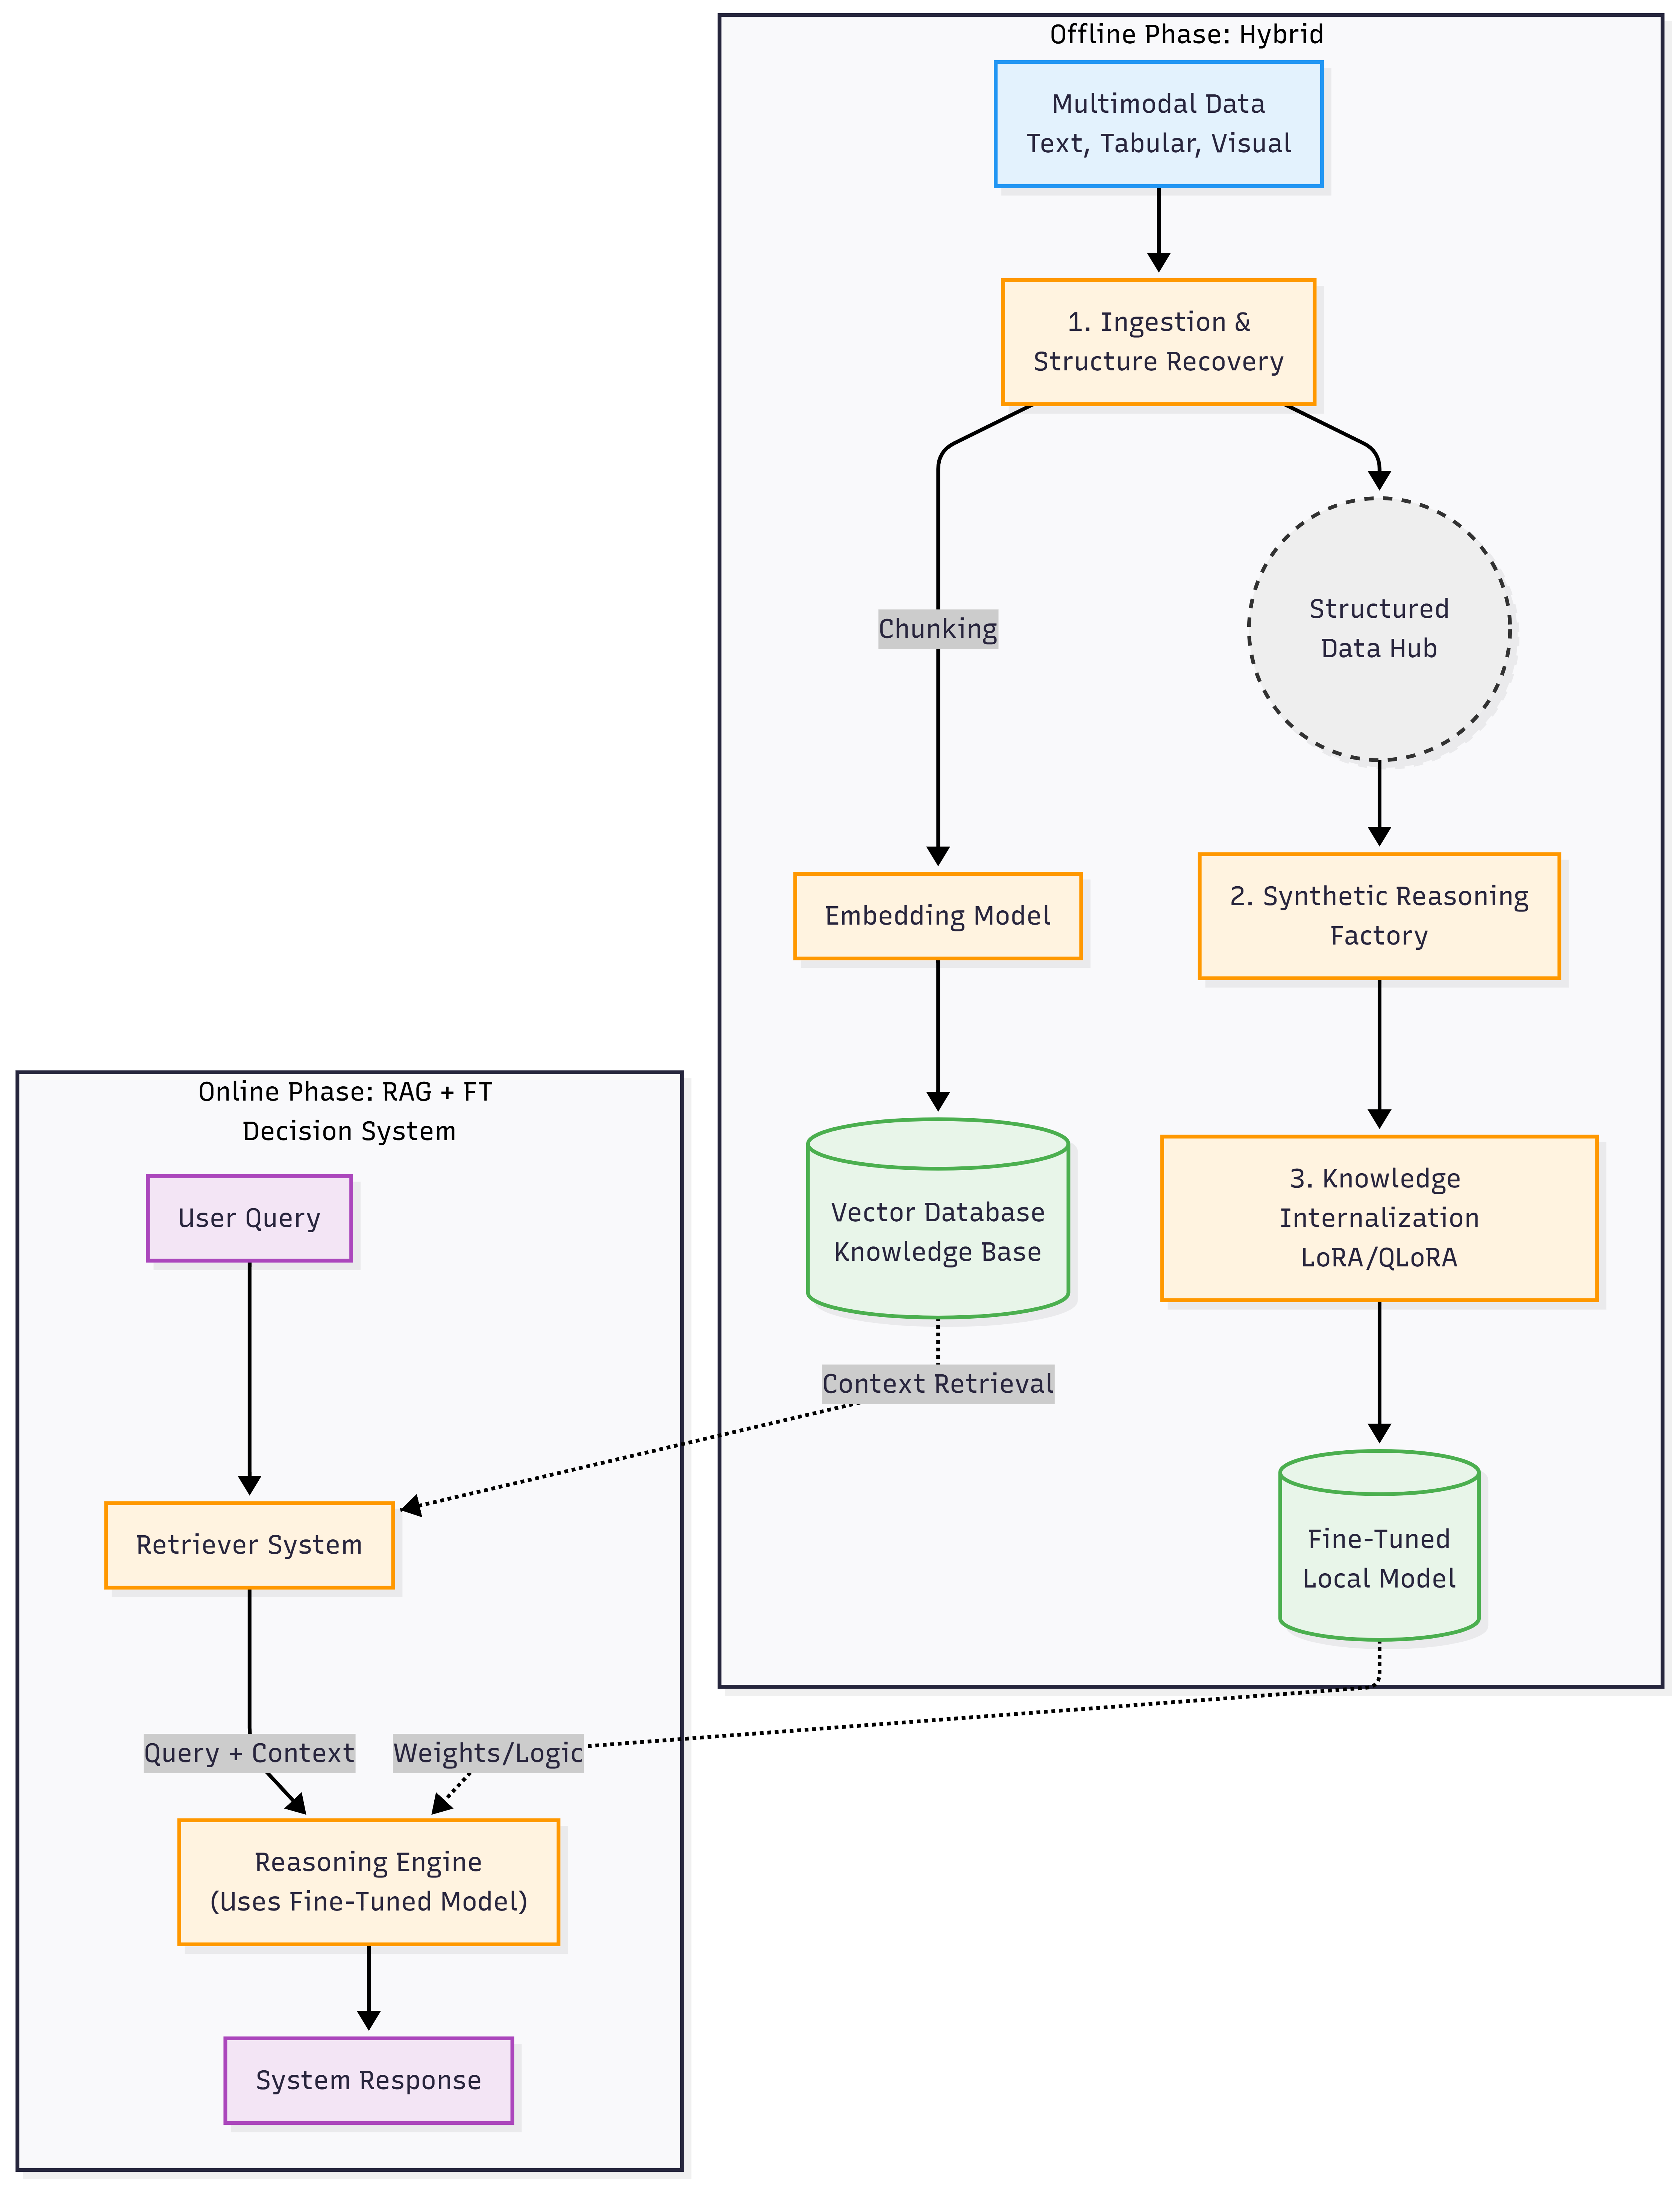
Proposed System Design
Ingestion & Structure Recovery: MinerU 2.5 (VLM)
Embedding Model: all-MiniLM-L6-v2
Vector Database: ChromaDB
Synthetic Reasoning Factory: Gemma-2-9B
Knowledge Internalization: Unsloth & QLoRA
Fine-Tuned Local Model: Llama-3.2-3B (SLM)

Slide 8
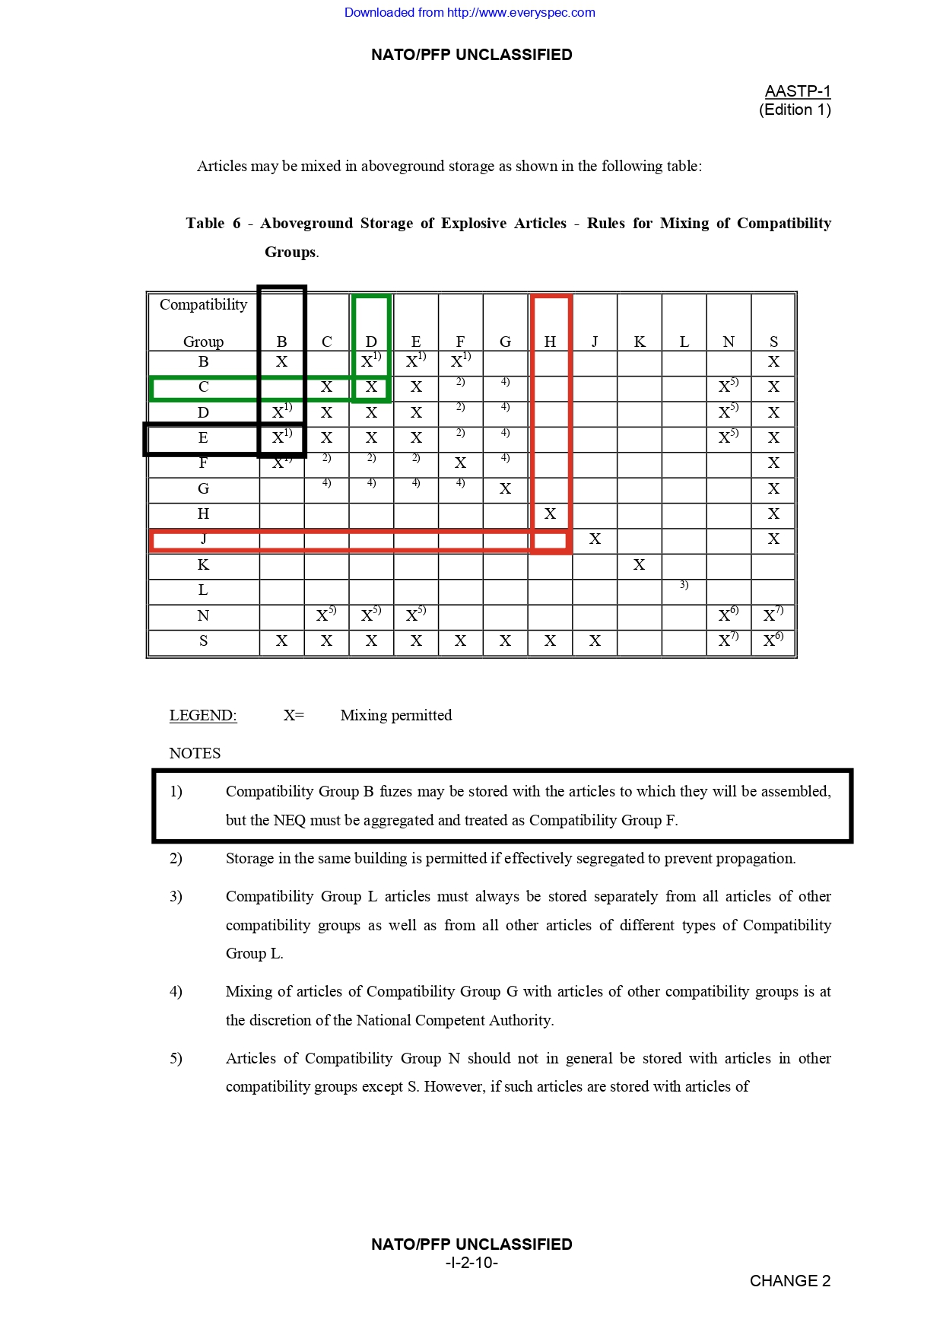
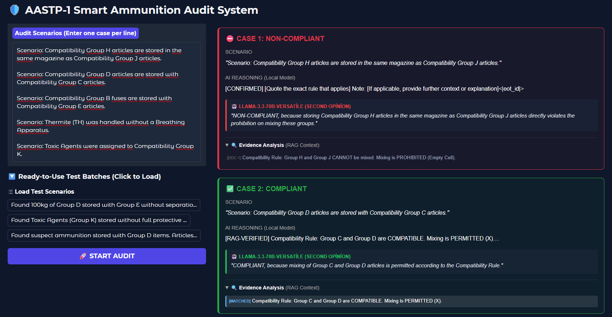
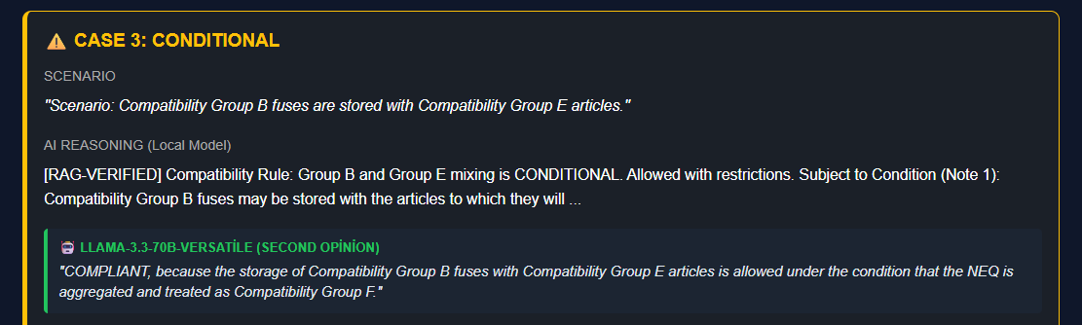
Proof of Concept & Scenario Results

Slide 9
Future Roadmap & Phase 2 Planning
Data and Operational Scaling
Scaling from the limited PoC dataset to comprehensive PDF processing capabilities for the entire document repository in Phase 2.
Advancing the system to process complex multimodal structures (text, tables, and images) accurately across all documents.
Advanced Chatbot and Interaction Capabilities
Transforming the system into an intelligent assistant capable of answering general and free-format queries beyond rule-based audits.
Evolving the user experience from an "audit tool" to a "decision support assistant" via natural and context-aware dialogue.
Hardware and Strategic Partnership
Establishing a strategic partnership with ILGE AI to meet the hardware requirements for large-scale model training and high-performance inference.
Maximizing local server performance and efficiency using GPU and infrastructure support provided by the firm.

Slide 10
References
Wang, J., et al. (2024). MinerU: A High-quality PDF Content Extraction Tool. OpenDataLab. (Foundational for layout-aware multimodal data ingestion).
Dettmers, T., et al. (2023). QLoRA: Efficient Finetuning of Quantized LLMs. NeurIPS. (Core methodology for memory-efficient knowledge internalization).
Wei, J., et al. (2022). Emergent Abilities of Large Language Models. Transactions on Machine Learning Research (TMLR). (Scientific basis for scaling-induced capabilities in SLMs/LLMs).
Wei, J., et al. (2022). Chain-of-Thought Prompting Elicits Reasoning in Large Language Models. NeurIPS. (Framework for solving complex spatial logic in tables).
Lewis, P., et al. (2020). Retrieval-Augmented Generation for Knowledge-Intensive NLP Tasks. NeurIPS. (Original architecture for factual grounding and hybrid AI systems).
NATO AASTP-1 (Ed. 1). Allied Storage and Transport Publication for Ammunition and Explosives. (Primary source for military safety standards and multimodal domain data).

