Slide 1
Multimodal RAG for Integrating Tabular, Text and Image Data (2-Term Project)
CSE 496
First Presentation
Taha Alparslan Atabey
Advisor: Asst. Prof. Dr. Salih Sarp
March 2026

Slide 2
Contents
Project Definition
Phase 1 Summary
System Architecture
Phase 2 Objectives & Scaling Strategy
Success Criteria
Project Timeline
References

Slide 3
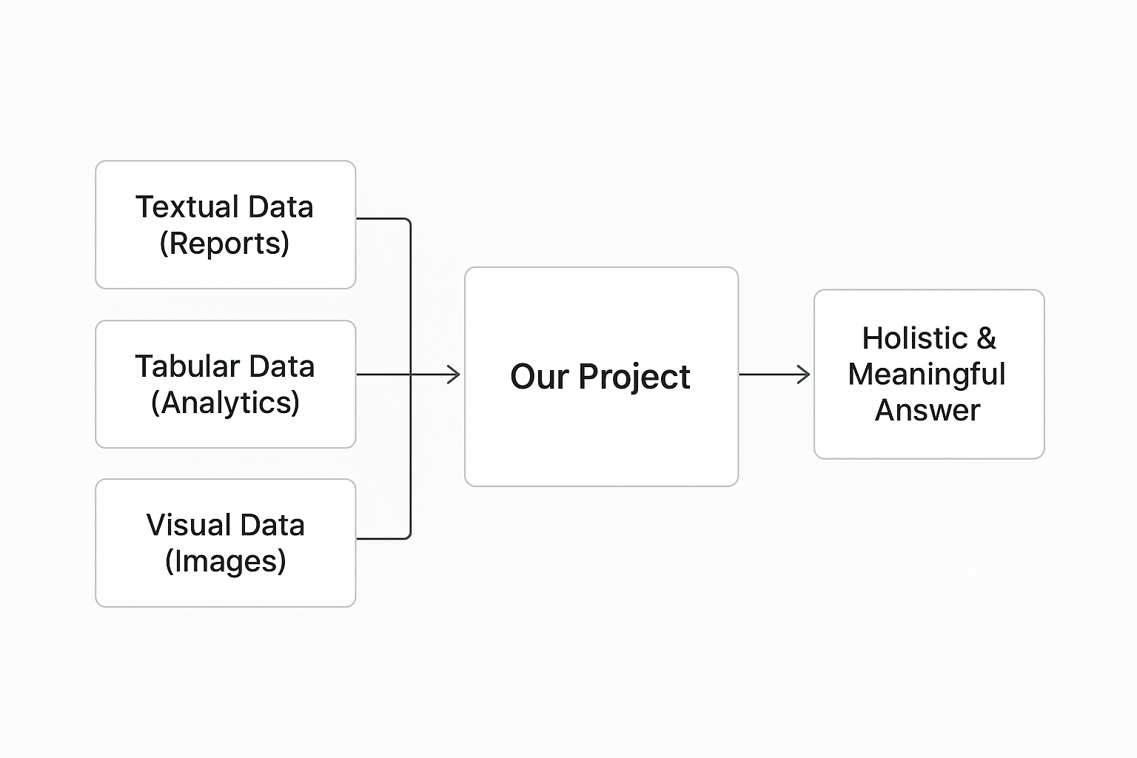
Project Definition
Problem: Critical rules in military and industrial standards are trapped inside complex tables, lengthy texts, and images, making manual analysis slow and error-prone.
Objective: To develop a Multimodal RAG agent that unifies these diverse formats, allowing users to ask natural language questions and receive completely holistic, hallucination-free answers.

Slide 4
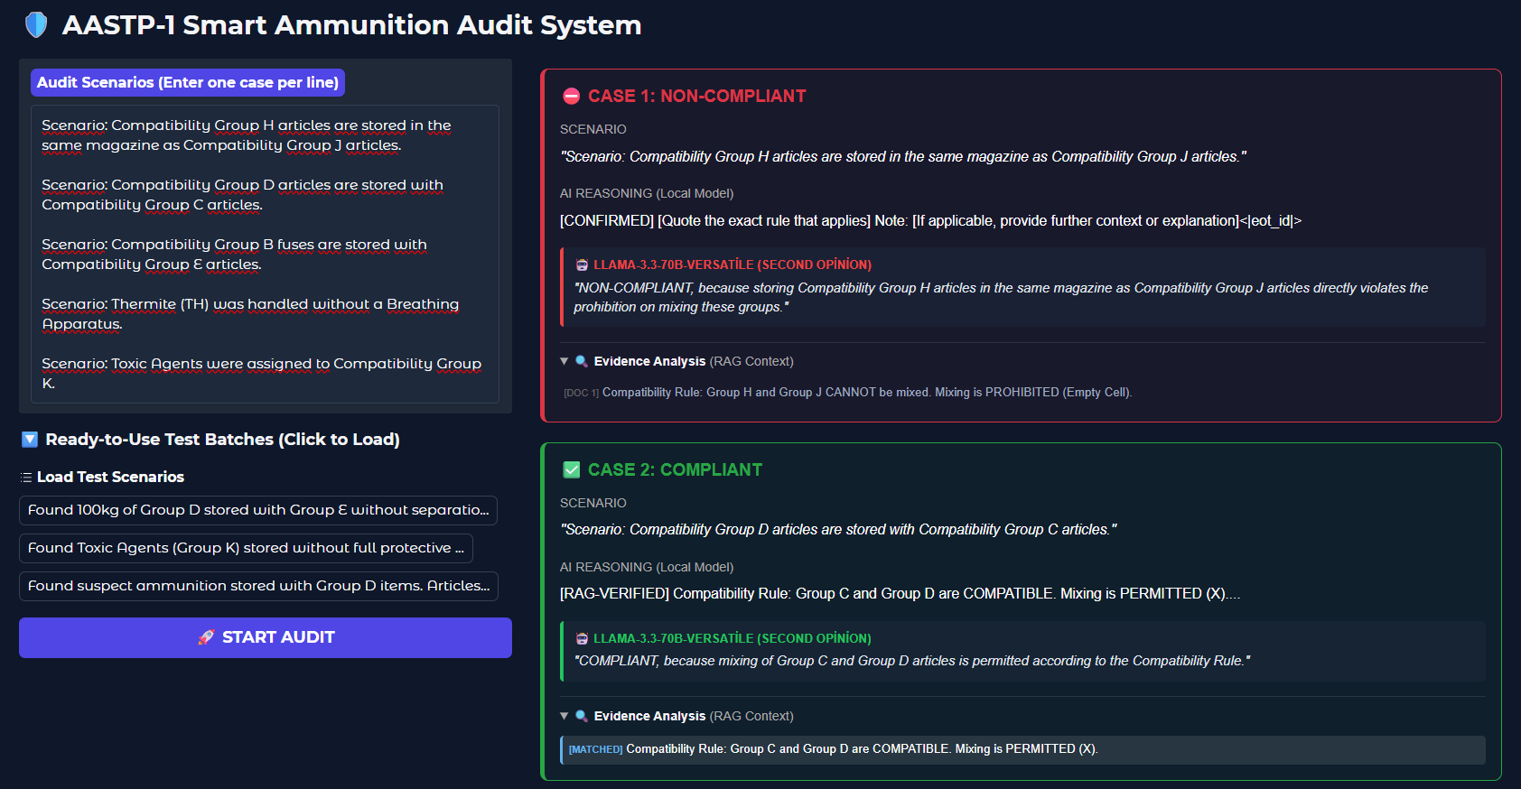
Phase 1 Summary
Initial Focus: Focused on extracting and processing specific, single tables (using MinerU) to prevent the structural loss of 2D data.
Architecture Shift: Transitioned to a "Task-Adaptive Fine-Tuning + RAG" hybrid architecture to accurately interpret tabular matrix logic.
Proof of Concept (PoC): Successfully developed and validated a working PoC audit tool operating on these single tables.

Slide 5
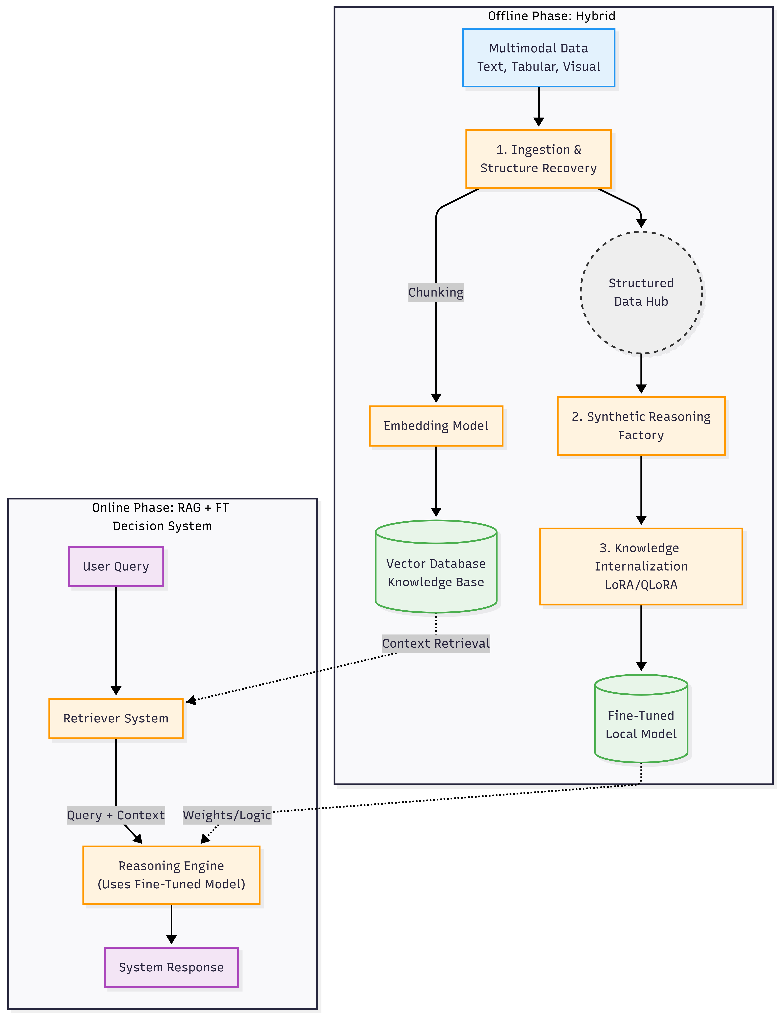
System Architecture
Phase 1 Baseline (Current Stack)
Ingestion & Structure Recovery: MinerU 2.5 (VLM)
Embedding Model: all-MiniLM-L6-v2
Vector Database: ChromaDB
Synthetic Reasoning Factory: Gemma-2-9B
Knowledge Internalization: Unsloth & QLoRA
Fine-Tuned Local Model: Llama-3.2-3B (SLM)
Phase 2 Scaling Note: Due to local hardware constraints in Phase 1, the architecture relied on APIs and smaller local models (SLMs). For Phase 2, the goal is to deploy higher-parameter foundation models fully locally (on dedicated AI servers) to achieve superior reasoning and accuracy.

Slide 6
Phase 2 Objectives & Scaling Strategy
Primary Objective: Scale the system from single-table processing to handling comprehensive, multi-page military standards and complex regulatory documents.
Overcoming the "Tabular RAG" Hurdle:
Linearizing 2D tables destroys spatial logic.
Action: We will implement a Multi-Vector Retrieval architecture where tables are summarized by a small AI, indexing only the summaries while keeping full tables for context.
Future Work & Infrastructure Upgrades:
Data Generation: Creating a synthetic training dataset with 10,000+ "Chain-of-Thought" reasoning scenarios.
Model & Hardware Scaling: Transitioning from 4GB VRAM local training to ILGE AI Servers (Multi-GPU) to fine-tune larger foundation models like Llama-3-8B.
UX Development: Finalizing the Conversational "Decision Support Assistant" interface.

Slide 7
Success Criteria
Criterion 1 (Retrieval Performance): Achieving a Hit Rate@3 ≥ 85% and maintaining an MRR score ≥ 0.75 on complex tabular queries.
Hit Rate@3: The percentage of times the correct information/table appears within the top 3 retrieved results.
MRR (Mean Reciprocal Rank): Evaluates the ranking quality of the retrieved correct information (how close it is to the top position).
Criterion 2 (Decision Accuracy): Achieving an Exact Match ≥ 88% in multi-hop compliance scenarios.
Criterion 3 (Safety Limits): Keeping the Hallucination Rate < 4% (System must output "Information Not Found" rather than fabricating rules).

Slide 8
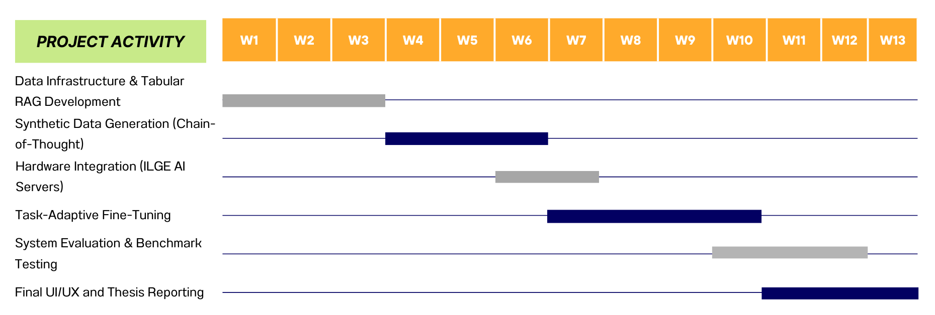
Project Timeline

Slide 9
References
Primary Domain Standard: NATO AASTP-1 (Ed. 1). Allied Storage and Transport Publication for Ammunition and Explosives
Conversational Agent & Reasoning: Yao, S., et al. (2023). ReAct: Synergizing Reasoning and Acting in Language Models
Summarization-Based Indexing (Multi-Vector): Sarthi, P., et al. (2024). RAPTOR: Recursive Abstractive Processing for Tree-Organized Retrieval
Tabular RAG & Linearization: Hegselmann, S., et al. (2023). TabLLM: Few-shot Classification of Tabular Data with Large Language Models
Large-Scale Foundation Models: AI@Meta. (2024). The Llama 3 Herd of Models
Efficient Fine-Tuning: Dettmers, T., et al. (2023). QLoRA: Efficient Finetuning of Quantized LLMs

