Slide 1
Multimodal RAG for Integrating Tabular, Text and Image Data
CSE 496
Second Presentation
Taha Alparslan Atabey
Advisor: Asst. Prof. Dr. Salih Sarp
April 2026

Slide 2
Contents
Project Definition & Architecture: Recap
Bottlenecks & Solutions
Semantic Gap in Dense Retrieval
The Linearization Problem
Automated Data Ingestion
Prove Evidence
To Do & RoadMap
References

Slide 3
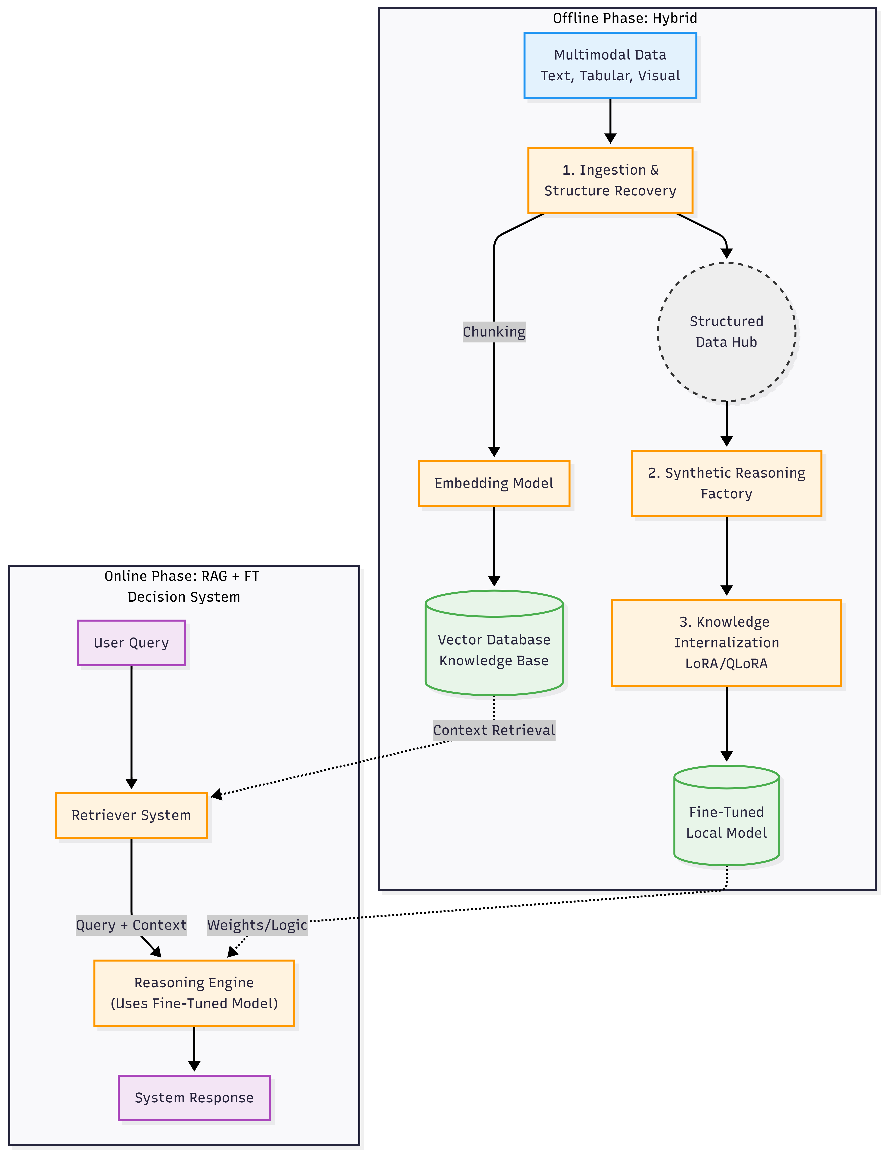
Project Definition & Architecture: Recap
Problem: Vital information is fragmented across disconnected formats (reports, analytical tables, and images) making accurate, fast analysis nearly impossible.
Objective: Develop an intelligent system that integrates multi-format data and generates holistic answers to complex natural language queries.

Slide 4
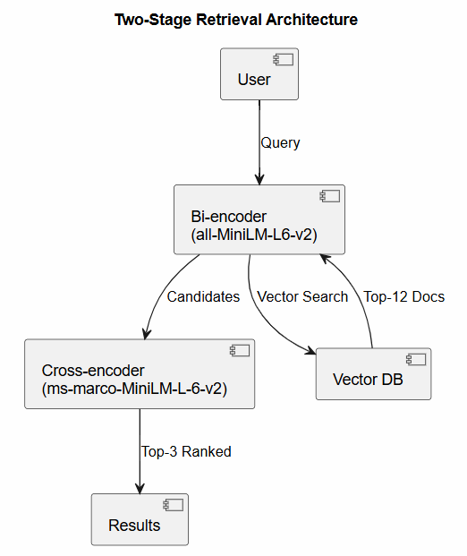
Bottlenecks & Solutions - Semantic Gap in Dense Retrieval
Problem: Military Standard Documents uses regulatory language. But users ask in natural language. For Example:
From Documents: Compatibility Group B mixed with Group F: PERMITTED.
From User: Can Group B be stored with Group F?
> Same meaning but different embedding space. → Wrong Table Retrieved
Solution: Two-Stage Retrieval Pipeline
A bi-encoder first casts a wide net (top-12), then a local cross-encoder re-scores each (query, document) pair together - resolving abbreviation and paraphrase mismatches.
Method | HR@3 | MRR | API
Semantic-only | 0.633 | 0.461 | —
Cross-encoder | 0.867 | 0.811 | None
HyDE (Groq) | ~0.90 | ~0.85 | ~500 tok/query

Slide 5
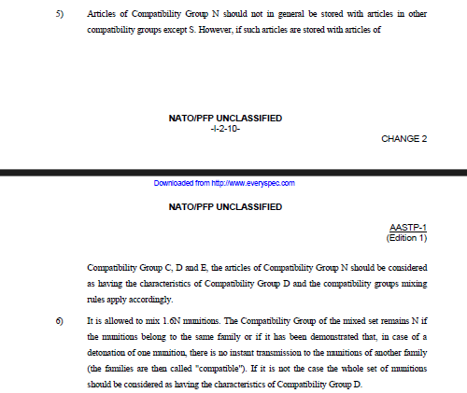
Bottlenecks & Solutions - The Linearization Problem
Problems
Tables encode meaning via row–column structure, not plain text.
HTML embeddings lose semantic structure.
Cross-page NOTES can be missed, causing incorrect decisions.
Solution
TableContextAssembler Script merges TABLE + NOTES + LEGEND across pages
Multi-Vector Indexing:
Summary (LLM) → semantic search
Raw table data → accurate final answer

Slide 6
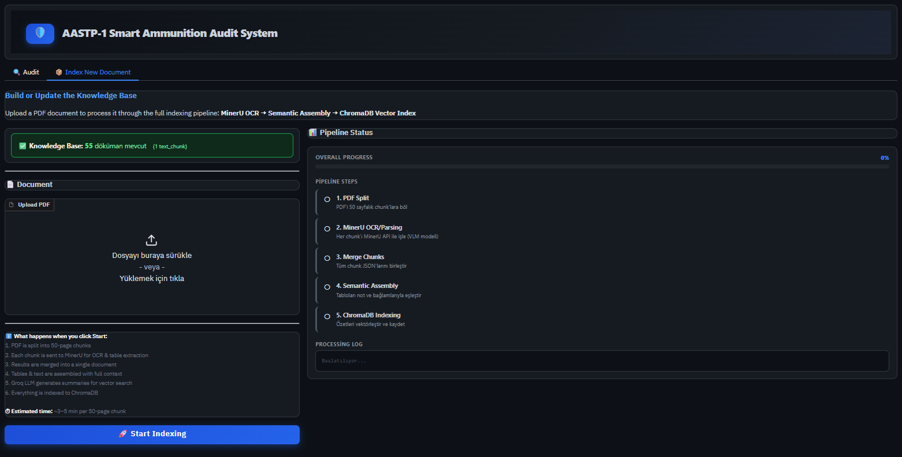
Automated Data Ingestion
From Manual to API: Replaced 20-page web demo limit with automated API calls.
Batch Processing: PDF is split into 50-page chunks for parallel processing.
Resume Support: Pipeline can recover from failures at specific page indices.
One-Click KB: User uploads PDF to System generates full Knowledge Base.

Slide 7
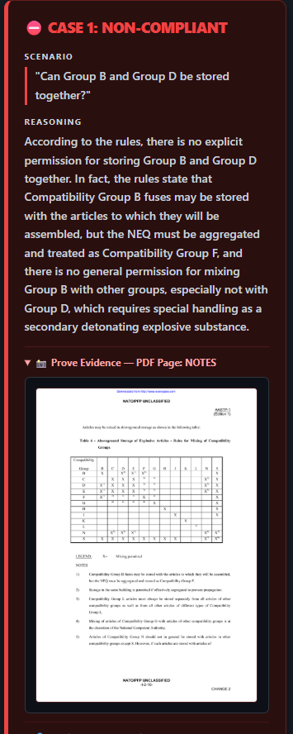
Prove Evidence
Transparency by Design
Large language models can hallucinate. In a compliance context where a wrong verdict can have real safety consequences the user should never be expected to simply trust the system's output.
The Prove Evidence feature is built on this principle: every audit result is accompanied by the exact page and table from the original NATO document that the system used to reach its conclusion.
This is not a debugging tool.
It is a deliberate design choice: the system's job is to accelerate the lookup.

Slide 8
To Do & RoadMap
Local-First Architecture: Replace all API dependencies (MinerU OCR Model) with self-hosted alternatives. Target: fully air-gapped deployment
Multi-Document Support & Scale-Up: Current system operates on a single PDF. Next phase introduces multi-standard indexing the system will automatically identify the relevant document per query. To be deployed on ILGE AI's infrastructure and validated in a real audit environment
Evaluation Targets: Phase 2 targets were Hit Rate@3 ≥ 0.85 and MRR ≥ 0.75. Final phase will define extended benchmarks covering multi-document retrieval and end-to-end verdict accuracy

Slide 9
References
Reimers, N., & Gurevych, I. (2019). "Sentence-BERT: Sentence Embeddings using Siamese BERT-Networks".
Nogueira, R., & Cho, K. (2019). "Passage Re-ranking with BERT".
Wang, Y., et al. (2022). "Self-Instruct: Aligning Language Models with Self-Generated Instructions".
Gao, L., et al. (2022). "Precise Zero-Shot Dense Retrieval without Relevance Labels". ACL 2023.
Wang, Z., et al. (2024). "MinerU: An Open-Source Solution for Precise Document Content Extraction".

