Slide 1
可加入Snubber filter來抑制SW peak voltage
37 V @100uA,10uH | w/o Snubber | w/i Snubber 5Ω + 20pF (Rsnub+Csnub) | w/i Snubber 5Ω + 40pF (Rsnub+Csnub)
Efficiency | 66.8 % | 62.3 % | 56 %

Slide 2
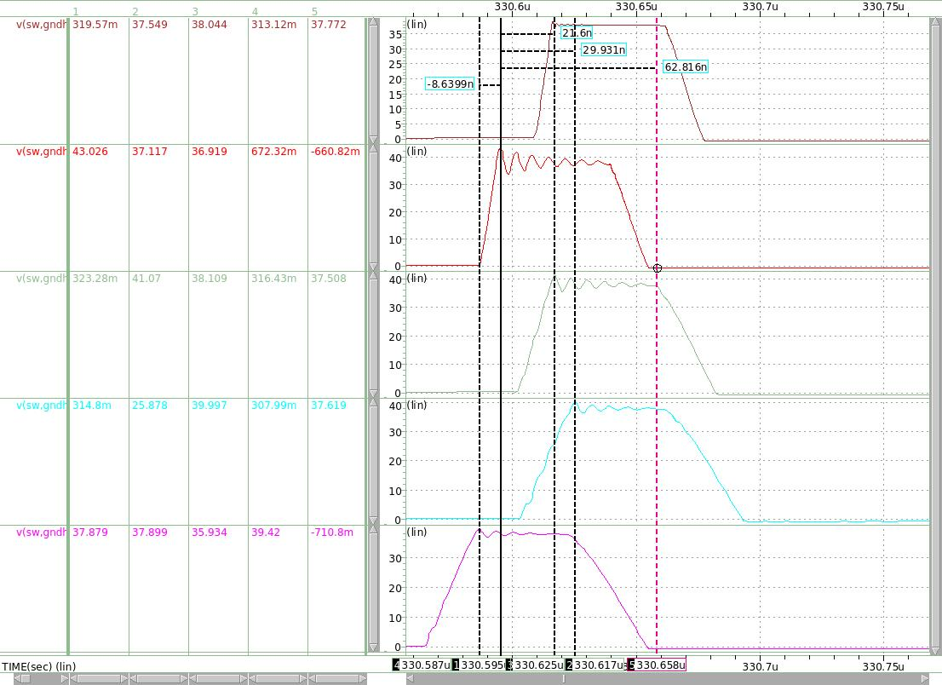
No SW peak
w/o Snubber
5Ω + 20PF
5Ω + 40PF
37 V @100uA,10uH | w/o Snubber | w/i Snubber 5Ω + 20pF (Rsnub+Csnub) | w/i Snubber 5Ω + 40pF (Rsnub+Csnub)
SW peak suppression | 0 % | -37 % | -58 %

