Slide 1
Assignment for Innovaccer SDE Internship
Entry Management System - ENTRYLITE
Vanshika Bansal
3rd year, Computer Science Major
Shiv Nadar University

Slide 2

FRONT PAGE
App name-EntryLite

Slide 3
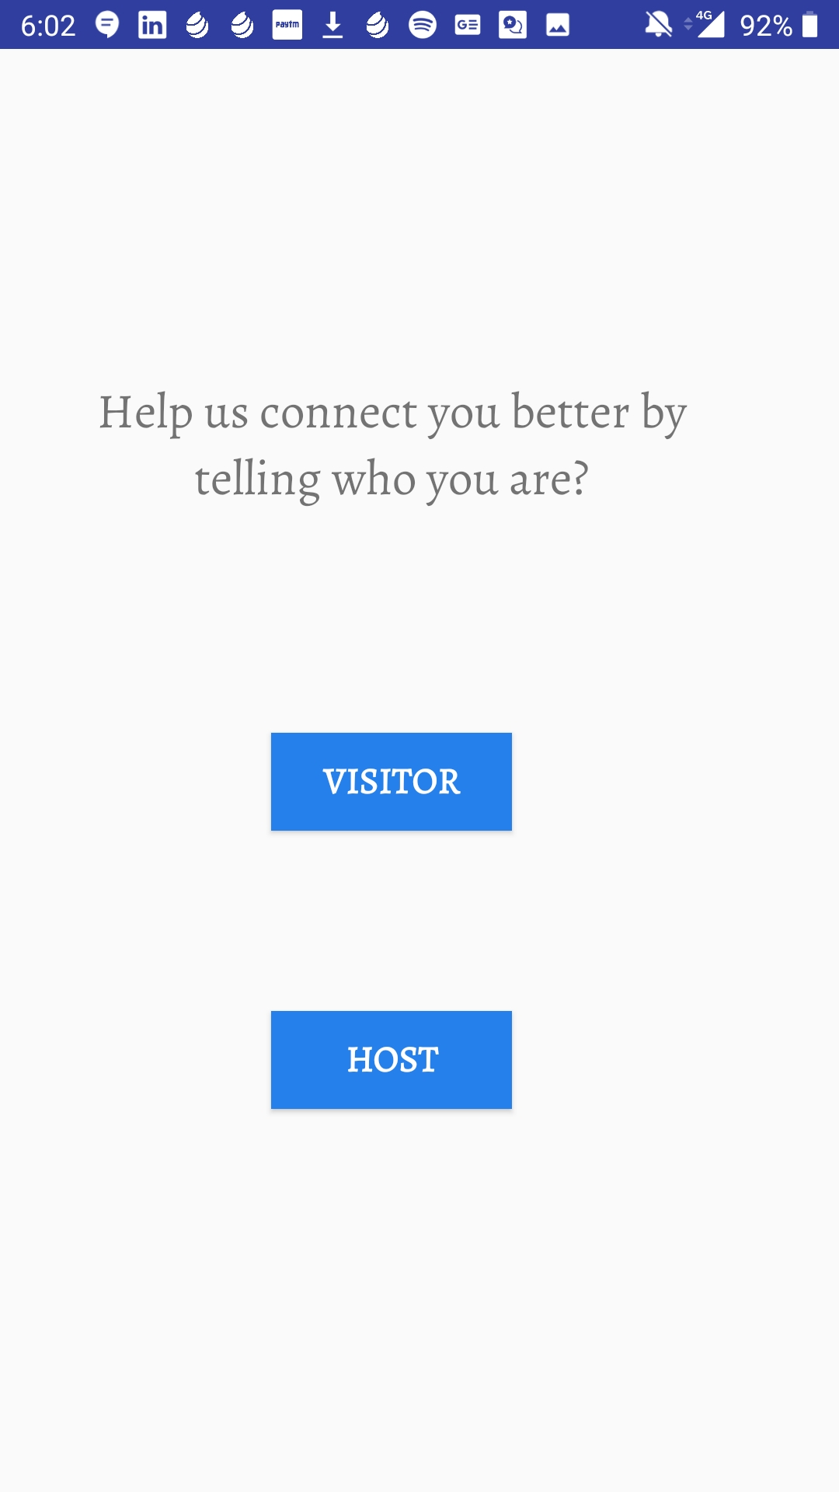
SECOND PAGE
Enter whether you are a host or visitor, there are two separate tables for both of them.

Slide 4
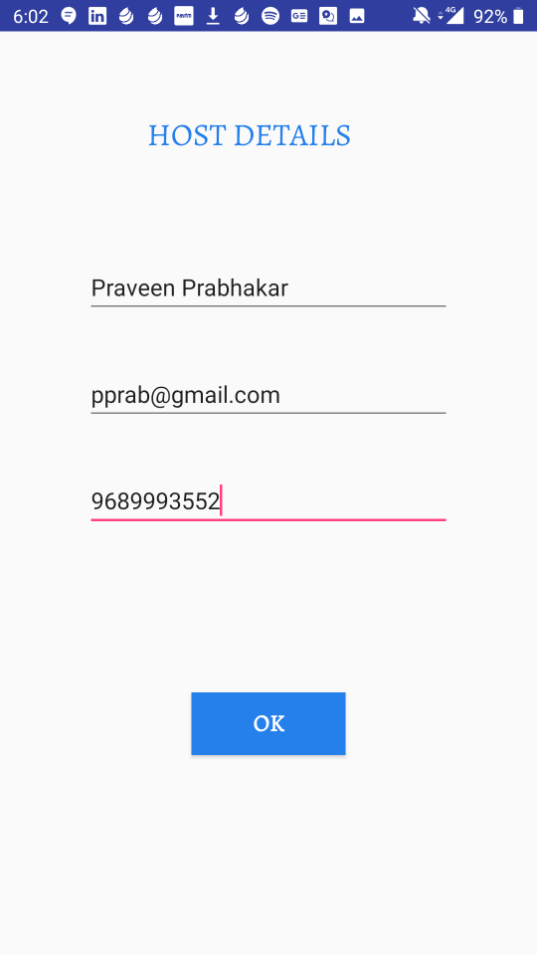
HOST PAGE
Firstly, hosts of the company will be registered.
Here my database was empty and this is the first host entry.
On clicking OK, the host will be registered

Slide 5
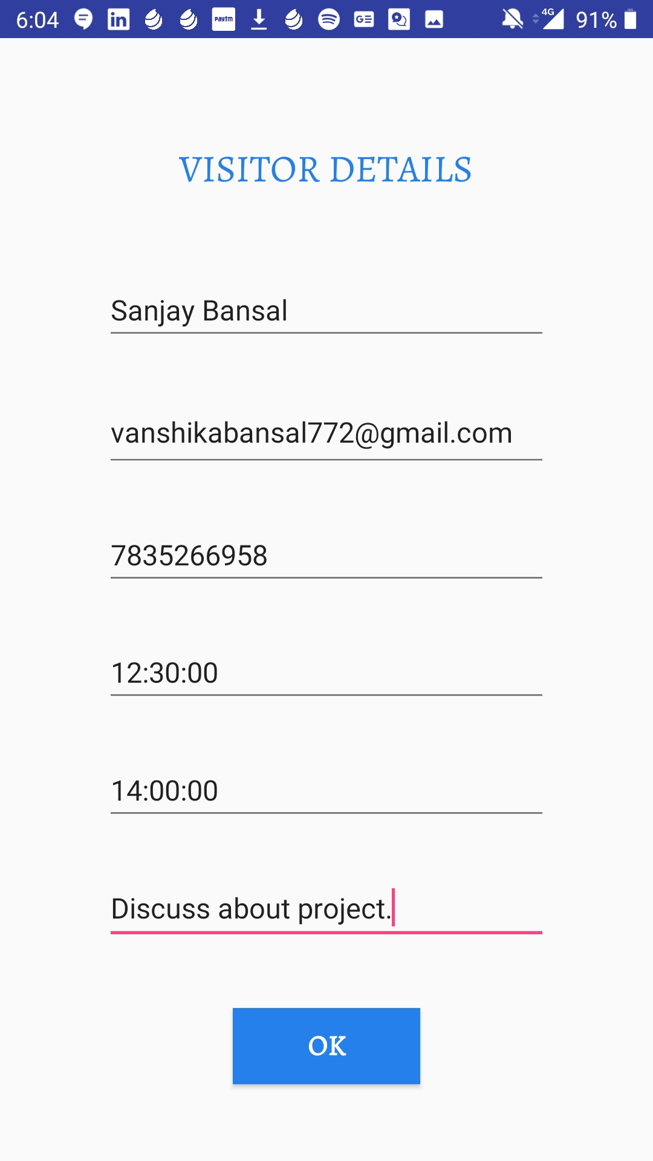
VISITOR PAGE
Now, the visitors will start flowing in.
I registered using my email id so that I receive the respective mail.
On clicking OK, the visitor will be registered and added to database.

Slide 6

LAST PAGE
The visitor is greeted and is now connected to a host.

Slide 7
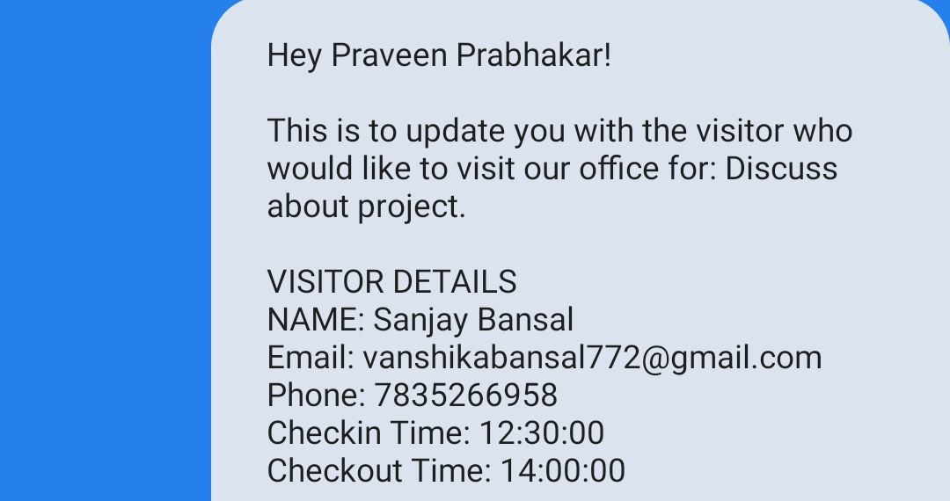
HOST NOTIFIED
A host is selected and informed about the visitor via a message.
So at the company’s office an alternative message transferring can be developed to decrease the dependency on gmail/yahoo can be atleast within the organisation.

Slide 8
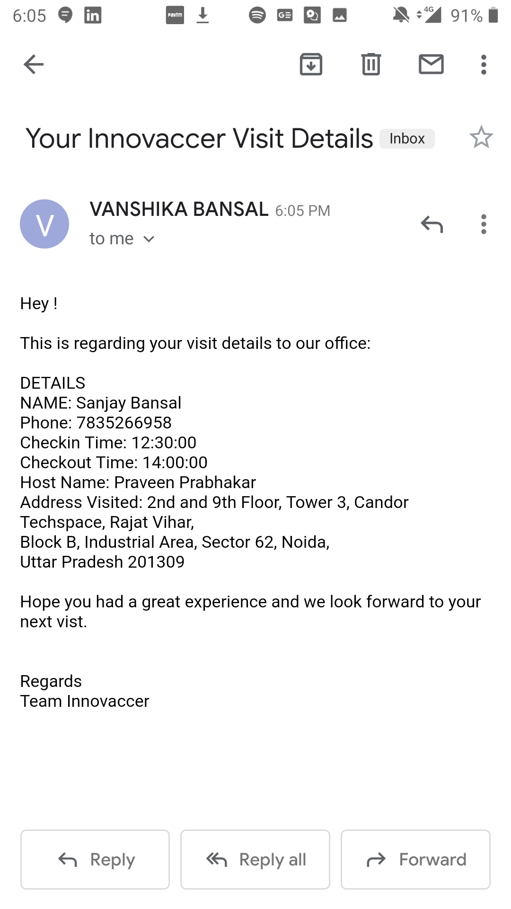
VISIT DETAILS FOR VISITOR
The visitor is sent his visit details via email after the meeting is over.
Here, a template for the mail is created and values are filled in every time visit takes place.
Here, the sender is my email as I tested on my phone.
Also, I sent the email right after registering to make the testing easier.

Slide 9
ASSUMPTIONS AND FUTURE PROSPECTS
Assumption:
The visitor visits only once in a day and the data is for a single day.
The host registers only once.
Currently, the hosts are assigned randomly.
Future:
Every visitor will be given a unique visit id(via mail) to keep track of the visit better.
Process can be made simpler if visitor visits for more than once.
The visitor’s experience and needs can be enhanced by looking at his/her past visits.
The host gives additional details like time slots, designation.
Keeps track of the number of visitors attended and not attended each day for surveys.
While assigning hosts, the type of meeting or reason, and free slots of host can be considered so that no one is over burdened.
Provision of group meetings registration.
If meeting cannot be scheduled due to any reason inform the visitor as soon as possible.

