Slide 1


International Islamic University Chittagong
আন্তর্জাতিক ইসলামী বিশ্ববিদ্যালয় চট্টগ্রাম
Quality with Morality
STUDENT INFORMATION MANAGEMENT SYSTEM PROJECT
Course Code: CSE-1122
Course Title: Computer Programming Lab - I

Slide 2
STUDENT INFORMATION MANAGEMENT SYSTEM

Slide 3

Special Thanks
…………………………………………………………
To our Honorable Lecturer
Nuren Nafisa
Assistant Lecturer,
Dept. of Computer Science and Engineering
International Islamic University Chittagong

Slide 4

Project Overview
Objective:
The primary goal of the system is to manage and organize information about students, including their names, roll numbers, CGPA, and the course IDs they are enrolled.

Slide 5

INTRODUCTION
This project is a console-based Student Information Management System written in C. It aims to provide a simple yet functional system for managing information about students. The program allows users to add new student records, search for students by various criteria (roll number, first name, course ID), view the total number of students, delete students, and update their information.
Key features added in our project are :
Add student
Find student by roll number
Find student by first name
Find student by course ID
Total number of students
Delete student by roll number
Update student information
Exit

Slide 6
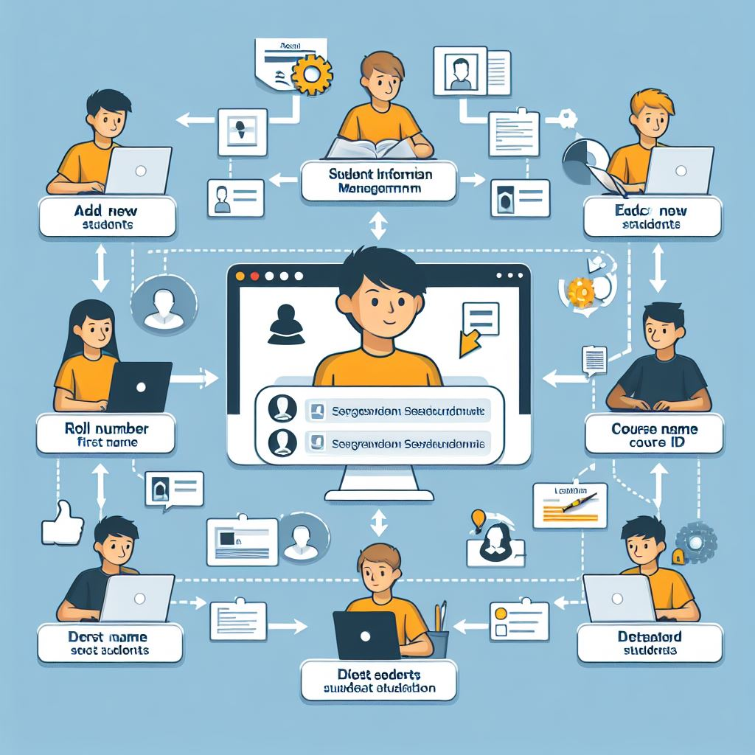
First and Last name
Add new students
Total students
Roll number
Ebtisam
Roll 10
CGPA 4.0
CGPA
Course ID
Delete student(s)
Update student info

Slide 7
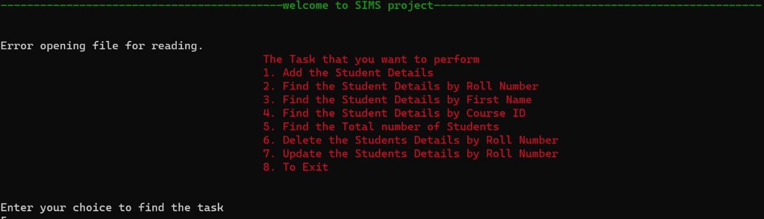
Now let’s study the console:
Welcome message
Menu
User will select any option they want but since there will be no students at the beginning ,tap 1

Slide 8
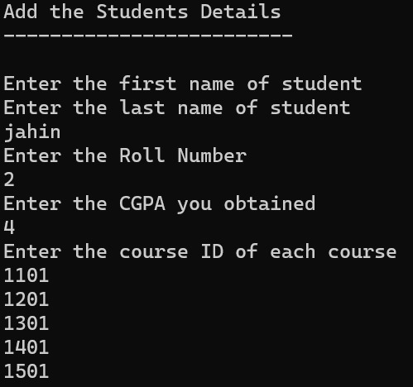
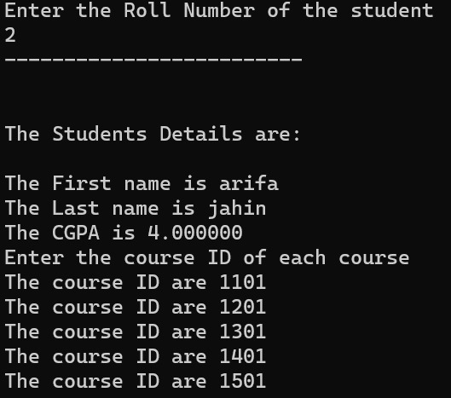
Adding a student
Finding a student using roll number

Slide 9
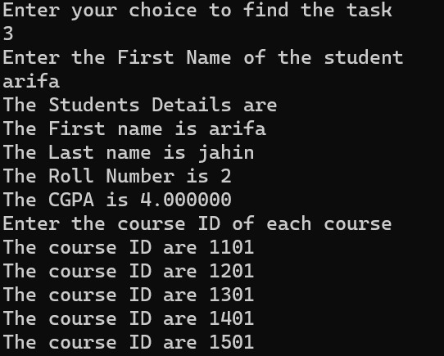
Same way you can find a student saved by their :
First name and Course ID

Slide 10
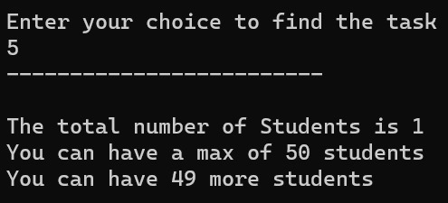
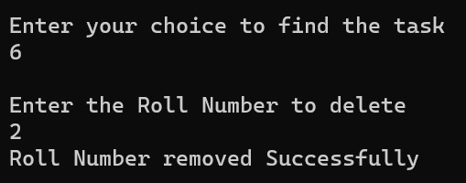
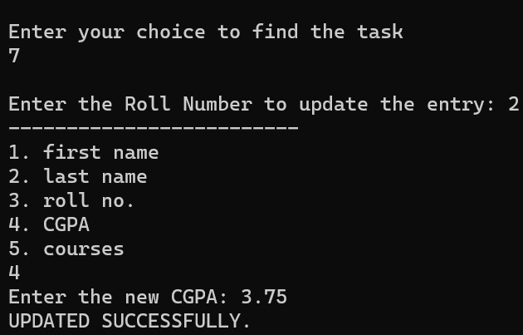
You can check for total number of students
Easily remove a student by their roll number
You can even update a student’s info if there’s wrong data initially provided

Slide 11
Our project on Student Information Management System allows users to:
Save and load student data to/from a file.
Input details for up to 5 courses per student.
Manage information for a maximum of 50 students.
Exit program , saving data to a file.

Slide 12

Easy-to-Use Interface - Make the system more user-friendly with clickable options and prompts.
Secure Student Data - Ensure student information is safe by adding a login system and protecting sensitive data.
More Courses - Allow for a variety of courses to accommodate different subjects.
Reports and Graphs - Create simple reports and graphs to see how students are doing.
Automate Daily Tasks - Add features that do common tasks automatically, like managing enrollments.
Multi-User Support - Let different people (admins, teachers, students) use the system with different levels of access.
Online Access - Make the system accessible online for convenience.
Mobile App - Build a mobile app so you can use it on your phone.
Save and Recover Data - Keep data safe by regularly saving it and having a way to get it back if something goes wrong.
Future-Friendly - Think about what might be needed in the future and plan for that.
Future Scope
This way, you're making the system more user-friendly, secure, and capable of handling more tasks easily.

Slide 13
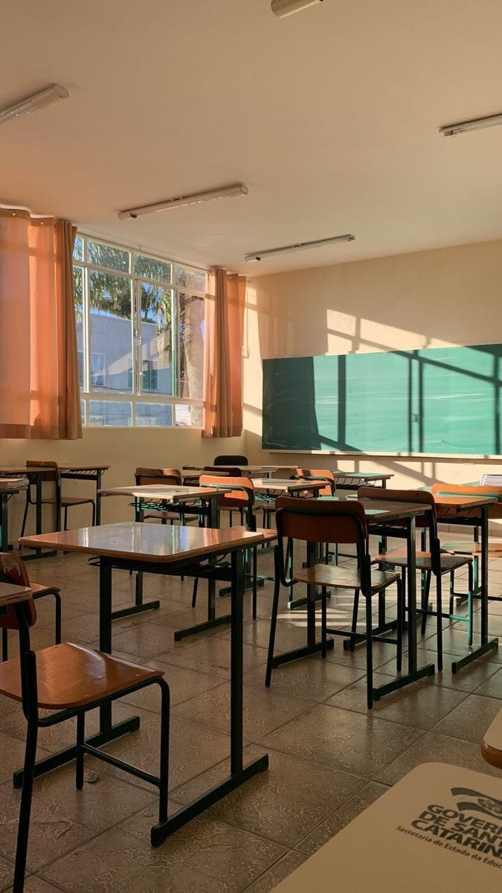


Let's say you want to adapt the Student Information Management System for an entire school, you may need to make the following enhancements:
Class Structure for Students: Instead of having a single array st for all students, you might want to organize students by classes. You can use a two-dimensional array or a structure to represent different classes.
Modular Code for Different Functionalities: Break down the code into modular functions that handle specific functionalities (e.g., add student, find student, delete student) to improve readability and maintainability.
Teacher and Course Information: Extend the system to manage information about teachers and courses. This could include structures for teachers, additional functions to add/update/delete teachers, and associations between teachers and classes.

Slide 14

Ever heard of the term Student Information System(SIS) ? Well, what's the difference between SIS and SIMS?
Let's see………..
SIS (Student Information System):-
Focus : Typically focuses on recording and managing basic student data.
Purpose : Mainly used for administrative tasks related to student information.
SIMS (Student Information Management System):-
Focus : Not just records, but also manages, analyzes, and helps in decision-making based on student data.
Purpose : Extends beyond basic information to include tools for better management and use of student data.
In essence, while SIS is a broader term that can cover a wide range of functionalities related to student information, SIMS might be a more focused system with specific features related to managing student data effectively.

Slide 15
Certainly, here are two modifications to the existing code that can help improve its functionality and flexibility:
Support for Dynamic Number of Courses : This modification allows each student to have a dynamic number of courses, up to a predefined maximum.
Improved Input Validation : This modification ensures that the user provides a valid number of courses within the specified range and prompts for re-entry if the input is invalid.

Slide 16
THANK YOU!!!

