Slide 1
SET
Autonomous multi-agent orchestration for Claude Code
Give it a spec — get merged features. | April 2026

Slide 2
Agenda
The problem — why prompt and pray isn't enough
Six pillars — SPECIFY, DECOMPOSE, EXECUTE, SUPERVISE, VERIFY, LEARN
The input — spec + design = quality input
E2E Demo: MiniShop — the full pipeline walkthrough
Works everywhere — greenfield, brownfield, isolated unit
Dashboard & monitoring — real-time visibility
Lessons learned — 100+ runs in production
Roadmap — where we're heading

Slide 3
The Problem
Why isn't prompting enough?

Slide 4
AI coding today — the challenges
Problem | Typical approach | Result
Divergence | Run prompt twice = 2 different results | Not reproducible
Hallucination | Agents make up what they don't know | Missing features
Quality roulette | LLM judges code quality | Inconsistent
Spec drift | "Tests pass" ≠ "spec is satisfied" | Partial implementation
Amnesia | Every session starts from scratch | Repeated mistakes
Bug fixing | Manual debugging, hours | Lost time
Most AI coding tools are non-deterministic — same prompt, different result.

Slide 5
How SET addresses it
Challenge | SET solution | Result
Divergence | 3-layer template system | 83-87% convergence
Hallucination | OpenSpec + acceptance criteria | Implements against spec
Quality roulette | Programmatic gates (exit codes) | Deterministic pass/fail
Spec drift | Coverage tracking + auto-replan | 100% spec coverage
Amnesia | Hook-driven memory (5 layers) | 100% context capture
Bug fixing | Issue pipeline: detect → fix | 30 second recovery
"We don't prompt — we specify."

Slide 6
Six Pillars
The architecture behind autonomous orchestration

Slide 7
SPECIFY → DECOMPOSE → EXECUTE → SUPERVISE → VERIFY → LEARN
Every feature, gate, and automation maps to one of these six pillars.

Slide 8
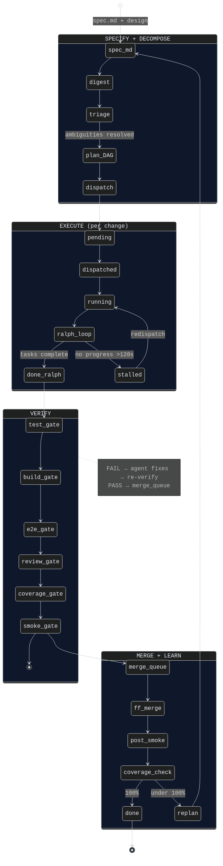
Change lifecycle — state machine
The system doesn't stop until the spec is 100% covered.

Slide 9
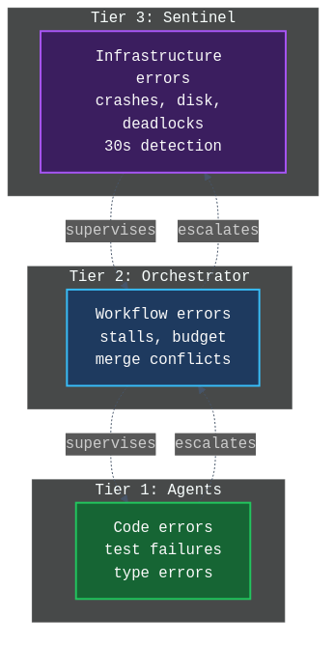
Three-tier supervision
Agents handle code errors. Orchestrator handles workflow. Sentinel handles infrastructure.

Slide 10
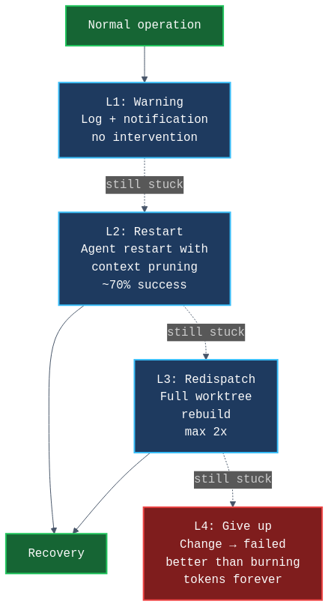
Gradual escalation — when things break
L2 (restart) solves 70% of problems. L4 (give up) is better than burning unlimited tokens.

Slide 11
The Input
Output quality depends on input quality

Slide 12
What a good spec looks like
Data model — entities, fields, relations, enums
Pages — sections, columns, components
Design tokens — hex colors, fonts, spacing
Auth & roles — protected routes, registration
Seed data — realistic names, not "Product 1"
i18n — locales, URL structure
Business requirements — user stories, acceptance criteria
You are the product owner. Agents are the dev team.
The spec is the sprint backlog.

Slide 13
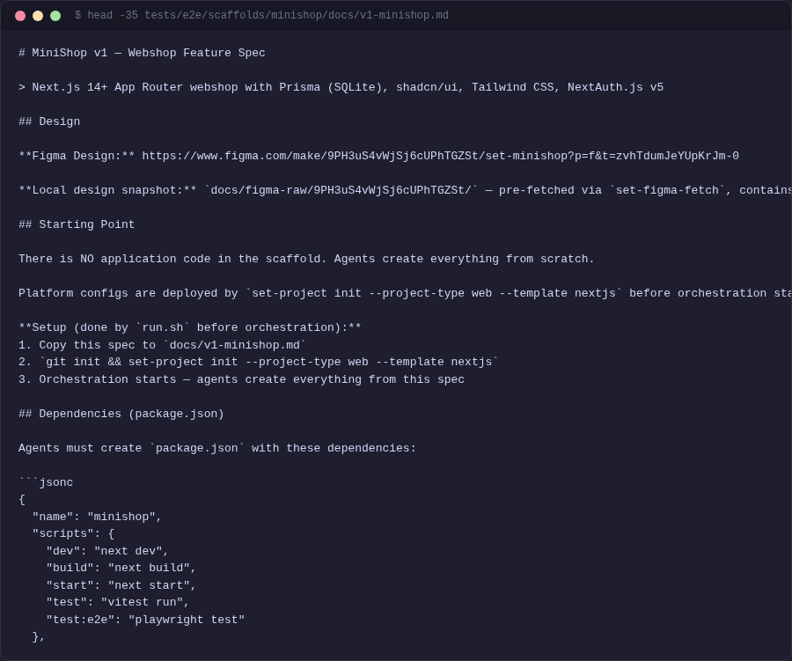
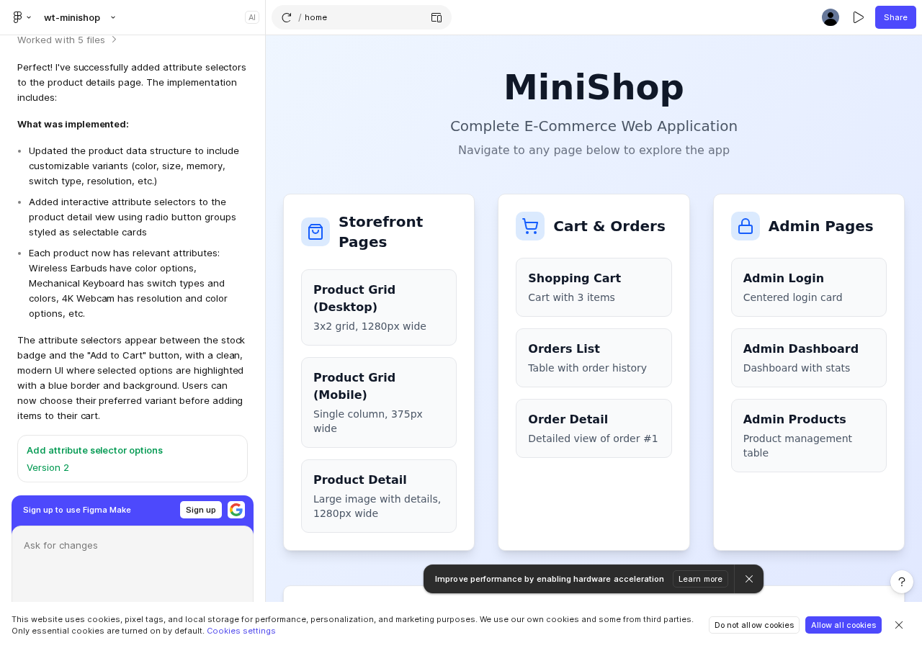
Spec + Figma Design
set-design-sync extracts Figma tokens → design-system.md → agents read before implementation

Slide 14
E2E Demo: MiniShop
Building a webshop from a spec — live

Slide 15
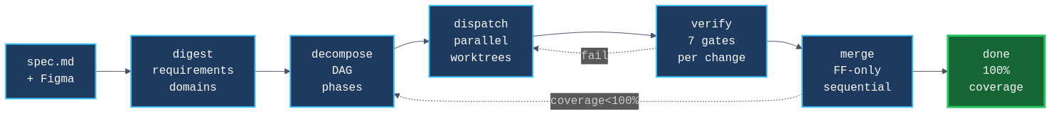
The pipeline
7 stages. Fully automatic. Sentinel supervises everything.

Slide 16
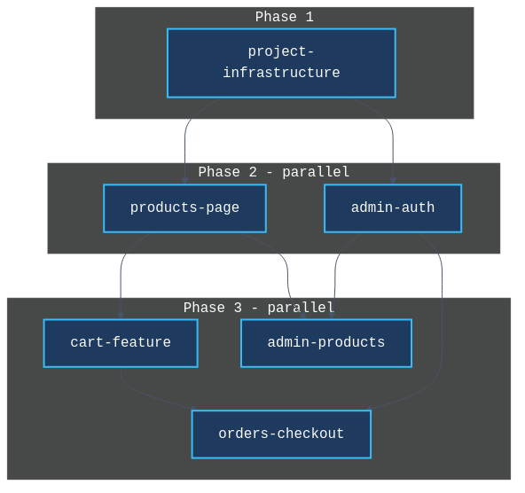
Dependency DAG — phased execution
Phase 2 runs in parallel: products + admin-auth have no dependencies on each other.

Slide 17
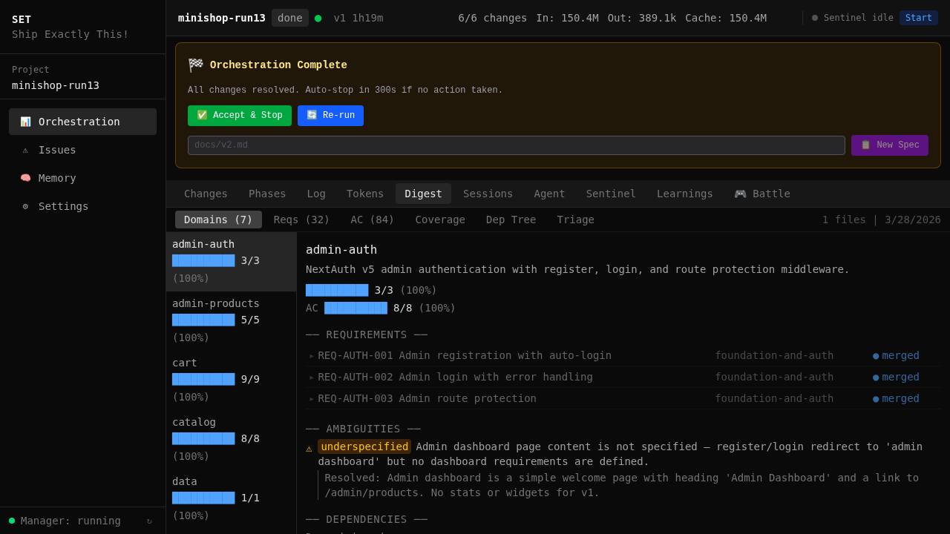
Step 1: Digest — extracting requirements
Domains: Products, Cart, Auth, Admin
32 requirements with REQ-IDs
84 acceptance criteria (WHEN/THEN)
Every REQ-ID tracked through
the entire pipeline.

Slide 18
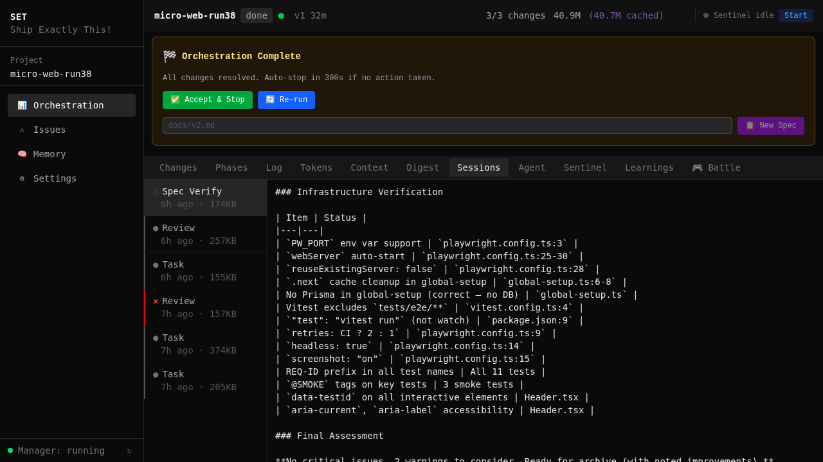
Step 3: Dispatch — parallel agents in worktrees
Each change → own git worktree
Full isolation: can't interfere
Even with 1 change: worktree keeps main clean
Inside each agent the Ralph Loop runs:
proposal → design → spec → tasks → code → test
One agent = one change = one worktree

Slide 19
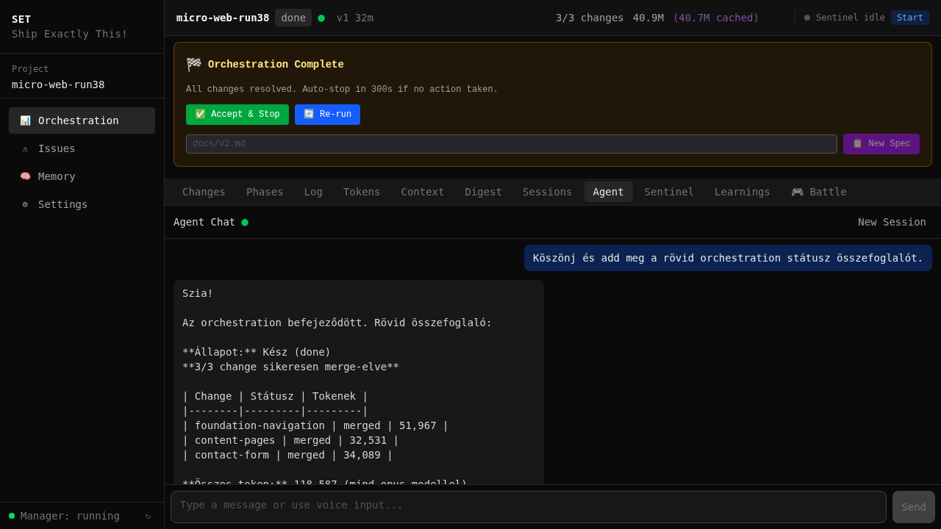
The agent works — real-time terminal
Not a black box — every step is observable: code writing, test running, bug fixing.

Slide 20
Step 5: Verify — 7 quality gates
Gate | Time | Checks | Type
Test | 8s | Unit/integration tests | Deterministic (exit code)
Build | 35s | Type check + bundle | Deterministic (exit code)
E2E | 45s | Browser-based tests | Deterministic (exit code)
Review | 25s | Code quality | LLM (CRITICAL=fail)
Coverage | — | Requirement coverage | LLM + pattern match
Smoke | 15s | Post-merge sanity | Deterministic
Total gate time: 422 seconds (12% of build time). Fast gates first — Jest fails? No waiting for Playwright.

Slide 21
Self-healing pipeline
MiniShop: 5 gate failures, 5 autonomous fixes. Including IDOR vulnerabilities caught and patched.

Slide 22
5 gate failures — 5 automatic fixes
# | Failure | Gate | Agent fix
1 | Missing test file | Test | Added test file
2 | Jest config error | Build | Fixed path mapping
3 | Playwright auth tests (3 specs) | E2E | Updated redirects
4 | Post-merge type error | Build | Synced with main
5 | Cart test race condition | E2E | Added waitForSelector
Without gates, these 5 bugs would have merged into main and caused cascading failures.

Slide 23
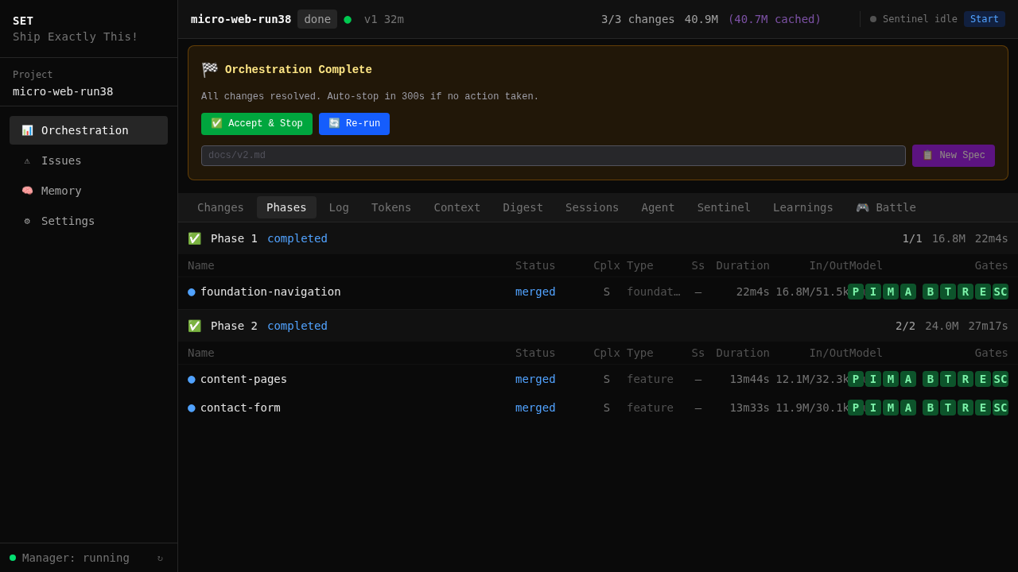
Step 6: Merge — integration
FF-only merge — clean history
Sequential merge queue
Phase ordering — phase 2 after 1
Post-merge smoke test
The merge queue is the bottleneck
— intentionally.

Slide 24
Works Everywhere
Not just "build me an app from scratch"

Slide 25
Greenfield, Brownfield, Isolated Unit
Mode | What it means | Example
Greenfield | Full app from spec + design | MiniShop: 6/6, 1h 45m, 0 interventions
Brownfield | Existing codebase + new features | SET builds itself: 1,500+ commits
Isolated unit | One module, one feature, one fix | 3 API endpoints with auth in existing Next.js
Same pipeline in all modes. The entry barrier is not a 30-page spec — it can be a single task description.

Slide 26
The Result
What the pipeline produced

Slide 27
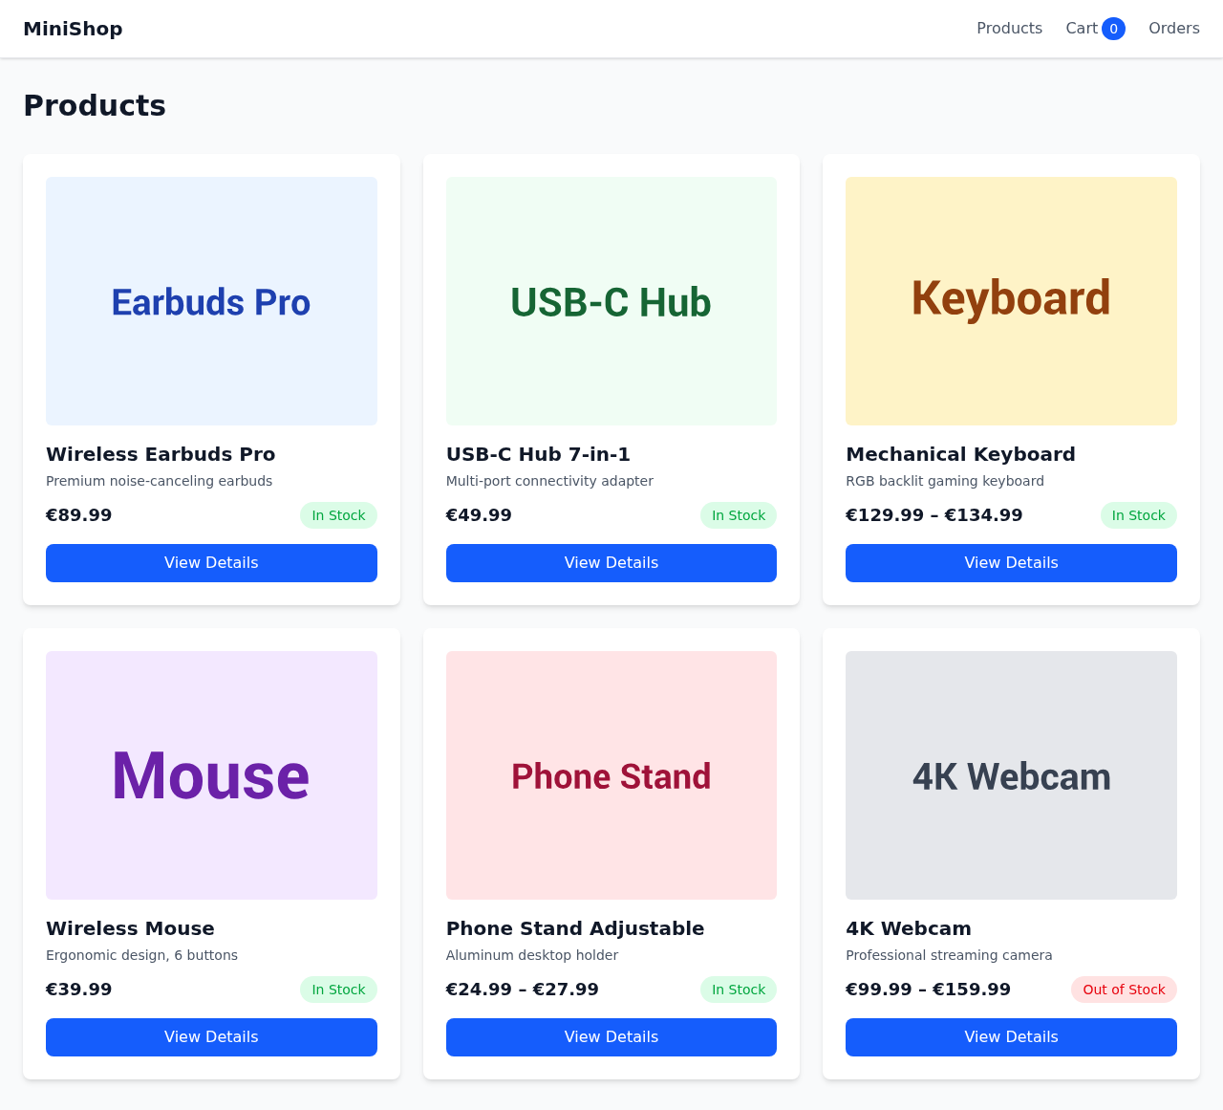
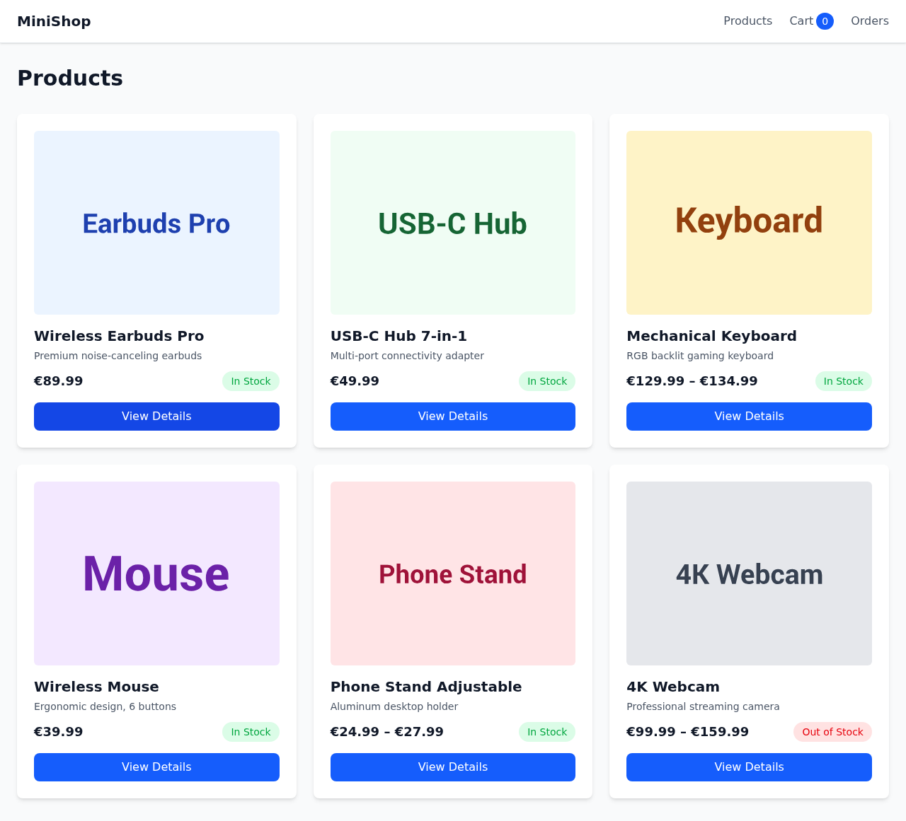
MiniShop — the finished application
Product listing + detail pages — real data, working navigation, responsive layout

Slide 28
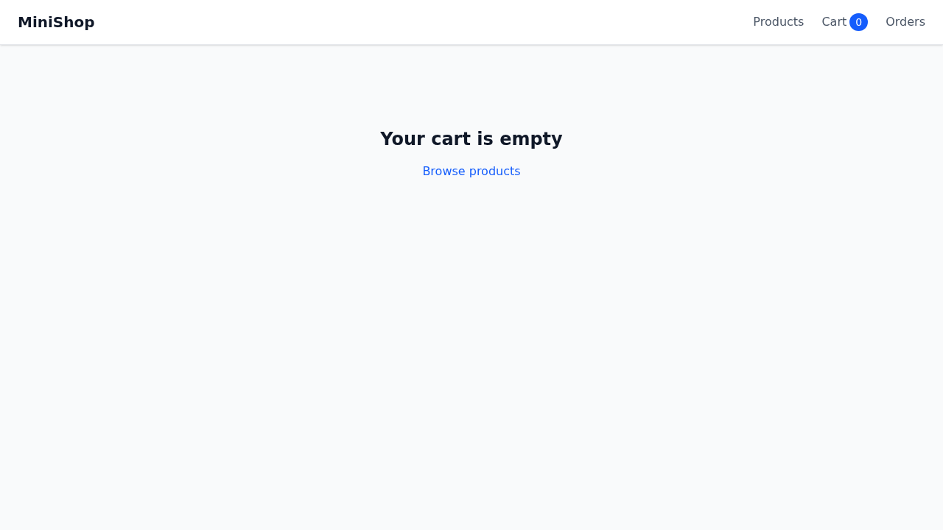
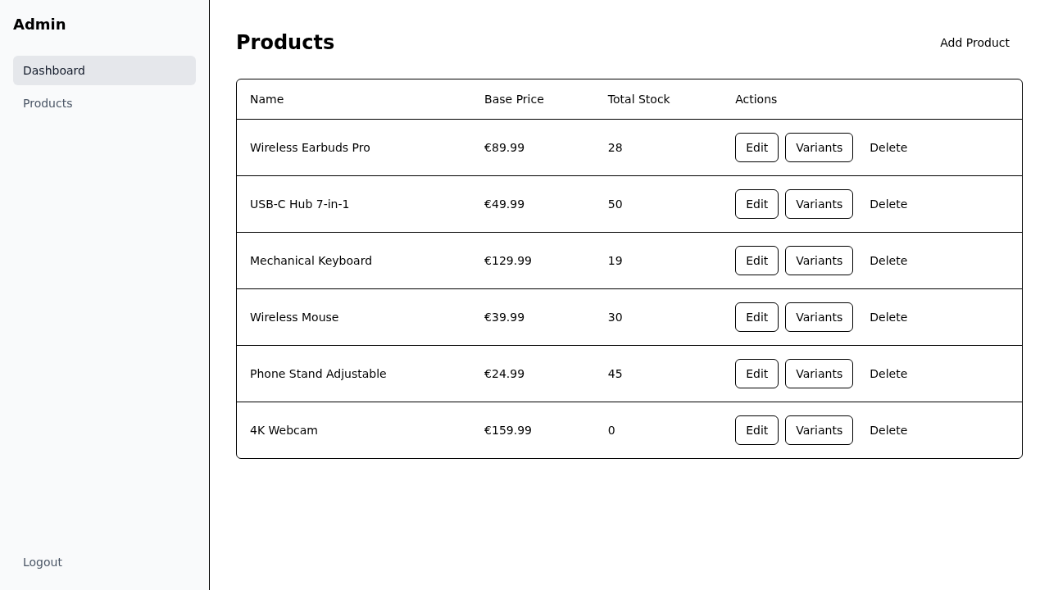
MiniShop — cart and admin
Working cart with totals | Admin dashboard — protected route, session-based auth

Slide 29
The numbers — MiniShop benchmark
Metric | Value
Changes planned/merged | 6/6 (100%)
Total wall time | 1h 45m
Human interventions | 0
Merge conflicts | 0
Jest unit tests | 38 (6 suites)
Playwright E2E tests | 32 (6 spec files)
Total tokens | 2.7M
Gate retries | 5 (all self-healed)
Roughly equivalent to a day's work by 3-4 senior developers.

Slide 30
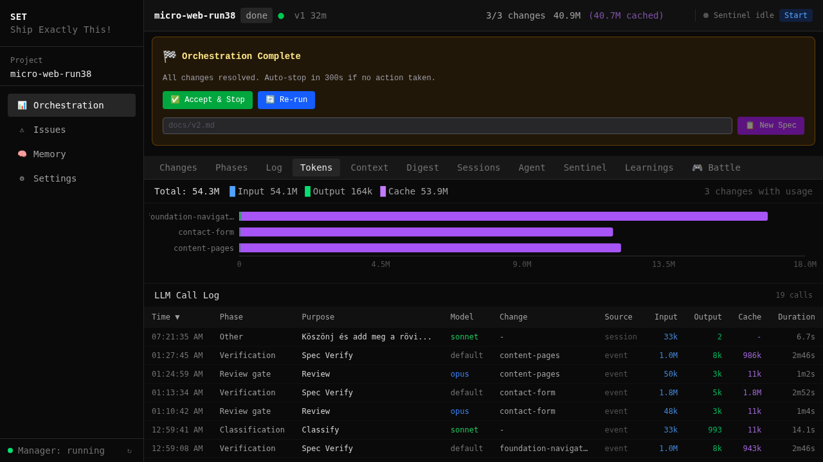
Token usage
Cache ratio 26:1 — prompt caching dramatically reduces cost. Only input + output billed.

Slide 31
Dashboard & Monitoring
Real-time visibility into everything

Slide 32
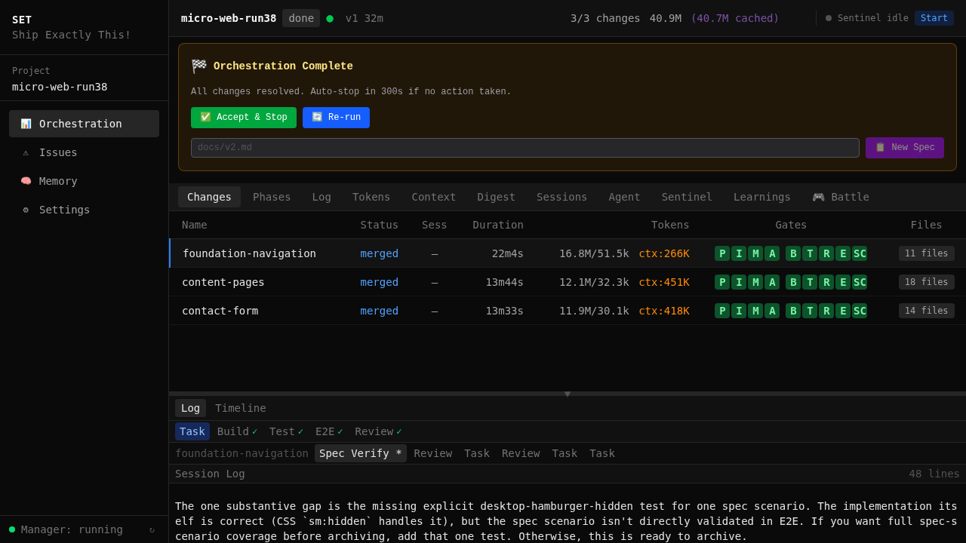
Web Dashboard — localhost:7400
Changes, Phases, Tokens, Sessions, Sentinel, Log, Agent, Learnings, Digest — all live.

Slide 33

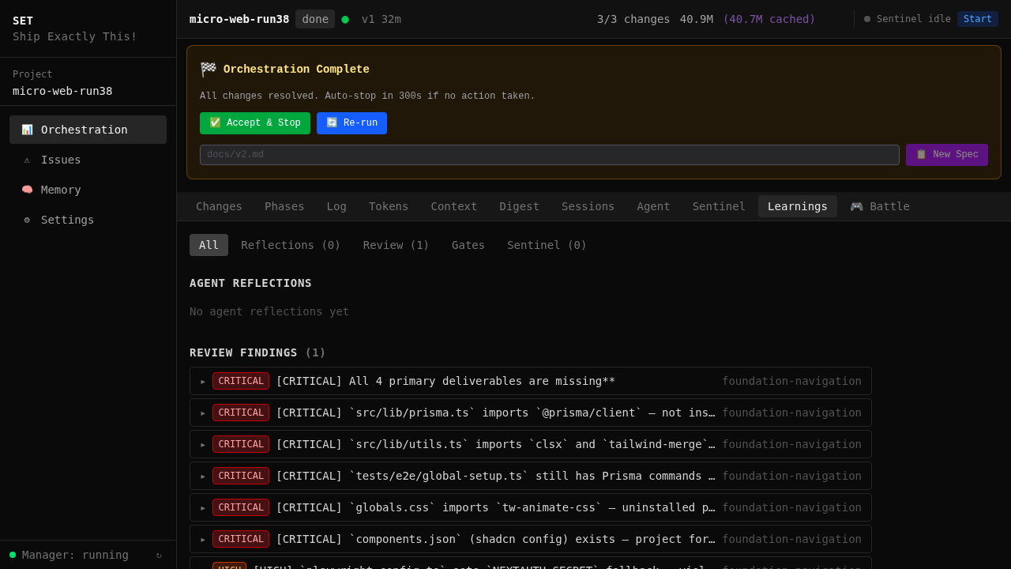
Dashboard tabs — live data
Changes: status at a glance | Learnings: gate failures, agent solutions, patterns

Slide 34
Architecture
3 layers, extensible plugin system

Slide 35
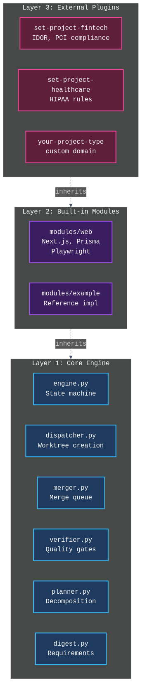
3-layer architecture
Layer 1 never contains project-specific logic. All web code lives in Layer 2.

Slide 36
Lessons Learned
100+ runs, real production experience

Slide 37
8 lessons from production
1. Agents need structure, not just prompts
OpenSpec artifacts keep them focused. Without: 3 agents, 3 table libs.
2. Quality gates must be deterministic
Exit code > LLM judgment. Agents gamed the LLM review.
3. Merge conflicts are #1 cascading failure
Phase ordering + DAG + sequential merge queue.
4. Memory without hooks is useless
15+ sessions, 0 voluntary saves. 5-layer hooks: +34% improvement.

Slide 38
8 lessons (continued)
5. E2E testing reveals what unit tests don't
Stale locks, zombie worktrees, race conditions in poll cycle.
6. Stall detection needs grace periods
pnpm install >60s = watchdog killed it. Context-aware timeouts.
7. The Sentinel pays for itself
3 overnight runs lost before sentinel. 5-10 LLM calls/run saves hours.
8. Templates beat conventions
"Make a Next.js project" = 5 structures. Templates = 0% divergence.

Slide 39
Scaling: MiniShop vs CraftBrew
Metric | MiniShop | CraftBrew #7 | Multiplier
Changes | 6 | 15 | 2.5x
Source files | 47 | 150+ | 3x
DB models | ~8 | 28 | 3.5x
Merge conflicts | 0 | 4 (all resolved) | —
Human intervention | 0 | 0 | —
Wall time | 1h 45m | ~6h | 3.4x
Tokens | 2.7M | ~11M | 4x
Token scaling is super-linear (4x tokens for 2.5x changes) — later changes need more context.

Slide 40
Convergence — measuring reproducibility
Dimension | Match
DB schema (models, fields, relations) | 100%
Conventions (naming, structure) | 100%
Routes (URLs, API endpoints) | 83%
Overall | 83/100
Remaining 17% is stylistic, not structural. Schema and conventions are fully deterministic.

Slide 41
Roadmap
Where we're heading

Slide 42
Development priorities
Divergence reduction — template optimization, scaffold testing
Build time optimization — parallel gates, incremental builds
Session context reuse — reduce cold-start token overhead
Memory optimization — relevance scoring, auto-rule conversion
Gate intelligence — adaptive thresholds from historical data
Merge conflict prevention — proactive file-level detection
Core/Web separation — 170+ web refs leaked into core
NIS2 Compliance Layer — EU 2022/2555 directive
shadcn/ui Design Connector — local design-system.md

Slide 43
Summary
SPECIFY → DECOMPOSE → EXECUTE → SUPERVISE → VERIFY → LEARN
6 changes | 1h 45m | 0 interventions | 70 tests | 100% spec coverage Greenfield, brownfield, isolated unit — same pipeline.

Slide 44
Questions?
GitHub: github.com/tatargabor/set-core
Website: setcode.dev
Benchmarks: docs/learn/benchmarks.md
Lessons learned: docs/learn/lessons-learned.md
Try it:
pip install -e . && pip install -e modules/web
./tests/e2e/runners/run-micro-web.sh
open http://localhost:7400

