Slide 1
The distribution of coronavirus in China and whether the spread of the virus is related to the population and GDP of provinces
Prepared By:
Yixue Wang
February 27, 2020

Slide 2
What is coronaviruses?
Coronaviruses (CoV) are a large family of viruses that cause illness ranging from the common cold to more severe diseases such as Middle East Respiratory Syndrome (MERS-CoV) and Severe Acute Respiratory Syndrome (SARS-CoV). Coronaviruses are zoonotic, meaning they are transmitted between animals and people. This report will focus on a novel coronavirus that has not been previously identified in humans, Coronavirus Disease 2019, first discovered in Wuhan, Hubei Province, China.

Slide 3
Source of the data
The Ministry of Health of each province publishes the latest confirmed diagnosis daily on the official website.
Foursquare location data
sina.com
google.ca

Slide 4

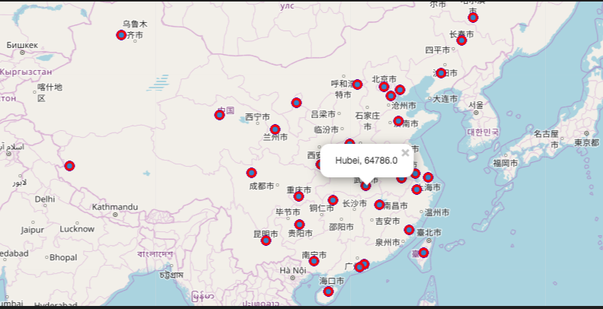
Methodology and data analysis
All provinces with confirmed cases will be displayed on the map, and when the user clicks on a marker, the map will show the name of the corresponding province and the number of confirmed people.
The data I used in the following picture is the epidemic data on February 24, 2020.

Slide 5
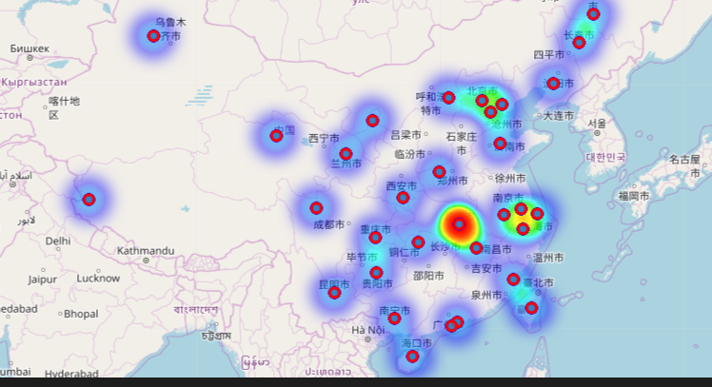
Methodology and data analysis(con’t)
Through the observation of heatmaps, we can find that in the past two months, the high incidence of coronavirus in China in 2019 was mainly concentrated around Hubei and Jiangsu.

Slide 6
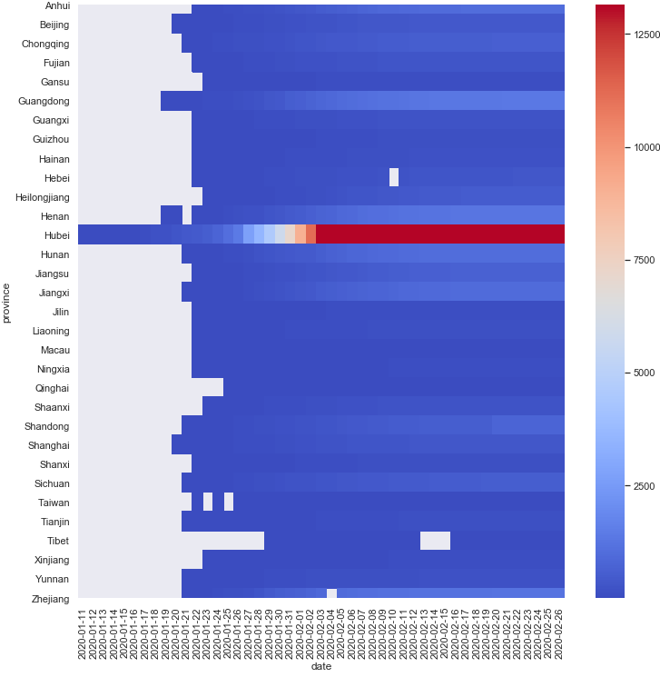
Methodology and data analysis(con’t)
From the number of confirmed cases, the number of people in Hubei province is much higher than in other provinces, and there is a surge in the number of people in late January and early February.

Slide 7
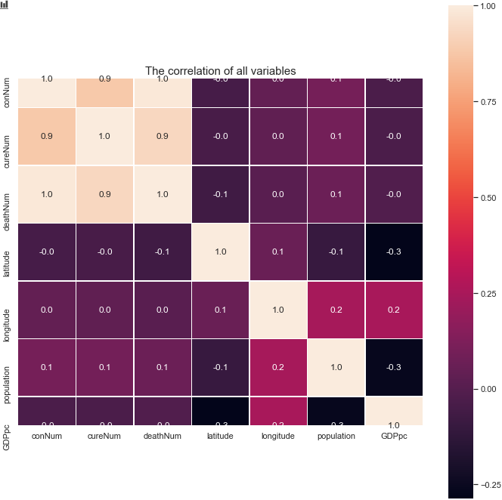
Methodology and data analysis(con’t)
From the perspective of correlation, the number of confirmed patients, the number of cured patients and the number of deaths have a very high positive correlation.
However, from the analysis of current data, it is difficult to see the impact of population and GDP on virus transmission.

Slide 8
Conclusion
that the high and frequent areas of coronavirus in China in January and February 2020 were mainly concentrated in Hubei Province.
the number of confirmed patients increased significantly at the end of January and early February.
the impact of population and GDP on the number of diagnoses cannot be seen from the currently limited data.

