Slide 1
BVC
Android Basics Camp,2017
By T.T.V.Vamsi Kirshna, N.Naveen and team
Headed by Mrs.Padma Priya mam

Slide 2

good morning

Slide 3
Who are we?

Slide 4
Why this Course?

Slide 5

What are you going to learn?

Slide 6
History Of Android
Andy Rubin
California,2003
Google 2005
2008

Slide 7
API History
Codename | Version | Released | API Level
Honeycomb | 3.0 - 3.2.6 | Feb 2011 | 11 - 13
Ice Cream Sandwich | 4.0 - 4.0.4 | Oct 2011 | 14 - 15
Jelly Bean | 4.1 - 4.3.1 | July 2012 | 16 - 18
KitKat | 4.4 - 4.4.4 | Oct 2013 | 19 - 20
Lollipop | 5.0 - 5.1.1 | Nov 2014 | 21 - 22
Marshmallow | 6.0 - 6.0.1 | Oct 2015 | 23
Nougat | 7.0 | Sept 2016 | 24

Slide 8
Why Android?

Slide 9
What do you need to know to develop android?

Slide 10
What do you need to have to develop android?

Slide 11
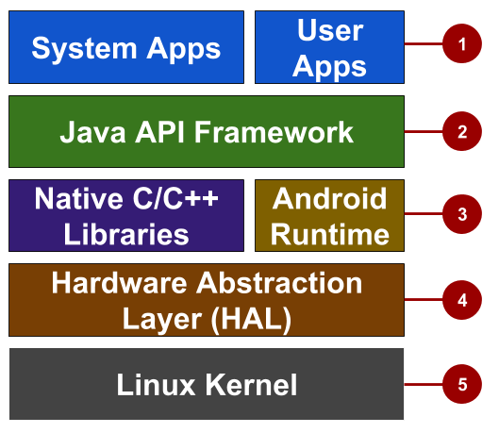
Android stack
System and user apps
Android OS API in Java framework
Expose native APIs; run apps
Expose device hardware capabilities
Linux Kernel

Slide 12
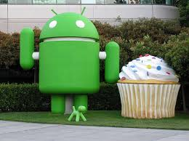
System and user apps
System apps have no special status
System apps provide key capabilities to app developers
Example:
Your app can use a system app to deliver a SMS message.

Slide 13
Java API Framework
The entire feature-set of the Android OS is available to you through APIs written in the Java language.
View class hierarchy to create UI screens
Notification manager
Activity manager for life cycles and navigation
Content providers to access data from other apps

Slide 14
Android runtime
Each app runs in its own process with its own instance of the Android Runtime.

Slide 15
C/C++ libraries
Core C/C++ Libraries give access to core native Android system components and services.

Slide 16
Hardware Abstraction Layer (HAL)
Standard interfaces that expose device hardware capabilities as libraries
Examples: Camera, bluetooth module

Slide 17
Linux Kernel
Threading and low-level memory management
Security features
Drivers

Slide 18
App Development
This work is licensed under a Creative Commons Attribution-NonCommercial 4.0 International License

Slide 19
What is an Android app?
One or more interactive screens
Written using Java Programming Language and XML
Uses the Android Software Development Kit (SDK)
Uses Android libraries and Android Application Framework
Executed by Android Runtime Virtual machine (ART)

Slide 20
Challenges of Android development
Multiple screen sizes and resolutions
Performance: make your apps responsive and smooth
Security: keep source code and user data safe
Compatibility: run well on older platform versions
Marketing: understand the market and your users
(Hint: It doesn't have to be expensive, but it can be.)

Slide 21
App building blocks
Resources: layouts, images, strings, colors as XML and media files
Components: activities, services, …, and helper classes as Java code
Manifest: information about app for the runtime
Build configuration: APK versions in Gradle config files

Slide 22
Component types
Activity is a single screen with a user interface
Service performs long-running tasks in background
Content provider manages shared set of data
Broadcast receiver responds to system-wide announcements

Slide 23
Think of Android as a hotel
Your app is the guest
The Android System is the hotel manager
Services are available when you request them (intents)
  In the foreground (activities) such as registration
  In the background (services) such as laundry
Calls you when a package has arrived (broadcast receiver)
Access the city's tour companies (content provider)

Slide 24
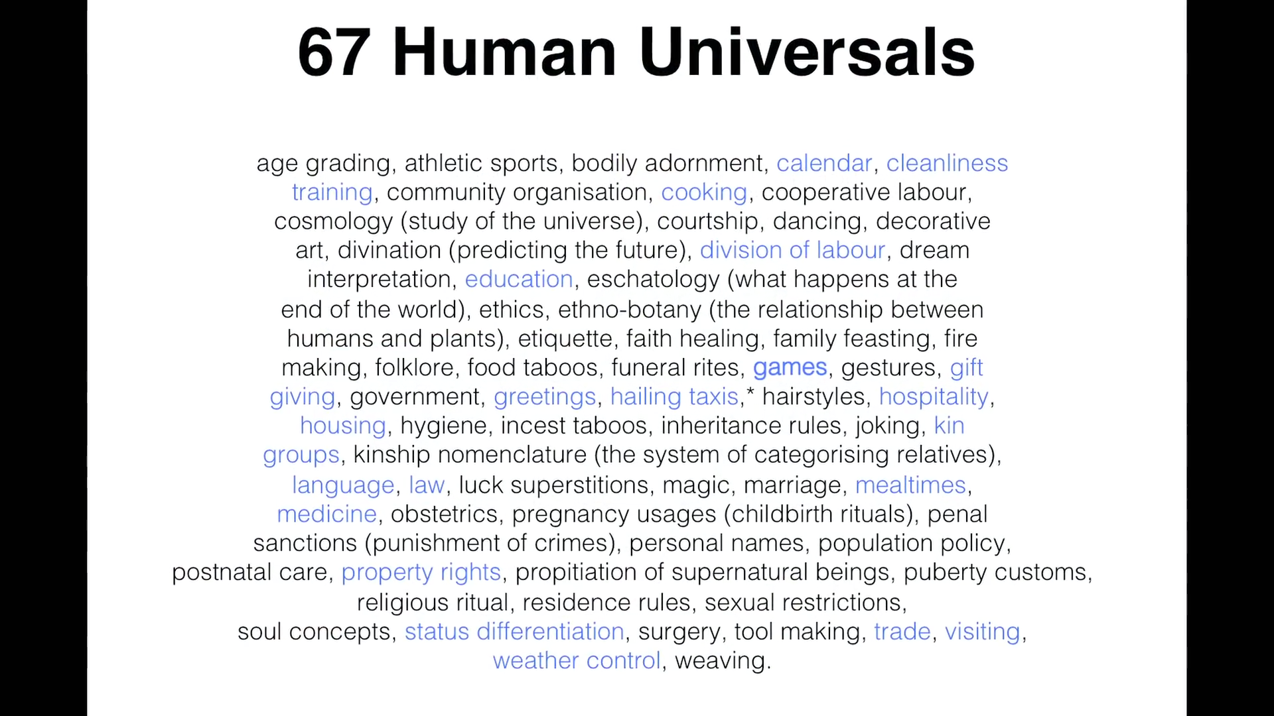

Slide 25
What’s up for tomorrow?

Slide 26
The end?
Nope,This is just a beginning

Slide 27
thank you
Have a nice day

