Slide 1
Book1
File created on: 2/22/20 6:10:45 PM EST

Slide 2
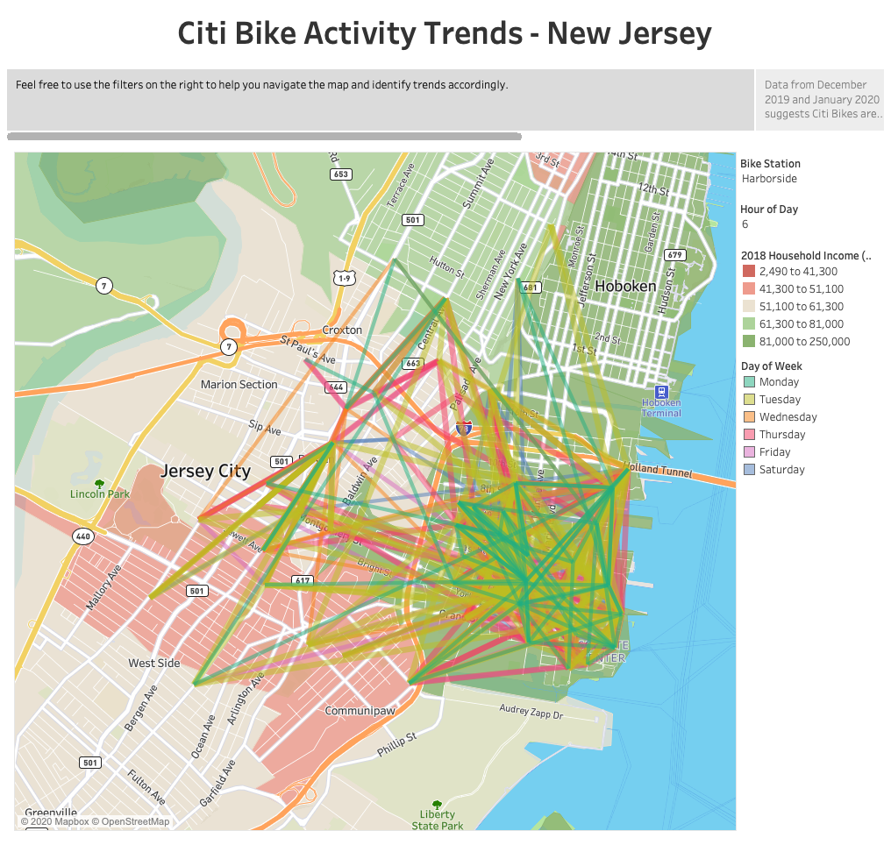

Slide 3
