Slide 1
COULD YOU LIVE THERE?
Alex Black, Aaron Isaacson, Michelle Salter
Hannah Tate, Justin Thomas

Slide 2
Project Proposal
Is there a correlation between housing prices and occupations by industry in the US? (Leave as question?)
Our project is to uncover patterns in criminal activity around Los Angeles. We'll examine relationships between types of crime and location; crime rates and times of day; trends in crime rates over the course of the year; and related questions, as the data admits.
Notes:
Motivation & Summary Slide
Define the core message or hypoth of your project
Describe the questions you asked and why you asked them
Describe whether you were able to answer these questions to your satisfaction, and briefly summarize your findings

Slide 3
Data Sources
Zillow API
Housing market prices data
Department of Labor API
Employment data
Bureau of Labor Statistis
Census API
Employment data
Household income data

Slide 4
A little “terminology” before we dive in…
FIPS
Federal Information Processing Series
NIST and ANSI
County-
A county or county equivalence determined to be statistically significant (parish, boroughs, city not-within a county , area not covered by a county)
Industry
NAICS
Census and BLS subsectors
Government vs Private
Notes:
Questions & Data
Elaborate on the questions you asked, describing what kinds of data you needed to answer them, and where you found them

Slide 5
Goods – Producing
Natural Resources & Mining
Construction
Manufacturing
Service – Providing
Trade, Transportation, & Utilities
Information
Financial Activities
Professional & Business Services
Education & Health Services
Leisure & Hospitality
Other
Unclassified
Industry
NACIS
Notes:
A breakdown on the industry subsectors by BLS

Slide 6
Notes:
Data Cleanup & Exploration
Describe the exploration and cleanup process
Discuss insights you had while exploring the data that you didn’t anticipate
Discuss any problems that arose after exploring the data , and how you resolved them
Present and discuss interesting figures developed during exploration, ideally with the help of Jupyter Notebook

Slide 7
Notes:
Data Analysis
Discuss the steps you took to analyze the data and answer each question you asked in your proposal
Present and discuss interesting figures developed during analysis, ideally with the help of J Notebook

Slide 8
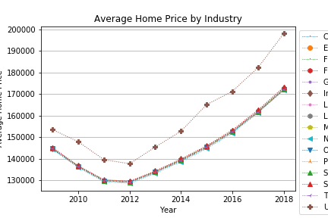
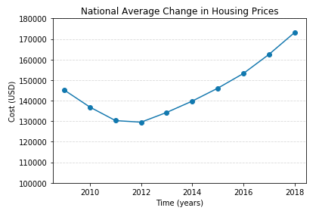
Notes:
Not sure why this was cut off

Slide 9
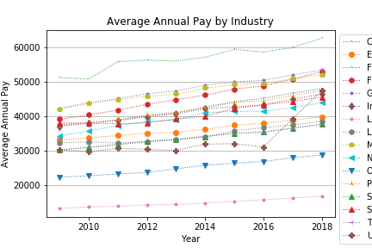

Slide 11
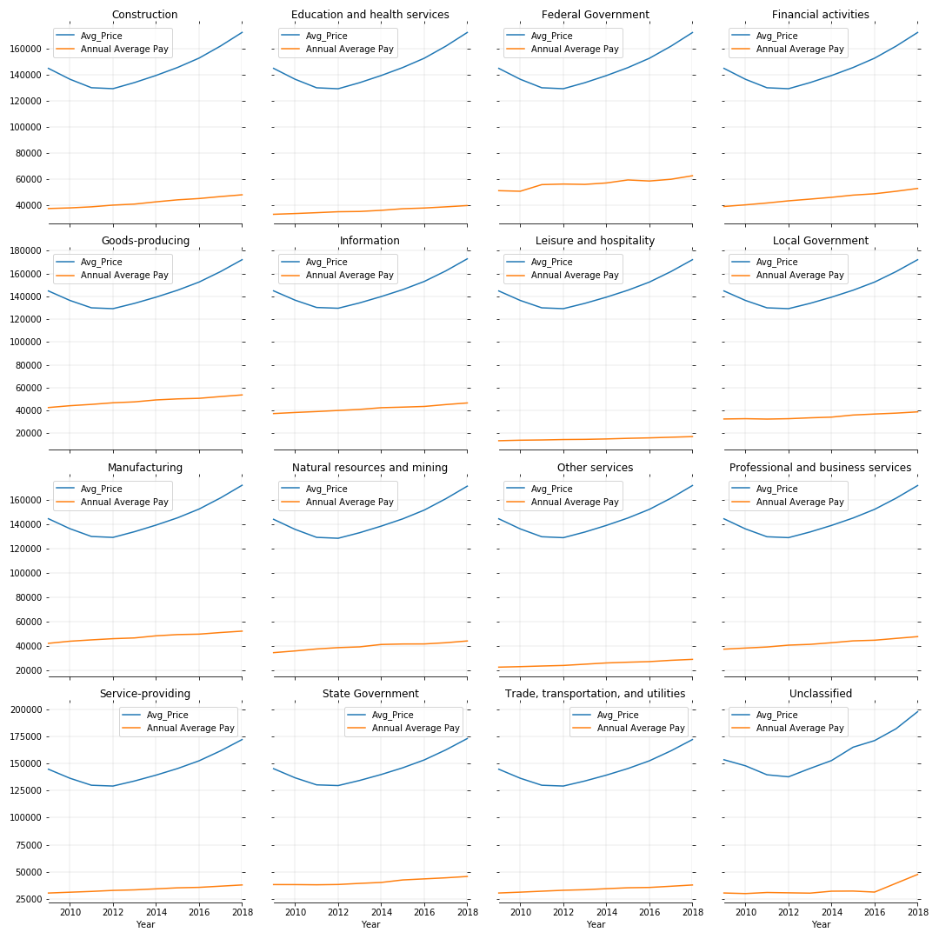
Notes:
Price Pay by Industry

Slide 12
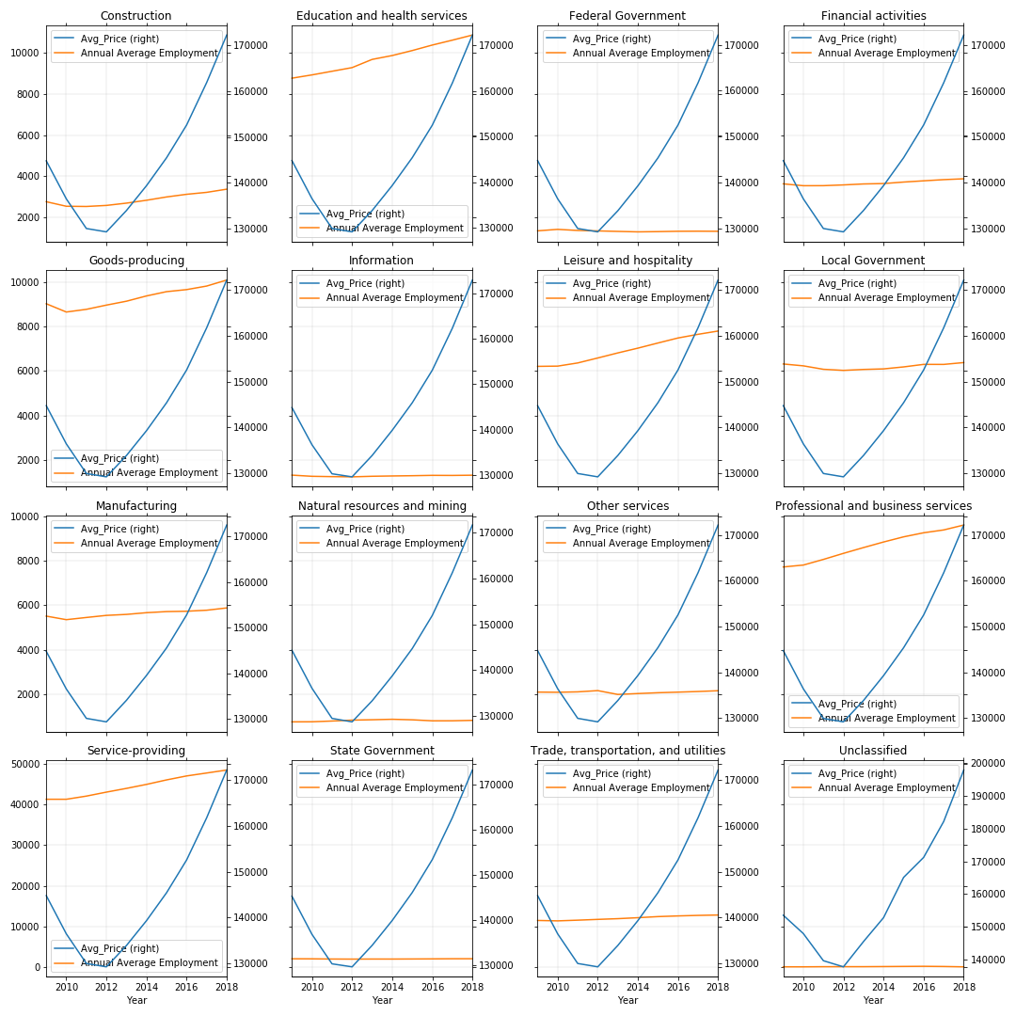
Notes:
Price Employment by Industry

Slide 14
Notes:
Discussion
Discuss your findings. Did you find what you expected to find?
If not why?
What inferences or general conclusions can you draw from your analysis?

Slide 15
Post Mortem
Looking at changes in underdeveloped neighborhoods
Notes:
Post Mortem
Discuss any difficulties that arose, and how you dealt with them
Discuss any additional questions that came up, but which you didn’t have time to answer: What would you research next, if you had two more weeks?

Slide 16
WORKS CITED
Zillow API
Department of Labor API
Census API

