Slide 1
MLB Player Aging by Offensive Profile
A pattern-discovery study of how hitters age, by hitter type
Tate York
CS 4412 — Data Mining · Kennesaw State University · April 2026

Slide 2
Discovery Questions
What this project set out to answer
Q1
Q2
How does offensive performance change with age across the MLB player population?
Do aging curves differ across recognizably distinct offensive profiles, and if so, how?
Exploratory pattern discovery — not predictive modeling.
Source: Lahman Baseball Database (SABR), 1980–2021.

Slide 3
The Dataset
Lahman Baseball Database, 1980–2021
13,412
42
≥ 200
6
player-seasons
seasons (1980–2021)
PA per season
offensive features
Features used for clustering
BA · OBP · SLG
rate-style production
HR · SO · OPS_plus_lg
volume / approach + league-adjusted production
OPS_plus_lg = 100 × OPS / LgAvgOPS (per season and league)

Slide 4
Approach
Three steps from raw data to interpretable profiles
1
2
3
Cluster
Profile
Interpret
K-Means on standardized offensive features. Choose k via elbow + silhouette over k = 2…8.
Map clusters to named profiles: power, balanced, contact, low-production. Compare aging curves.
Decision tree on cluster labels surfaces which features drive separation.
Random seed pinned at 42. KMeans n_init=10. Stratified 75/25 train/test split for the tree.

Slide 5
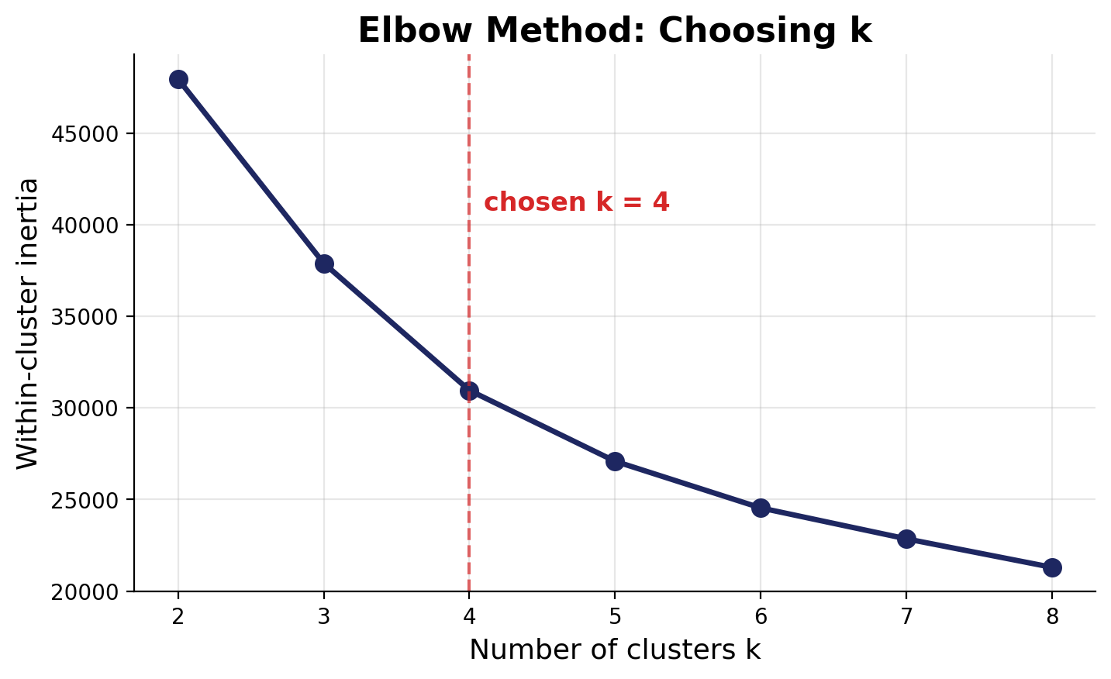
Choosing k = 4
Elbow says 3–4, silhouette peaks at 2 — interpretability breaks the tie
Why k = 4?
Silhouette is highest at k = 2,
but a 2-cluster solution merges
distinct hitting styles into broad
“good / weak hitter” groups.
The elbow plot bends between k = 3
and k = 4.
k = 4 gives clusters that map onto
recognizable offensive profiles —
our analytical sweet spot.

Slide 6
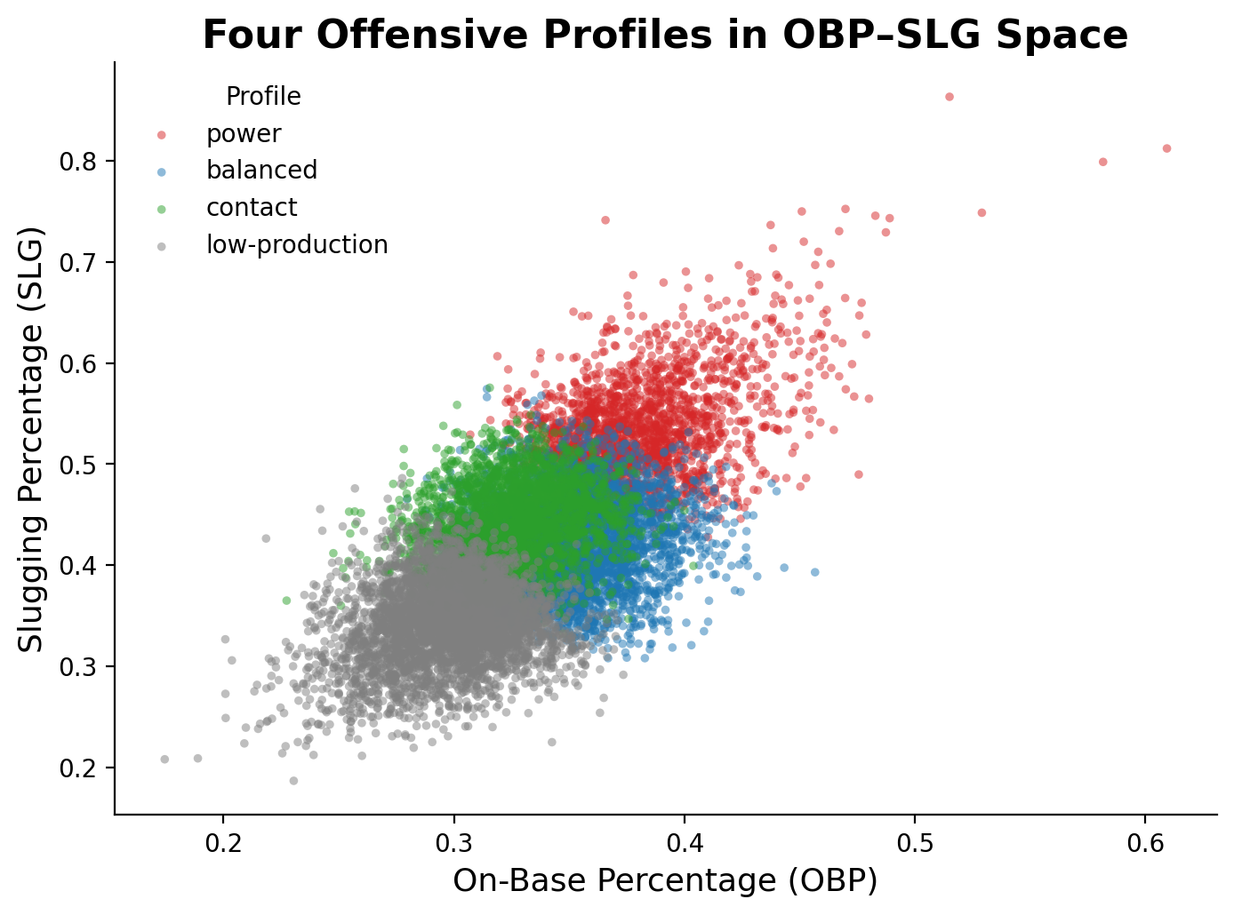
Four Offensive Profiles
Cluster centroids tell a clean story
power
highest SLG · 27 HR avg · OPS+ ≈ 121
balanced
above-average across the board
contact
high BA + OBP, lower power
low-production
weakest offensive output

Slide 7
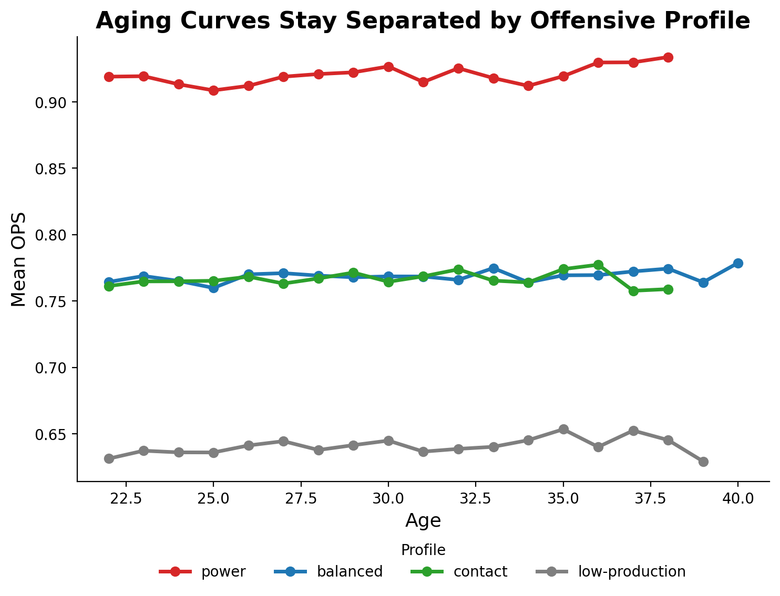
Aging Curves Stay Separated
Profiles differ in level, not curve shape
Key finding
Profile order is preserved at every age.
Power hitters hit hardest, balanced hitters hit second, contact and low-production stay below — and the ordering holds from age 22 through the late 30s.

Slide 8
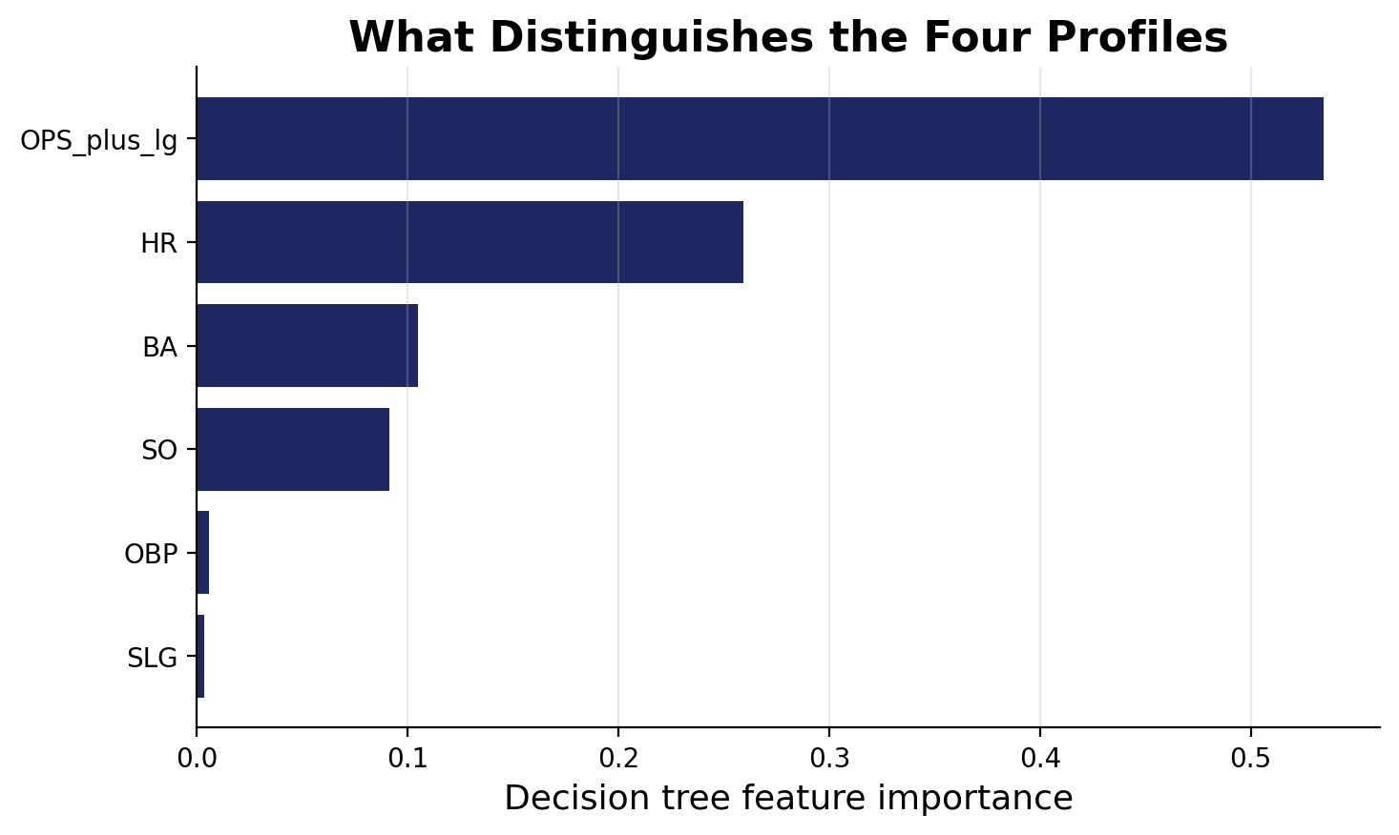
What Drives the Profiles
Decision tree feature importance (interpretability tool, not a prediction model)
Reading the tree
Top of the tree
OPS_plus_lg ≈ 0.53 — the dominant
split. Separates high vs. low
producers.
Secondary splits
HR ≈ 0.26 separates power; BA ≈
0.11 separates contact; SO ≈ 0.09
contributes a smaller share.
Rate stats fade
OBP and SLG carry near-zero
standalone weight — their info is
absorbed by OPS_plus_lg.

Slide 9
Critical Assessment
Validity, limitations, and ethical considerations
Validity
Limitations
Ethics
• Cluster partition is stable across multiple random seeds (high ARI).
• Decision tree train ≈ test accuracy on cluster labels.
• k = 4 chosen for interpretability over the silhouette-optimal k = 2 — explicit tradeoff.
• Survivorship bias: late-career curves are conditional on continued tenure.
• PA ≥ 200 filter removes part-time and end-of-career players.
• League adjustment is approximate; park effects are not removed.
• Defense, position, baserunning, and injury are not in the model.
• Public dataset; no medical or financial PII.
• Profile labels describe regions of feature space — not judgments of individual players.
• Intended for academic pattern discovery, not roster decisions.

Slide 10
Takeaways
Q1 — How does offensive performance change with age?
Q2 — Do aging curves differ across profiles?
Improvement through the early-to-mid 20s, plateau, then decline. Visible at the population level; muted within the PA ≥ 200 sample.
Yes — by level, not shape. The four profiles stay separated at every age. Power on top, low-production at the bottom, all the way through.
Future work
• Survival-analysis framing to model player exit alongside performance.
• Add defensive value, position, baserunning, and health context.
• Use full park-adjusted OPS+ rather than the simple league-mean adjustment.
Tate York · CS 4412 — Data Mining · Kennesaw State University · April 2026

