Slide 1
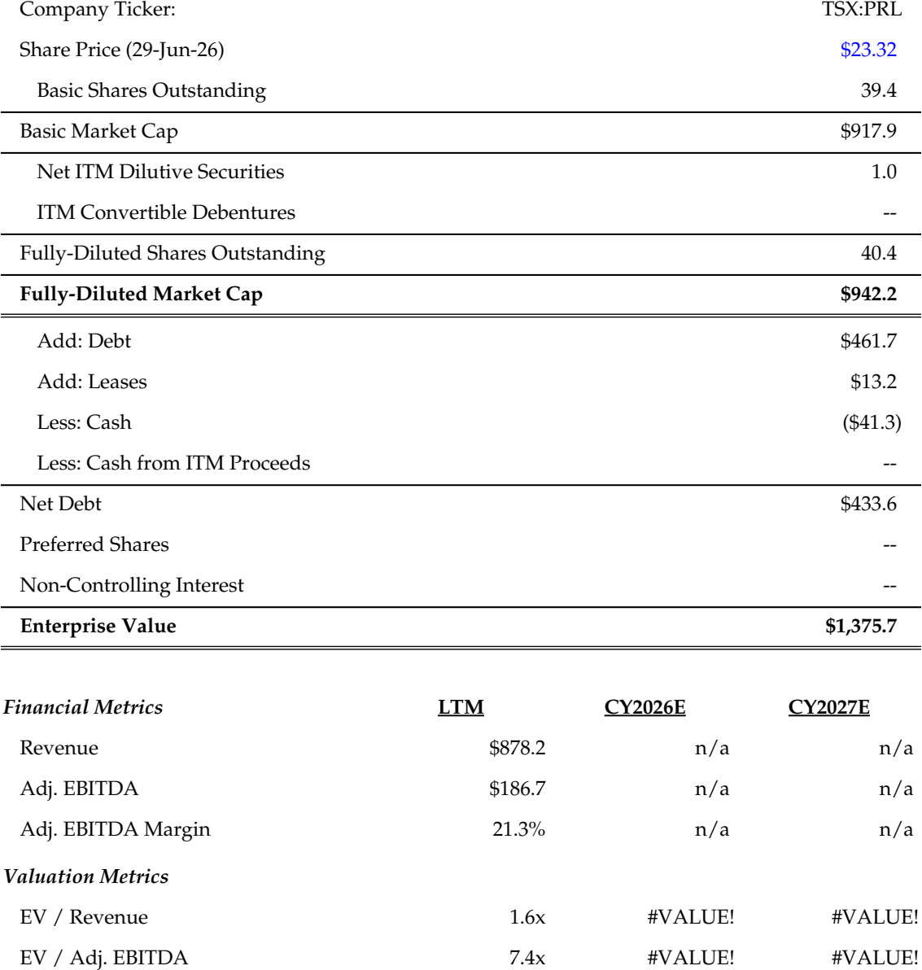
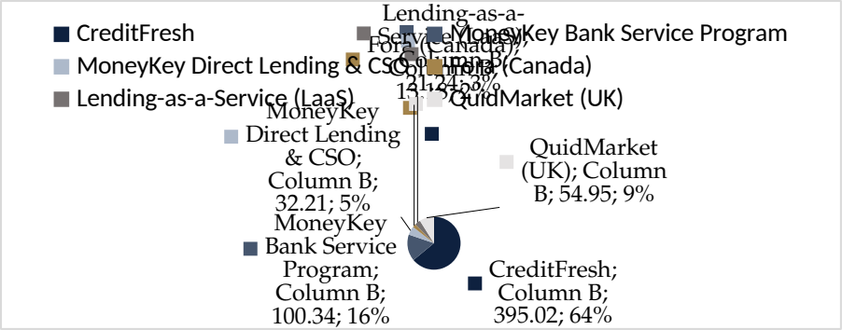
Introduction to Propel Holdings, Inc.
Company Overview
Capitalization Summary
Propel is a Toronto-based financial technology company operating an AI-driven, online consumer-lending platform serving consumers underserved by traditional banks
The Company originates and services unsecured instalment loans and lines of credit through four brands: Fora Credit (Canada), MoneyKey and CreditFresh (United States) and QuidMarket (United Kingdom)
The Company's proprietary, AI-powered underwriting and decisioning engine is its core competitive moat, enabling high rates of auto-decisioned originations and disciplined credit performance
The Company further extends its platform through Lending-as-a-Service ("LaaS") and Bank Partner programs, broadening reach across the near-prime credit spectrum
Q1 2026 financial performance reflected record results: revenue of US$166.1MM (up 20% year-over-year) and Adjusted EBITDA of US$42.0MM
Ending Combined Loan and Advance Balances reached a record US$592.7MM as at March 31, 2026, up 23% year-over-year, on record Total Originations Funded of US$199.3MM
The Company's proven multi-geography operating model positions Mexico as a logical next leg of international expansion
LTM Revenue Breakdown
Source: Company filings, S&P Capital IQ
Note: All figures in C$MM, except per share figures and where indicated otherwise
Notes:
Arr 2021 March: $20.963

