Slide 1

Open Text Corporation
Q3 2026 Earnings Update
Private and Confidential
May 2026

Slide 2
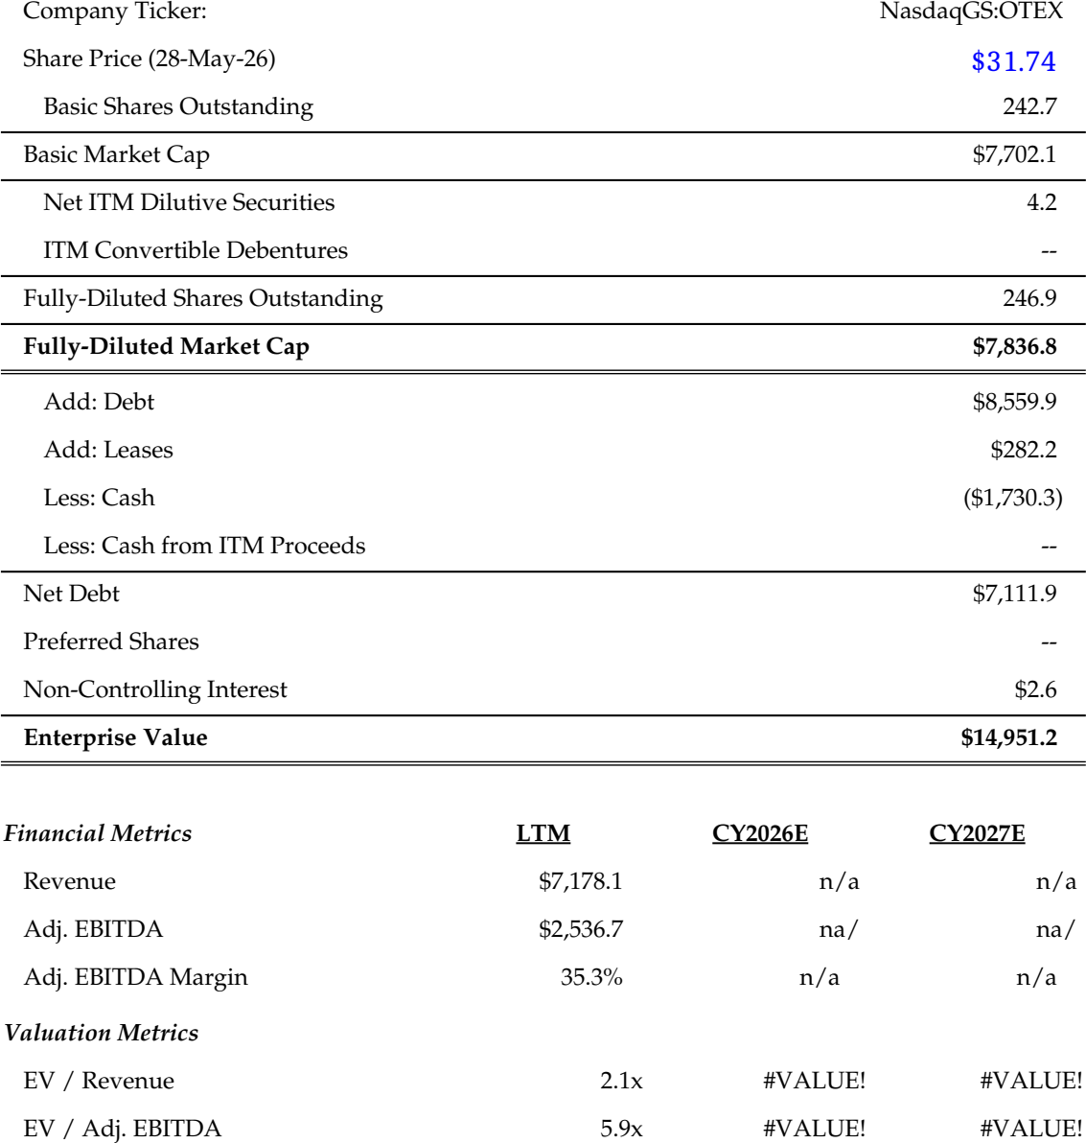
Introduction to Open Text Corporation
Company Overview
Capitalization Summary
Open Text Corporation (“OpenText” or the “Company”) is a leading Information Management software provider serving global enterprises, governments and SMBs
The Company offers an integrated portfolio across its Content, Cybersecurity, DevOps, Business Network and Analytics clouds, increasingly AI-oriented
The business is anchored by recurring revenue, with total annual recurring revenue of $1,058MM supporting visible, defensible cash flows
Enterprise customers contribute approximately 90% of total revenues, underpinning a sticky, diversified base
Headquartered in Waterloo, Ontario, the Company employs roughly 21,400 people across 42 countries and trades on the NASDAQ and TSX under “OTEX”
Management is reshaping the portfolio through tuck-in acquisitions and non-core divestitures while returning capital via dividends and buybacks
LTM Revenue Breakdown
[Pie Chart Placeholder]
Source: Company filings, S&P Capital IQ
Note: All figures in US$MM, except per share figures and where indicated otherwise
Notes:
Arr 2021 March: $20.963

Slide 3

Open Text Corporation Q3 2026 Earnings Summary
Business Updates
Financial Highlights
Effective April 20, 2026, Ayman Antoun was appointed Chief Executive Officer, succeeding James McGourlay, who served as Interim CEO and was named President and Chief Client Officer
Enterprise cloud bookings reached $196MM, up from $151MM a year ago, with 41 cloud services contracts greater than $1MM closing in the quarter
On February 2, 2026 the Company agreed to divest Vertica to Rocket Software for $150MM, with proceeds earmarked to reduce debt; closing is expected in Fiscal 2026
The Company completed the eDOCS divestiture to NetDocuments on January 12, 2026 for $163MM, applying proceeds to prepay the Acquisition Term Loan
The Company repurchased and cancelled 9.7MM common shares for $252MM, well above the prior-year quarter
On May 7, 2026 Management raised its full-year Fiscal 2026 outlook for cloud revenue, free cash flow and enterprise cloud bookings growth
Q3 2025
Variance
Q3 2026
$1.3B
Total Revenue
2.2%
$1.3B
Total Revenue
$463MM
Cloud Services & Subscriptions Rev.
6.6%
$493MM
Cloud Services & Subscriptions Rev.
$395MM
Adj. EBITDA
10.8%
$438MM
Adj. EBITDA
$216MM
Non-GAAP Net Income
15.9%
$250MM
Non-GAAP Net Income
Broker Estimates vs Actuals
Management Guidance
Figures in US$MM | Reported | Bloomberg Estimate | Variance
Revenue | $1,283 | $1,272 | $11
Adj. EBITDA | $438 | $419 | $19
Operating Income (non-GAAP) | $404 | $389 | $15
Net income (Adj.) | $250 | $234 | $16
EPS, Adj. (US$) | $1.01 | $0.92 | $0.09
Ayman Antoun – CEO
“We continue to focus on our three strategic priorities: expanding our competitive advantage, driving total revenue growth and achieving operational excellence”
Open Text Corporation – Management
OpenText delivered Q3 2026 revenue of $1,283MM, up 2.2%, with Adj. EBITDA up 10.8% to $438MM, ahead of consensus
“We are advancing our AI-first Information Management offerings, well positioned for Agentic AI, while redeploying capital from non-core assets toward our core business”
Source: Company filings, S&P Capital IQ, Bloomberg, equity research
Note: All figures in US$MM, except where indicated otherwise

Slide 4
Disclaimer
These materials are confidential and proprietary to, and may not be reproduced, disseminated or referred to, in whole or in part without the prior consent of INFOR Financial Inc. (“INFOR Financial”). These materials have been prepared exclusively for the INFOR Financial client or potential client to which such materials are delivered and may not be used for any purpose other than as authorized in writing by INFOR Financial. INFOR Financial assumes no responsibility for verification of the information in these materials, and no representation or warranty is made as to the accuracy or completeness of such information. INFOR Financial assumes no obligation to correct or update these materials. These materials do not contain all information that may be required to evaluate, and do not constitute a recommendation with respect to, any transaction or matter. Any recipient of these materials should conduct its own independent analysis of the matters referred to herein.
INFOR Financial does not provide tax or legal advice. Any discussion of tax matters in these materials (i) is not intended to be used, and cannot be used or relied upon, for the purposes of avoiding any tax penalties and (ii) may have been written in connection with the “promotion or marketing” of the transaction or matter described herein. Accordingly, the recipient should seek advice based on its particular circumstances from an independent tax advisor.

Slide 5

Contact
200 Bay Street, Suite 2350 Toronto, Ontario Canada M5J 2J2
Neil Selfe, Managing Principal
(416) 560-5551
nselfe@inforfg.com
[x]
[x]
[x]
[x]
[x]
[x]
[x]
[x]
[x]

