Slide 1

Propel Holdings Inc.
Internal Discussion Materials
Private and Confidential
July 2026

Slide 2
Executive Summary
Propel enters H2 2026 with record momentum — FY2025 revenue of US$589.8MM (+31% YoY) and record Q1 2026 revenue of US$166.1MM (+20% YoY)
Q1 2026 Adjusted EBITDA of US$42.0MM and Ending Combined Loan and Advance Balances of US$592.7MM (+23% YoY) both set records
Management's 2026 targets — revenue of US$725–775MM, Adjusted EBITDA of US$152.5–177.5MM and net income of US$70–90MM — imply another year of profitable growth
The platform is diversifying beyond on-balance-sheet lending — Propel Bank launched in December 2025 and the Column LaaS partnership adds US$210MM of committed forward-flow capital
QuidMarket extends the model to the UK's ~20MM underserved consumers; the Freshline rollout targets the near-prime segment
INFOR believes public markets do not fully reflect Propel's growth, returns and capital-light evolution — comparable companies and precedent transactions frame the value opportunity
These materials review Propel's positioning, financial trajectory, valuation context and potential strategic paths, including acquisition-led entry into new markets such as Latin America

Slide 3
INFOR Financial Inc. Overview
INFOR Financial Inc. (“INFOR”) is one of Canada’s leading independent investment banks
Our team has been directly involved in originating and executing over 2,000 transactions totaling more than $400 billion
Extensive experience providing advisory services on complex, transformational transactions and related capital markets activities
Since inception, INFOR has consistently ranked as one of Canada’s top independent M&A advisors by Bloomberg
Core Expertise
Sell-Side M&A
Buy-Side M&A
Capital Raising
Restructuring
Industry Experience
Consumer & Retail
Business Services
Technology, Media & Communication
Energy & Renewables
Industrial & Manufacturing
Metals & Mining
Healthcare
Agriculture
Financial Services
INFOR is Canada’s leading provider of innovative, independent, forward thinking financial & strategic advice

Slide 4














Canada’s Top Independent M&A Advisor
INFOR Financial has established itself as the #1 Canadian independent M&A advisory investment bank since inception in March 2015, total M&A transaction value of ~$47 billion
Canadian M&A Advisory Rankings (C$B)
2015-2026 – Independent Advisory Investment Banks
2025 – Independent Advisory Investment Banks
Source: Bloomberg M&A League Tables (Mar. 23, 2015 – Mar. 31, 2026)
Select Landmark Transactions
Advisor
Advisor
Advisor
Advisor
Various Roles
Advisor
$12,101,000,000
$8,600,000,000
$3,268,000,000
$1,500,000,000
Valuation
$1,415,685,663
US$1,250,000,000
Sale to Mubadala Capital
Acquisition of GE Capital’s Fleet Operations
(U.S., Mex, Aus, NZ)
Sale to GTCR
Strategic Minority Investment from
Kelso Private Equity
Initial Public Offering and 6 Bought Deal Financings
Advisor to U.S. and Canadian Institutional Investors on Acquisition
Source: Bloomberg M&A League Tables

Slide 5








INFOR Key Highlights
Landmark Canadian Transaction Experience⁽¹⁾
Largest Restructuring
in Canadian History
Largest Take Private
in Canadian History
Largest Tech IPO
in Canadian History
~$73B
~$12B
~$610MM
Largest Secondary Offering
in Canadian History
One of the Largest Consolidations
in the Montney Formation
First Ever Bought High Yield Deal in Canadian History
~$3B
~$1B
~US$971MM
Top Independent
Canadian M&A Advisor
~$6B
M&A Transaction Value (2025)
$47B+
M&A Transaction Value Since Inception
$400B+
Lifetime Principal Transaction Value
2,000+
Lifetime Principal Transactions
$8B+
Capital Raised Since Inception
110+
M&A Transactions Since Inception
$90B+
Retail Partner
AUA
100%
Independent and Employee-Owned
Source: Bloomberg M&A League Tables
Deals led by INFOR Financial principals; all deal statistics as at time of deal

Slide 6
Overview
Valuation
Financial Summary
Process

Slide 7
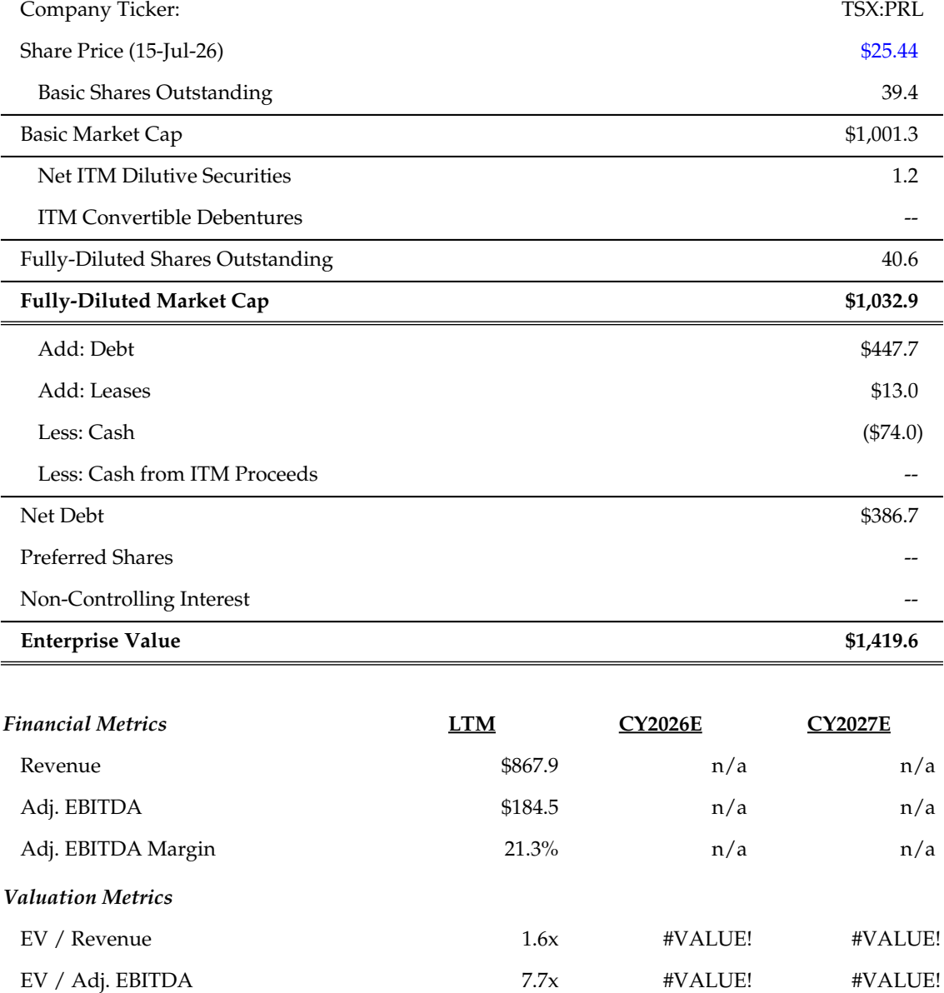
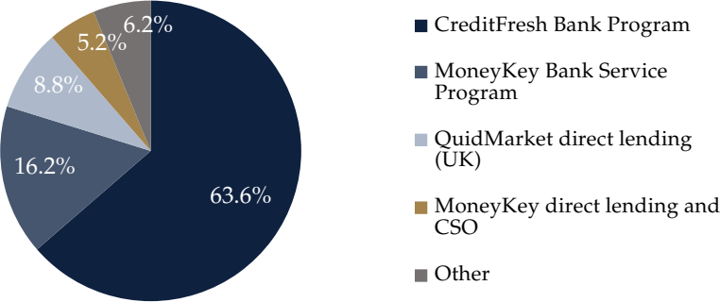
Introduction to Propel Holdings Inc.
Company Overview
Capitalization Summary
Toronto-based fintech (TSX: PRL) facilitating access to credit for US, Canadian and UK consumers underserved by traditional financial institutions
AI-powered platform evaluates thousands of applicant attributes beyond traditional credit scores, powering installment loans and lines of credit
Operates MoneyKey and CreditFresh in the US, Fora Credit in Canada and QuidMarket in the UK, plus a white-label Lending-as-a-Service (LaaS) line
Propel Bank, a Puerto Rico IFE-licensed subsidiary launched in December 2025, adds regulated banking infrastructure and flexibility
Serves 46 US states, 6 Canadian provinces and all UK countries as of Q1 2026
FY2025 revenue of US$589.8MM (+31% YoY); record Q1 2026 revenue of US$166.1MM and Adjusted EBITDA of US$42.0MM
LTM Revenue Breakdown
Source: Company filings, S&P Capital IQ
Note: All figures in C$MM, except per share figures and where indicated otherwise
Notes:
Arr 2021 March: $20.963

Slide 8
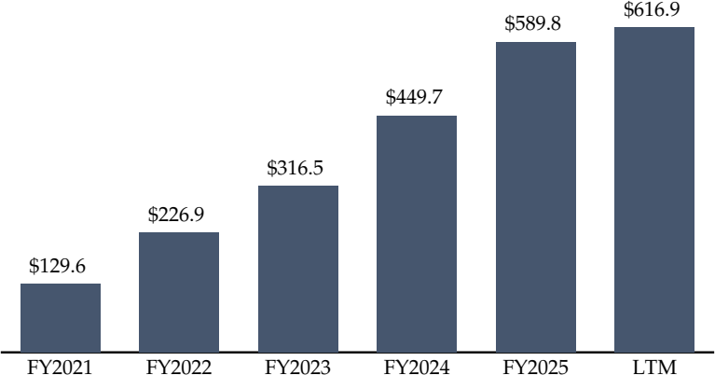
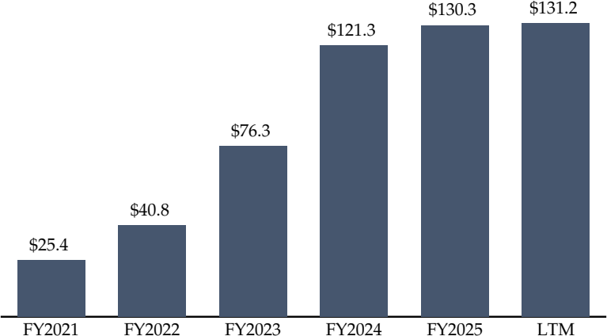
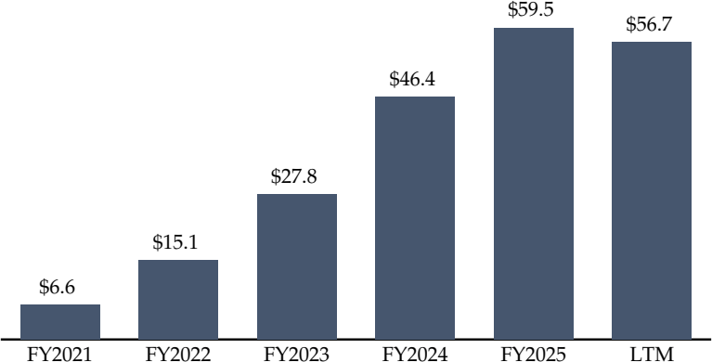
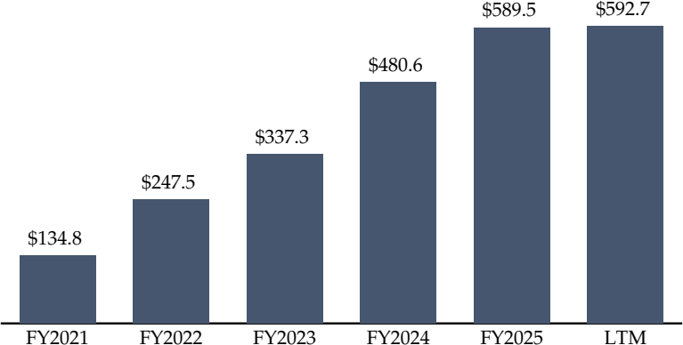
Financial Summary
Revenue
Adjusted EBITDA
Net Income
Ending Combined Loan & Advance Balances
Sources: Company filings

Slide 9
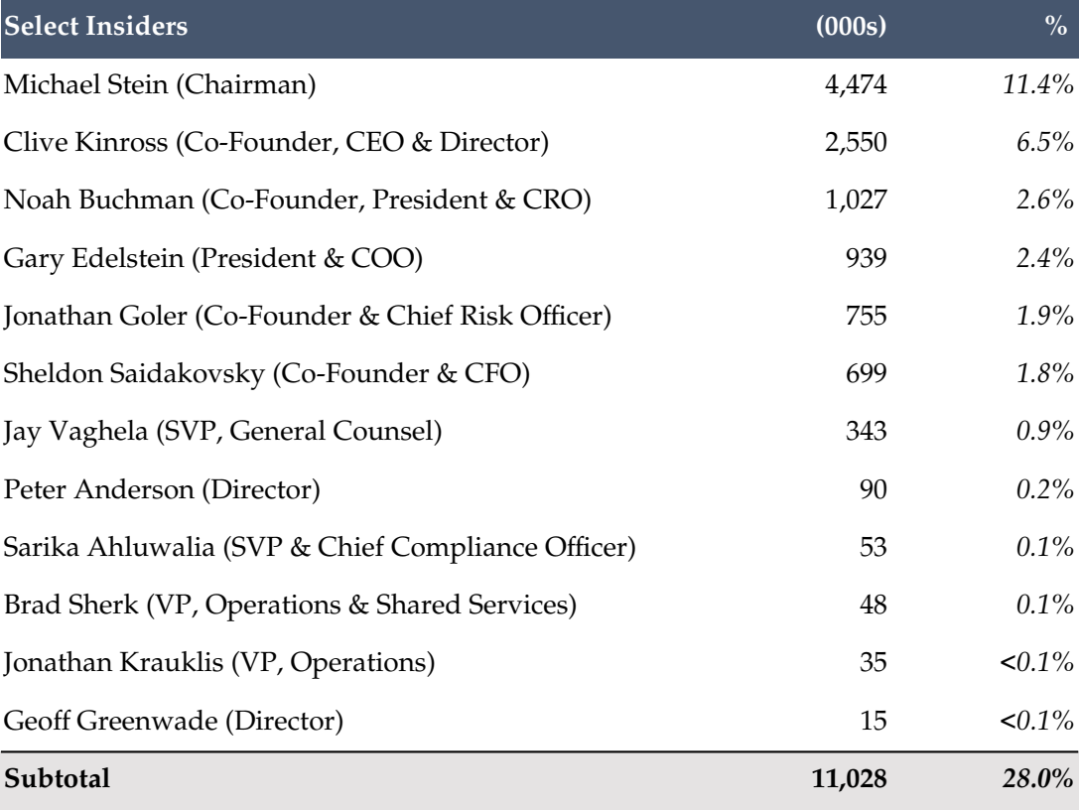
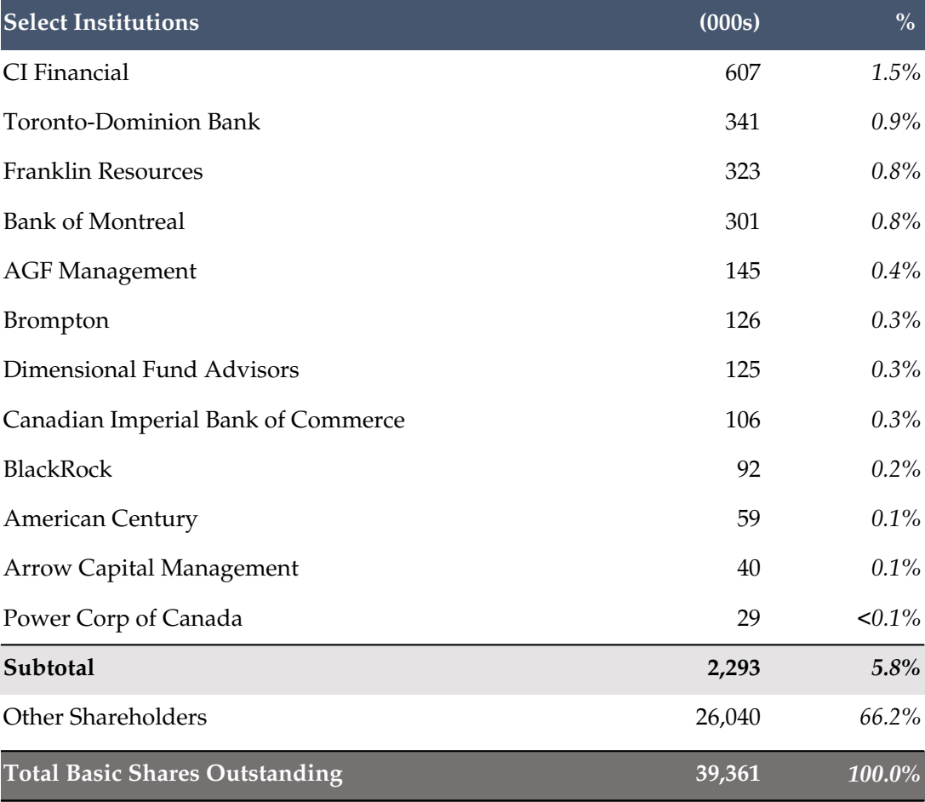
Ownership
Insiders
Institutions
[x]
Source: Bloomberg

Slide 10
Potential Perceived Acquiror Considerations and Mitigants
Considerations | Mitigants
Regulatory scrutiny of non-prime consumer lending (CFPB, state rate caps, UK FCA) | Compliance-first platform adhering to all federal, state, provincial and FCA rules Bank Partner, LaaS and direct programs diversify exposure across regulatory regimes Propel Bank adds regulated infrastructure and long-term operational flexibility
Credit losses could rise in a weaker macro environment for non-prime consumers | AI underwriting recalibrates in real time to macro and credit conditions 2025 tightening shifted mix toward higher-quality, returning customers Target consumers are resilient, with steady essential-sector employment
Reliance on Bank Partners and third-party forward-flow purchasers | Multiple FDIC-insured partners plus Pathward and Column limit concentration Propel Bank provides an owned lending channel independent of partners US$210MM of committed forward-flow capital anchors the LaaS pipeline
Access to debt capital underpins receivables growth | US$415MM of US revolver capacity plus an upsized C$40MM Fora facility MoneyKey facility repaid and terminated in April 2026, reducing leverage Strong operating cash flow; QuidMarket self-funds from retained earnings
Earnings volatility from upfront IFRS 9 provisioning on rapid portfolio growth | Provisions front-run revenue; record balances seed 2026 earnings 2026 targets of US$725–775MM revenue and US$152.5–177.5MM Adjusted EBITDA Q1 2026 delivered record revenue and Adjusted EBITDA with stable credit
INFOR believes each perceived consideration is addressable with data — proactively framing the story ahead of any process mitigates valuation friction

Slide 11
Comparable Companies Analysis
[Placeholder for Comps Chart]
Propel's growth and profitability screen at the top of the non-prime lending peer set, supporting a valuation toward the high end of the peer multiple range.
Sources: S&P Capital IQ
Note: All figures in [x]$MM, except where indicated otherwise

Slide 12
Precedent Transactions Analysis
[Placeholder for Precedents Chart]
Precedent non-prime lending and Canadian specialty finance transactions evidence control premiums for scaled, profitable platforms — supportive of value above trading levels.
Sources: S&P Capital IQ
Note: All figures in [x]$MM, except where indicated otherwise

Slide 13
Key Investment Highlights
Scaled, Profitable Growth
Revenue grew from US$129.6MM (FY2021) to US$589.8MM (FY2025), a ~46% CAGR, with FY2025 net income of US$59.5MM
Record Q1 2026 revenue of US$166.1MM and Adjusted EBITDA of US$42.0MM
1
AI-Powered Underwriting Moat
Proprietary AI/ML decisioning evaluates thousands of attributes beyond traditional credit scores
Automation across acquisition, underwriting, servicing and collections drives operating leverage
2
Diversified, Capital-Light Platform
Four consumer brands across the US, Canada and UK plus fee-based LaaS with US$210MM of committed forward-flow capital
Propel Bank (December 2025) adds regulated infrastructure for new products and geographies
3
Large, Underserved Market
Millions of non-prime consumers underserved by traditional banks across three operating countries
QuidMarket provides a foothold in the UK's ~20MM-consumer underserved market and a template for further expansion
4
A scaled, profitable and diversifying fintech compounder in underserved consumer credit
Note: All figures in C$MM unless indicated otherwise

Slide 14
Potential Latin American Market Entry Targets (1 of 3)
[Kueski Logo]
[Stori Logo]
Overview | Leading Mexican online consumer lender and BNPL platform | Mexican digital credit card and deposits platform for the underbanked
Headquarters | Guadalajara, Mexico | Mexico City, Mexico
Year Founded | 2012 | 2018
Products | BNPL (Kueski Pay); personal loans (Kueski Cash) | Credit cards; deposits (SOFIPO licence)
Geography | Mexico | Mexico
Business Model | Direct balance-sheet lender | Direct issuer; deposit-funded
Credit Segment | Non-prime / thin-file | Underbanked / new-to-credit
Customers | 2MM+ customers | 3.7MM+ customers
Capital Raised | US$300MM+ equity and debt | US$650MM+ equity and debt
Key Investors | StepStone, Kaszek, Altos Ventures, Victory Park | Lightspeed, GIC, Granite Asia, BAI Capital
Scale KPIs | 20MM+ loans disbursed | ~US$300MM annualized revenue; profitable
Strategic Rationale | Anchor entry into Mexico's large underserved market via a scaled AI-driven lender | Adds card and deposit capabilities; graduation path for underbanked customers
Note: All figures in C$MM unless indicated otherwise
Source: Public sources

Slide 15
Potential Latin American Market Entry Targets (2 of 3)
[Baubap Logo]
[Aplazo Logo]
Overview | App-based Mexican microlender with fully automated underwriting | Mexican BNPL provider embedded at online and offline retail checkout
Headquarters | Mexico City, Mexico | Mexico City, Mexico
Year Founded | 2018 | 2020
Products | Instant personal microloans | BNPL installments; payment card
Geography | Mexico | Mexico
Business Model | Direct mobile-first lender | Merchant-embedded BNPL
Credit Segment | Thin-file / no credit history | No-card / thin-file
Customers | 1MM+ borrowers | Millions of shoppers
Capital Raised | US$120MM credit facility (2024) | US$100MM+ equity plus credit lines
Key Investors | Park Cities Asset Management (credit) | QED, Oak HC/FT, Kaszek
Scale KPIs | Millions of loans funded; profitable | 10K+ merchant partners
Strategic Rationale | Automated micro-credit engine mirrors Propel's AI underwriting playbook | Omnichannel BNPL distribution and merchant network in Mexico
Note: All figures in C$MM unless indicated otherwise
Source: Public sources

Slide 16
Potential Latin American Market Entry Targets (3 of 3)
[Open Co Logo]
[Addi Logo]
Overview | Brazilian online unsecured personal lender formed from the Geru–Rebel merger | Colombian BNPL and point-of-sale consumer credit platform
Headquarters | São Paulo, Brazil | Bogotá, Colombia
Year Founded | 2021 | 2018
Products | Unsecured personal loans | BNPL; point-of-sale loans
Geography | Brazil | Colombia
Business Model | Direct digital lender | Merchant-embedded lender
Credit Segment | Near / non-prime | Near / non-prime
Customers | 1MM+ customers served | 2MM+ customers
Capital Raised | US$115MM Series C (2021) | US$85MM Series D plus credit facilities
Key Investors | SoftBank, IFC, Goldman Sachs (debt) | a16z, GIC, Union Square, Goldman Sachs (debt)
Scale KPIs | R$ multi-billion originations | Thousands of merchant partners
Strategic Rationale | Entry into Brazil, Latin America's largest consumer credit market | Beachhead in the Andean region; POS distribution complements direct model
Note: All figures in C$MM unless indicated otherwise
Source: Public sources

Slide 17
Disclaimer
These materials are confidential and proprietary to, and may not be reproduced, disseminated or referred to, in whole or in part without the prior consent of INFOR Financial Inc. (“INFOR Financial”). These materials have been prepared exclusively for the INFOR Financial client or potential client to which such materials are delivered and may not be used for any purpose other than as authorized in writing by INFOR Financial. INFOR Financial assumes no responsibility for verification of the information in these materials, and no representation or warranty is made as to the accuracy or completeness of such information. INFOR Financial assumes no obligation to correct or update these materials. These materials do not contain all information that may be required to evaluate, and do not constitute a recommendation with respect to, any transaction or matter. Any recipient of these materials should conduct its own independent analysis of the matters referred to herein.
INFOR Financial does not provide tax or legal advice. Any discussion of tax matters in these materials (i) is not intended to be used, and cannot be used or relied upon, for the purposes of avoiding any tax penalties and (ii) may have been written in connection with the “promotion or marketing” of the transaction or matter described herein. Accordingly, the recipient should seek advice based on its particular circumstances from an independent tax advisor.

Slide 18

Contact
200 Bay Street, Suite 2350 Toronto, Ontario Canada M5J 2J2
Neil Selfe, Managing Principal
(416) 560-5551
nselfe@inforfg.com
[x]
[x]
[x]
[x]
[x]
[x]
[x]
[x]
[x]

