Slide 1

Bengal College of Engineering and Technology
Project Title : Social Networking Site(WeConnect)
Group No. : 5
Year : 4th; Semester:8th; Department: CSE-B
Group Members Details:
Group Members Details
Name | University Roll No. | Phone No.
Pranab Pal | 12500118061 | 8250017772
Sayandeep Barai | 12500118033 | 7319262699
Tathagata Bandyopadhyay | 12500118007 | 6295124507

Slide 2
PROJECT TITLE : WECONNECT (SOCIAL NETWORKING SITE)
This Project submitted to the Department of Computer Science & Engineering of
BENGAL COLLEGE OF ENGINEERING & TECHNOLOGY affiliated to Maulana
Abul Kalam Azad University of Technology, West Bengal(Formerly known as West
Bengal University of technology) for the requirements of the partial fulfilment of the Degree of Bachelor of Technology (B.TECH) in Computer Science &
Engineering.
PROJECT SUBMITTED BY:
1. Pranab Pal (12500118061)
2. Sayandeep Barai (12500118033)
3. Tathagata Bandyopadhyay(12500118007)

Slide 3
ACKNOWLEDGEMENT
We gratefully acknowledgement for the assistance cooperation guidance and classification provided by our respected teacher Mr. Partha Pratim Paul Sir to encourage the students to go under winter training to gain practical experience from various industries and companies. We would like express our thankfulness to our project guide.
We express to our gratitude to SK. Abdul Rahim (HOD) Dept of CSE, BCET, Durgapur, for his constant supervision and cooperation throughout the Project.
We also extend our thanks to our Team Members for this cooperation during our course.
Words are inadequate to offering our thanks to the other teachers, project assistants and other members of our college for their encouragement and cooperation in carrying our this project work. The guidance and support received from all the members and who are contributing to this project, is vital for the success of this project.

Slide 4
Introduction
A social networking site is an online platform that allows users to create a public profile and interact with other users. Social networking sites usually allow a new user to provide a list of people with whom they share a connection, and then allow the people on the list to confirm or deny the connection. After connections are established, the new user can search the networks of connections to make more connections.
A social networking site is also known as a social networking website or social website.
Social networking sites have different rules for establishing connections, but they often allow users to view the connections of a confirmed connection. They may even suggest further connections based on a person’s established network.
Some social networking websites, like LinkedIn, are used for establishing professional connections, while sites like Facebook straddle the line between private and professional. There are also many networks that are built for a specific user base, such as cultural or political groups within a given area, or even traders in financial markets.
Social network is the mapping and measuring of relationships and flows between people, groups, organizations, computers, URLs, and other connected information/knowledge entities. The nodes in the network are the people and groups while the links show relationships or flows between the nodes. Social network provides both a visual and a mathematical analysis of human relationship.

Slide 5
Literature Survey
The Web-based social networking services make it possible to connect people who share interests and activities across political, economic, and geographic borders. Through e-mail and instant messaging, online communities are created where a gift economy and reciprocal altruism are encouraged through cooperation. Information is suited to a gift economy, as information is a non-rival good and can be gifted at practically no cost. Facebook and other social networking tools are increasingly the object of scholarly research. Scholars in many fields have begun to investigate the impact of social- networking sites, investigating how such sites may play into issues of identity, privacy, social capital, youth culture, and education. Several websites are beginning to tap into the power of the social networking model for philanthropy. Such models provide a means for connecting otherwise fragmented industries and small organizations without the resources to reach a broader audience with interested users. Social networks are providing a different way for individuals to communicate digitally. These communities of hypertexts allow for the sharing of information and ideas, an old concept placed in a digital environment.

Slide 6
Project Scope
This system provides users to register their various types of profile like social, personal, general, professional.
This system provides users to send a scrap message, images, and data files to their friends. User can maintain the scrap book whatever scraps he has sent to users.
The system provides user to upload the photos so that user can maintain own album.
This system provides user to join the communities according to their scenario.
This system provides the user to maintain their friend list and user can update their friend list.
This system provides user to send invitation to another friend and can add to their friend list for future.

Slide 7
Functional Specifications
Server Object : The Server class acts as a wrapper for all server functions for our social networking site. It essentially act as a link between all of the information such as accounts, account details, pages, notes, etc. to our database. When any other model object such as a page is pulled from the server, a temporary copy is made. If that temporary copy is changed in any way. The new version must be sent to the server in order to update the permanent copy. The reason behind local copies is that all the necessary information for the object is sent over in one easy-to-use package. Then the update to the database can be done all at once by sending back that single object. There is no need for multiple functions or a function that takes a large number of parameters.
Account Object : Each user who wants to use the site must create an account. This is the head class that all other objects use to determine what a user does and when the user did it. The account’s information has four purposes: hold the login information, hold friend information, hold profile information, and hold privacy information with such a large amount of information to keep track of, the Account class would be very large and difficult to work with. Therefore to ease the load, the Account class was broken up into three different classes. There is the actual account class which keeps track of login information and friend information. It also holds the other two classes within it.

Slide 8
Profile information was outsourced to the Account Details class, and privacy settings were outsourced to the Privacy Settings class. The only time the Account class needs to be updated is when the user changes his/her username and/or password. All other settings are handled by the Account Details and Privacy Settings classes.
Account Details Object : An Account Details object is a helper class created whenever a new Account object is created. The object contains all the information that shows up in the user’s profile. The user can edit this by modifying his/her profile. Overall, this class has no other purpose but to be a helper class to its account object.
Privacy Settings Object : A Privacy Settings object is the other helper class created whenever a new Account object is created. This object contains all the privacy settings that a user has, such as who can view his/her 5 media or custom pages. This class is called any time a user visits a profile or content created by another user. However, it does not directly interact with the other model classes, only the view.
Chat Session Object, Event Object, Link Object, Note Object and Page Object These objects contain unique information for a particular type of action a user performs. All of these contain a reference to the account that owns them. Each object is a ‖working-copy‖ of an object in the Server. Anytime one of these objects is created on the Server, an entry of its creation is added to the news feed database.
Message Object : A Message object is created when a user composes a new message to be sent to a friend. After it is confirmed that the friend is located in the database, the Message object adds its information to the database. When a user checks his or her inbox, a list of messages that were sent to the user will be shown in descending order of when they were received.

Slide 9
Friends : The most important feature is being able to add and remove friends. In our Social Networking site, making friends is a fairly straightforward process. Users can type in the name of a friend in the search bar at the top of their home page. The database is queried for an account that has the search term contained in the full name, any media files with the search terms in the description, any pages with the search terms in the titles, any links with the search terms in the titles, and any notes with the search terms in the title. For example, User A could search for User B in the search bar. After clicking on User B’s profile, User A will see a button that says Send Friend Request. Clicking on it will send an alert to User B that User A wants to be a friend. The friend request will now be in the friends list of User B, where he/she can either accept it or ignore it, letting it sit there indefinitely. If user B accepts the request, User A will be added to User B’s friends list and vice versa. Being friends has its advantages. For example, only friends can chat to each other. Also, friends can view any part of a profile that is marked as friends only. Finally, for a user to view his/her friends and incoming friend requests, he/she just clicks on the friend’s tab which brings up a frame.
Account Creation : When a user accesses the site for the first time, he/she must create an account before using any of the site features. The account creation process is broken into three sections. The first section deals with the login information and is required for the user to fill out. This includes the email, password, and password confirmation. The purpose behind the password confirmation is to ensure that the user didn’t accidentally mistype when creating a password. The second section deals with information about who you are such as name, location, and gender. Most of these fields are optional except for your name and gender. It wouldn’t be much of a social network if everyone was named anonymous. The final section deals with information about the users likes and dislikes, such as interests and activities. Unlike the other two sections, user clicks create account, a new account, account details, and privacy settings are added to the server, and the user is brought back to the login page.

Slide 10
Privacy Options : Privacy is very important feature for some people, and social networking is no exception to this. Our system provides three levels of privacy: open, friends only, and closed. A feature with an open privacy level is public and may be viewed by anyone. By contrast, a feature with a closed privacy level is completely private and can only be viewed by the account owner. A feature with a friends only privacy level is fairly self explanatory. By default, al privacy levels are set to open when a new account is created. To change privacy levels, the user can click on the options tab on the top menu bar. The current features with privacy levels are media share, account wall, user pages, notes, and the overall profile privacy. The implementation of privacy is a fairly straightforward process. When the user makes changes to the privacy level, the Privacy Settings object in the account is updated with the new privacy settings. That working copy is then passed into the update method of the server, and that queries the database to set the record for that privacy settings object to the new values. When a user visits another profile, the profile owner is pulled from the database. A function called can view page() is and is passed the profile owner, the viewer profile and the page type. In the function the privacy settings object is pulled from the viewer profile and the page type determines which privacy setting is pulled from the object. If the setting is open, the function automatically returns true. If the setting is friends only, the function only returns true if the viewer profile is a friend of the page owner or if the viewer profile and the page owner are the same. Finally, if the setting is closed, the function only returns true if the viewer profile is the page owner. Once the function returns its answer the page will either do one of to things. If the function returns true, the viewer is allowed to view this page, and it will load normally. If the function returns false, the viewer is not supposed to view the page, and it will redirect to an error page.

Slide 11
Chatting : One of the advantages of having friends is the ability to have live communications with them via chat. When a friend is online, he/she will appear in the chat tab as an available friend to chat with. To start a chat session, simply click on the name of the friend which will begin a new chat session. The little bar at the bottom will change from chat disabled to chatting with friend name as seen in the figure below. Also, the friend receiving the chat will get a notification that a new chat session has started. Then the two friends can chat with each other until one or both log out.
➢ Messaging : Unlike with chatting, users can send a message to any other user. For user A to send a message to user B, he/she simply goes to the message centre tab and clicks compose message. He then fills out the form as shown in the figure below with the email of the recipient, the message title, and the message content. The new message will then be in User B’s inbox in the message centre. Messaging is implemented by storing a record of the message in the server. First a message object is constructed that takes in the to and from accounts, the message body, and the date it was sent. The message body is retrieved from a user submitted form, the from account is retrieved from the user session, and the receiver account is retrieved from the recipient email address. The receiver account is validated, to ensure the sender didn’t try to send a message to a non-existent receiver. Finally, the new message is stored in the server. Retrieving messages sent to the user is a simple method of querying the server for any messages that have been sent to the user, and this is done by checking the receiver id of each message against the account id of the user. Any matches are returned to the inbox of the user as shown in the figure below.
Events : In addition to messaging your friends, social networking sites are a great place to alert your friends of important upcoming events. For example, if a user is throwing a birthday party, he/she could create an event an invite friends he/she wants to attend or simply make it a public for anyone. The process of creating an event is as simple as filling out a form which looks like this. After filling out the form, the user will be brought to the standard confirmation page. He/she can then view the new event by clicking on the Events tab and clicking on the new event. If the user wishes to edit some information about the event, he/she can click on the edit link next to the event where a similar form to creating an event will be displayed with all the fields populated with the current event information. Storing the event is a fairly straightforward process. Once the form data is submitted, a new Event object is created storing the Account that created the event as well as all the information sent along with the form. That new event is then sent to the server, which creates a database query and stores the fields of the event object into equivalent fields of the event database table. Retrieving events is also a fairly straightforward process. A MySQL query is called to pull the contents of the event into an array, and that array is used to instantiate a new working copy of the event in an Event object.

Slide 12
Media Uploading : As people use their social networking account, they will want to be able to upload funny or interesting images, video, music, etc., to share with their friends. The media upload section will be located at the media tab, where users are able to specify a file to upload as well as provide a short description of the file to be uploaded. In order to prevent users from uploading potentially malicious files such as executables, only certain file extensions are supported. These allowed extensions cover popular image extensions such as png, jpg, gif, and bitmap, video extensions wmv and avi, audio extensions mp3, wma, and wav, and some document files including txt, rtf, doc, and pdf. The inner workings of this uploading process are surprisingly simple, since the HTTP server takes care of requesting the file from the client automatically. After the user clicks upload, the file is sent to the server and stored in a temporary location. Through PHP all information about these temporary files can be accessed through the $ FILES variable. The temporary location is stored in that variable and can be used to pull the file name and file extension. That extension is then checked against an array of allowed extensions. If the extension is in the list, the file is then moved to a permanent location in the media folder under a subfolder for the user’s account. If the extension is not on the list, it is left in the temporary folder where it will be automatically deleted by the server once the PHP script completes.

Slide 13
Software Tools Specification
MySQL : MySQL is a popular choice of database for use in web applications, and is a central component of the widely used LAMP open-source web application software stack (and other 'AMP' stacks). LAMP is an acronym for "Linux, Apache, MySQL, Perl/PHP/Python." Free-software-open-source projects that require a full-featured database management system often use MySQL. MySQL can be built and installed manually from source code, but this can be tedious so it is more commonly installed from a binary package unless special customizations are required. On most Linux distributions the package management system can download and install MySQL with minimal effort, though further configuration is often required to adjust security and optimization settings. Though MySQL began as a low-end alternative to more powerful proprietary databases, it has gradually evolved to support higher-scale needs as well. It is still most commonly used in small to medium scale single-server deployments, either as a component in a LAMP-based web application or as a standalone database server. Much of MySQL's appeal originates in its relative simplicity and ease of use, which is enabled by an ecosystem of open source tools such as phpMyAdmin. In the medium range, MySQL can be scaled by deploying it on more powerful hardware, such as a multi-processor server with gigabytes of memory. There are however limits to how far performance can scale on a single server ('scaling up'), so on larger scales, multi-server MySQL ('scaling out') deployments are required to provide improved performance and reliability. A typical high-end configuration can include a powerful master database which handles data write operations and is replicated to multiple slaves that handle all read operations. The master server synchronizes continually with its slaves so in the event of failure a slave can be promoted to become the new master, minimizing downtime. Further improvements in performance can be achieved by caching the results from database queries in memory using Memcached or breaking down a database into smaller chunks called shards which can be spread across a number of distributed server clusters.

Slide 14
Language : PHP is a scripting language designed to fill the gap between SSI (Server Side Includes) and Perl, intended for the web environment. Its principal application is the implementation of web pages having dynamic content. PHP has gained quite a following in recent times, and it is one of the frontrunners in the Open Source software movement. Its popularity derives from its C-like syntax, and its simplicity. PHP is currently divided into two major versions: PHP 4 and PHP 5, although PHP 4 is deprecated and is no longer developed or supplied with critical bug fixes. PHP 6 is currently under development. PHP was designed by Rasmus Lerdorf to display his resume online and to collect data from his visitors. PHP allows a static webpage to become dynamic. "PHP" is an acronym that stands for "PHP: Hypertext Preprocessor". The word "Preprocessor" means that PHP makes changes before the HTML page is created. This enables developers to create powerful applications which can publish a blog, remotely control hardware, or run a powerful website such as Wikipedia or Wiki books. Of course, to accomplish something such as this, you need a database application such as MySQL. PHP code is interpreted by a web server with a PHP processor module, which generates the resulting web page: PHP commands can be embedded directly into an HTML source document rather than calling an external file to process data. It has also evolved to include a interface capability and can be used in standalone graphical applications. The PHP language was originally implemented as an interpreter, and this is still the most popular implementation. Several compilers have been developed which decouple the PHP language from the interpreter. Advantages of compilation include better execution speed, static analysis, and improved interoperability with code written in other languages. PHP includes free and open source libraries with the core build. PHP is a fundamentally Internet-aware system with modules built in for accessing File Transfer Protocol (FTP) servers, many database servers, embedded SQL libraries such as embedded PostgreSQL, MySQL, Microsoft SQL Server and SQLite, LDAP servers, and others. Many functions familiar to C programmers such as those in the studio family are available in the standard PHP build.
Front End : We used HTML5 CSS and JavaScript in the front end and as a framework we used bootstrap. For the data fetching from the Back End, we used Ajax for no page refreshment.
Back End : we used Php language in the backend part and established the collection through MySQL database for set and get the data from the users. Frequently used operations (managing databases, tables, columns, relations, indexes, users, permissions, etc.) can be performed via the user interface, while you still have the ability to directly execute any SQL statement.

Slide 15
Data Flow Diagrams
Definition of DFD : DFD(Data Flow Diagram) or DFG(Data Flow Graph) is an abstract description of a system. It is a simple graphical information from a system to its equivalent structure or diagram. DFD is used during problem analysis. DFD is very useful in understanding in a system .It shows the flow of data through a system. Levels in DFD are numbered 0, 1, 2 or beyond. Here, we will see primarily three levels in the data flow diagram, which are: level-0 DFD, level-1 DFD, and level-2 DFD.
Data Flow Diagram of Social Networking Site :
Zero Level Data flow Diagram of Social Networking Site : This is the Zero Level DFD of Social Networking Site, where we have elaborated the high-level process of Social Networking. It’s a basic overview of the whole Social Networking Site or process being analyzed or modeled. It’s designed to be an at-a-glance view of Photos, Videos and Social Network showing the system as a single high-level process, with its relationship to external entities of Users, Friends and Posts. It should be easily understood by a wide audience, including Users, Posts and Photos In zero level DFD of Social Networking Site, we have described the high-level flow of the Social Networking system.

Slide 16
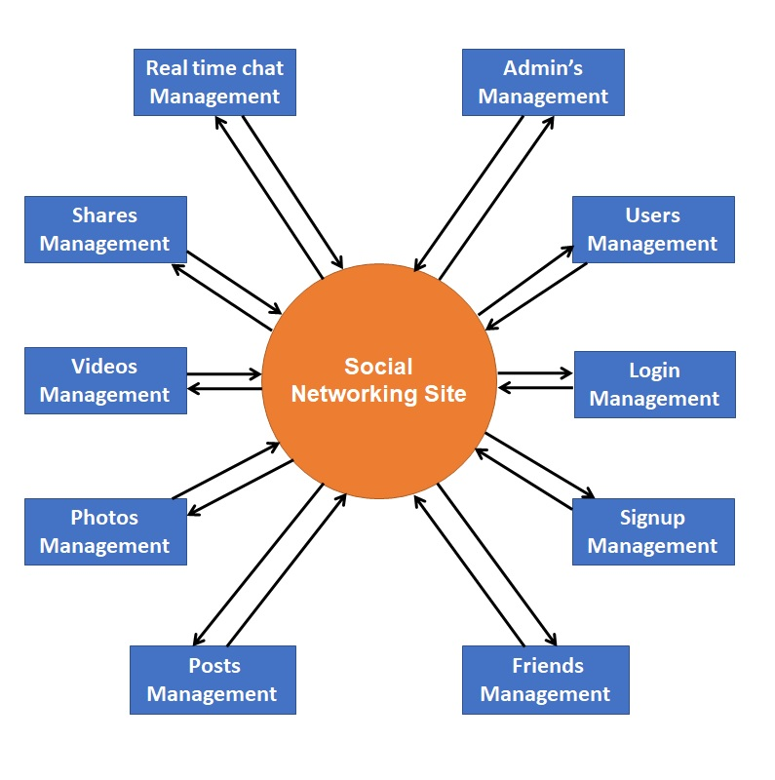
High Level Entities and process flow of Social Networking Site :
Managing Admin
Managing all the Users
Managing all the Friends
Managing all the Posts
Managing all the Photos
Managing all the Videos
Managing all the Shares
Managing all the Real time Chat
Zero Level DFD of Social Networking Site

Slide 17
First Level Data flow Diagram of Social Networking Site : First Level DFD (1st Level) of Social Networking Site shows how the system is divided into sub-systems (processes), each of which deals with one or more of the data flows to or from an external agent, and which together provide all of the functionality of the Social Networking Site system as a whole. It also identifies internal data stores of Social Network, Videos, Photos, Shares, Posts, Real time Chat that must be present in order for the Social Networking system to do its job and shows the flow of data between the various parts of Users, Posts, Videos, Social Network, Photos, Real time Chat of the system. DFD Level 1 provides a more detailed breakout of pieces of the 1st level DFD. You will highlight the main functionalities of Social Networking.
Main entities and output of First Level DFD :
Processing admin’s records and generate report of all admins.
Processing Users records and generate report of all Users.
Processing Friends records and generate report of all Friends.
Processing Photos records and generate report of all Photos.
Processing Videos records and generate report of all Videos.
Processing Real time Chat records and generate report of all Real time Chat.
Processing Social Network records and generate report of all Social Network.

Slide 18
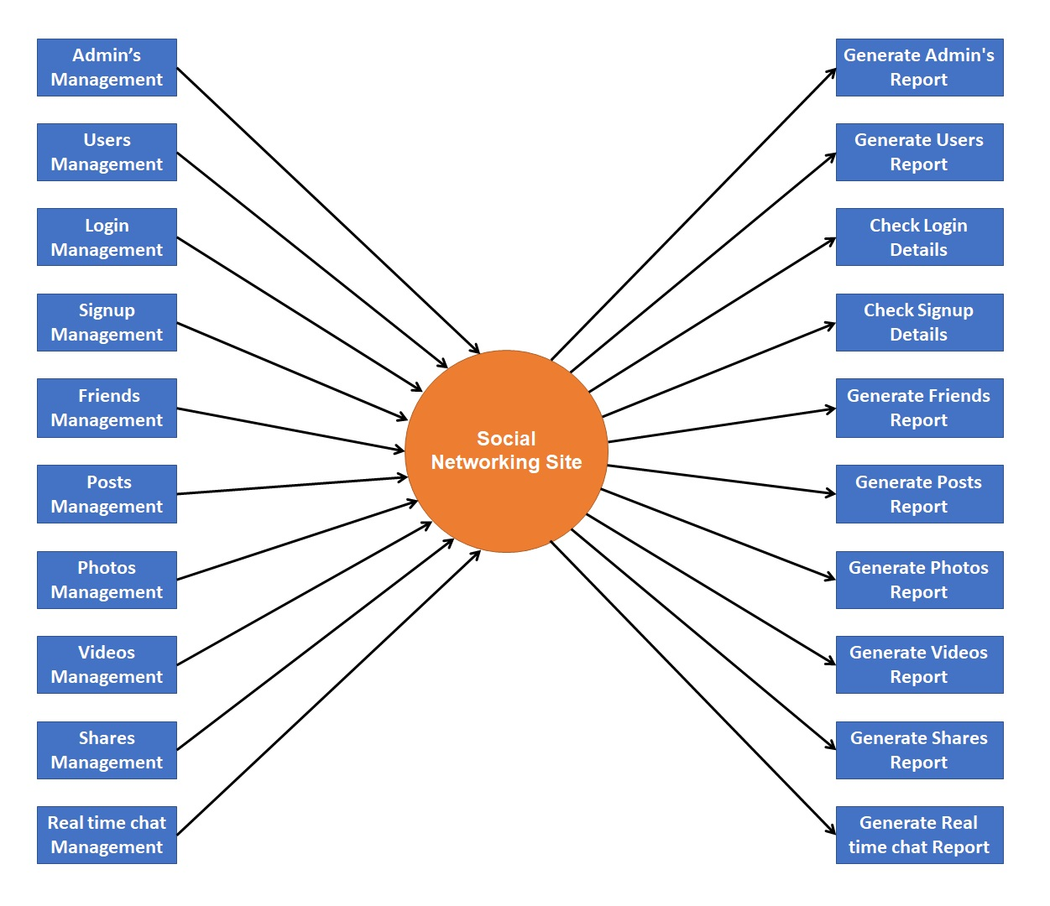
First Level DFD of Social Networking Site

Slide 19
Second Level Data flow Diagram of Social Networking Site : DFD Level 2 then goes one step deeper into parts of Level 1 of Social Networking. It may require more functionalities of Social Networking to reach the necessary level of detail about the Social Networking functioning. First Level DFD (1st Level) of Social Networking Site shows how the system is divided into sub-systems (processes). The 2nd Level DFD contains more details of Social Network, Videos, Photos, Shares, Posts, Real Time Chat, Friends, Users.
Low level functionalities of Social Networking Site :
Admin logins to the system and manage all the functionalities of Social Networking Site.
User logins to the system and manage functionalities of Social Networking Site.
Admin can add, edit, delete and view the records of Users, Posts, Photos, Social Network.
User can add, edit, delete and view the records of Posts, Photos, Videos.
Admin can manage all the details of Friends, Shares, Videos.
Admin can also generate reports of Users, Friends, Posts, Shares, Photos, Videos.
Admin can apply different level of filters on report of Users, Shares, Photos.
Admin can track the detailed information of Friends, Posts, Shares, Photos.
User can send, delete, view the records of Real time Chat.
Admin can send, delete and view the records of Real time Chat.

Slide 20
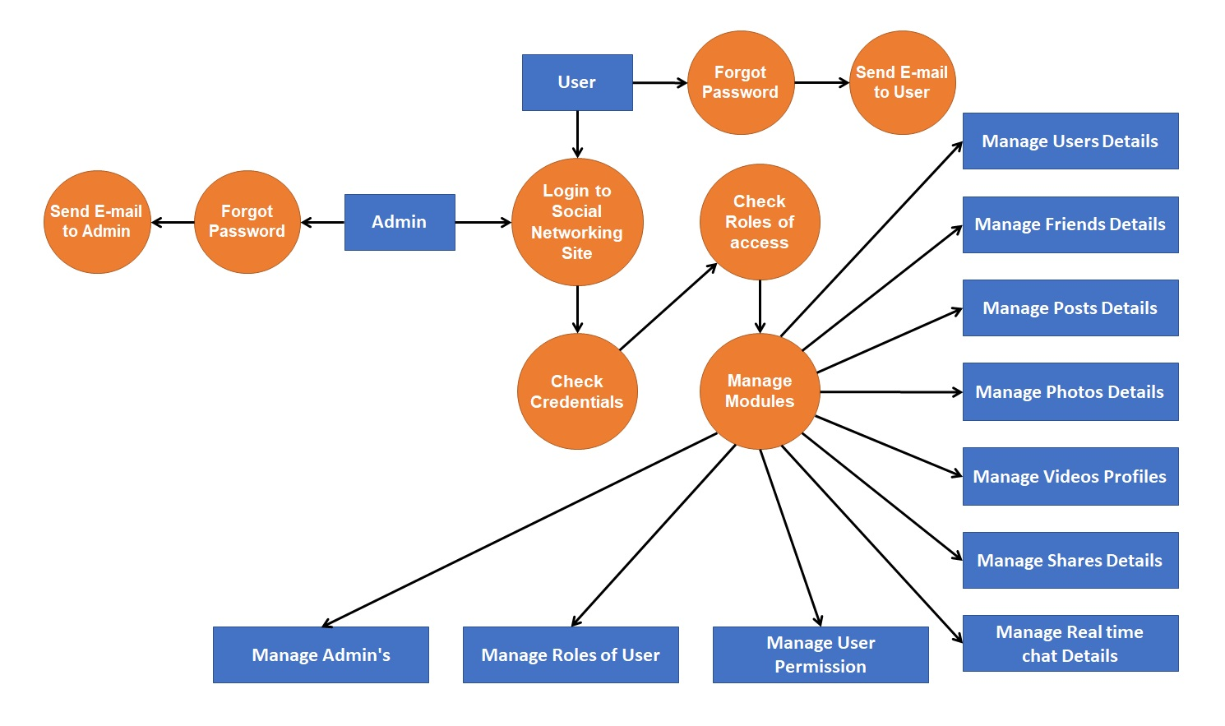
Second Level DFD of Social Networking Site

Slide 21
ER-Diagram
Definition of ER-Diagram : ER-modeling is a data modeling method used in software engineering to produce a conceptual data model of an information system. Diagrams created using this ER-modeling method are called Entity Relationship Diagram or ER-Diagram.
ER-Diagram of Social Networking Site : This ER (Entity Relationship) Diagram represents the model of Social Networking Site Entity. The entity-relationship diagram of Social Networking Site shows all the visual instrument of database tables and the relations between Friends, Shares, Users, Videos, chat etc. It used structure data and to define the relationships between structured data groups of Social Networking Site functionalities. The main entities of the Social Networking Site are Users, Friends, Posts, Shares, Photos, Videos and real time chat.

Slide 22
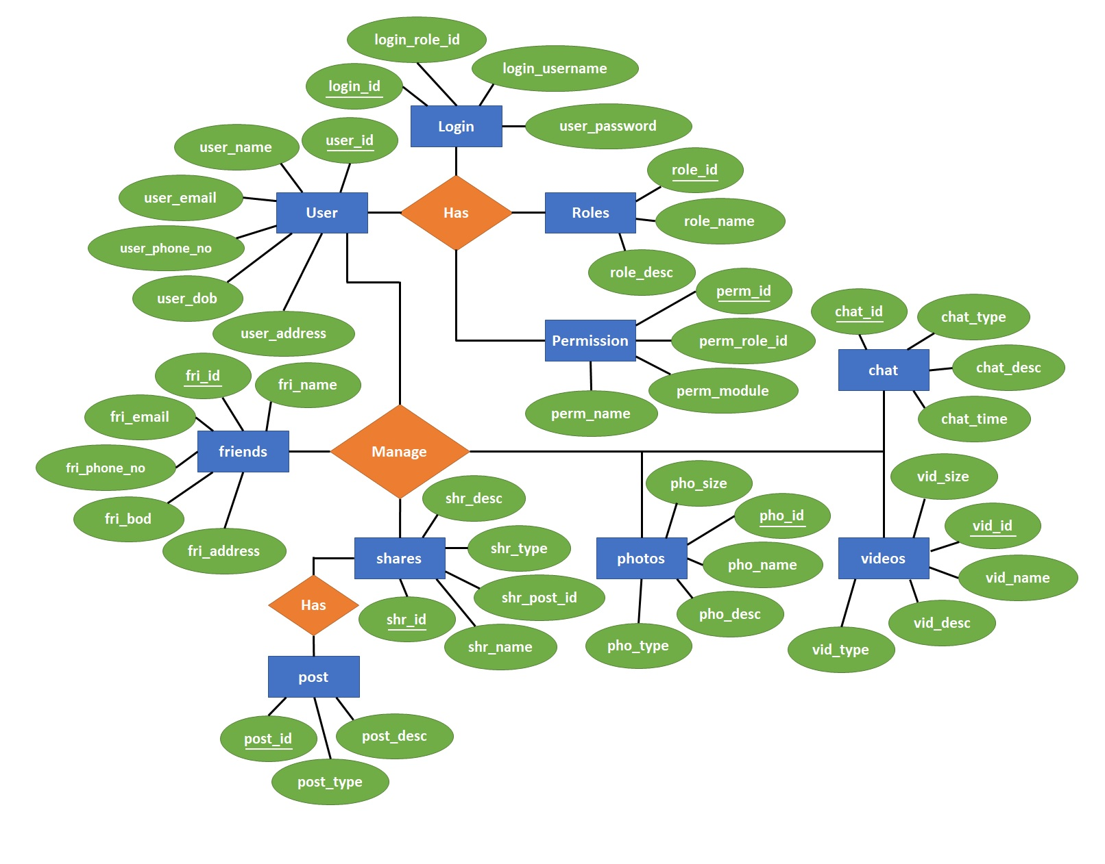
ER-Diagram of Social Networking Site

Slide 23
UML (Unified Modelling Language)
UML, short for Unified Modelling Language, is a standardized modelling language consisting of an integrated set of diagrams, developed to help system and software developers for specifying, visualizing, constructing, and documenting the artifacts of software systems, as well as for business modelling and other non-software systems. The UML represents a collection of best engineering practices that have proven successful in the modelling of large and complex systems. The UML is a very important part of developing object-oriented software and the software development process. The UML uses mostly graphical notations to express the design of software projects. Using the UML helps project teams communicate, explore potential designs, and validate the architectural design of the software.

Slide 24
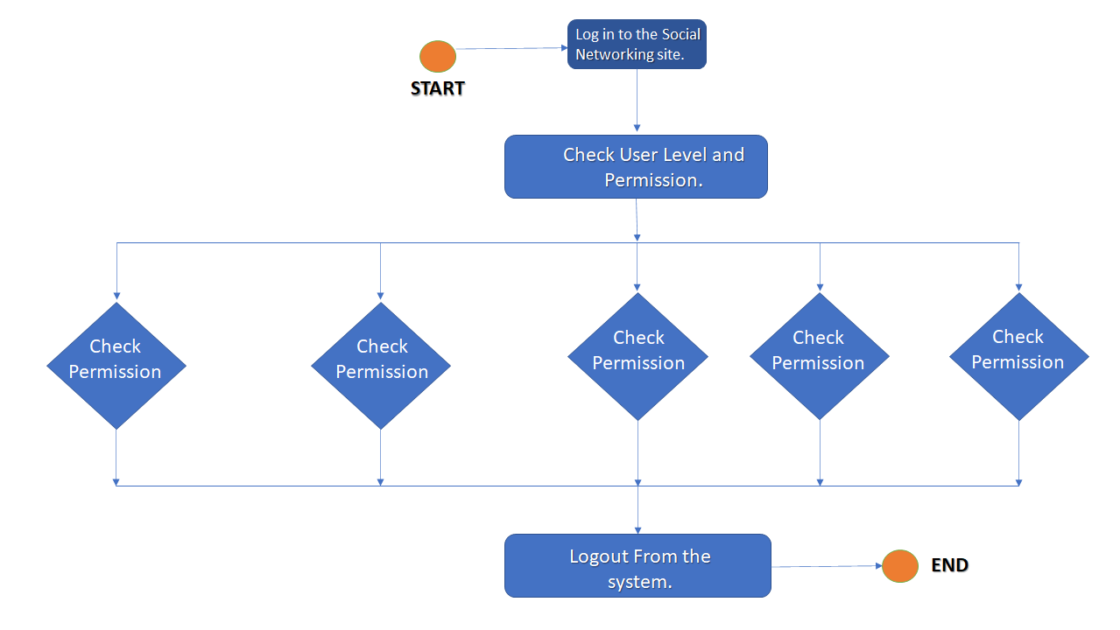
UML Diagram of Social Networking Site

Slide 25
CONCLUSION
While developing the system a conscious effort has been made to create and
develop a software package, making use of available tools, techniques and
resources – that would generate a proper system for ONLINE SOCIAL
NETWORKING SITE.
While making the system, an eye has been kept on making
it as user-friendly. As such one may hope that the system will be acceptable to
any user and will adequately meet his/her needs. As in case of any system
development process where there are a number of short comings, there have
been some shortcomings in the development of this system also. We will keep
updating the app and make it as a better user-friendly software. There are some
sections where still have some work to do to make things better and seamless
performance. Day by Day we will fix these sections based on user experience.

Slide 26
references
YOUTUBE
GOOGLE.COM
PHP.NET
GITHUB

Slide 27
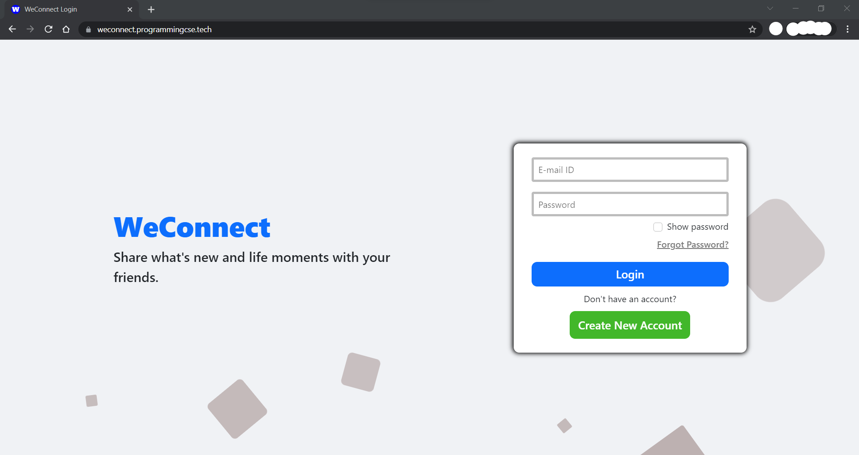
Social Networking Site Project Interface
Project Interface 1

Slide 28
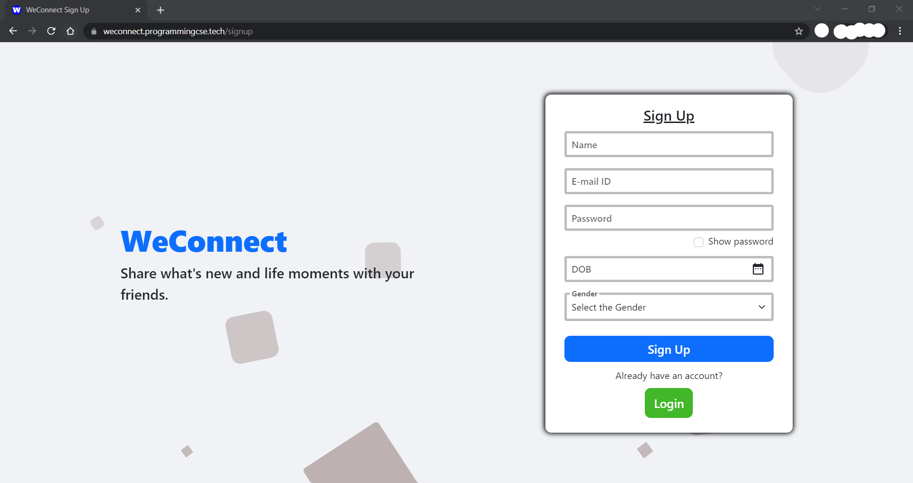
Project Interface 2

Slide 29
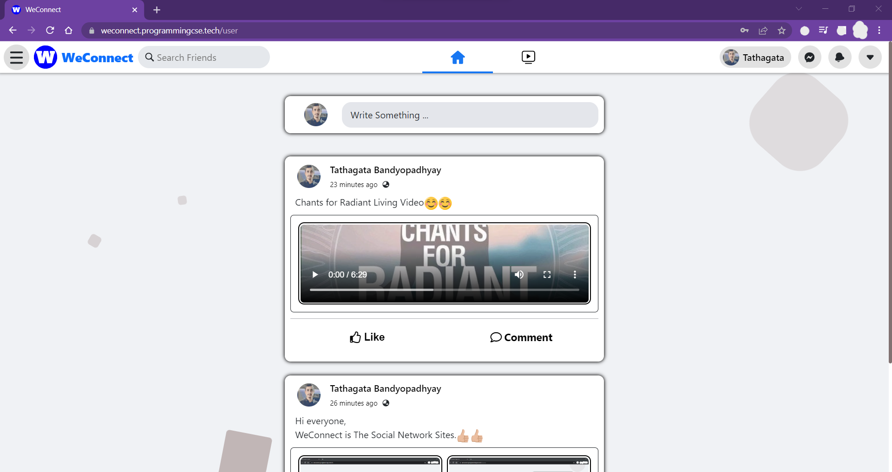
Project Interface 3

Slide 30

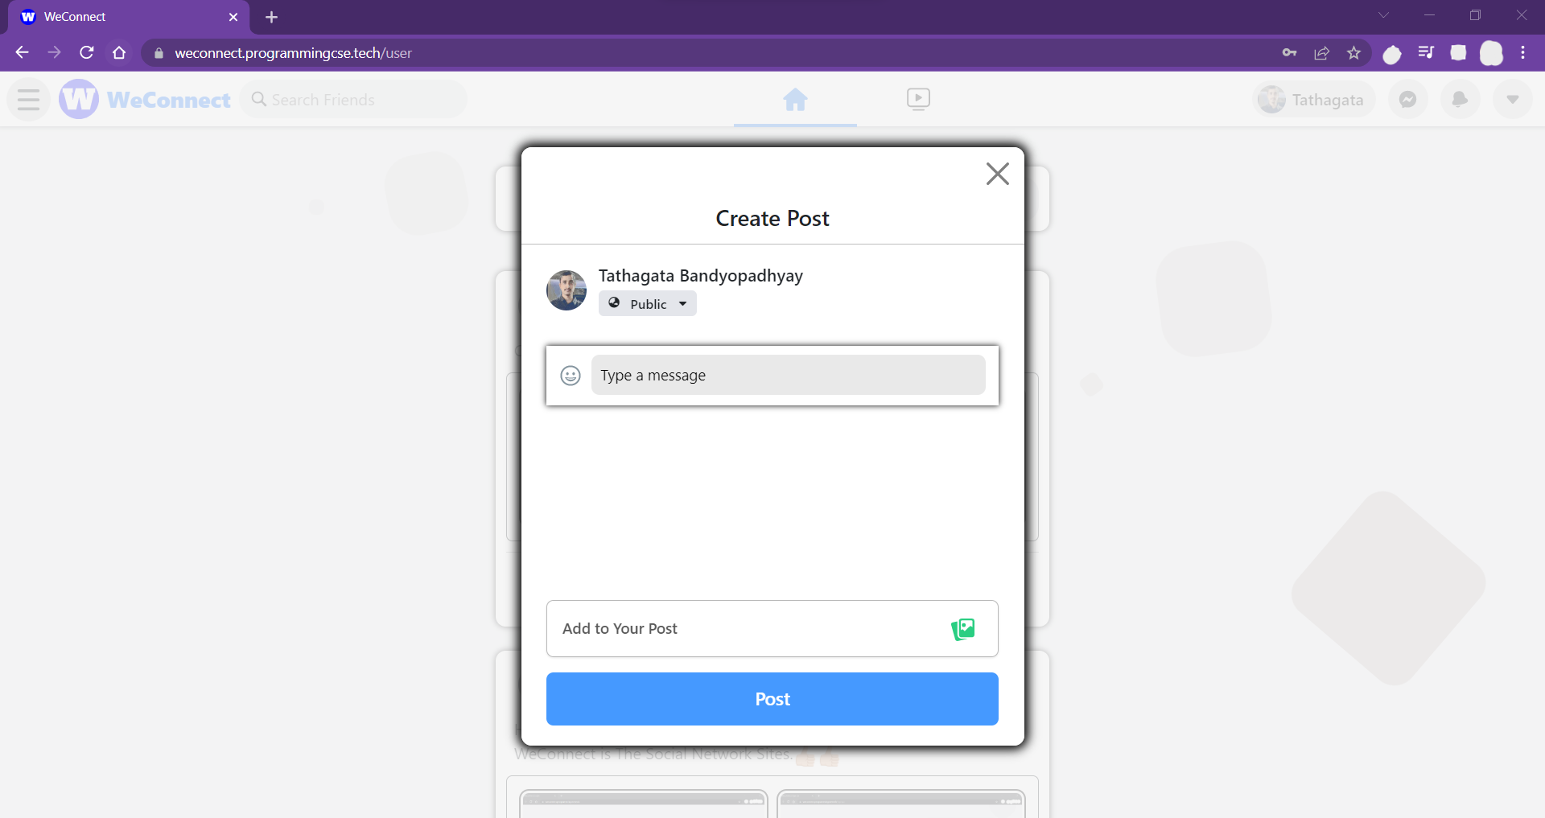
Project Interface 4

Slide 31
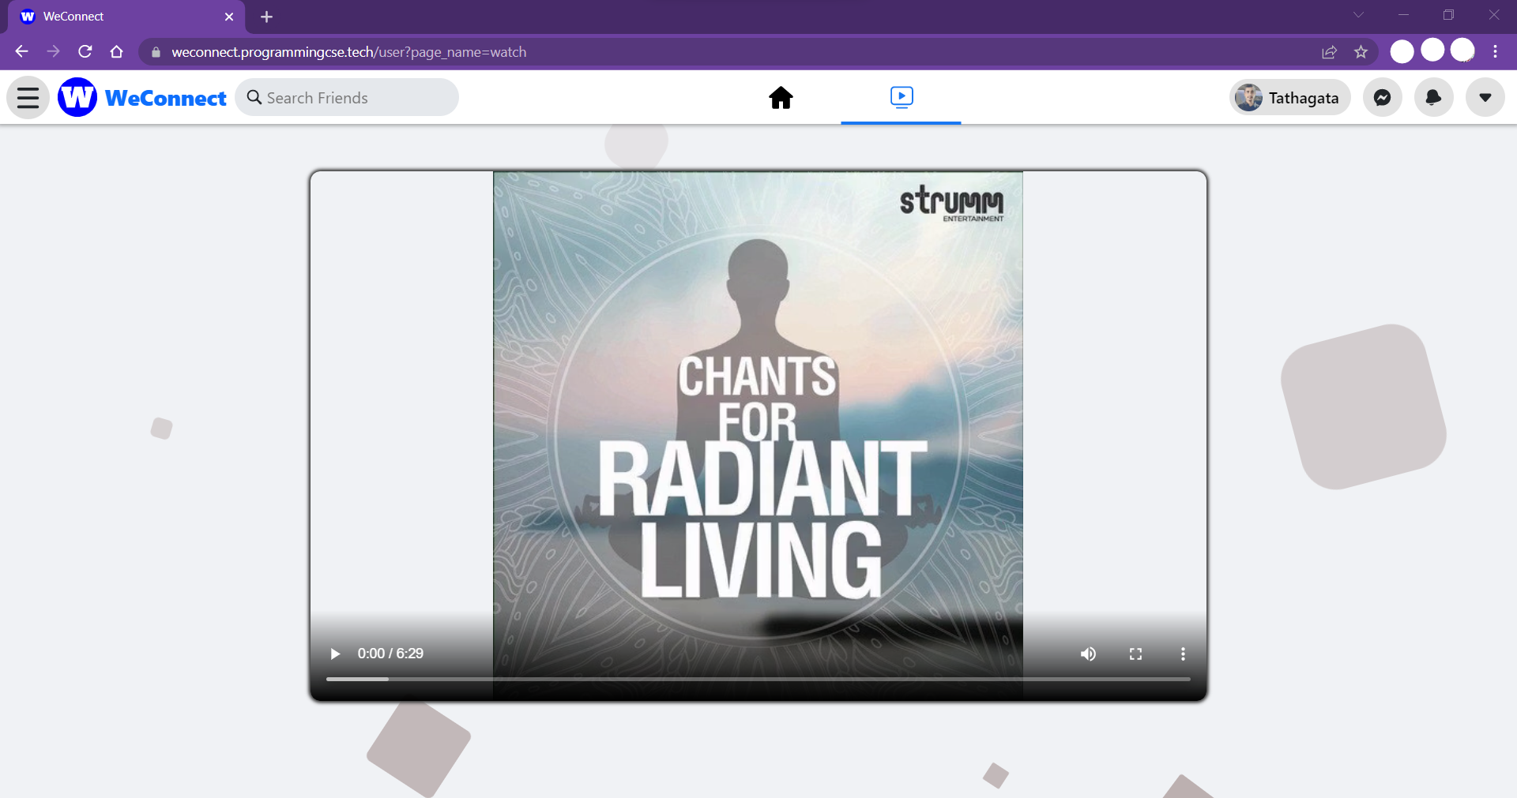
Project Interface 5

Slide 32
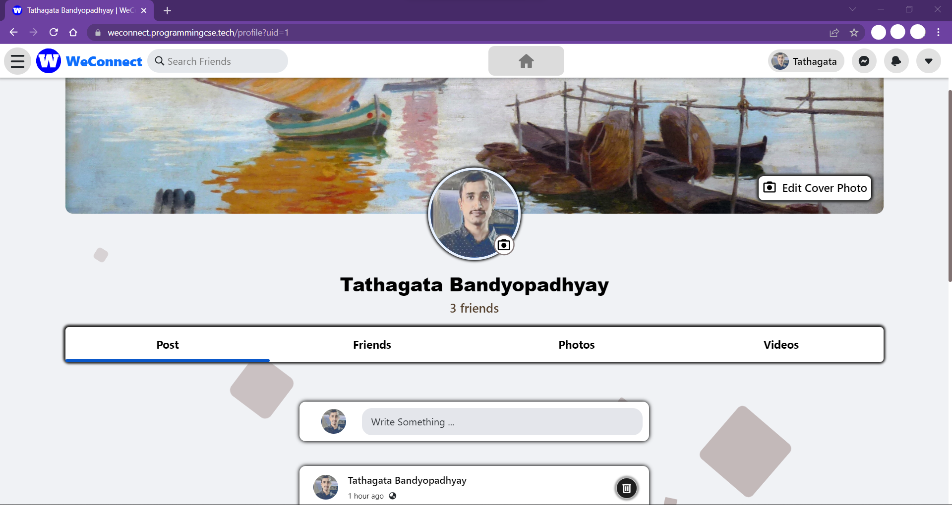
Project Interface 6

