Slide 1
CAPSTONE PROJECT · DATA ANALYTICS WITH GENAI
Black Friday
Sales Analysis
Turning 550,068 transactions into a data-driven retail strategy
Tathagat Mukherjee
Data Analytics Capstone Project

Slide 2




BUSINESS UNDERSTANDING
BLACK FRIDAY SALES ANALYSIS
Business Context
Black Friday is a single high-stakes sales window: millions of shoppers, thousands of products, and immense pressure on pricing, promotions, and inventory — for a retailer spanning both metro and non-metro cities.
Key Challenges
Fragmented customer behavior across age, occupation, and marital status · Uneven city-level purchasing power · Unpredictable product-category demand · Unclear return on promotional spend.
Analytical Objectives
Identify high-value and underpenetrated customer segments · Quantify how demographics shape spend · Surface top-performing categories and cross-sell opportunities · Recommend a data-backed retention strategy.
2

Slide 3

DATASET OVERVIEW
BLACK FRIDAY SALES ANALYSIS
550,068
12
5,891
3,631
Transactions
Columns
Unique Customers
Unique Products
What the data captures
Customer demographics — gender, age band, occupation code, marital status
City context — city category (A/B/C) and years in current city
Product hierarchy — up to 3 product-category levels per transaction
Purchase amount — the transaction-level target variable
3

Slide 4




DATA QUALITY & CLEANING
BLACK FRIDAY SALES ANALYSIS
Missing Values
Data Validation
Product_Category_2 was missing in ~32% of rows and Product_Category_3 in ~70% — expected, since not every product carries a secondary or tertiary category.
Excel conditional formatting was used to check key fields (User_ID, Product_ID, Purchase), flag Purchase outliers, and confirm categorical columns had no inconsistent entries.
Treatment of Category 2 & 3
Other Cleaning Performed
Blanks were deliberately converted to true NULLs during SQL load (via NULLIF) rather than imputed — preserving the honest signal that no category was recorded.
Verified zero duplicate rows, confirmed all Age / Gender / City / Tenure values were clean, and validated the final row count (550,068) after load.
4

Slide 5
KPI OVERVIEW
BLACK FRIDAY SALES ANALYSIS
₹5.09B
₹9,264
₹865.02K
~100%
Cat. 1, 5, 8
Total Sales
Average Purchase
Avg. Purchase / Customer
Repeat Purchase Rate
Category Penetration (top)
City B
35.7%
Highest City Contribution
High-Value Segment Share
Seven KPIs defined in Step 1 were calculated end-to-end and tracked live on the Power BI Executive Dashboard.
5

Slide 6




CUSTOMER ANALYSIS
BLACK FRIDAY SALES ANALYSIS
Gender
Age
Male customers spend more: ₹9,437.53 vs. ₹8,734.57 for female customers — a statistically significant gap (t-test, p < 0.001).
26–35 is the leading age group by total spend. Age has a statistically significant but comparatively modest effect (ANOVA F = 40.6).
Marital Status
Occupation
No meaningful difference: Single ₹9,265.91 vs. Married ₹9,261.17 (p = 0.731) — an initial hypothesis this project disproved.
Correlation with purchase amount is negligible (r = 0.02) despite a tiny p-value — not a practically useful targeting variable.
Customer Segments: High-Value Loyal 35.7% · Regular 33.1% · Loyal 31.2% — no meaningful one-time-buyer or deal-seeker segment emerged.
6

Slide 7




PRODUCT ANALYSIS
BLACK FRIDAY SALES ANALYSIS
Top Categories
Underperforming Categories
Categories 1, 5, and 8 show by far the highest transaction volume — the clearest “penetration” leaders across the customer base.
Product_Category_1 correlates negatively with purchase value (r = -0.34): higher-numbered categories skew toward lower-value items.
Product / Category Affinity
Cross-Selling Opportunities
Customers routinely purchase across multiple category levels per visit, reflecting broad cross-category browsing rather than single-item trips.
A single hero product (P00025442) generated ₹27.99M alone — bundling adjacent SKUs within categories 1, 5, and 8 is the clearest cross-sell lever.
7

Slide 8

GEOGRAPHICAL ANALYSIS
BLACK FRIDAY SALES ANALYSIS
Sum of Purchase by City Category
City B
City A
₹2.3bn
Volume Leader
Highest total revenue — driven by the largest active customer base rather than the biggest average ticket.
City B
₹3.55bn
City C
City C
₹3.05bn
Value Leader
Highest average purchase per transaction — a smaller but higher-spending customer base (ANOVA-confirmed).
Statistical takeaway: City Category is the strongest driver of purchase behavior of every variable tested (ANOVA F = 1130.7) — over 27× the effect size of Age.
8

Slide 9

STATISTICAL ANALYSIS
BLACK FRIDAY SALES ANALYSIS
Hypothesis / Test | Method | Result
Metro (City A) customers spend more | ANOVA | Not supported — City C leads
Married customers show greater category breadth | T-test | Not supported (p = 0.731)
Purchase amount varies by gender | T-test | Supported (p < 0.001)
Purchase varies significantly across city categories | ANOVA | Strongly supported (F = 1130.7)
Occupation / city tenure predict spend | Pearson r | Negligible effect (r < 0.03)
Key Conclusion: City Category and Gender are the two statistically and practically significant drivers of purchase behavior. Marital Status, Occupation, and City Tenure remain statistically “significant” only because of the huge sample size — their real-world effect is negligible.
9

Slide 10
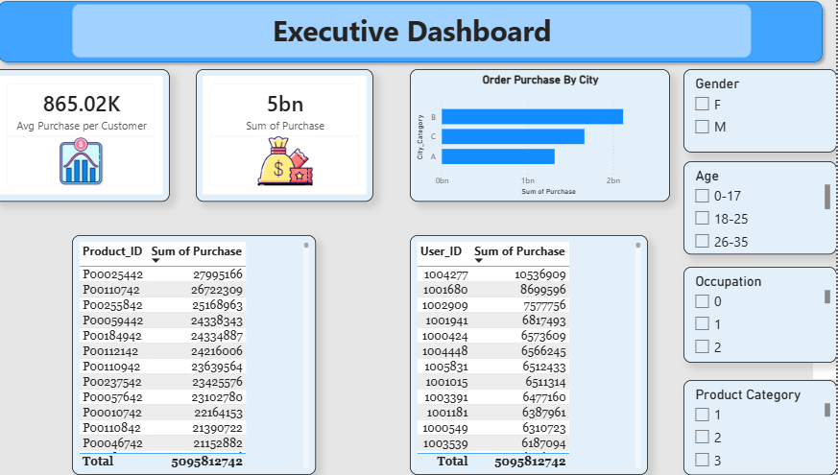
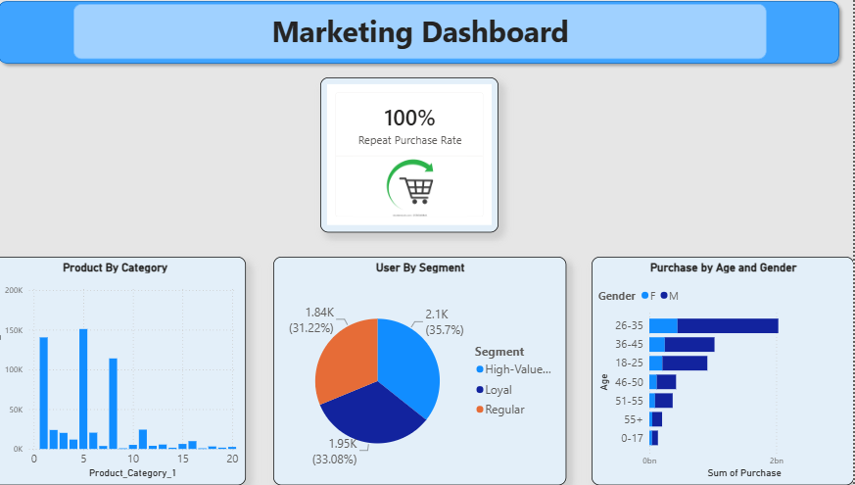
POWER BI DASHBOARDS
BLACK FRIDAY SALES ANALYSIS
Executive Dashboard
Marketing Dashboard
Total Sales, Avg. Purchase/Customer, Top Customers & Products, City-wise revenue — with live Age / Occupation / Gender / Category filters.
Age/Gender segmentation, Repeat Purchase Rate, Category Penetration, and the Customer Segment breakdown (High-Value Loyal / Loyal / Regular).
10

Slide 11
TOP 5 BUSINESS INSIGHTS
BLACK FRIDAY SALES ANALYSIS
1
Gender significantly drives purchase value.
Male customers average ₹9,437.53/txn vs. ₹8,734.57 for female customers (p < 0.001).
2
City Category is the strongest — and most counterintuitive — driver of spend.
City C leads on average purchase; City B leads on total revenue via volume, not “metro” City A.
3
This customer base is exceptionally loyal.
~93 transactions per customer on average; effectively no one-time-buyer segment exists.
4
A small set of products and categories drives disproportionate revenue.
One product alone (P00025442) generated ₹27.99M; Categories 1, 5, 8 dominate volume.
5
Marital status does not meaningfully affect spending.
An initial hypothesis, disproved: Single vs. Married spend is statistically identical (p = 0.731).
11

Slide 12
STRATEGIC RECOMMENDATIONS
BLACK FRIDAY SALES ANALYSIS
1
City-specific strategy: Volume vs. Value
2
Tiered loyalty program for High-Value Loyal customers
Run acquisition-focused campaigns in City B and premium/personalized offers in City C rather than one national campaign.
Build exclusive perks (early access, bundles) around the 35.7% segment that already drives the most repeat, high-value engagement.
Expected impact: Higher ROI per marketing rupee spent.
Expected impact: Stronger retention & lifetime value.
3
Concentrate inventory on hero categories & products
4
Reallocate budget away from marital-status targeting
Prioritize stock and promotional spend on Categories 1, 5, 8 and top SKUs like P00025442 to avoid stockouts during peak demand.
Shift spend toward gender-based and city-based targeting, the two variables with proven statistical and practical significance.
Expected impact: Fewer stockouts, larger basket size.
Expected impact: More efficient campaign spend.
12

Slide 13

CONCLUSION
This project carried 550,068 raw transactions through a complete analytics pipeline — Excel validation, a normalized MySQL schema, Python-based statistical testing, and two interactive Power BI dashboards — to produce insights a retailer can act on immediately.
City Category and Gender are the confirmed, statistically validated drivers of spend
An exceptionally loyal customer base with an untapped high-value segment (35.7%)
A small set of hero categories and products carrying disproportionate revenue
Four concrete recommendations translating analysis directly into retail strategy
Thank you.
13

