Slide 1
ARITHMETIC PROBLEM SOLVER
Team Members:
Tathagat Nawadia 1BI12CS118
Vikas Yadav 1BI12CS125
Soundarya Srinivas 1BI12CS088
Ramya R 1BI12CS080
Faculty In Charge:
Mrs M.S. Bhargavi
Assistant Professor
Department of CSE, BIT.

Slide 2
Agenda
Introduction
Literature Survey
Existing System
Problem Statement
Proposed System
Architecture
Dataflow Diagram
Module Descriptions
Implementation Details
Testing
Snapshots
Applications
Conclusion
Limitations
Future enhancement
References

Slide 3
Introduction
AIM
Designing an Aptitude solver- machine that accepts , extracts, understands and solves an arithmetic aptitude question.
OBJECTIVES
Design system capable of performing computations without external resource (E.g. Google, Yahoo)
Identify a domain from a clutter to make the machine understand the domain.
Apply logical techniques to map objects and their properties into a mathematical model to compute the desired result
Rigorous analysis of the training set to extract as much information.

Slide 4
Literature Survey
Title of the Research Papers | Year of Publication | Authors | Method Proposed
Question Answering System: A Survey | 2015 | Ashish Mathur and M.T.U. Haider | Information Retrieval (IR), Natural Language Processing (NLP) and Information Extraction (IE).
An Integrated Pattern Matching and Machine Learning Approach for Question Classification | 2015 | Vaishali Singh, Sanjay K. Dwivedi | Classifying a question to appropriate class and identification of the focus word play key role in determining accurate answer
Machine Learning for Question Answering from Tabular Data | 2011 | Mahboob Alam Khalid, Valentin Jijkoun | use a classiﬁer to identify appropriate tables and columns in a structured database

Slide 5
Existing System
AVAILIBILITY
There are currently no significant projects which approaches the problem in this manner.
DRAWBACK
The existing systems tries to get to the solution by scraping the web and leveraging search results by quick search algorithms.
The mapping of objects in text to a mathematical or a computation model is weak. This area is still a research in Artificial Intelligent mapping and correlation.
Notes:
Of

Slide 6
Problem Statement
Efficient processing of aptitude questions of various domains to identify and solve domain specific aptitude problems accurately.
Input | Aptitude question in English Language
Output | Domain of the question Abbreviation / Features of the domain and the question Partial Parse Tree

Slide 7
Proposed System
In this model, a user is asked to input a question from a terminal screen, the question is further sent for processing and the existing corpus is loaded to learn a generalized model
Identification of the domain and pipe it to further clean the corpus as well as input question
Cache metadata and relevant information for a domain, if the cache is available, update cache and pipe it along to the domain specific scripts
Process natural language to get the best features of the question and TRY to map it to the variables in solving module
Notes:
Of

Slide 8
Architecture
Training Set
Document
Questions
FEATURE VECTOR
MACHINE LEARNING ALGORITHMS
LABELS
1.5
EXPECTED
OUTPUT
PREDECTIVE MODEL
NEW PROBLEM
INSTANCE
FEATURE VECTOR

Slide 9
Data Flow Diagram
User
HTML CODE FROM EXTERNAL RESOURCE
WEB
SCRAPING
1
EXTRACTED DATA
External Website
APTITUDE PROBLEM
D1
EXTRACTED DATA
CLASSIFICATION
2
VARIABLES
and
OBJECTIVES
COMPUTATION
LANGUAGE
PROCESSING
4
3
User
RESULT
CLASSIFIED INPUT

Slide 10
Data Flow Diagram (Module 1)
Web
Executing Website Structure
1.1
Website Specific Structures
PARTIAL DOM NODES
DOM Parser
Extractor
1.2
Persistent DB
File Saver
Q1
1.3
Q2
Q3
FILE SYSTEM
Questions

Slide 11
Data Flow Diagram (Module 2)
Test
Set
Classifier Data Splitter
Frequency Distribution Analysis
2.1
2.2
FILE SYSTEM
Train
Set
Feature
Enhance
Label Result
NumPy Arrays
LABELED FEATURE
VECTOR
Machine Learning
Classifier Stack
Feature Vector Extractor
2.4
2.3
User
New Problem
Instance
QUESTION FEATURE

Slide 12
Data Flow Diagram (Module 3)
Cache Re-correction
Domain Specific File Reader
3.2
3.1
WRITEBACK
FILE SYSTEM
Abbr.
Cache
METADATA
EVALUATOR
FALLBACK
Units
Cache
Feature
Cache
Manual Correction Mode

Slide 13
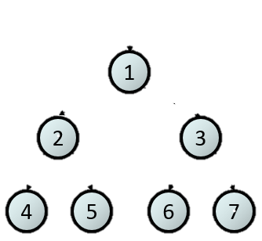
Data Flow Diagram (Module 4)
Objectify
Preprocessing Input
4.1
4.2
Non Objective
Q
Question
Tokenize
Dictionary Replace
Part of Speech
Objective
Semantic Analysis
Parse grammar
4.3

Slide 14
Modules
Data Extraction and Scraping: Raw data for the system was identified from selective websites and their DOM structure was sculpted to selectively extract data by automatic migration of the websites
Domain Identification: This employed reading and semi cleaning of the data to learn the features of the labeled domain by feature learning. Re-employing feature correction and enhancement techniques to improve accuracy scores.
Cache Correction: Generate analysis results for abbreviation, units used and striking objective features. The cache can improve NLP phase with better results and map production

Slide 15
Modules
Natural Language Understanding and Processing: Try to structure a tree for the given input, identify the attributes and their values. Get the objects in the sentence and objective of interrogative intension.
Mathematical Solver: Solves most mathematical equation with data sufficiency, if a data sufficiency is not established, it will try to associate with one or more other mathematical models find the missing variable. The mathematical models to be associated should have predefined domain relationship with the original model.

Slide 16
Implementation
Here the proposed system includes following parts
1. Downloading the corpus
2. Processing the corpus to obtain features and multi-classification
3. Apply Natural Language Understanding

Slide 17
Implementation
AUTO RECURIVE WEB SCRAPER
Identify <ul></ul> tags with iterative cursor for domains iterator
Select a child of the <ul> tag with the first <li> element
Search for Hyperlinks (E.g. www.indiabix.com/domain/permutations ) and NON HTML text to make a dictionary data structure
Load the Hyperlink as another variable and put the page on recursive mode with non initial setting of page iterator
<html_element class=“XYZ”></html_element> : We hooked all the DOMS with the class as XYZ to store in an array. Array was further processed to get the relevant contents out of it

Slide 18

Implementation
LOGISTICS REGRESSION AND MULTICLASSIFICATION
Q
Question
Weight Analysis
01010001000011110000
Frequency Distribution
Corpus
0101000100010010000
0101000000011110000
Bad Vectors

Slide 19
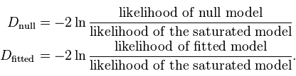
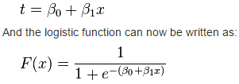
Implementation
t is a linear function
F(x) is evaluated with the score of maximum likelihood
The maximum likelihood changes with the gradient descent
The gradient descent is done in a normal stepwise increase in the weights

Slide 20
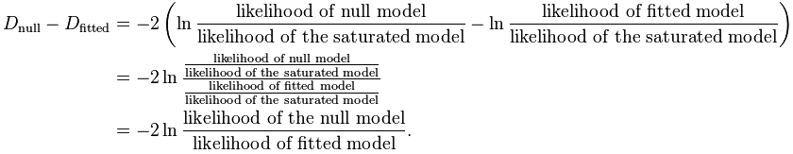
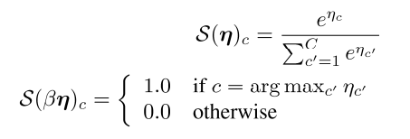
Implementation
Softmax Function takes into account the matrices obtained during learning to obtain a value for each label
These values are normalised to the scale of (0 , 1) to come up with most significant label

Slide 21
Implementation
ABBREVIATION AND UNIT ANALYSIS
ABBREVIATION : A simple regular expression combination \s(?:(?<=\.|\s)[A-Za-z]\.)+\s (Just one shown here) identifies the abbreviation throughout the corpus.
These abbreviation are corrected in a manual mode. If the manual mode has already been applied. We cache the abbreviations as binary python files to do automatic correction for the next load cycle.
UNIT ANALYSIS :
NOUN
NUMERAL
NOUN
10
Immediate Neighbor

Slide 22
Implementation
NATURAL LANGUAGE PROCESSING
Objectification : The objective of the input question is extracted with help of already analyzed
Patterns in similar questions. With the POS Tagging , "NP: {<DT>?<JJ>*<NN>}“ is the grammar
Applied to the corpus in order to find the questions words.
The above grammar is parsed using RegexpParser and applied over the corpus to find the
Objective of the question.
The observed pattern shows that the objective of the question starts with one of the following
Patterns i.e (<WP>,<WRB>,<WDT>,”,” etc}
Once the above patterns are found, the next nearest word which is supposed to be either a Noun,Verb,Adverb is the Objective of the question.

Slide 23
Implementation
NATURAL LANGUAGE PROCESSING
Once the objectification is done ,the objective part of the question isremoved.The rest of the question is preprocessed by removing the stopwords and Punctuations.
Then the units and various measures in the input question is replaced to standard format
by using the dictionary generated in data cleaning module.
Once it is replaced, by observing the patterns of various questions the following grammar
is created.
chunkGrammar=r""“ OBJ:{<JJ><NN>|<NN><NN>}
ATT:{<NN><IN>|<NN>|<NN><IN><DT><NN>}
VALUE:{<CD><NNS>|<CD>}
FIND:{<WP>}
""“
The grammar is parsed using Regexp Parser and applied over the question to get labelled chunks as tree output

Slide 24
Implementation
The objectives and the attributes are passed into the queue to pop the contents in a defined format For eg. length 52cm, length 2* width.
Predefined classes are created for objects such as rectangle ,square in case of area and volume problems with attributes defined.
The attributes obtained from the queue is matched to attributes after instantiating an object
And the values are substituted to find the solution.

Slide 25
Testing
Test case ID | Test Case | Input | Expected output | Obtained Output | Result
TID1 | Scraping Test | Website Name | .store files | .store files | Pass
TID2 | Feature Extraction | Domain Question Files | List of Features | Dictionary of features | Pass
TID3 | Abbreviation Detection | Domain Question Files | All possible abbreviation | Maximum abbreviation detected | Partial Pass
TID4 | Domain Identification | Domain Question Files | Domain | Domain | Pass
TID5 | Units Detection | Domain Question File | All possible units | Maximum units detected | Partial Pass
TID6 | NLP Parse Tree | Question, Abbr. , Unit, Features | Parse Tree | Correct parse Tree in some cases | Partial Pass
TID7 | Unknown variable evaluation | Formula and known variables | Value of unknown variable | Value of unknown variable | Pass

Slide 26
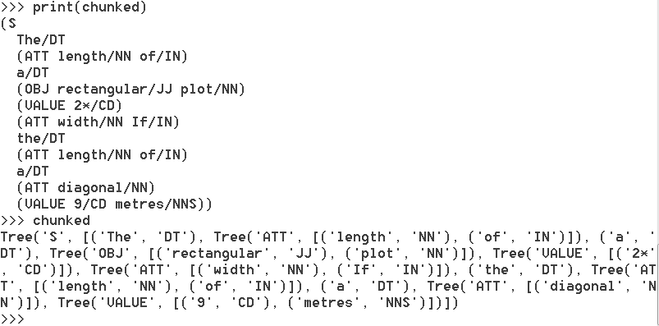

Snapshots

Slide 27
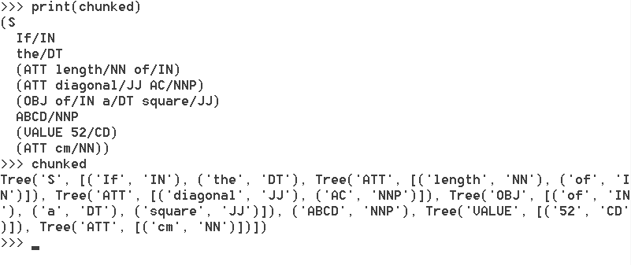
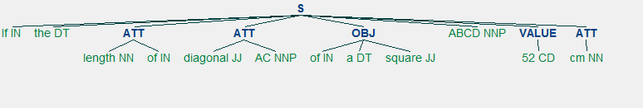
Snapshots

Slide 28
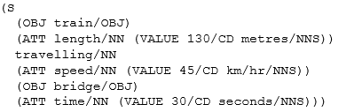
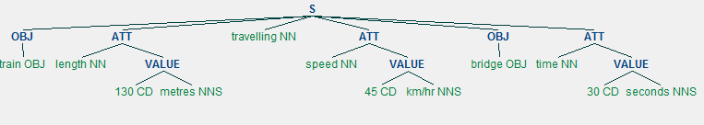
Snapshots

Slide 29
Applications
Can be used in integration with personal assistants like Google Now or SIRI to solve general purpose questions involving trivial mathematics.
System can be implemented in various online websites and tutorial programs.
Instead of adding manual answers to correct the arithmetic questions,
machine can evaluate the answers to do auto correction.

Slide 30
Conclusion
A auto scraping tool for html pages was developed to save time in data collection.
Concepts of NumPy arrays and vector tables where used to convert language to roughly equivalent mathematical format for the machine to derive on conclusion.
Data cleaning techniques where used to find and remove or replace anomalies in data.
Natural Language module harnessed the features of the data to make correlation with domain specific mathematical model.
The following conclusions were made:
A strong and pretty accurate model of feature vector was developed for a high accuracy score.
The Natural language model requires a huge corpus and strong integration with machine learning

Slide 31
Limitations
The model generated by iterative machine learning gives an accuracy of 85–90% only.
Data cleaning techniques have to a long way before highly incorrect grammars can be detected and most importantly rectified.
Mapping of objects from NLU to a generalised mathematical model is challenging.

Slide 32
Future Enhancements
Machine learning can be extended towards NLU to train the system about the objects, their instances for a better accuracy.
The project can be integrated with voice commands to bring high level a sophistication where a machine can actually convert English language to a RELEVANT and GENERALISED mathematical model
Artificially intelligent web hooks can be integrated to expand the project to all domains and make a futuristic intelligent assistant.

Slide 33
References
[1] A Question Answer System for Math Word Problems Christian Liguda and Thies Pfeiffer Artificial Intelligence Group, Faculty of Technology, Bielefeld University.
[2] Natural Language Processing for Solving Simple Word Problems, Sowmya S Sundaram Indian Institute of Technology, Madras Chennai .
[3] A Novel Framework for Math Word Problem Solving, International Journal of Information and Education Technology, Vol. 3, No. 1, February 2013
[4] Learning to Solve Arithmetic Word Problems with Verb Categorization, Mohammad Javad Hosseini1,Hannaneh Hajishirzi1,Oren Etzioni, Nate Kushman. University of Washington, Allen Institute for AI, Massachusetts Institute of Technology.
[5] Automatically Solving Number Word Problems by Semantic Parsing and Reasoning Shuming Shi1, Yuehui Wang , Chin-Yew Lin, Xiaojiang Liu1 and Yong Rui, Microsoft Research.
[6] Machine-Guided Solution to Mathematical Word Problems Bussaba Amnuey pornsakul, Suma Bhat University of Illinois, Urbana-Champaign,USA. Bussaba Amnuey pornsakul and Suma Bhat 28th Pacific Asia Conference on Language, Information and Computation pages 111–119.

