Slide 1
PROBABILITY AND STATISTICS
Statistical Data Analysis
and Insights Platform
A Comprehensive Statistical Investigation Using Probability, Correlation, Regression,
Hypothesis Testing, ANOVA and Interactive Visualization
Tathwa Y Kumar
B.Tech Computer Science and Engineering (Data Science)
Vellore Institute of Technology (VIT), Vellore
Course: Probability and Statistics
Academic Semester: Fall Semester 2026
Faculty: Dr.Rachna Bhatia
Registration Number: 25BDS0209
Independent additional-learning project — not submitted for, or claimed to have received, academic credit, approval or endorsement.

Slide 2
Presentation Roadmap
AGENDA
01
Research Design
Problem statement, objectives and research questions
02
Data & Methodology
Dataset source, variables, cleaning and a critical independence caveat
03
Descriptive & Probability
Central tendency, dispersion, distributions and Bayes' theorem
04
Correlation & Regression
Pearson/Spearman correlation and multiple linear regression
05
Hypothesis Testing & ANOVA
Formal tests, decisions, and validated sum-of-squares decomposition
06
Discussion & Conclusion
Assumptions, limitations, key findings and future scope

Slide 3
Problem Statement and Research Objectives
INTRODUCTION
Problem Statement
Research Objectives
Educational outcomes are shaped by a mix of demographic, behavioural and academic-history factors. This project investigates, using rigorous statistical methods, which measurable variables are associated with secondary-school final grades, and whether demographic or behavioural subgroups differ meaningfully in performance.
Characterize the distribution of final grades and other key numeric variables
Quantify probability relationships between study behaviour, support factors and passing
Measure correlation between study time, absences and prior grades with final grade
Build and validate regression models predicting the final grade
Test hypotheses about group differences (sex, subject, benchmarks)
Assess whether categorical factors are associated with grade variance via ANOVA
Research Design
A quantitative, secondary-data research design: a real, publicly available dataset is analyzed with descriptive and inferential statistics to answer predefined research questions. No experimental manipulation or new data collection was performed — the contribution lies in analysis design, independent verification, and communication of results.

Slide 4
Research Questions Mapped to Statistical Methods
INTRODUCTION
RQ | Research Question | Statistical Method
1 | Is the distribution of final grades (G3) approximately normal? | Descriptive statistics + Shapiro–Wilk test
2 | Is weekly study time associated with final grade? | Pearson correlation
3 | Is the number of absences associated with final grade? | Spearman rank correlation
4 | How well do prior grades, study time and absences predict G3? | Multiple linear regression (OLS)
5 | Do male and female students differ in final grade? | Independent two-sample t-test
6 | Does the second-period grade differ from the first? | Paired t-test
7 | Does the pass rate differ from a 60% benchmark? | One-proportion z-test
8 | Is passing independent of student sex? | Chi-square test of independence
9 | Does final grade differ across mother's occupation? | One-way ANOVA + Tukey HSD

Slide 5
PART II
Dataset and Methodology
Source, variables, data preparation and a critical data-integrity finding

Slide 6
Dataset: UCI Student Performance
DATA & METHODOLOGY
Source: UCI Machine Learning Repository — “Student Performance” dataset (Cortez & Silva, 2008)
Two real secondary-school cohorts from Portuguese schools: Math (395 students) and Portuguese language (649 students)
Combined dataset: 1,044 observations × 38 variables (demographic, behavioural, academic-history and grade variables)
License: UCI repository terms permit academic/research re-use with attribution
Selected after evaluating 5 candidate datasets against 14 criteria (sample size, variable mix, missing-value profile, fit for correlation/regression/ANOVA)
Total Observations
Variables
1,044
38
Math Course
Portuguese
395
649
Missing Values
0 (0.0%)

Slide 7
Data Dictionary — Key Variables
DATA & METHODOLOGY
Variable | Type | Description
G1, G2, G3 | Numeric (0–20) | First, second and final period grades — primary outcome is G3
studytime | Ordinal (1–4) | Weekly study time: <2h, 2–5h, 5–10h, >10h
failures | Numeric (0–4) | Number of past class failures
absences | Numeric (0–93) | Number of school absences
Medu / Fedu | Ordinal (0–4) | Mother's / father's education level
Mjob / Fjob | Nominal | Mother's / father's occupation category
sex, address, internet, higher | Categorical (binary) | Demographic and support-factor indicators
average_grade, pass_fail | Derived | Mean of G1/G2/G3; Pass if G3 ≥ 10 (derived, not original)
Full data dictionary (33 original variables) documented in docs/DATASET_SOURCE.md

Slide 8
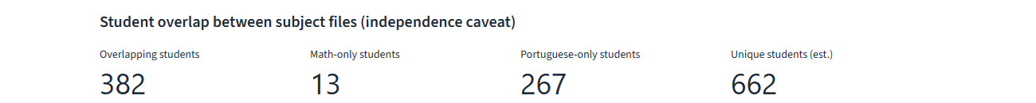
Data Cleaning and the Subject-Overlap Finding
DATA & METHODOLOGY — CRITICAL FINDING
No missing values; no exact-duplicate rows (consistent with dataset documentation)
Outliers flagged (IQR rule) but retained — extreme values are legitimate, not errors
Derived columns (average_grade, pass_fail) documented separately from original variables
Why this matters: 382 of 395 Math students also appear in the Portuguese file, verified using the dataset authors’ own merge key (student-merge.R). The 1,044-row dataset represents only ~662 unique students. Any analysis comparing the two subjects directly treats substantially overlapping, non-independent samples — this is disclosed wherever such a comparison is reported in this project.

Slide 9
PART III
Descriptive Statistics and Probability
Central tendency, dispersion, distribution shape, and probability foundations

Slide 10
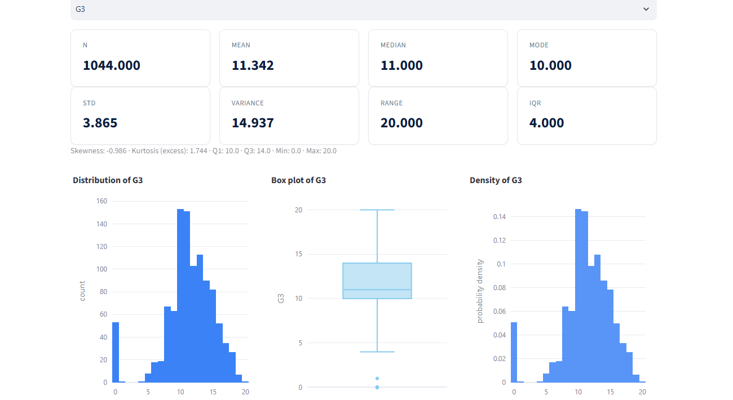
Descriptive Statistics — Final Grade (G3)
DESCRIPTIVE STATISTICS & PROBABILITY
Interpretation
Mean (11.34) exceeds median (11.0): slight left skew
Skewness = −0.99 — a long left tail (some very low grades)
Kurtosis (excess) = 1.74 — more peaked than normal
Mode = 10 (pass mark) — many students cluster near passing
IQR = 4.0 (Q1=10, Q3=14); range 0–20
Shapiro–Wilk normality test
W = 0.918, p = 2.6×10⁻²³ → reject normality

Slide 11
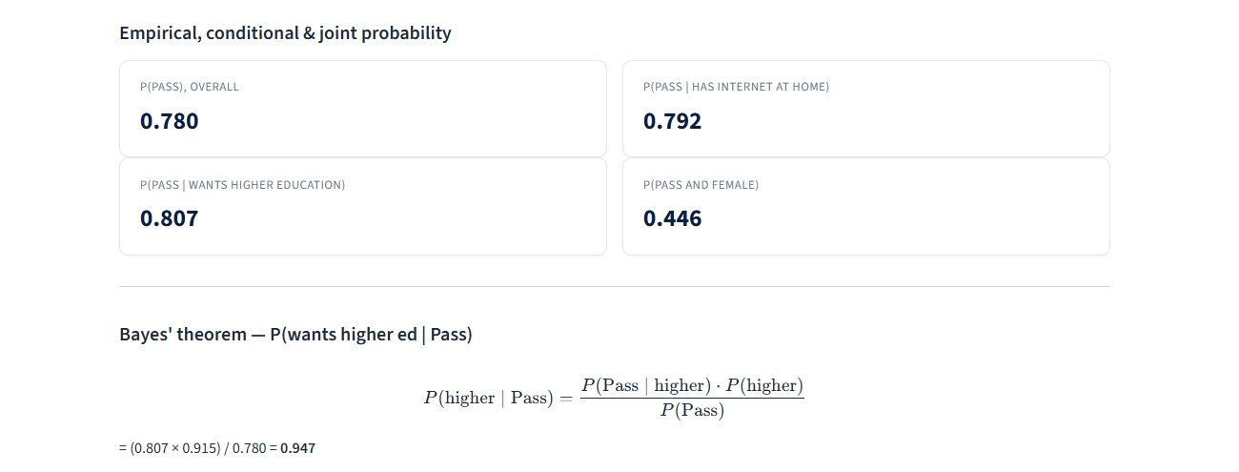
Probability Concepts and Bayes' Theorem
DESCRIPTIVE STATISTICS & PROBABILITY
Bayes’ theorem applied: P(wants higher ed | Pass) = [P(Pass | higher) × P(higher)] / P(Pass) = (0.807 × 0.915) / 0.780 = 0.947
Interpretation: Among passing students, about 94.7% expressed a desire to pursue higher education — far above the 78.0% overall pass rate, suggesting aspiration is strongly linked to passing.

Slide 12
PART IV
Correlation and Regression Analysis
Measuring association and building predictive models for final grade

Slide 13
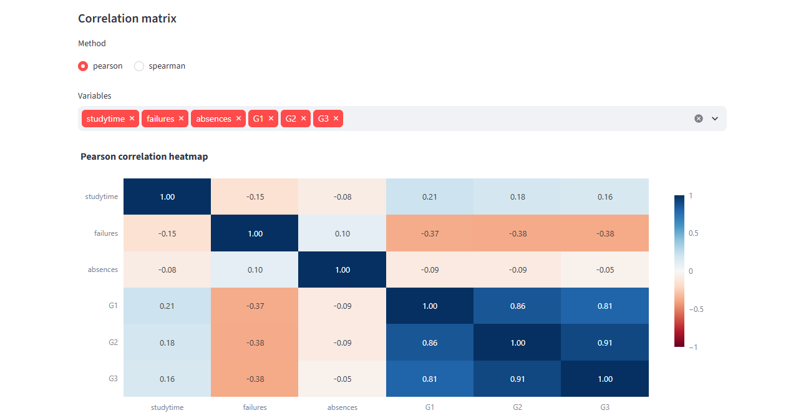
Correlation Analysis
CORRELATION & REGRESSION
Key Pairwise Results
Pair | r / ρ | p-value
G2 ↔ G3 (Pearson) | 0.911 | <0.001
G1 ↔ G3 (Pearson) | 0.809 | <0.001
failures ↔ G3 (Pearson) | −0.383 | <0.001
studytime ↔ G3 (Pearson) | 0.162 | <0.001
absences ↔ G3 (Spearman) | −0.109 | 0.0004
Prior grades (G1, G2) show very strong association with G3. Study time is weakly but significantly positive; absences show a weak negative monotonic association.
Correlation measures linear (Pearson) or monotonic (Spearman) association — it does not establish causation. A significant r does not prove one variable causes changes in the other.

Slide 14
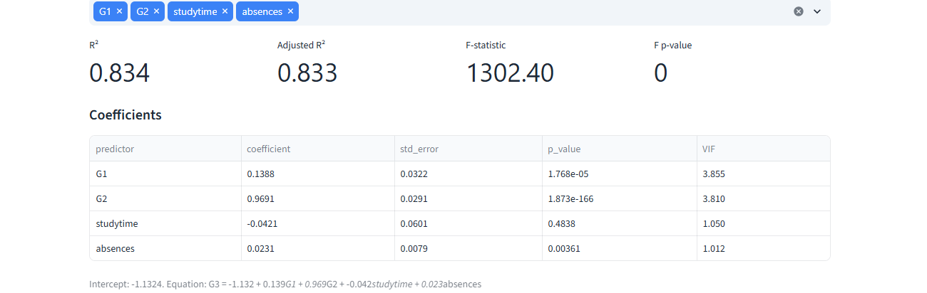
Multiple Linear Regression — Predicting G3
CORRELATION & REGRESSION
G3 = −1.132 + 0.139·G1 + 0.969·G2 − 0.042·studytime + 0.023·absences
R²
0.834
Adj. R²
0.833
F-statistic
1302.4
83.4% of the variance in final grade is explained by the model. G2 is by far the strongest predictor (p<0.001); studytime is not significant once prior grades are included; VIF values (all <5) show no problematic multicollinearity.

Slide 15
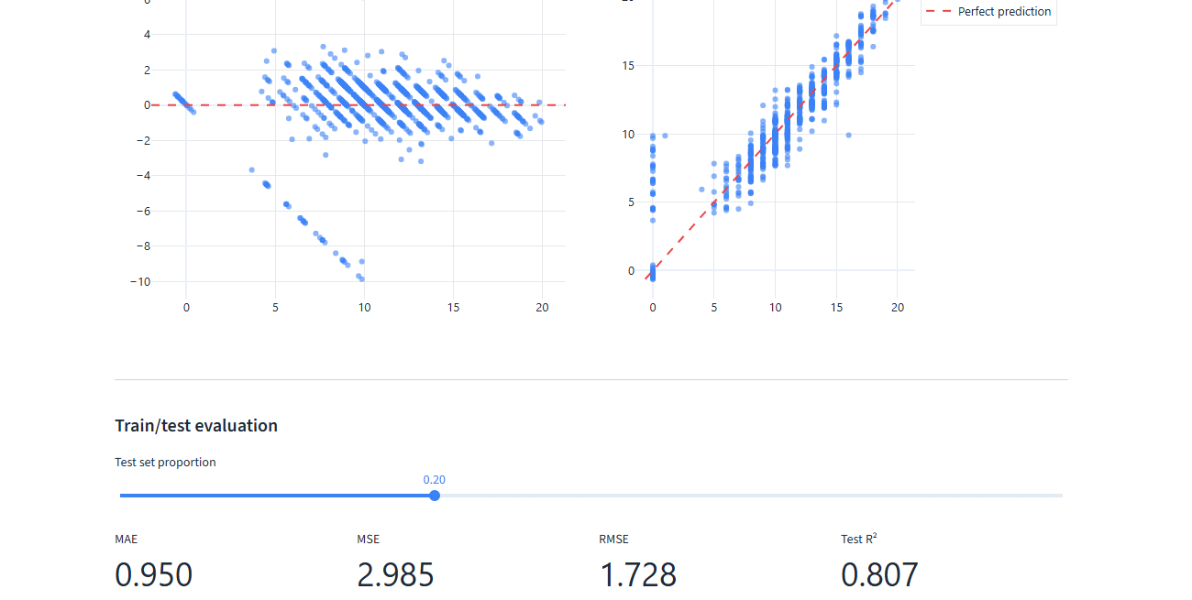
Regression Diagnostics and Model Validation
CORRELATION & REGRESSION
Assumption Checks
Linearity: predicted ≈ actual along the diagonal
Residual mean ≈ 0 (unbiased predictions)
Residuals non-normal (Shapiro p<0.001) — noted limitation
No strong heteroscedasticity signal detected
80/20 train/test split: Test R² = 0.807, RMSE = 1.73
Regression quantifies association under the model's assumptions — it does not, by itself, establish causation.

Slide 16
PART V
Hypothesis Testing and ANOVA
Formal inference: null/alternative hypotheses, test statistics and decisions

Slide 17
Hypothesis Testing — Framework and Results
HYPOTHESIS TESTING & ANOVA
Framework: every test states H₀, H₁, significance level (α = 0.05), checks assumptions, reports the test statistic, degrees of freedom, p-value and a decision (reject / fail to reject H₀).
Test | H₀ | Statistic | p-value | Decision
One-sample t-test: mean G3 vs 10 | μ = 10 | t = 11.22 | <0.001 | Reject H₀
Two-sample t-test: G3 by sex | μ_M = μ_F | t = −1.02 | 0.310 | Fail to reject
Paired t-test: G1 vs G2 | mean diff = 0 | t = 0.62 | 0.534 | Fail to reject
Proportion z-test: pass rate vs 60% | p = 0.60 | z = 11.85 | <0.001 | Reject H₀
Chi-square: sex independent of pass/fail | independent | χ² = 0.50 | 0.479 | Fail to reject
Key takeaway: Final grades significantly exceed the pass mark on average, and the actual pass rate (78.0%) significantly exceeds a 60% benchmark — but sex shows no significant association with grade or pass/fail outcome in this sample.
Caveat on the subject-variance F-test: F = 2.011, p < 0.001 (Reject H₀) for Math vs Portuguese G3 variance — but 382 of 395 Math students also appear in the Portuguese sample, so the “independent samples” assumption is violated; this result is reported with that caveat, not as a clean two-cohort comparison.

Slide 18
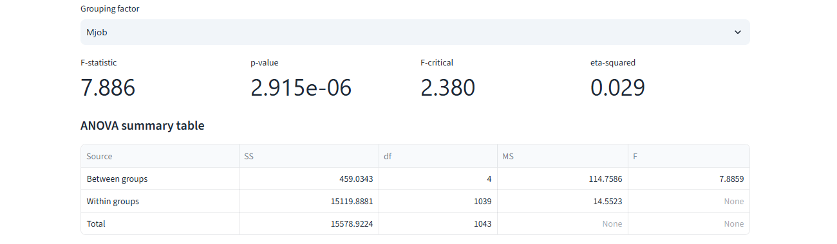
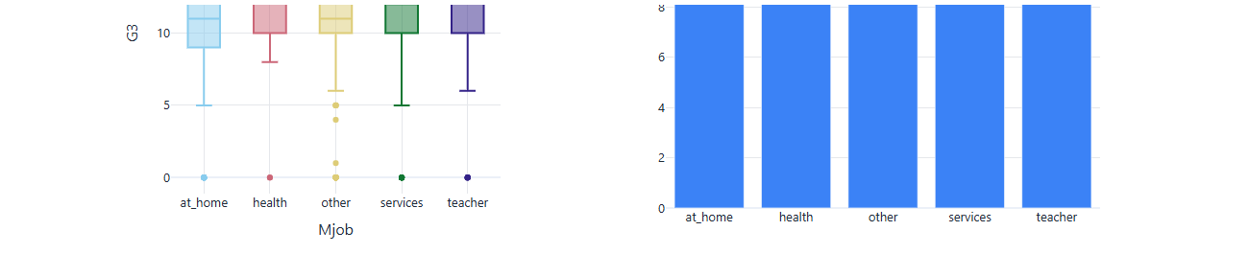
ANOVA — Final Grade Across Mother's Occupation
HYPOTHESIS TESTING & ANOVA
H₀: all group means equal H₁: at least one group mean differs
SST = SSB + SSW
15578.92 = 459.03 + 15119.89
Verified ✓
F = 7.886, p = 2.9×10⁻⁶
η² = 0.029
Levene p = 0.715 (variance
homogeneity holds)
Tukey HSD
post-hoc
at_home differs significantly from health, services and teacher groups (p-adj < 0.05). Other pairwise differences are not significant.
Reject H₀ at α = 0.05: mother's occupation is significantly associated with final grade (small effect, η² ≈ 0.03).

Slide 19
Assumptions, Validation and Limitations
DISCUSSION
Mathematical Validation
Limitations
ANOVA: SST = SSB + SSW re-derived independently of SciPy and cross-checked — verified exactly
Regression R² independently recomputed from residual/total sum of squares
All t-, z- and χ²-statistics cross-checked against direct SciPy calls
24 automated tests pass, covering every statistical module
Self-reported survey data from two schools, 2008 — may not generalize
382 overlapping students mean subject comparisons are not fully independent
G3 and residuals are non-normal — addressed via rank-based/robust alternatives where appropriate
Correlational and regression findings show association, not causation
Assumption Checks Applied Throughout
Normality: Shapiro–Wilk tested before choosing parametric vs rank-based methods
Homogeneity of variance: Levene's test run before every ANOVA (Welch's ANOVA used automatically if violated)
Independence: checked for every group comparison — and explicitly flagged where violated (subject overlap)
Multicollinearity: Variance Inflation Factor checked for every regression model

Slide 20
Key Findings Summary
DISCUSSION
of variance in final grade explained by prior grades, study time and absences (R²)
Pearson correlation between second-period and final grade — very strong
overall pass rate, significantly above a 60% benchmark (p < 0.001)
83.4%
0.911
78.0%
of grade variance explained by mother's occupation (ANOVA, significant but small)
difference in final grade by sex (t-test, p = 0.310)
overlapping students between subject files — a key data-integrity caveat
η² = 0.029
No sig.
382

Slide 21
Conclusion and Future Scope
CONCLUSION
Conclusion
Future Scope
Demonstrated the full statistical workflow — descriptive, probability, correlation, regression, hypothesis testing and ANOVA — on a genuine educational dataset
Every claim independently re-verified (including explicit SST = SSB + SSW validation)
Prior-period grades dominate as predictors; demographic factors (sex) show no significant effect; mother's occupation shows a small but significant association
Data-integrity issues (student overlap) identified and transparently disclosed rather than hidden
Two-way ANOVA with interaction terms (subject × sex) — implemented in code, not yet on a dedicated view
Deduplicate the 382 overlapping students for a truly independent subject comparison
Extend regression with regularization (ridge/lasso) given correlated predictors
Collect a larger, more recent and more geographically diverse sample for stronger generalizability

Slide 22
References
REFERENCES
Cortez, P., & Silva, A. (2008). Using Data Mining to Predict Secondary School Student Performance. In A. Brito & J. Teixeira (Eds.), Proceedings of 5th FUture BUsiness TEChnology Conference (FUBUTEC 2008), pp. 5–12.
UCI Machine Learning Repository: Student Performance Data Set. https://archive.ics.uci.edu/dataset/320/student+performance
Montgomery, D. C. (2017). Design and Analysis of Experiments (9th ed.). Wiley.
Field, A. (2017). Discovering Statistics Using IBM SPSS Statistics (5th ed.). Sage.
Integrity statement: All results in this presentation are computed directly from the project's statistical engine and independently re-verified. No data, citation, finding, or approval has been fabricated. This project has not been submitted for, or claimed to receive, academic credit.

Slide 23
Thank You
Questions & Discussion
Tathwa Y Kumar · 25BDS0209
B.Tech CSE (Data Science) · VIT Vellore
Probability and Statistics · Fall Semester 2026

