Slide 1
NETWORK OPS & RL ANALYTICS
3
RL-Based SDN Traffic Routing
and Flow-Table Optimization
controller variants
4
traffic workloads
A working Mininet + OpenFlow prototype that uses tabular Q-learning to jointly optimise traffic routing and flow-rule idle timeouts — measured against a conventional shortest-path baseline on identical, seeded traffic.
60
Computer Networks Project Review · Final Demonstration
primary matrix runs
Team / Student name(s): ___________________ Date: ___________

Slide 2
MOTIVATION
Why routing and flow-table control belong together
Software-Defined Networking separates the control plane from the dataplane, which makes the network programmable — but conventional SDN controllers still route traffic with static, hand-written rules (shortest path by hop count) and manage flow-table entries with fixed idle timeouts.
THE QUESTION THIS PROJECT ASKS
Does jointly learning routing AND flow-rule timeouts beat learning routing alone — and does either beat a conventional fixed policy — under identical, seeded traffic?
Static routing is blind to load. A fixed shortest path is only correct in the load regime it was designed for.
Flow-table entries are a scarce resource. Switch TCAM is small; idle timeouts too long waste it, too short thrash the controller.
These two problems are usually solved separately. Most SDN+RL work optimises routing OR flow-table management, rarely both under one reward.
Answered empirically under “Results”, later in this deck, with measured data — not simulation.
RL-Based SDN Traffic Routing and Flow-Table Optimization
2

Slide 3
PROBLEM STATEMENT
The research gap
1
Conventional SDN routing (shortest-path-by-hop-count) is provably sub-optimal whenever the shortest path is also the narrowest one, under load.
2
Static flow-rule idle timeouts trade off controller load against flow-table occupancy with no way to adapt to traffic pattern.
3
RL can in principle adapt both — but most published SDN+RL work optimises only routing, is evaluated in pure simulation, or is not checked against what the switches actually installed.
This project's position: build an emulated, OpenFlow-faithful testbed where both the routing path AND the flow-rule idle timeout are RL actions, verified against switch-side flow-table dumps rather than controller logs.
RL-Based SDN Traffic Routing and Flow-Table Optimization
3

Slide 4
OBJECTIVES & METHODOLOGY
What was built, and how it is evaluated
1
Build a 5-switch emulated OpenFlow 1.3 network (Mininet + Open vSwitch) with two link-disjoint, asymmetric paths.
2
Implement three controller variants (A/B/C) that isolate RL routing and RL flow-timeout control one variable at a time.
3
Drive all variants with identical seeded traffic across four workloads designed to stress different parts of the system.
4
Measure outcomes independently of the reward (ping, iperf3); verify installed switch state against flow-table dumps.
5
Report results with 95% confidence intervals across seeds; run control experiments (frozen / shuffled agent).
6
Expose every stage — decisions, rewards, Q-values, comparisons — in a live, read-only research dashboard.
RL-Based SDN Traffic Routing and Flow-Table Optimization
4

Slide 5
SYSTEM ARCHITECTURE
From the dataplane to the dashboard
Dataplane
Controller
Agent
Experiments
Dashboard
Mininet + Open vSwitch 3.7.1
os-ken (OpenFlow 1.3 apps)
Tabular Q-learning
Runner + workload generator
FastAPI backend, React frontend
5 switches, 4 hosts
OpenFlow 1.3 southbound
baseline.py — variant A
rl_route.py — variant B
rl_joint.py — variant C
rl_mixin.py — shared Q-learning
State discretisation
ε-greedy action selection
Reward computation
Seeded traffic (iperf3, ping)
results/runs/<run>/ (append-only)
Reads files only — zero extra OF traffic
Read-only; never writes run data
Design discipline: the dashboard reads telemetry the controller and runner already write to disk and never queries the switches itself — so A/B/C measurements (incl. controller message load) are identical whether or not anyone is watching.
RL-Based SDN Traffic Routing and Flow-Table Optimization
5

Slide 6
MININET / OVS TOPOLOGY
A load-dependent optimum, by construction
h1 --. .-- h3
+-- s1 ------- s2 ------- s4 -----+
h2 --' | | '-- h4
'--- s3 ---- s5 -----'
Path A: s1 → s2 → s4 2 hops, 1 ms/link, 5 Mbit/s bottleneck
Path B: s1 → s3 → s5 → s4 3 hops, 2 ms/link, 10 Mbit/s bottleneck
Path A is shorter but narrower; Path B is longer but wider. The asymmetry is the whole experiment: a fixed hop-count policy always picks A, which is correct at low load and wrong at high load. A state-conditioned policy can be right in both regimes — this is the property every workload is designed to probe.
RL-Based SDN Traffic Routing and Flow-Table Optimization
6

Slide 7
CONTROLLER DESIGN
Three variants, one variable changed at a time
Variant | Routing | Flow-rule idle timeout | Role
A | Conventional shortest-path (fewest hops) | Fixed for the whole run | Baseline — no agent
B | Q-learning chooses the path | Fixed for the whole run | Isolates routing control
C | Q-learning chooses the path | Q-learning chooses the timeout | Isolates + adds timeout control
A and B differ in exactly one respect; B and C differ in exactly one respect. Any measured difference between B and C is therefore attributable to flow-timeout control alone.
RL-Based SDN Traffic Routing and Flow-Table Optimization
7

Slide 8
RL WORKFLOW
One decision, start to finish
1
2
3
4
5
6
Observe
Decide
Route
Measure
Reward
Learn
Network state as 4 coarse bins: path A/B utilisation, flow-table occupancy, table-miss rate (144 states)
ε-greedy: current best-known action, or a random one to keep exploring
Controller installs the decision via OpenFlow (routing; B/C also set the idle timeout)
Switches report what happened, from their own OpenFlow counters
Outcome scored by the project's fixed reward formula
Q(s,a) updated by the Q-learning rule — only the one cell just taken
Decision cadence: one MDP step per 1 s polling interval, not per packet — a throughput measurement can always be attributed to one specific decision.
RL-Based SDN Traffic Routing and Flow-Table Optimization
8

Slide 9
REWARD DESIGN
Scored only from what the switches report
r = 1.00×throughput − 0.40×utilisation − 0.60×loss − 0.25×occupancy − 0.15×controller_msgs
+ Throughput Delivered bits/sec, scaled 0–1 against a fixed reference rate
− Max link utilisation Congestion / queueing proxy — OpenFlow counters cannot see queue depth
− Packet loss From OVS flow/port counters, not ping
− Flow-table occupancy Installed-rule count per switch against a soft cap
− Controller messages Reactive PacketIn + FlowMod per second — stats polling excluded
Each term is clamped 0–1, weighted, summed, then clamped to [-1, +1]. The agent never sees ping or iperf3 — an improvement in those independently-measured metrics is an out-of-sample consequence of the policy, not a self-fulfilling optimisation.
RL-Based SDN Traffic Routing and Flow-Table Optimization
9

Slide 10
EXPERIMENTAL DESIGN
Four workloads, each testing a different failure mode
light
heavy
One 1 Mbit/s flow
Two saturating TCP flows exceeding path A's capacity
Tests: Checks the agent doesn't over-use the big pipe when the small one is already enough
Tests: Tests whether adaptive routing spills the second flow onto path B
churn
failure
24 short flows (4s each), seeded 5-tuples
heavy + a scripted cut of link s1–s2, then repair
Tests: Stresses the flow table — where idle-timeout control has something to win or lose
Tests: Tests reconvergence: how fast and correctly a policy reacts to a link going down
Every workload is driven by random.Random(seed), so a given (workload, seed) pair offers identical traffic to all three variants — differences in results come only from routing choices.
RL-Based SDN Traffic Routing and Flow-Table Optimization
10

Slide 11
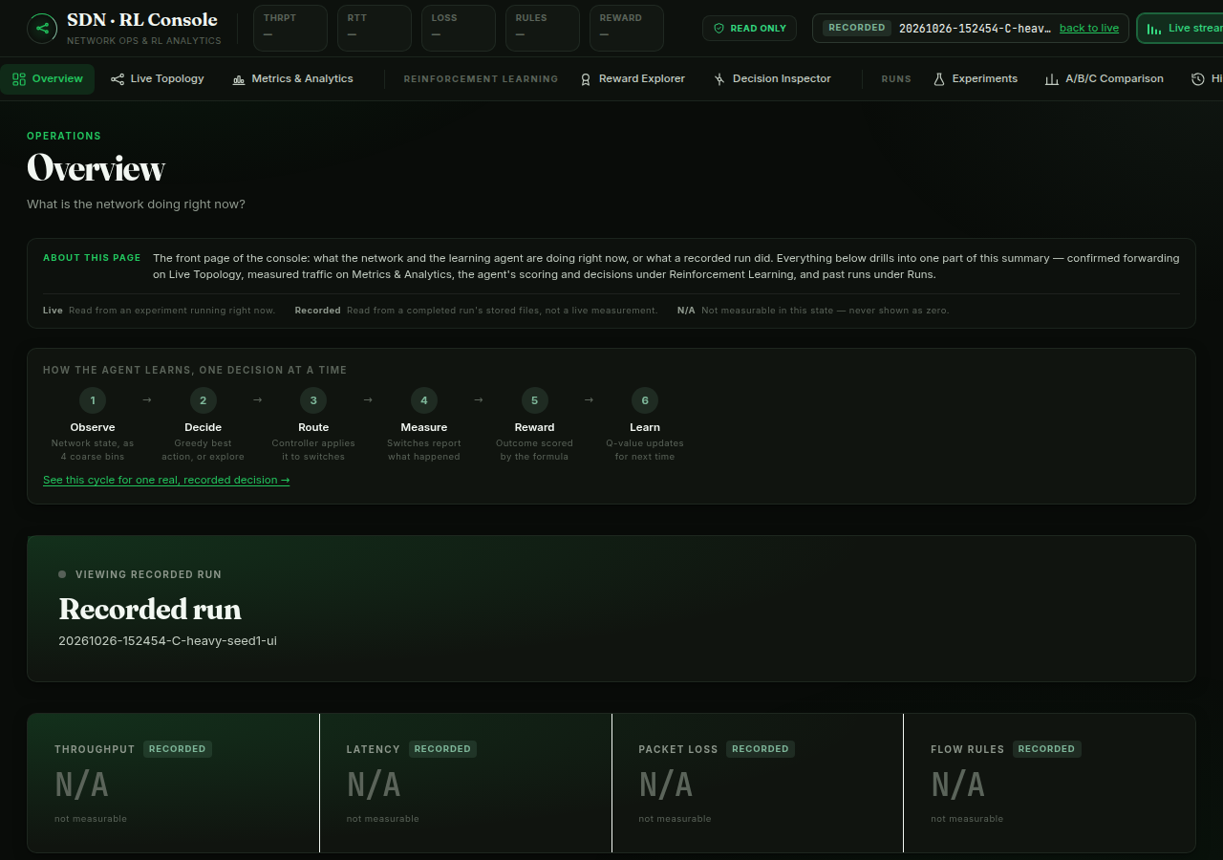
RESEARCH DASHBOARD
A read-only console for every stage of the pipeline
The dashboard never queries the switches — it reads the same telemetry files the controller and runner already write, so watching the console adds zero OpenFlow traffic and never perturbs a measured run.
Overview
Live Topology
System status, live vitals, recent runs
Confirmed forwarding, from switch evidence
Metrics & Analytics
Reward Explorer
Throughput, latency, loss, occupancy
What score the agent earned, and why
Decision Inspector
A/B/C Comparison
One decision's full life cycle
Is the difference between variants real?
Overview — status, workflow strip, recent runs
Experiments
History
Start / stop / monitor runs
Every run, with full provenance
RL-Based SDN Traffic Routing and Flow-Table Optimization
11

Slide 12
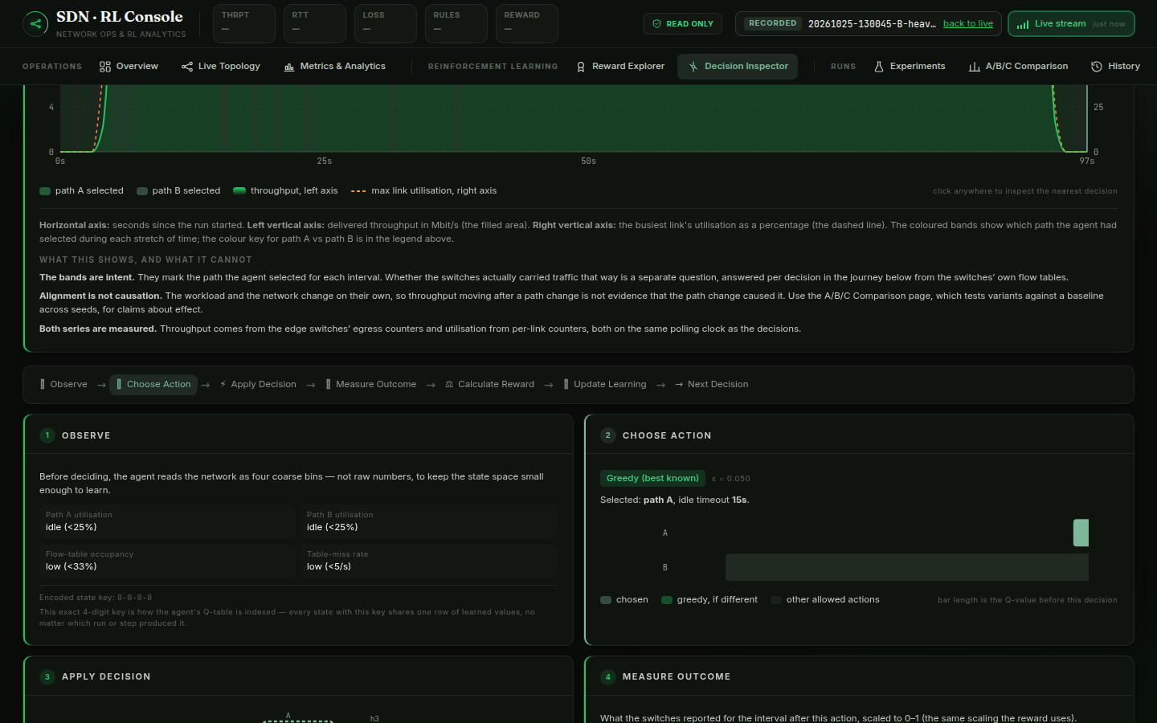
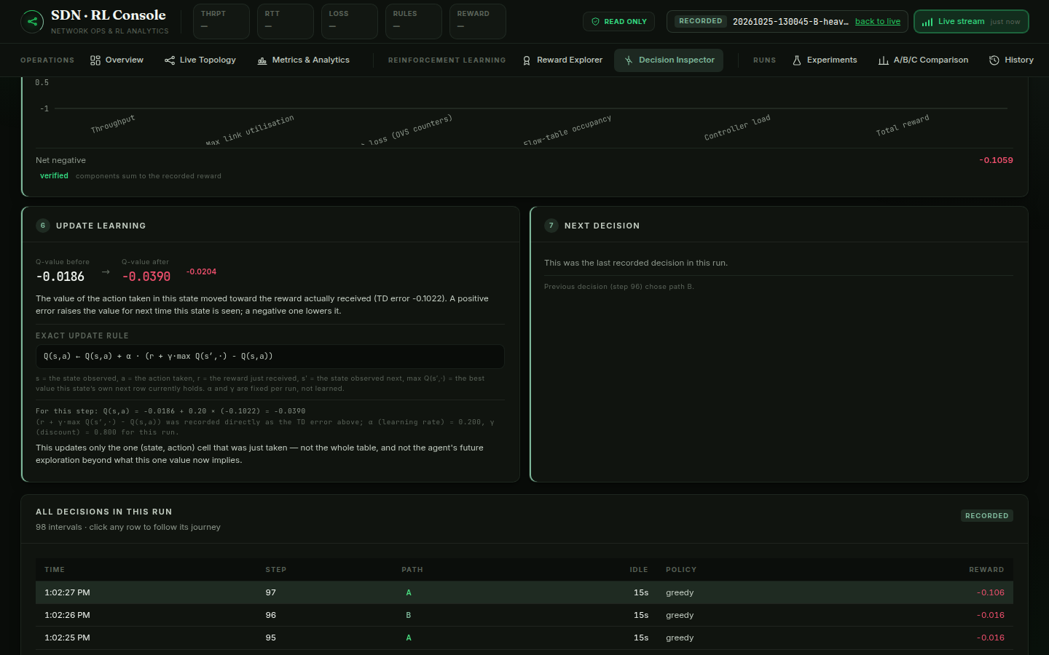
DASHBOARD — DECISION INSPECTOR
Observe → Choose → Apply → Measure → Reward → Learn
Every decision is traced through its full life cycle using only recorded data: what the agent observed, the Q-values behind its choice, whether the switches actually confirmed the routing change (checked against flow-table dumps, never controller logs), the measured outcome, the exact reward computation, and the precise Q-learning update.
RL-Based SDN Traffic Routing and Flow-Table Optimization
12

Slide 13
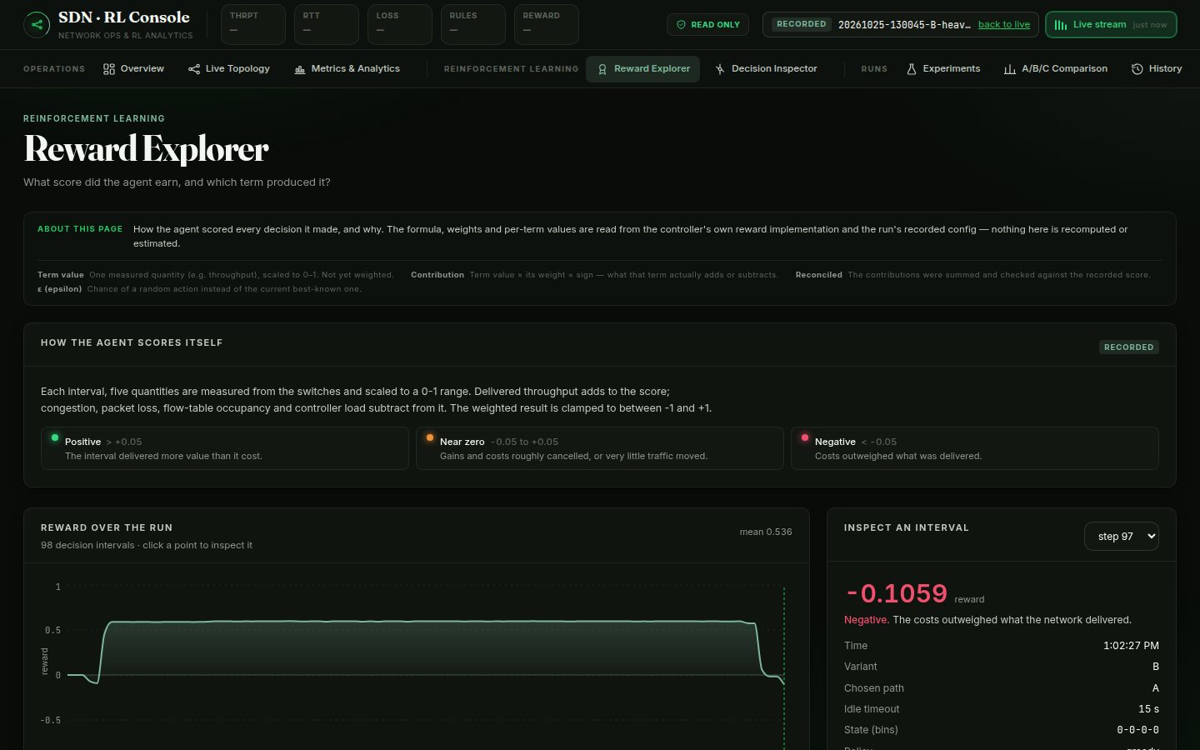
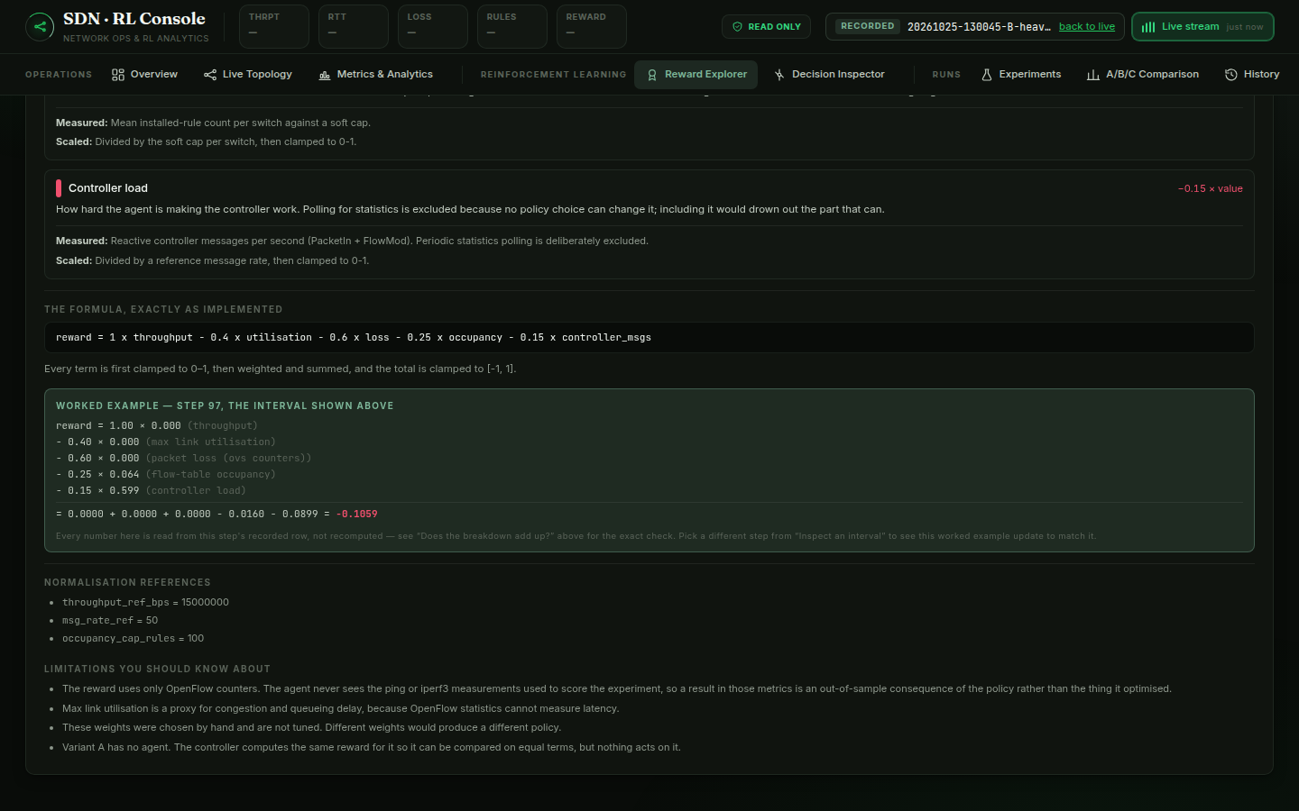
DASHBOARD — REWARD EXPLORER
What score did the agent earn, and which term produced it?
The formula, weights and per-term values are read from the controller's own reward implementation and the run's recorded config — nothing here is recomputed or estimated. A worked example substitutes the actually-recorded numbers for the selected step directly into the formula.
RL-Based SDN Traffic Routing and Flow-Table Optimization
13

Slide 14
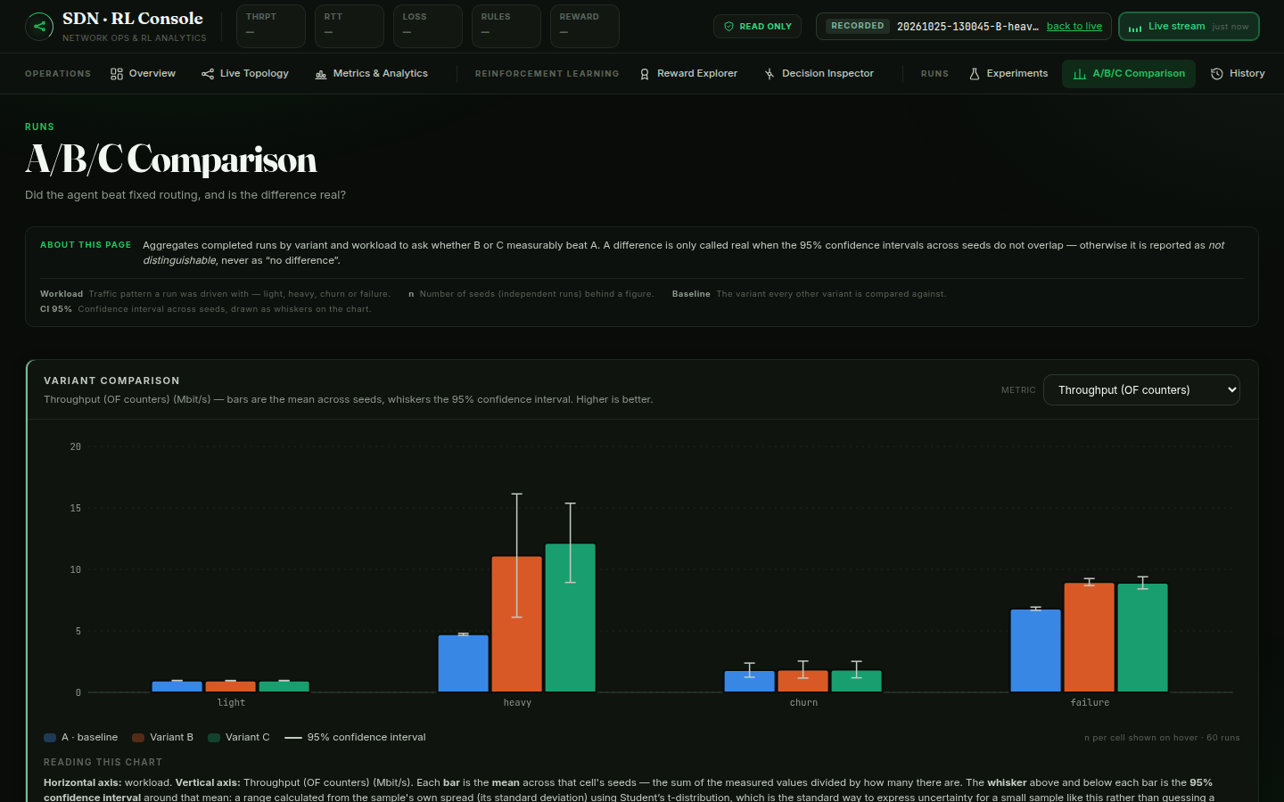
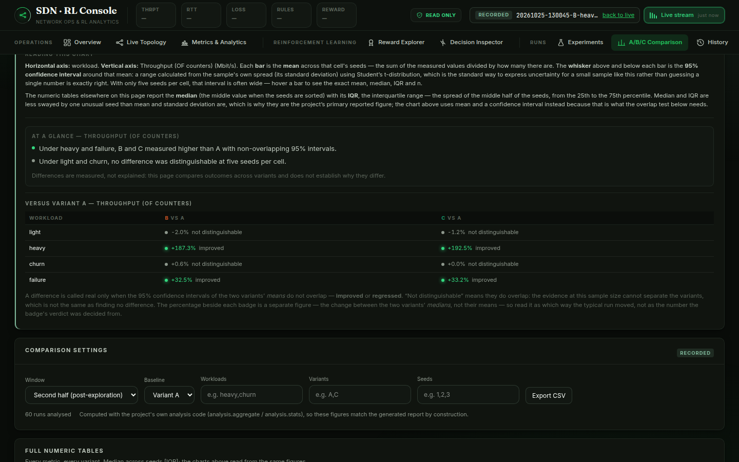
DASHBOARD — A/B/C COMPARISON
Did the agent beat fixed routing — and is it real?
A difference is only called real when the 95% confidence intervals across seeds do not overlap — otherwise it is reported as “not distinguishable,” never as “no difference.” Figures are computed with the project's own analysis code, so dashboard numbers match the generated report by construction.
RL-Based SDN Traffic Routing and Flow-Table Optimization
14

Slide 15
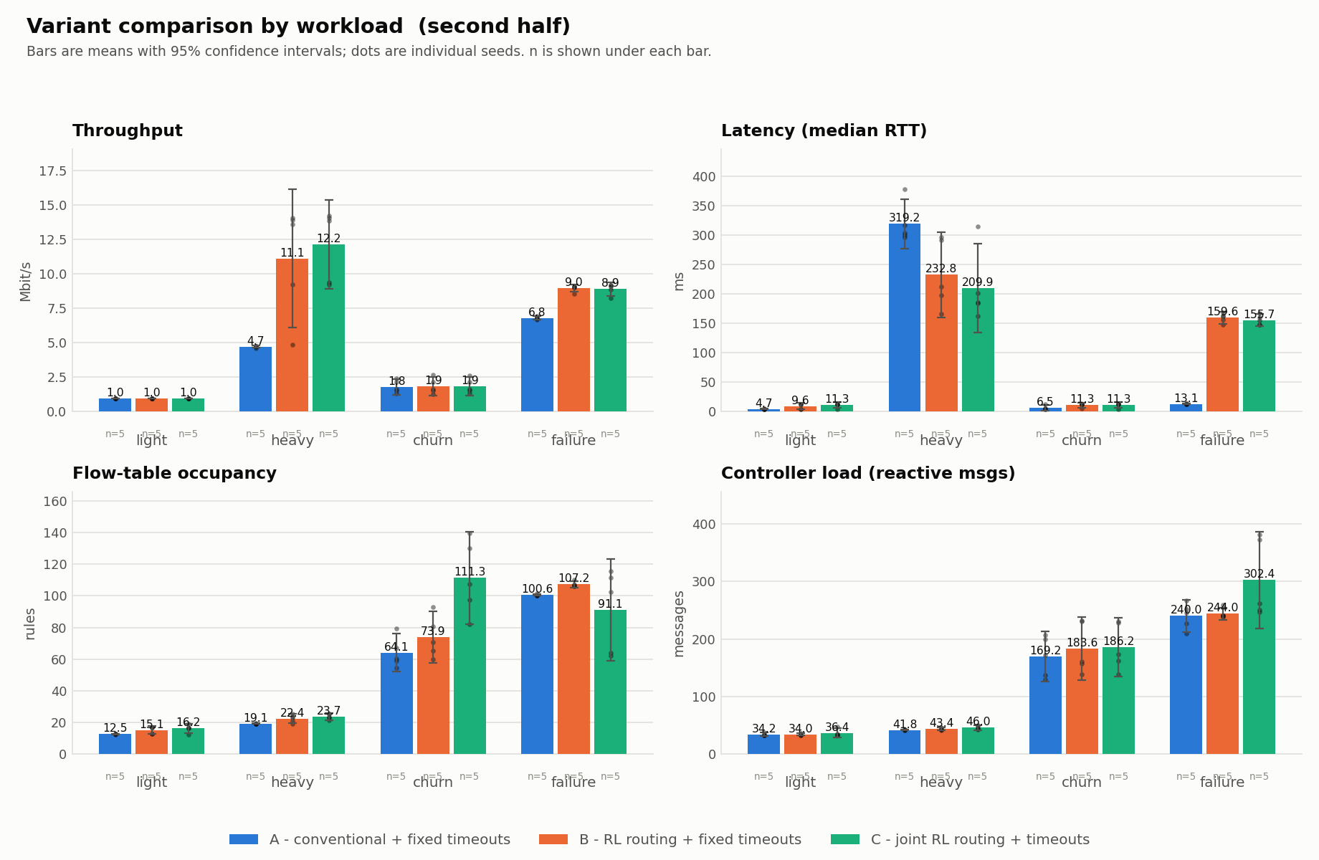
EXPERIMENTAL RESULTS
Variant comparison across all four workloads
60-run primary matrix · 3 variants × 4 workloads × 5 seeds · second-half window (closest approximation to the converged policy)
RL-Based SDN Traffic Routing and Flow-Table Optimization
15
Source: analysis/out/fig_comparison_second_half.png — generated by analysis/plots.py directly from results/runs/, never hand-edited.

Slide 16
EXPERIMENTAL RESULTS
Where the 95% intervals say the difference is real
+187–193%
+32–33%
throughput under heavy
throughput under failure
B and C vs A — intervals do not overlap
B and C vs A — intervals do not overlap
not distinguishable
+22% to +78%
throughput under light & churn
flow-table occupancy, heavy & churn
at n=5 seeds — reported honestly, not hidden
Variant C vs A — intervals do not overlap; a real cost
Figures verified against analysis/out/REPORT.md §6, generated from results/runs/ by analysis/report.py — no number entered by hand.
RL-Based SDN Traffic Routing and Flow-Table Optimization
16

Slide 17
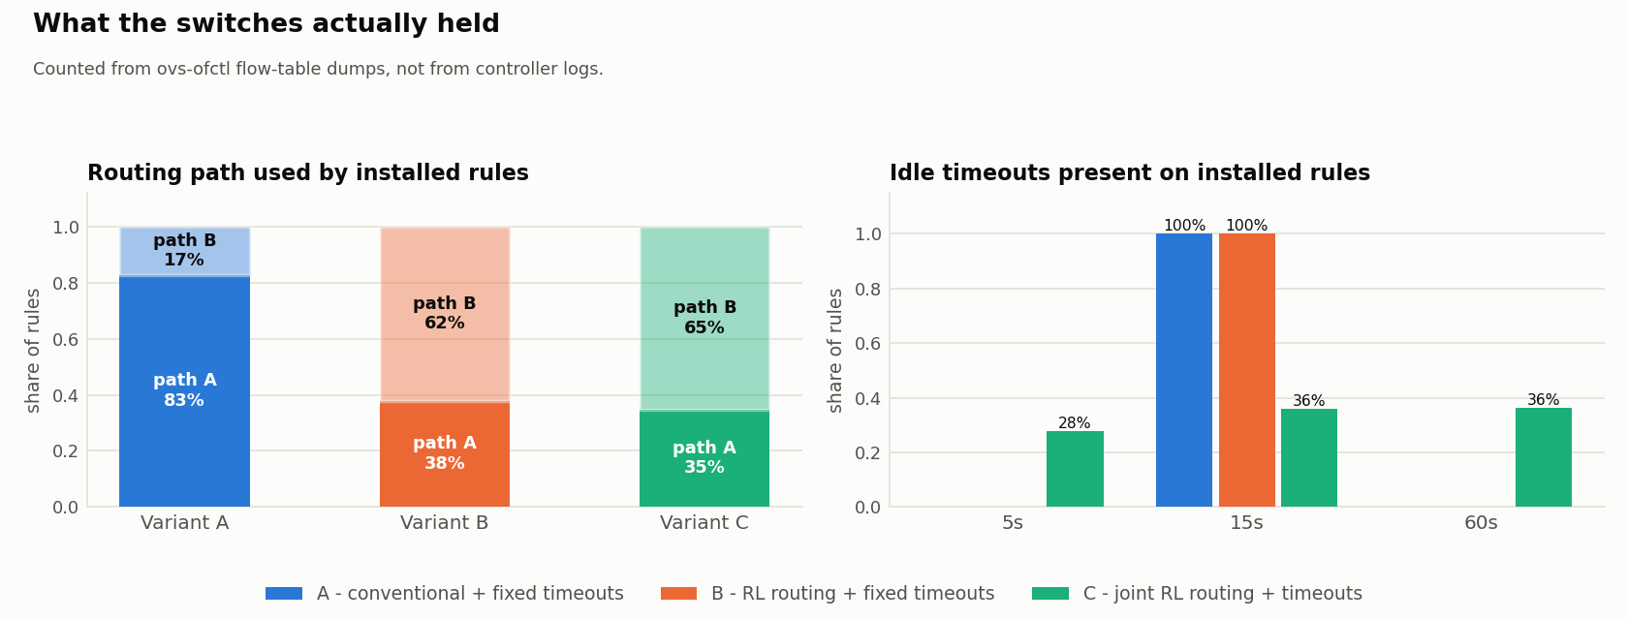
RIGOR CHECKS
Did the switches actually do it — and did learning matter?
Control experiment: does the learned Q-table matter?
trained Normal Q-learning agent
frozen All-zero Q-table, no exploration — collapses to one action
Checked against ovs-ofctl flow-table dumps, never controller logs — 97–99% of installed rules agree with the decision in force when they were written.
shuffled Learns normally, but action indices map to different dataplane effects
Frozen collapses to one action and scores far below trained. But shuffled scores close to trained, so most of the benefit likely comes from distributing traffic across paths/timeouts at all, not from having learned which action is best in which state. (n=3 seeds — a direction, not a significance claim.)
RL-Based SDN Traffic Routing and Flow-Table Optimization
17

Slide 18
LIMITATIONS
Stated plainly, not discovered after the results were in
WSL2 is emulation, not a testbed. Shared, non-real-time scheduling adds latency/jitter noise; relative A/B/C comparison stays valid.
Short runs, few seeds. ~90 decision steps from a cold start, 5 seeds/cell — wide confidence intervals.
Sparse state coverage. A handful of the 144 states are visited per run — most gain reflects behaviour during learning, not a converged policy.
Small, fixed topology. 5 switches, one path pair — generalisation is not established by this project.
Reward weights are hand-chosen, untuned. Different weights would produce a different policy.
Full detail: docs/LIMITATIONS.md and docs/ASSUMPTIONS.md (12 stated assumptions, 8 limitation categories).
RL-Based SDN Traffic Routing and Flow-Table Optimization
18

Slide 19
CONCLUSION & FUTURE WORK
What this project establishes — and what's next
Conclusions
Future Work
RL routing (B, C) measurably beats conventional shortest-path under heavy and failure workloads.
Joint flow-timeout control (C) does not clearly beat routing-only control (B) at this seed/step budget.
Every claimed behaviour is checked against switch-side flow-table evidence, not controller logs.
A frozen-agent control confirms the gain is not an artefact of the RL machinery itself.
Longer runs / more seeds for full state coverage and a real train-then-freeze evaluation.
Function approximation (e.g. DQN) to scale beyond the 144-state tabular representation.
Larger, more realistic topologies with more than two candidate paths.
Hardware or dedicated-testbed validation to remove WSL2 scheduling noise.
Automated reward-weight tuning instead of hand-chosen weights.
RL-Based SDN Traffic Routing and Flow-Table Optimization
19

Slide 20
REFERENCES & PROJECT ARTEFACTS
Where every claim in this deck comes from
▸ README.md — architecture, topology, agent design, quick-start commands
▸ dashboard/README.md — dashboard design, live/mock modes, security model
▸ docs/ASSUMPTIONS.md — 12 stated experimental assumptions
▸ docs/LIMITATIONS.md — 8 categories of stated limitations and threats to validity
▸ analysis/out/REPORT.md — full generated results report (60-run primary matrix)
▸ analysis/out/fig_*.png — figures generated by analysis/plots.py, used unmodified in this deck
▸ results/runs/<run>/ — raw per-run measurement files (append-only, never hand-edited)
Regenerate the report at any time: python3 -m analysis.aggregate && python3 -m analysis.verify_behaviour && python3 -m analysis.plots && python3 -m analysis.report
RL-Based SDN Traffic Routing and Flow-Table Optimization
20

