Slide 1

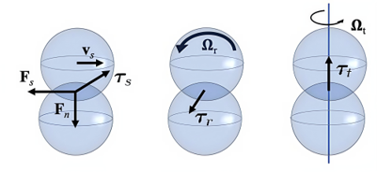
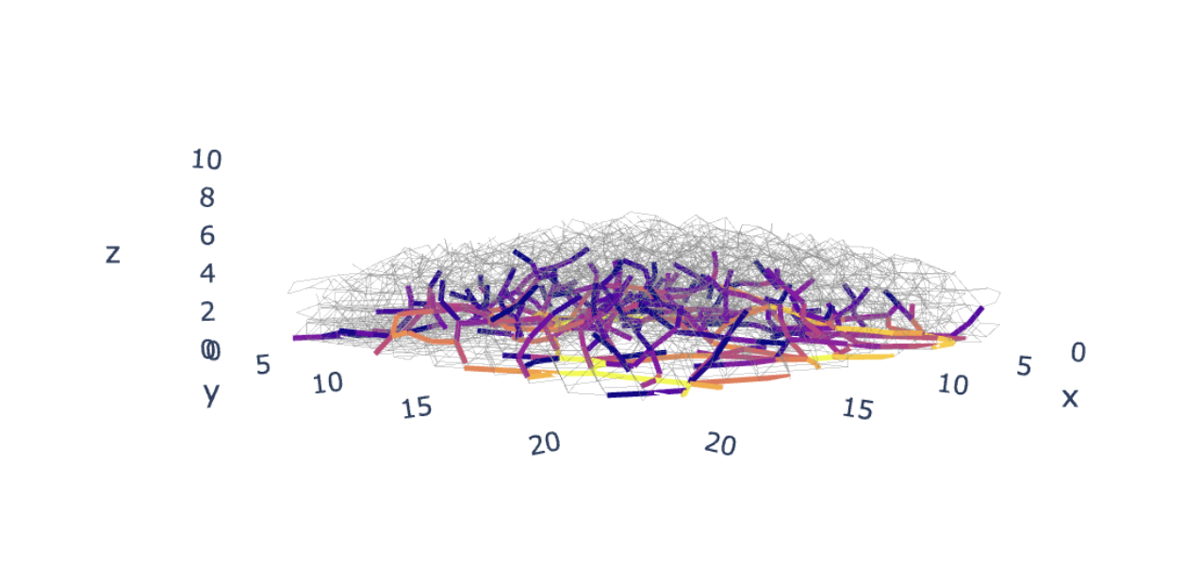
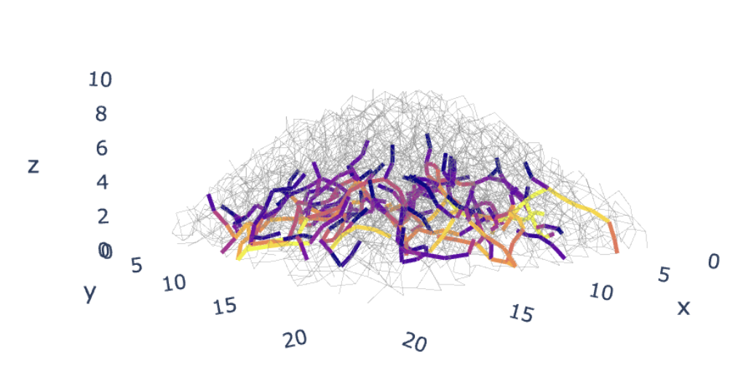
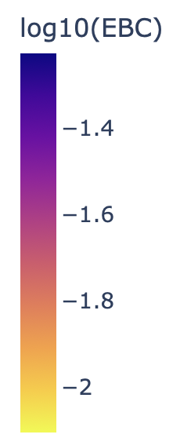
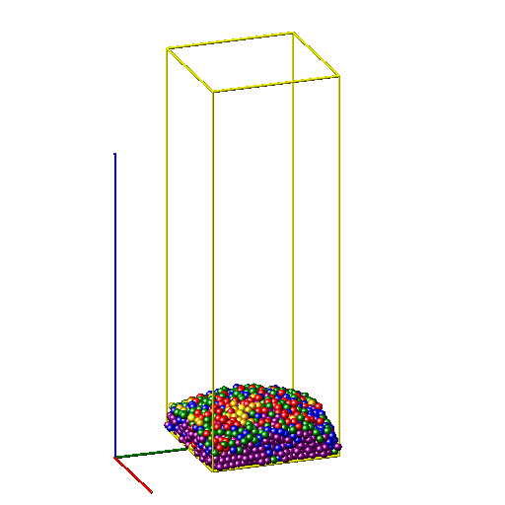
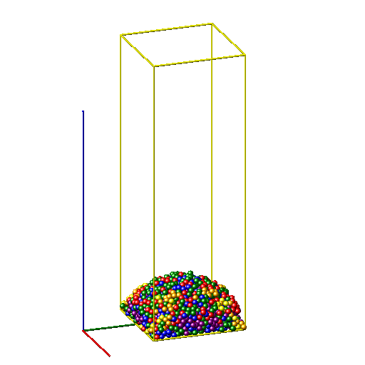
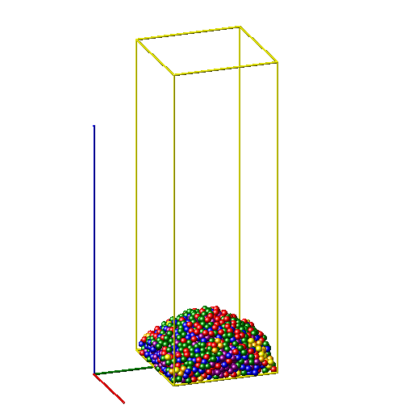
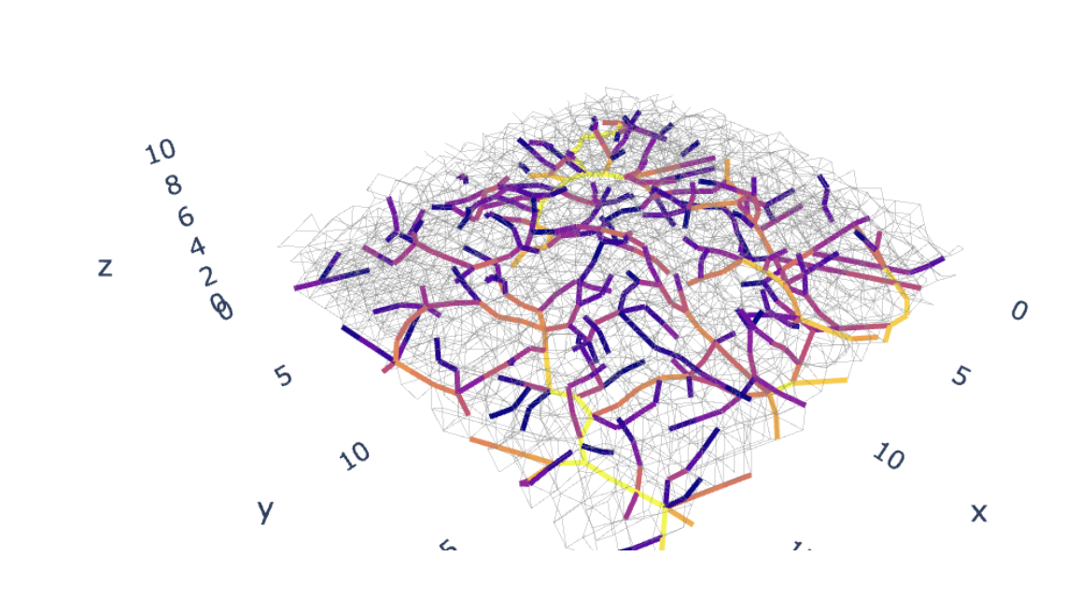
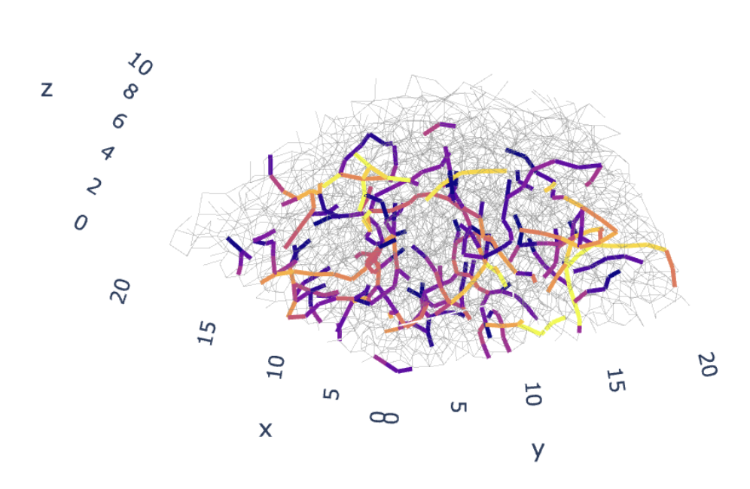
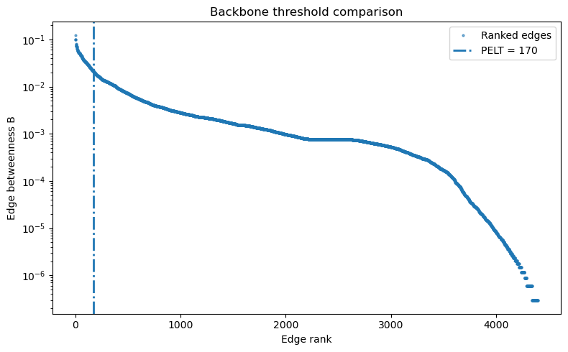


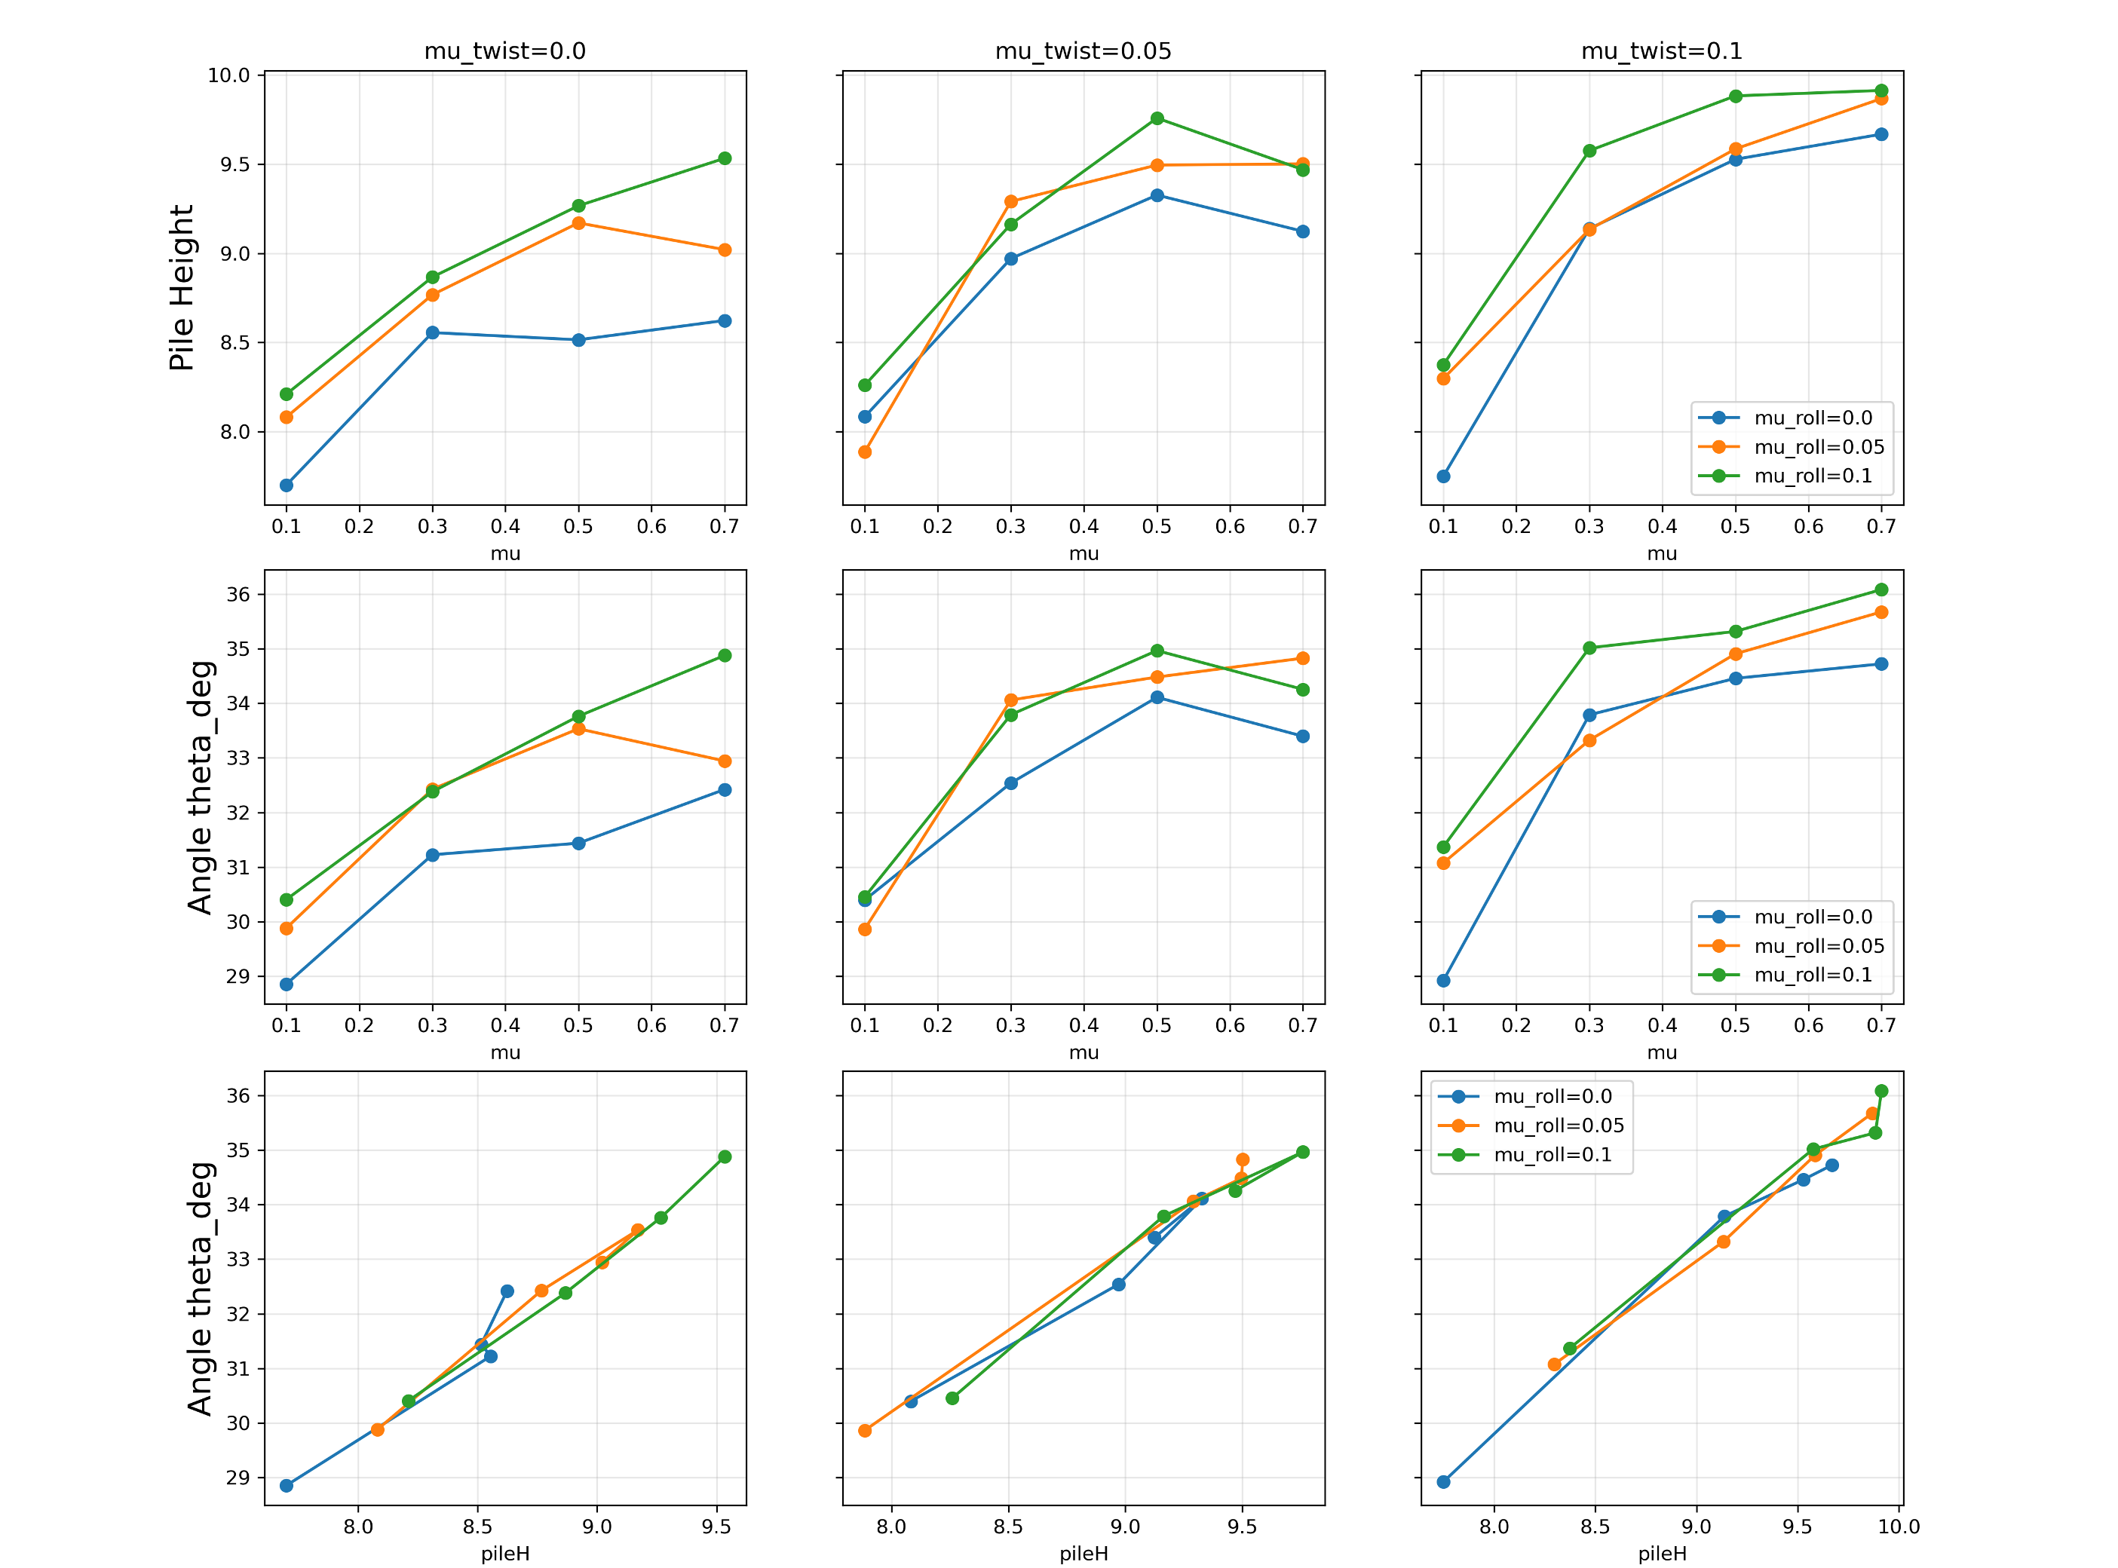


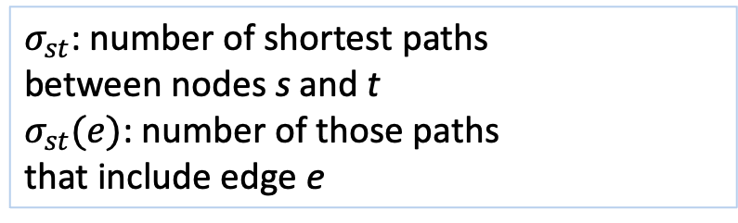
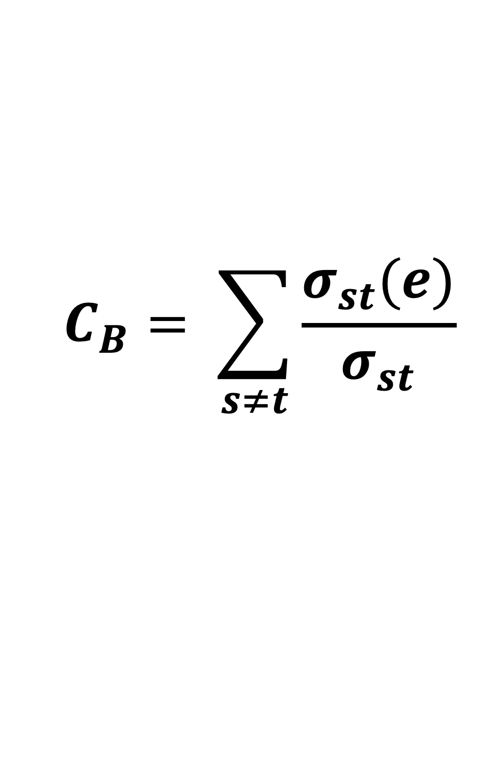
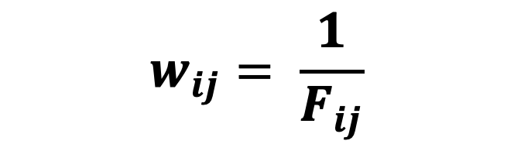
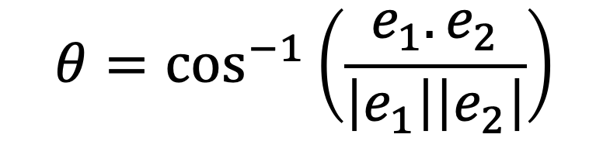
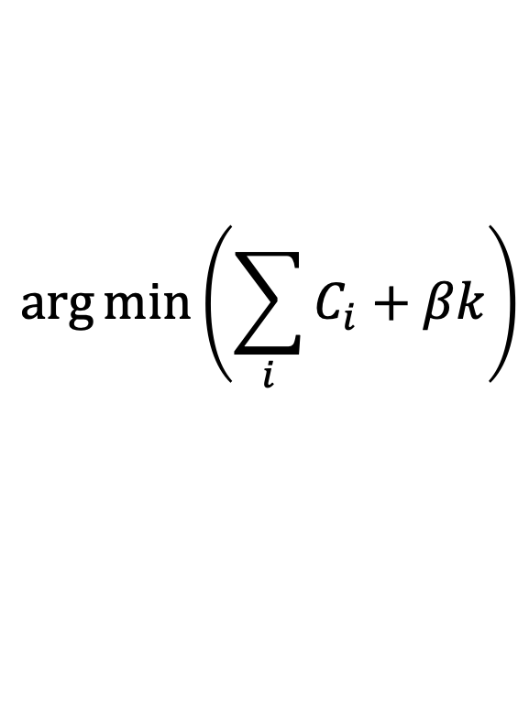
Saved: edges_with_neff_knee_pelt_labels.csv knee_backbone_edges_only.csv pelt_backbone_edges_only.csv Saved figures: threshold_comparison_rank_plot.png threshold_comparison_logB_plot.png knee_detection_diagnostic.png threshold_cumulative_importance.png knee_backbone_force_vs_B.png
How Friction Shapes Force Chains in Granular Piles:
A Network Approach
Tatiana Flanagan & Leonardo Silbert
Central New Mexico Community College School of Math, Science, and Engineering
Background
Methods
Methods
Force-Chain Geometry and Distribution
Granular packings of grains represent a class of complex systems as the self-organization between the constituent particles develops to maintain pile stability. How the grains organize within the pile depends on many factors, such as particle shape, particle softness, and particle smoothness.
Here, we focus on the role of particle friction for hard spherical beads poured under gravity using DEM computer simulations.
We investigate how sliding, rolling, and twisting friction reorganize the force-chain backbone that supports granular piles.
We combine weighted edge betweenness centrality, change-point
detection, and geometric chain extraction to identify force-bearing
structures in granular piles.
Friction broadens the force-chain network while preserving
apex anchoring.
Larger friction coefficients generate larger local bend angles in force chains, more tortuous chains.
Larger friction coefficients push force chains up and towards the edges of the pile at the bottom and middle (r_{anchor}, r_{mid}) of the chains. Chains remain anchored at the top (r_{tip}).
Chain count decreases, suggesting more connectivity.
1
INVERSE-FORCE WEIGHTED CONTACT NETWORK
Granular contacts represented as an undirected graph G=(V,E).
w_{ij}
i
Edge weight:
$$w_{ij}= \frac{1}{F_{ij}}$$
j
Metric | Low Friction | High Friction | Change
Chain count | 154 | 66 | ↓57%
Chain height (z) | 1.62 | 1.79 | ↑10%
Bend angle | 20° | 29° | ↑45%
Anchor radius (r_{anchor}/R) | 0.55 | 0.61 | ↑10%
Midpoint radius (r_{mid}/R) | 0.57 | 0.65 | ↑14%
Tip radius (r_{tipr}/R) | 0.54 | 0.54 | no change
LAMMPS Simulation
Strong contacts correspond to low-cost paths and therefore dominate shortest-path transport.
Friction modes. We simulated granular packings with friction across a variation of coefficients that include LAMMPS extended friction modes: rolling and twisting..
2
IDENTIFICATION OF CRITICAL EDGES USING EDGE BETWEENNES CENTRALITY (EBC)
EBC (Brandes, 2001) quantifies how often a contact lies on force-preferred pathways through the contact network.
High-EBC contacts
-carry many force-preferred routes
-connect distant regions
-critical for stress transmission
-system-wide
$$C_{B}= \sum_{s≠t}{\frac{σ_{st}(e)}{σ_{st}}}$$
Figure 1. Friction Modes (Santos et al., 2021). Sliding, rolling, and twisting (left to right)
$σ_{st}$: number of shortest paths
between nodes s and t
$σ_{st}(e)$: number of those paths
that include edge e
3
IDENTIFICATION OF HIGH IMPORTANCE FORCE CHAINS USING CHANGE POINT DETECTION
μ=0.1, μ_{roll}=0.0, μ_{twist}=0.0
μ=0.7, μ_{roll}=0.1, μ_{twist}=0.5
μ=0.7, μ_{roll}=0.1, μ_{twist}=0.1
PELT (Killick et al., 2012) identifies statistically significant changes in the ranked EBC distribution.
The first major change point separates highly important transport edges from the background contact network.
Figure 2. Sample images of settled piles. Poured hard particles (D=1.00mm) settle into a stable pile under gravity and different friction coefficients. Low friction, medium friction, high friction -piles. Darker colors represent larger force magnitude.
Threshold using PELT.
μ=0.1, μ_{roll}=0.0, μ_{twist}=0.0
μ=0.7, μ_{roll}=0.1, μ_{twist}=0.1
$$\arg{\min\left(\sum_{i}{C_{i}+βk}\right)}$$
Scan for interactive 3D
Scan for interactive 3D
4
C_{i} : fitting error of segment
k: number of change points
β: penalty for over segmentation
Figure 5. Different perspectives of extracted force chains colored by log10(EBC) against a full set of background force chains. Stronger EBC is darker in color, background chains (smaller EBC) in gray.
PILE MORPHOLOGY
FORCE-CHAIN STRUCTURAL CHARACTERIZATION
Quasi-linear force chains extracted using local bend-angle criterion (consistent with force-chain alignment criteria in Peters et al., 2005; Tordesillas et al., 2010).
Edges connected if θ ≤ 45°. Θ: deviation from straight path.
e₂
Conclusions
θ
e₁
Friction reorganizes the force-chain backbone.
Increased friction produces a more anisotropic and spatially distributed force-chain architecture.
Higher friction produces:
taller, steeper piles
fewer but more connected force chains
larger bend angles
outward migration of load-bearing pathways
Force transmission becomes less centralized and more distributed.
$$θ=\cos^{−1}\left(\frac{e_{1}. e_{2}}{\left|e_{1}\right|\left|e_{2}\right|}\right)$$
TRADITIONAL vs EBC APPROACH
Traditional
Force threshold
Local alignment
This work
Global transport importance (EBC)
Change-point thresholding
Geometric chain extraction
Figure 3. Effect of friction on pile height and angle of repose. Larger friction coefficients correspond to higher, steeper piles.
Acknowledgements
References
Dan Bolintineanu, Joel Clemmer, Gary Grest, Jeremy Lechman, Joe Monti, Scott Roberts
Sandia National Laboratories
Andrew Santos
NASA
Ishan Srivastava
Lawrence Berkeley National Laboratory
Mike Salerno
Johns Hopkins APL
Brandes, Ulrik. "A faster algorithm for betweenness centrality." Journal of mathematical sociology 25.2 (2001): 163-177.
Killick, Rebecca, et al. "Optimal detection of changepoints with a linear computational cost." Journal of the American Statistical Association 107.500 (2012): 1590-1598.
Peters, J. F., et al. "Characterization of force chains in granular material." Physical Review E—Statistical, Nonlinear, and Soft Matter Physics 72.4 (2005): 041307.
Santos, Andrew, et al. "Granular packings with sliding, rolling, and twisting friction." Physical Review E 102.3 (2020): 032903.
Tordesillas, Antoinette, et al. "Force cycles and force chains." Physical Review E—Statistical, Nonlinear, and Soft Matter Physics 81.1 (2010): 011302.
Sandia National Laboratories is a multi-program laboratory managed and operated by Sandia Corporation,
a wholly owned subsidiary of Lockheed Martin Corporation, for the U.S. Department of Energy’s National
Nuclear Security Administration under contract DE-AC04-94AL85000.

