Slide 1

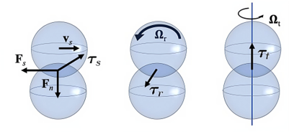
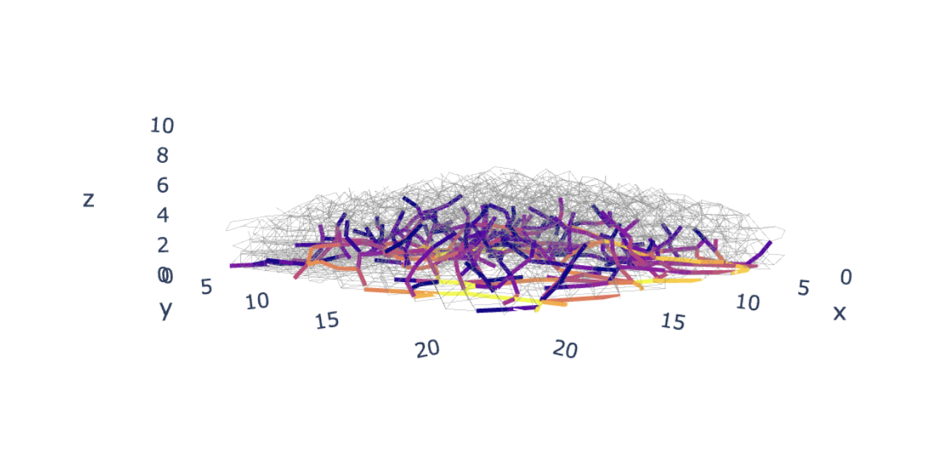
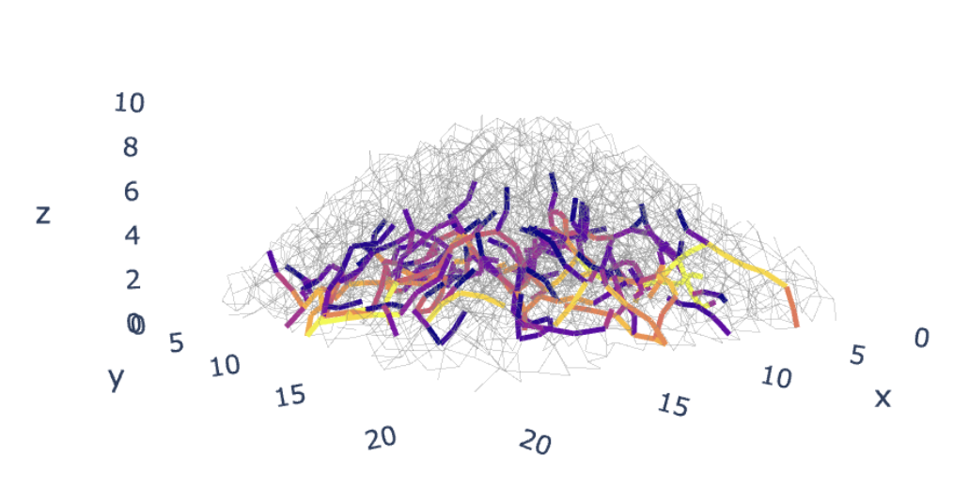
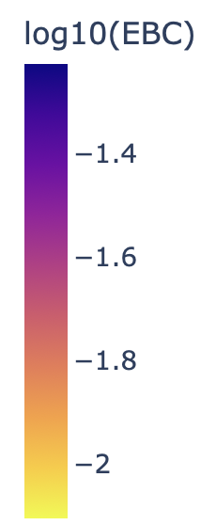
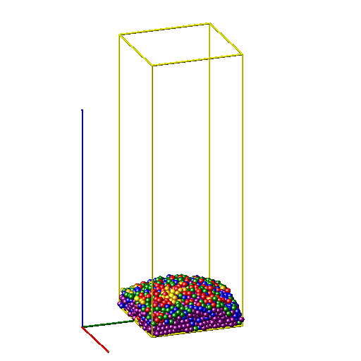
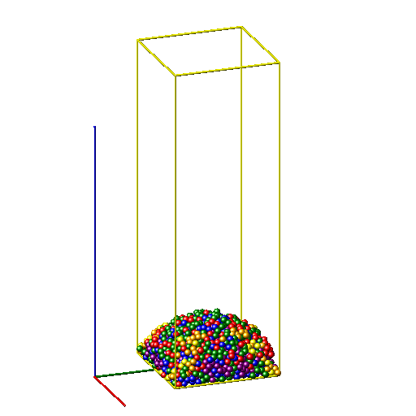
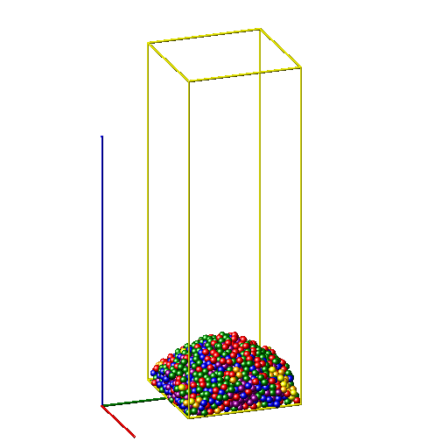
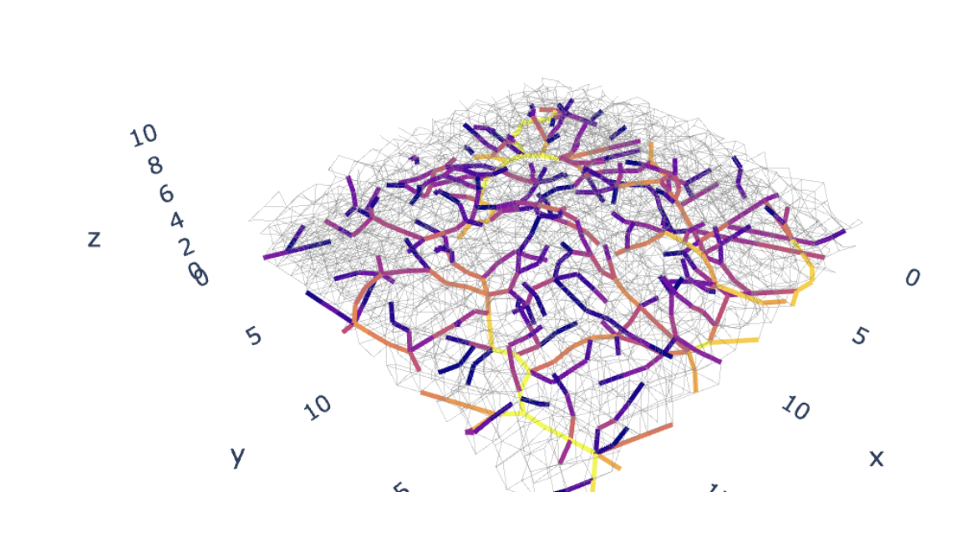
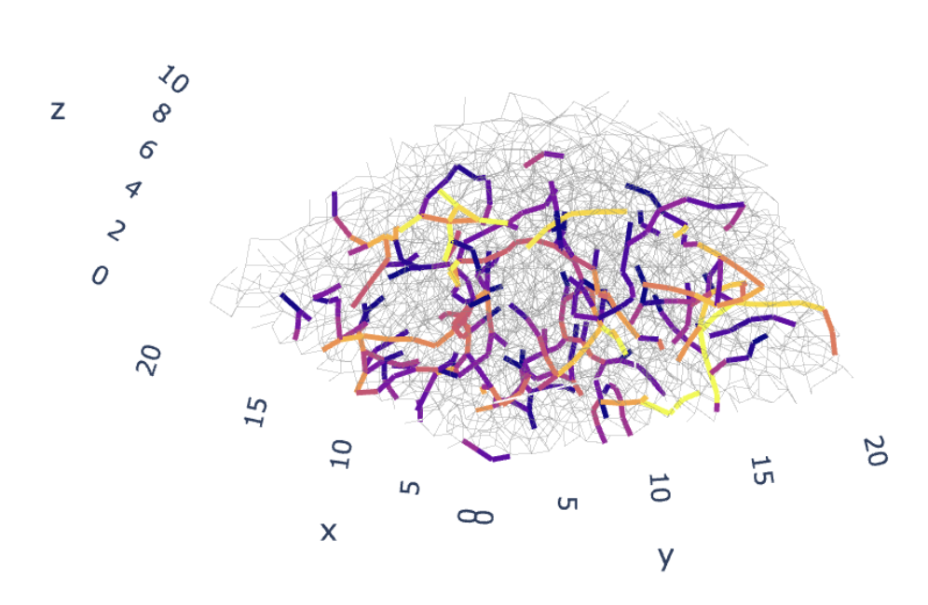
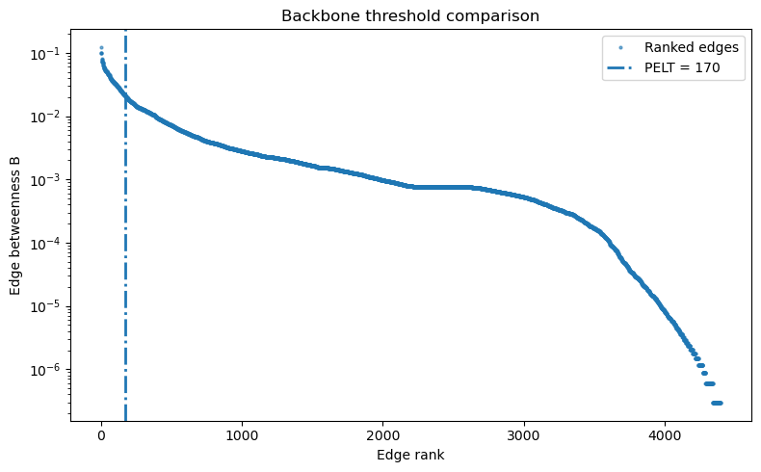


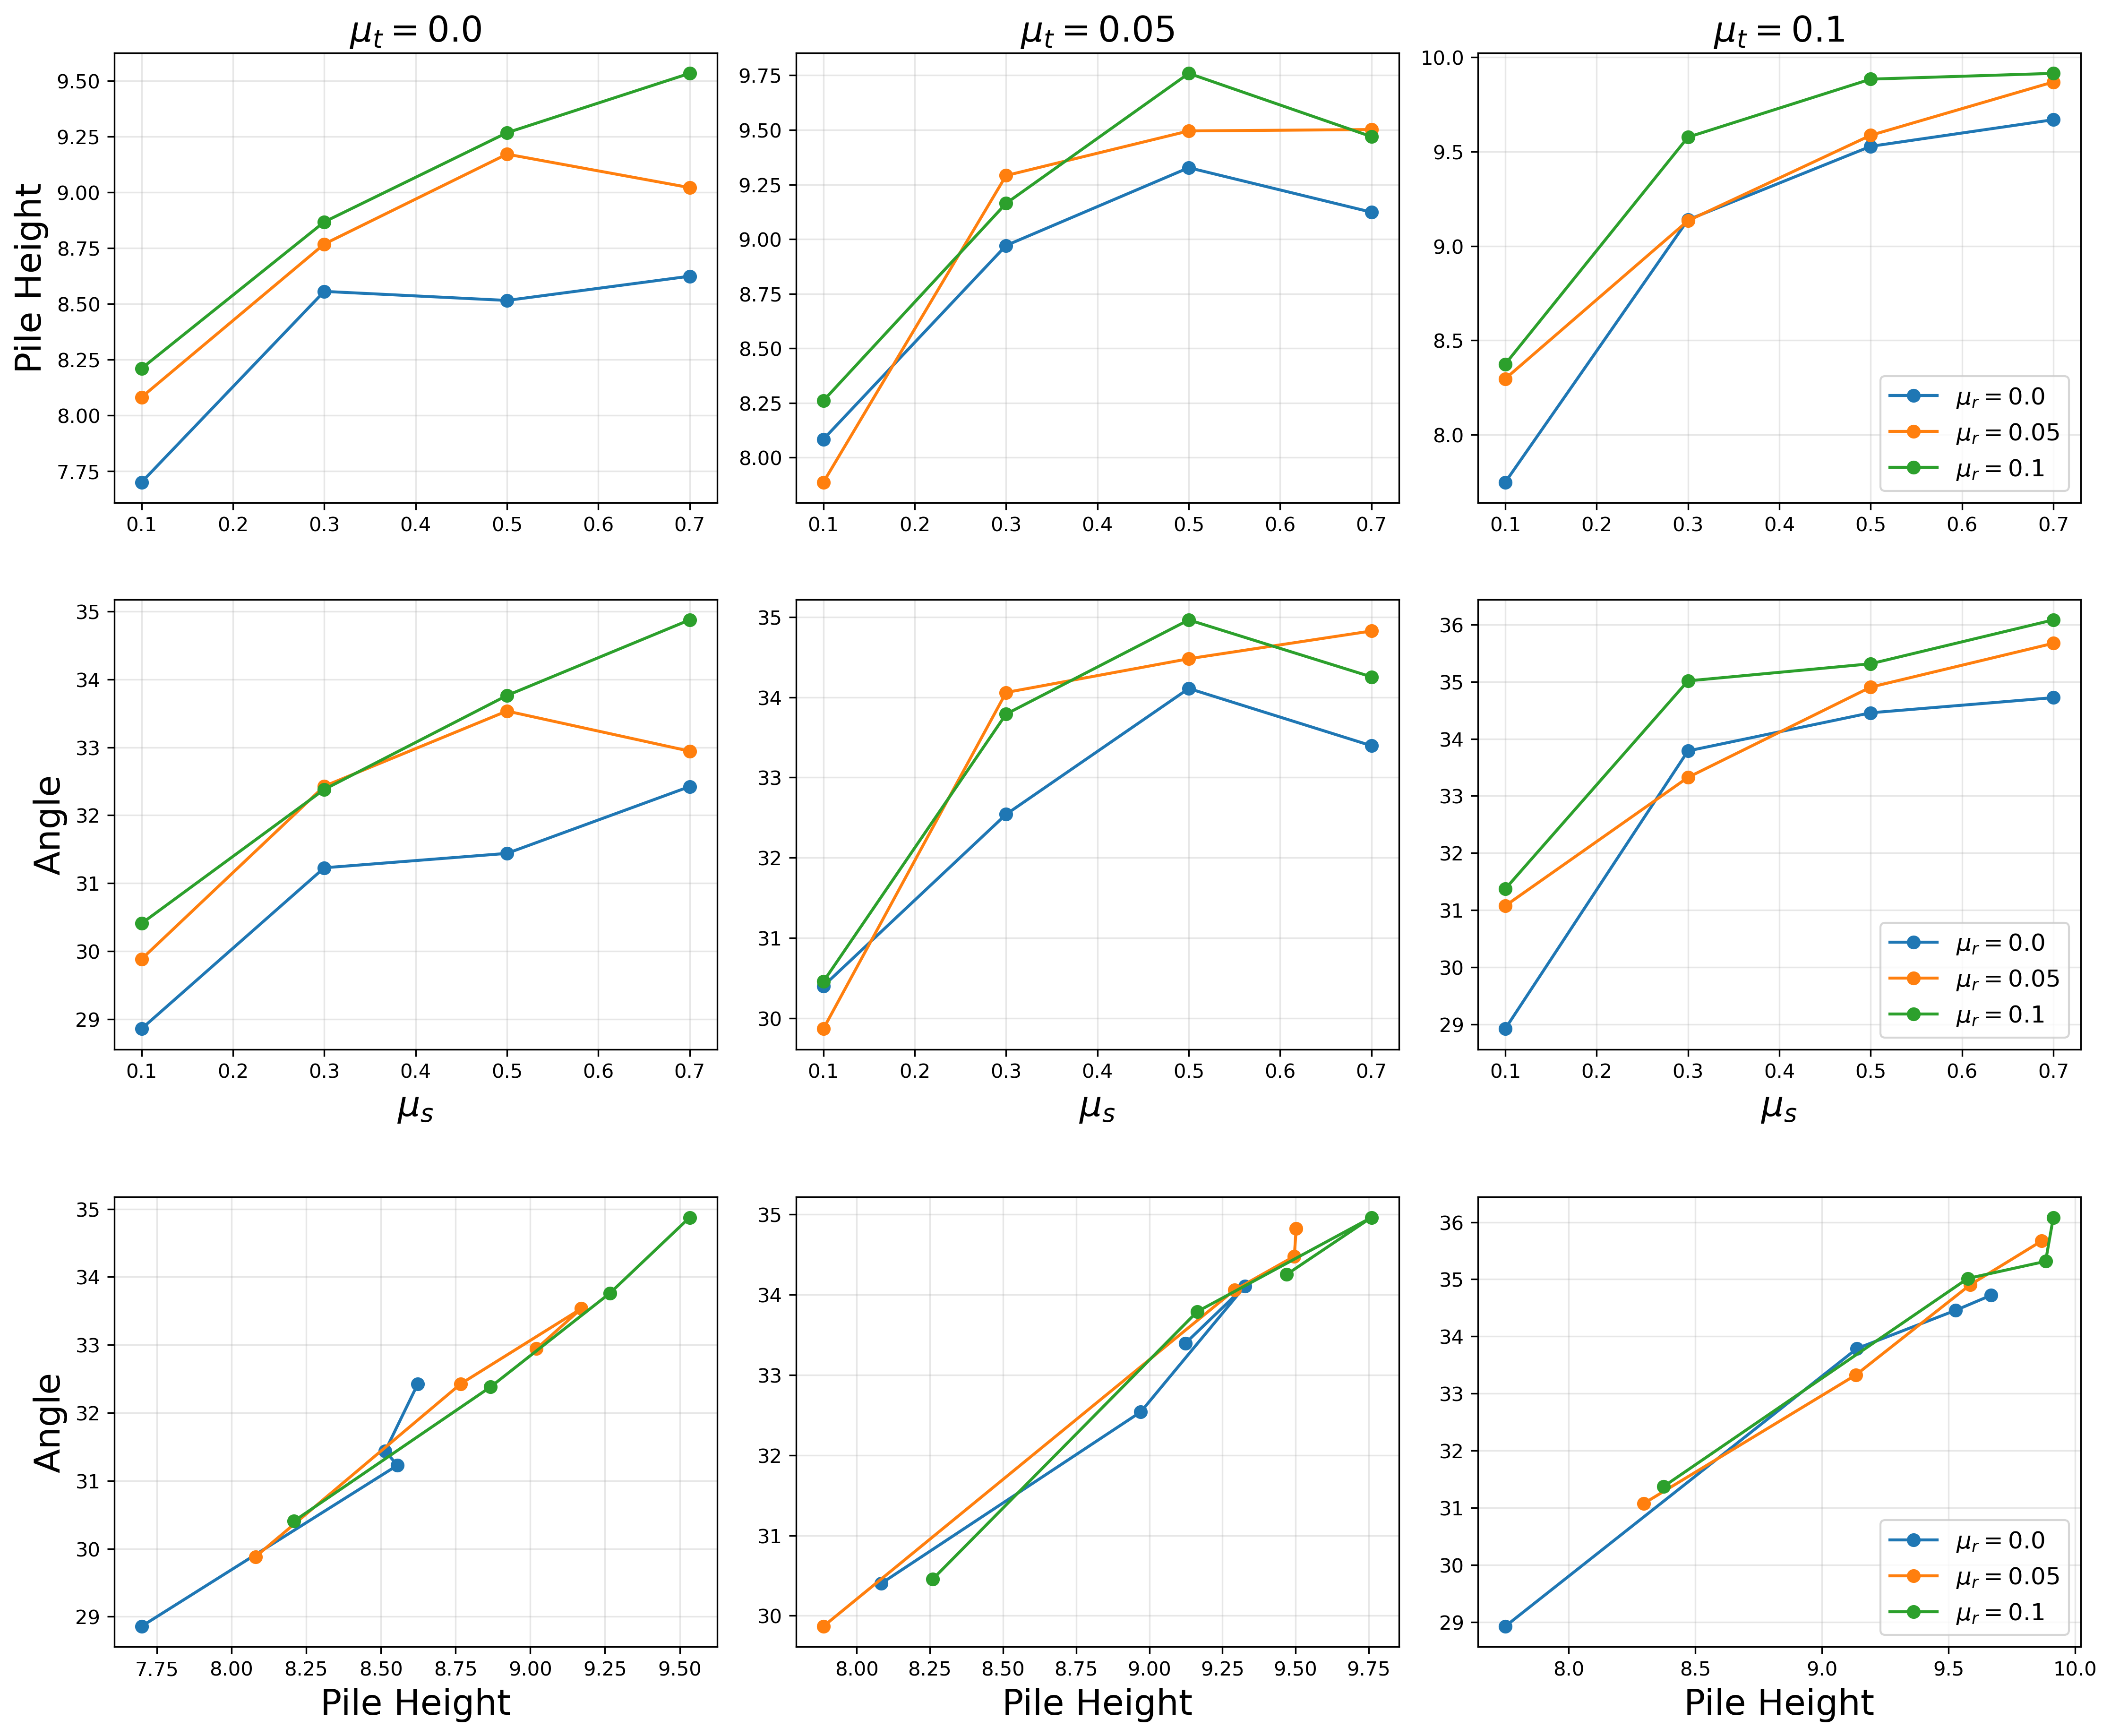


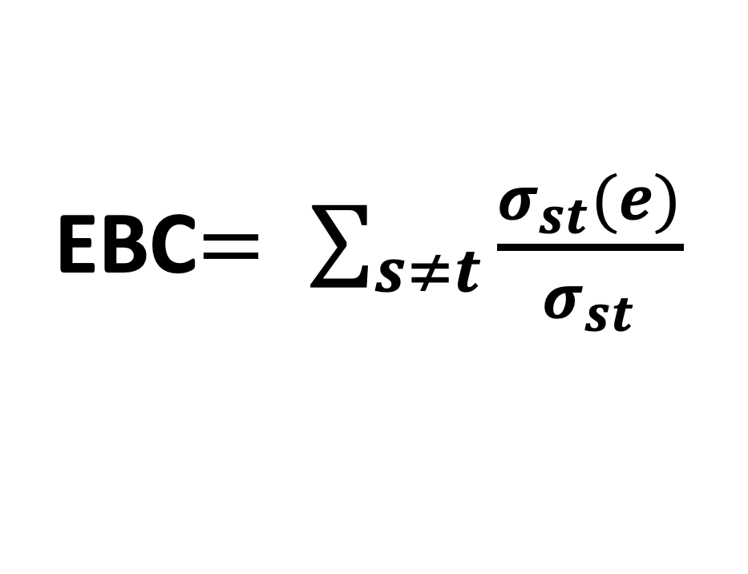
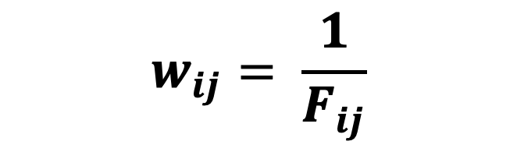
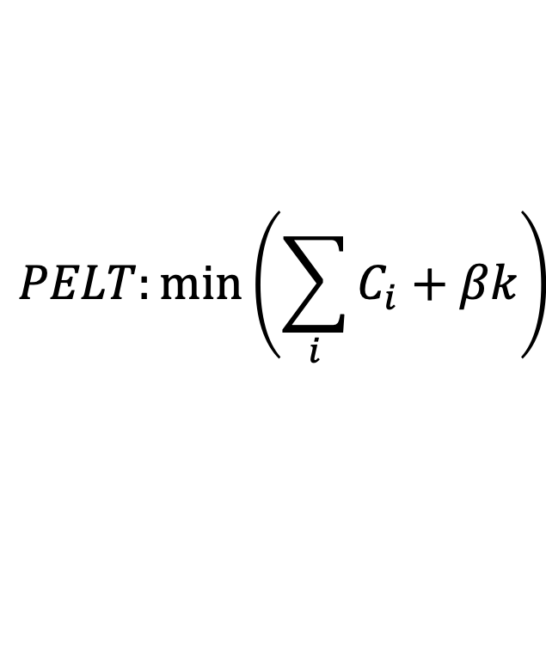
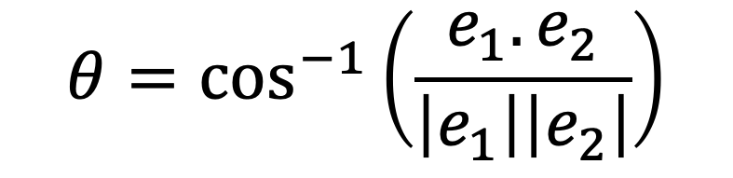
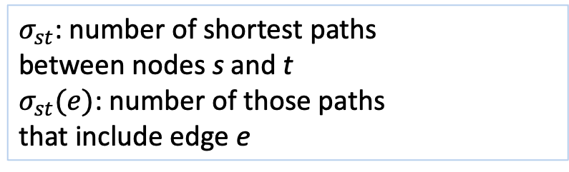
How Friction Shapes Force Chains in Granular Piles:
A Network Approach
Tatiana Flanagan & Leonardo Silbert
School of Math, Science, and Engineering, Central New Mexico Community College
Background
Force-Chain Geometry and Distribution
Methods
Methods
We investigate how sliding, rolling, and twisting friction reorganize the force-chain backbone that supports granular piles.
Granular packings of grains represent a class of complex systems as the self-organization between the constituent particle develops to maintain pile stability. How the grains organize within the pile depends on many factors, such as particle shape, particle softness, and particle smoothness.
Here, we focus on the role of particle friction for hard spherical beads poured under gravity using DEM computer simulations.
Friction broadens the force-chain network while preserving
chain tip anchoring and organizing into fewer structures.
Chain count decreases
Force chains move up, and towards the edges of the pile at the bottom (r_{anchor},) and middle points (r_{mid}) of the chains.
Chains remain anchored at the top (r_{tip}).
Larger local bend angles in force chains form curlier chains.
We combine weighted edge betweenness centrality, change-point
detection, and geometric chain extraction to identify force-bearing structures in granular piles.
1
INVERSE-FORCE WEIGHTED CONTACT NETWORK
Granular contacts represented as an undirected graph G=(i,w_{ij}).
G
w_{ij}
i
Edge weight:
$$w_{ij}= \frac{1}{F_{ij}}$$
j
Metric | Low Friction | High Friction | Change
Chain count | 154 | 66 | ↓57%
Chain height (z) | 1.62 | 1.79 | ↑10%
Bend angle | 20° | 29° | ↑45%
Anchor radius (r_{anchor}/R) | 0.55 | 0.61 | ↑10%
Midpoint radius (r_{mid}/R) | 0.57 | 0.65 | ↑14%
Tip radius (r_{tip}/R) | 0.54 | 0.54 | no change
Strong contacts correspond to low-cost
shortest paths -> this allows definition of EBC:
LAMMPS Simulation
2
IDENTIFICATION OF CRITICAL EDGES USING EDGE BETWEENNESS CENTRALITY (EBC)
Friction modes. We simulated granular packings with friction across a variation of coefficients that include LAMMPS extended friction modes: sliding, rolling and twisting.
EBC (Brandes, 2001) quantifies how often a contact/edge lies on “shortest paths” accross the contact network (importance), through a global network analysis.
High-EBC contacts
-identify structurally important
paths
-cannot easily be removed
-connect distant regions
-critical for defining force texture
EBC$= \sum_{s≠t}{\frac{σ_{st}(e)}{σ_{st}}}$
Figure 1. Friction Modes (Santos et al., 2021). Sliding, rolling, and twisting (left to right).
$σ_{st}$: number of shortest paths
between nodes s and t
$σ_{st}(e)$: number of those paths
that include edge e
3
IDENTIFICATION OF HIGH IMPORTANCE FORCE CHAINS USING CHANGE POINT DETECTION
μ_{s}=0.1, μ_{r}=0.0, μ_{twist}=0.0
μ_{s}=0.7, μ_{r}=0.1, μ_{t}=0.5
μ_{s}=0.7, μ_{r}=0.1, μ_{t}=0.1
PELT (Killick et al., 2012) identifies statistically significant changes in the ranked EBC distribution.
The first major change point separates highly important transport edges from the background contact network.
Figure 2. Images of settled piles. Poured hard particles settled into a stable pile under gravity and different friction coefficients. Low friction, medium friction, high friction -piles. Friction coefficients: μ_{s}=sliding, μ_{r}=rolling, μ_{t}=twisting.
Bluer colors represent larger coordination. Simulation box is 20x20 particle diameters with pbc.
μ_{s}=0.1, μ_{r}=0.0, μ_{t}=0.0
μ_{s}=0.7, μ_{r}=0.1, μ_{t}=0.1
$$PELT:{\min\left(\sum_{i}{C_{i}+βk}\right)}$$
Scan for interactive 3D
Scan for interactive 3D
C_{i} : fitting error of segment
k: number of change points
β: penalty for over segmentation
Pile Morphology
Figure 5. Different perspectives of extracted force chains colored by log10(EBC) against a full set of background force chains. Stronger EBC is bluer in color, background network in gray. Friction coefficients: μ_{s}=sliding, μ_{r}=rolling, μ_{t}=twisting.
4
FORCE-CHAIN STRUCTURAL CHARACTERIZATION
Quasi-linear force chains extracted using local bend-angle criterion (consistent with force-chain alignment criteria in Peters et al., 2005; Tordesillas et al., 2010).
Edges connected if θ ≤ 45°. Θ: deviation from straight path.
CONCLUSIONS
e₂
Friction reorganizes force chain texture
Increased friction produces a more anisotropic and spatially distributed force-chain architecture.
taller, steeper piles
fewer force chains
larger bend angles – curlier chains
outward migration of load-bearing pathways
less centralized and more distributed force chains
θ
e₁
$$θ=\cos^{−1}\left(\frac{e_{1}. e_{2}}{\left|e_{1}\right|\left|e_{2}\right|}\right)$$
TRADITIONAL vs EBC APPROACH
Traditional
Local forces
Local force threshold
Local alignment
This work
Global transport importance
Change-point thresholding
Geometric chain extraction
Figure 3. Effect of friction on pile height and angle of repose. Larger friction coefficients correspond to higher, steeper piles. Friction coefficients: μ_{s}=sliding, μ_{r}=rolling, μ_{t}=twisting.
Acknowledgements
References
Dan Bolintineanu, Joel Clemmer, Gary Grest, Jeremy Lechman, Joe Monti
Sandia National Laboratories
Andrew Santos
NASA
Ishan Srivastava
Lawrence Berkeley National Laboratory
Brandes, Ulrik. "A faster algorithm for betweenness centrality." Journal of mathematical sociology 25.2 (2001): 163-177.
Geng, Junfei, et al. "Memory in two-dimensional heap experiments." Physical Review E 64 (2001): 060301(R).
Killick, Rebecca, et al. "Optimal detection of changepoints with a linear computational cost." Journal of the American Statistical Association 107.500 (2012): 1590-1598.
Peters, J. F., et al. "Characterization of force chains in granular material." Physical Review E—Statistical, Nonlinear, and Soft Matter Physics 72.4 (2005): 041307.
Santos, Andrew, et al. "Granular packings with sliding, rolling, and twisting friction." Physical Review E 102.3 (2020): 032903.
Tordesillas, Antoinette, et al. "Force cycles and force chains." Physical Review E—Statistical, Nonlinear, and Soft Matter Physics 81.1 (2010): 011302.
Sandia National Laboratories is a multi-program laboratory managed and operated by Sandia Corporation,
a wholly owned subsidiary of Lockheed Martin Corporation, for the U.S. Department of Energy’s National
Nuclear Security Administration under contract DE-AC04-94AL85000.

