Slide 1
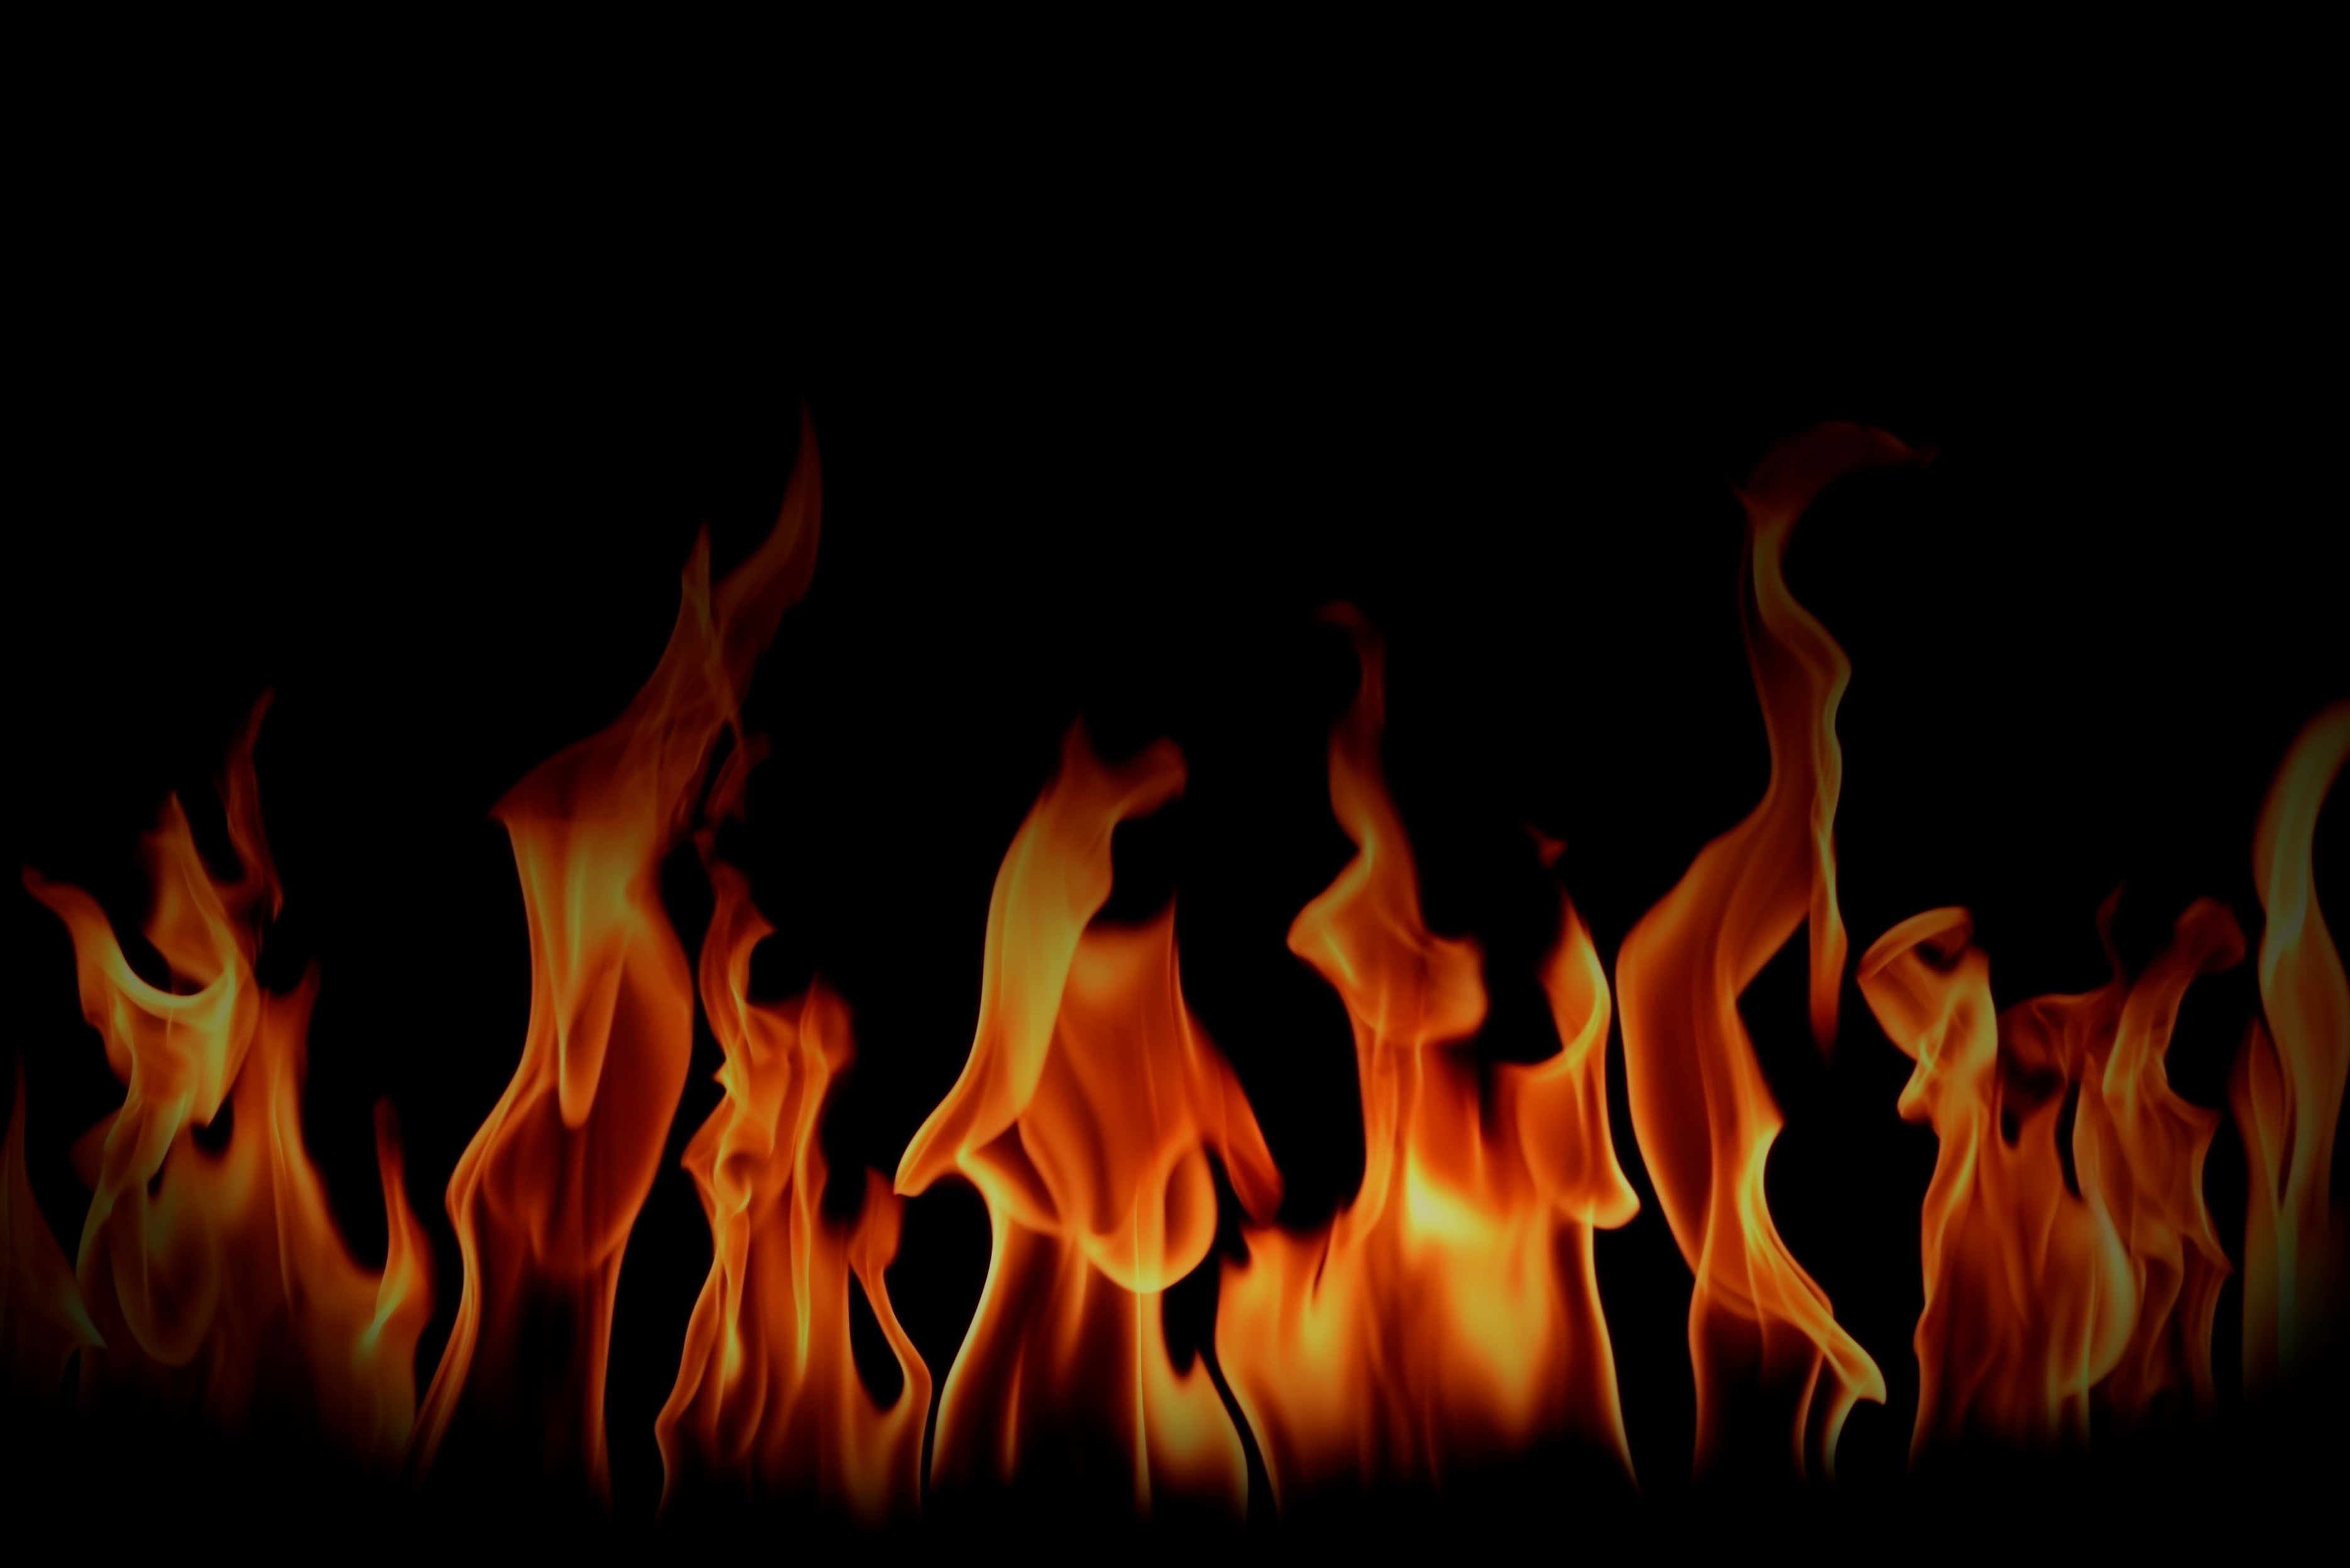
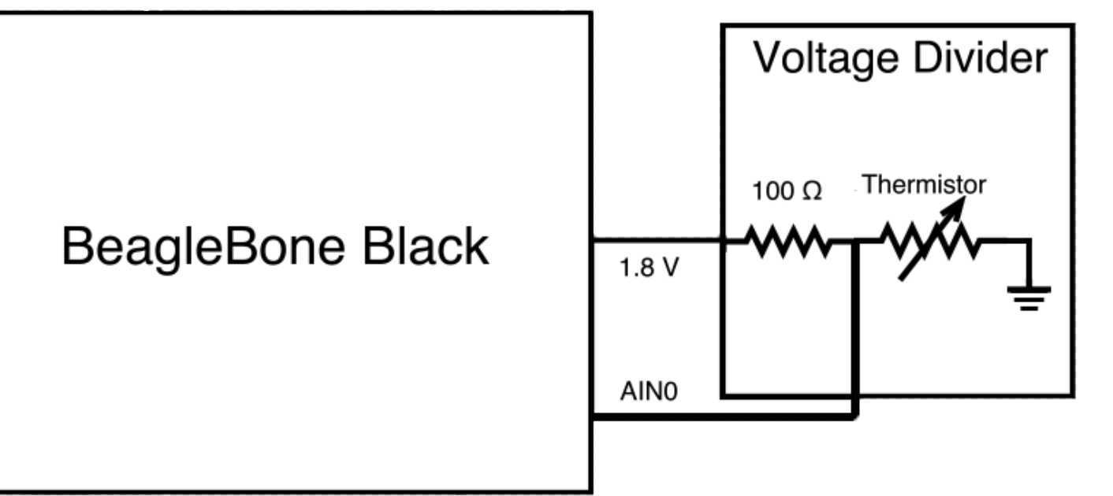







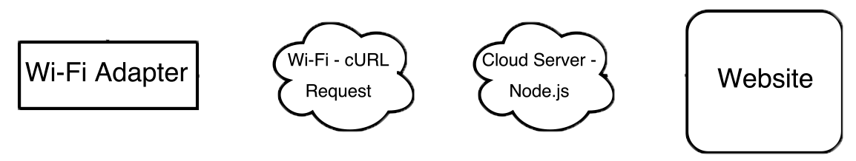
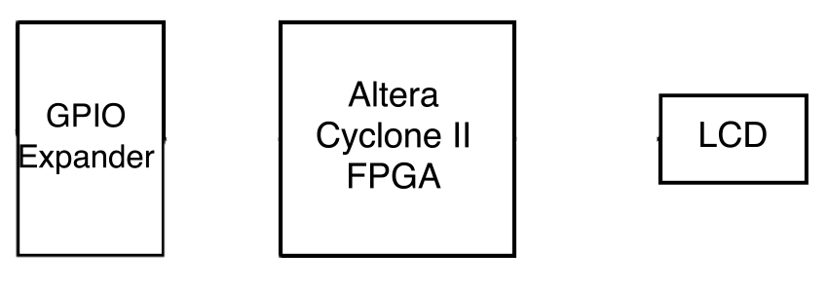

Fire! Fire!
Christina Tobias, Giovanni Soto, Tatiana Ensslin
Department of EECS, Syracuse University - College of Engineering & Computer Science
Materials
A Heat-Based Warning System
Design
BeagleBone Black with Debian
LCD Display
Altera Cyclone II FPGA
GPIO Expander
OURLiNK USB Wi-Fi Adapter
Nichrome Wire
Voltage Divider
640$Ω$ Thermistor / 100$Ω$ Resister
Node.js Server
Power Supply
Fire! Fire! uses a circuit that detects heat and calculates the temperature. It displays heat levels from “Normal” to “Fire! Fire!” and temperature on an LCD and relays this information to a website, updated in real-time. As the temperature increases to dangerous levels, it notifies the user when a fire occurs.
The power supply will control voltage applied to the nichrome wire
The thermistor's resistance will be altered based on the heat from the nichrome wire
Analog voltage is received by the BeagleBone Black - the temperature is calculated from this voltage
The BeagleBone will send this data through the Wi-Fi adapter to a node.js server via cURL request
Using Node.js/JavaScript/AJAX, the cloud server will display information on the website regarding the temperature level
Block Diagram
Real World Applications
Hardware temperature control
Climate control systems
Greenhouses
Residential homes
Monitor temperature levels in senior homes
Regulate heat in commercial food warmers

