Slide 1

Fine-tuning
Geert Jan Bex (geertjan.bex@uhasselt.be)
License: this presentation is released under the Creative Commons CC BY 4.0,
see https://creativecommons.org/licenses/by/4.0/deed.ast

Slide 2


Slide 3
Overview
Getting ready
Why LLMs locally?
What are LLMs?
Can I run an LLM on my laptop?
How can I use LLMs?
Can I chat with my data?
Shrink your model: quantization
Fine-tuning models
Can I start from scratch?
Conclusions

Slide 4
Getting ready

Slide 5
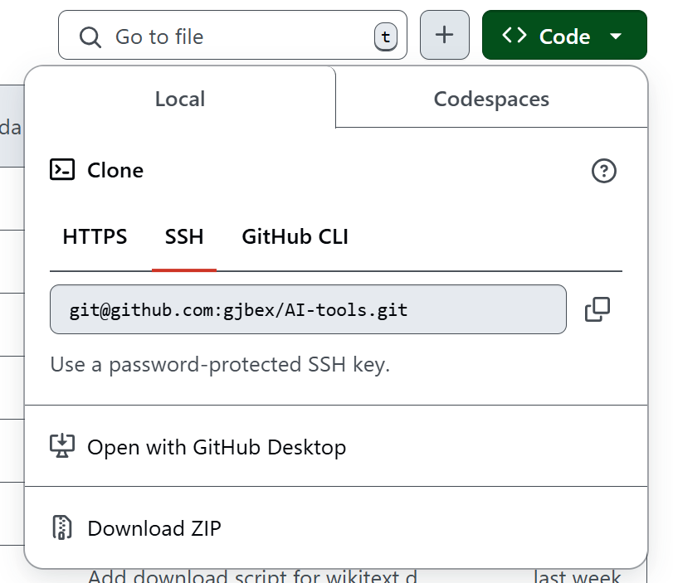
GitHub repository
Get repository (clone or download)
https://github.com/ENCCS/castiel-multi-gpu-ai

Slide 6
Hugging Face account
To get an account
  Go to https://huggingface.co/
  Click "Sign Up"
  Enter required information

Slide 7
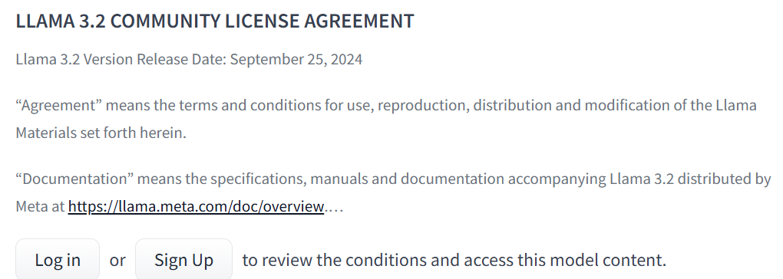
Hugging Face gated repositories
To get permission for gated Llama 3.2 models
  Go to https://huggingface.co/meta-llama/Llama-3.2-3B-Instruct
  Go to https://huggingface.co/mistralai/Mistral-7B-v0.1
You will get email confirmation

Slide 8
Fine tuning

Slide 9
Why fine-tuning?
Task specialization
  Question answering
  Named-entity recognition
  Summarization
  ...
Domain-specific specialization
Risks
  Lack of alignment
  Catastrophic forgetting
Expensive!

Slide 10
Number of parameters
Problems
  Memory consumption
  Training time
  Catastrophic forgetting
  Inference latency
Solution: Parameter-Efficient Fine-Tuning (PEFT)
  Adapters
  LoRA
  QLoRA

Slide 11
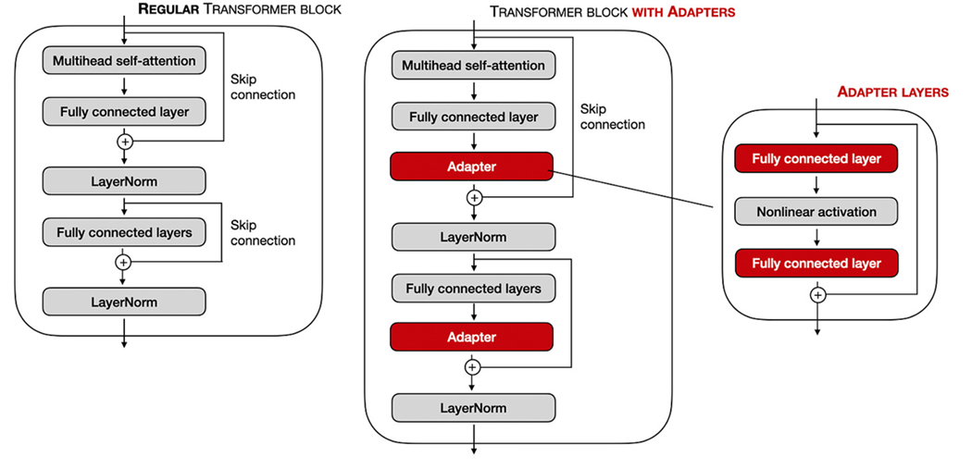
Adapters
Add adapter layer after
  Multi-head attention layers
  Feedforward layers
Original weights not modified!
Trained

Slide 12
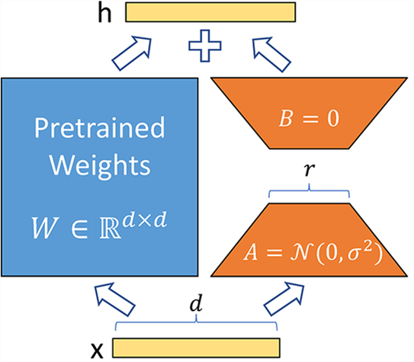

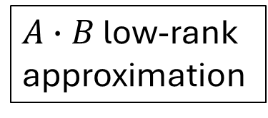
Low-order Rank Adaptation (LoRA)
$W∈ℝ^{d×d}→W+∆W$
$∆W=A∙B$
  $A∈ℝ^{d×r}$
  $B∈ℝ^{r×d}$
  $r<d$
Trained
$A∙B$ low-rank approximation
Original weights not modified!

Slide 13
Squeezing even more: QLoRA
Quantization of pre-trained model
  NF4
  Block-wise quantization to mitigate outliers
  Double quantization: quantize quantization constants
Dequantization layer-by-layer as required
  Forward pass
  Backward pass

Slide 14
Shrink your model: quantization

Slide 15
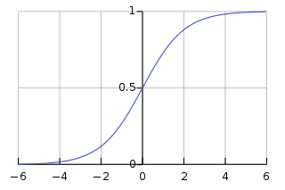











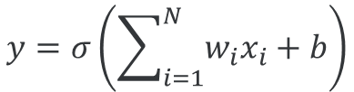


Network representation for training
32-bit single precision floating point
$$x_{1}$$
$$w_{1}$$
E.g., Llama 3.2
3.2b parameters
4 GB of memory
$$x_{2}$$
$$w_{2}$$
???
$$y$$
$$w_{3}$$
$$x_{3}$$
$$b$$
$$y=σ\left(\sum_{i=1}^{N}{w_{i}x_{i}+b}\right)$$
$$σ\left(x\right)$$
...
$$+1$$
activation function
$$w_{N}$$
$$x$$
$$x_{N}$$

Slide 16
Quantization
Represent 32-bit single precision floating point by
  Half precision16-bit floating point (FP16)
  Brain floating point 16-bit (BF16)
  8-bit integer (INT8)
Advantages
  Decrease memory requirements
  More efficient operations
  Decrease power consumption
Disadvantages
  Potential loss of accuracy

Slide 17
32-bit floating point representation
Example: 5.239 in FP32, 1 sign bit + 8 exponent bits + 23 mantissa bits
Sign: positive → 0 (1 bit)
Integer part: 5 → 101
Fractional part: 0.239 → 00111101001011...
Combine: 101.00111101001011...
Normalize: 1.0100111101001011... × 2² (23 bits mantissa)
Bias for exponent: 2 + 127 = 129 → 10000001 (8 bits)
0
10000001
0100111101001011...
sign
exponent
mantissa

Slide 18
16-bit floating point representation
Example: 5.239 in FP16, 1 sign bit + 5 exponent bits + 10 mantissa bits
Sign: positive → 0 (1 bit)
Integer part: 5 → 101
Fractional part: 0.239 → 00111101001011...
Combine: 101.00111101
Normalize: 1.0100111101001011... × 2² (10 bits mantissa)
Bias for exponent: 2 + 15 = 17 → 10001 (5 bits)
0
10001
0100111101
sign
exponent
mantissa

Slide 19
16-bit brain floating point representation
Example: 5.239 in BF16, 1 sign bit + 8 exponent bits + 7 mantissa bits
Sign: positive → 0 (1 bit)
Integer part: 5 → 101
Fractional part: 0.239 → 00111101001011...
Combine: 101.00111101001011...
Normalize: 1.0100111101001011... × 2² (7 bits mantissa)
Bias for exponent: 2 + 127 = 129 → 10000001 (8 bits)
0
10000001
0100111
sign
exponent
mantissa

Slide 20
8-bit integer representation
Example: 5.239 in INT8
Scale: 5.239 × 127 → 665.353
Round to nearest integer: 665.353 → 665
Clip to [-128, 127]: 665 → 127
Binary: 127 → 11111111

Slide 21
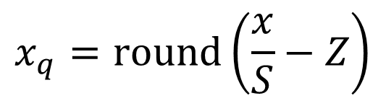

n-bit integers
FP32 floating point value $x$
n-bit integer$x_{q}$
FP32 scaling factor$S$
n-bit integer zero-point $Z$
$S$influenced by outliers
$$x_{q}=\text{round}\left(\frac{x}{S}−Z\right)$$
Must be stored for
dequantization
⇒ applied to blocks of weights (64 or 128)

Slide 22
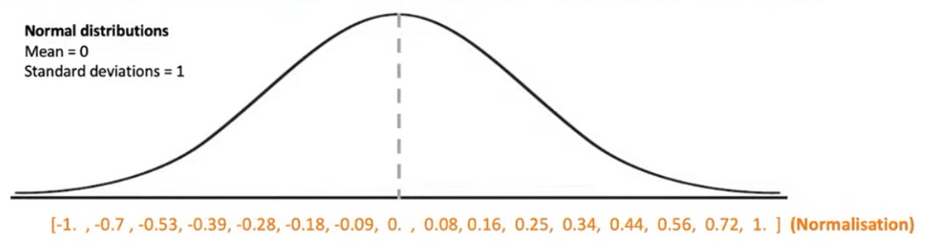
Normalized 4-bit floating point representation
Normalize x between -1.0 and 1.0
Keep track of offset, scale
"Bin" x into appropriate bucket = 15 equidistant points

Slide 23
Quantization methods
Post-Training Quantization (PTQ)
  Can be applied to any model
  Potentially higher loss of accuracy
Quantization-aware training
  Requires fine-tuning, training data
  Better accuracy
... (very active area of research)

Slide 24
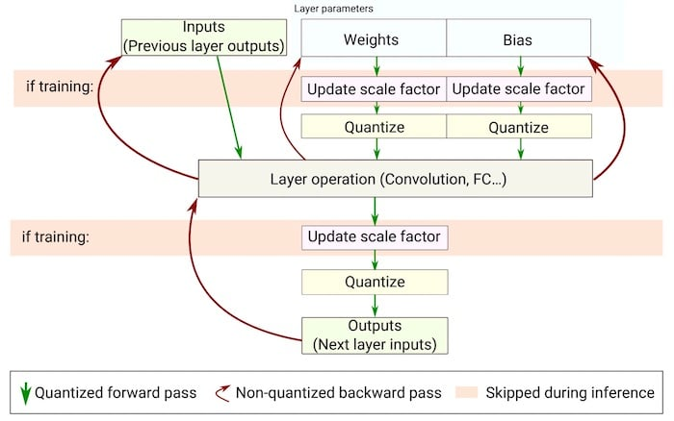
Quantization-aware training

Slide 25

k-quant
Implemented in LLaMA.cpp
Model stored in GPT-Generated Unified Format (GGUF)
Family of methods: Q2_K_S, Q3_K_S, Q3_K_M, Q3_K_L, ..., Q5_K_M
Uses k-means clustering on weight values, e.g., Q2_K_S
  Most important weights: higher precision (4 bits)
  Less important weights: lower precision (2 bits)
List quantization methods
$ lllama-quantize --help

Slide 26
Quantization using LLaMa.cpp
Model in GUFF format
  If necessary, convert
$ lllama-quantize llama-2.2-3B-instruct-F16.gguf \
llama-2.2-3B-instruct-Q3_K_S.gguf Q3_K_S
...
llama_model_loader: - type f32: 58 tensors
llama_model_loader: - type f16: 197 tensors
...
llama_model_quantize_internal: model size = 6128.17 MB
llama_model_quantize_internal: quant size = 1463.90 MB
main: quantize time = 282342.12 ms
main: total time = 282342.12 ms
4.1 ×
± 5 minutes

Slide 27
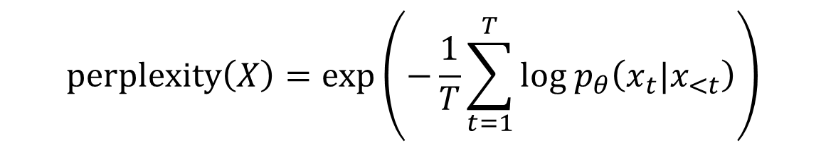
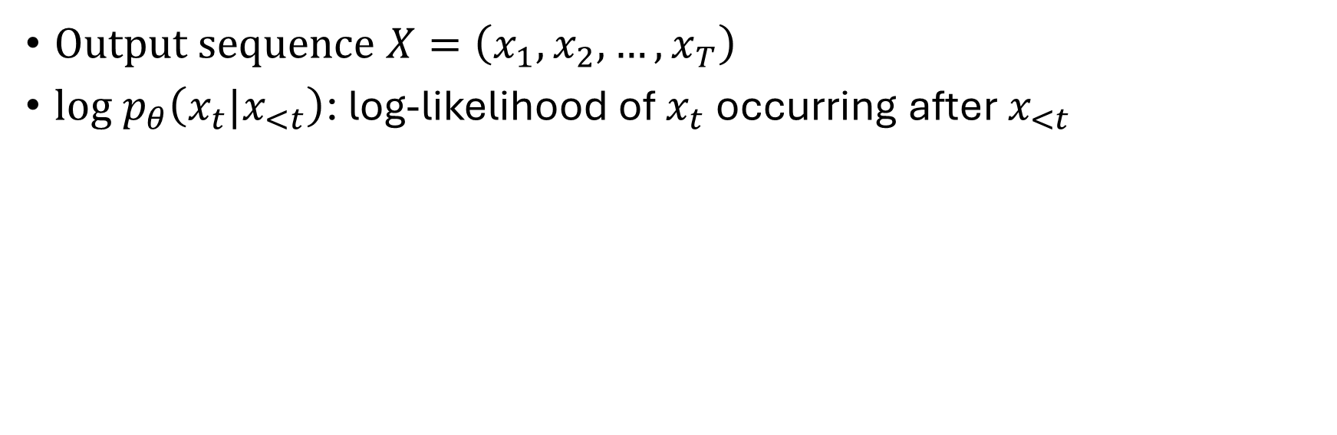
Assessing accuracy: perplexity
$$\text{perplexity}\left(X\right)=\exp\left(−\frac{1}{T}\sum_{t=1}^{T}{{\text{log} p}_{θ}\left(x_{t}|x_{<t}\right)}\right)$$
Output sequence $X=\left(x_{1},x_{2},…,x_{T}\right)$
${\text{log} p}_{θ}\left(x_{t}|x_{<t}\right)$: log-likelihood of $x_{t}$ occurring after $x_{<t}$
Lower is better
Requires dataset

Slide 28
Perplexity using LLaMa.cpp
Original model
$ lllama-perplexity -m llama-2.2-3B-instruct-F16.gguf -f wikitext-2-raw/wiki.test.raw
...
llama_model_loader: - type f32: 58 tensors
llama_model_loader: - type f16: 197 tensors
...
Final estimate: PPL = 10.5262 +/- 0.07552
llama_perf_context_print: load time = 266365.05 ms
llama_perf_context_print: prompt eval time = 852444.50 ms / 288768 tokens ( 2.95 ms per token )
llama_perf_context_print: eval time = 0.00 ms / 1 runs ( 0.00 ms per token )
llama_perf_context_print: total time = 868809.79 ms / 288769 tokens

Slide 29
Perplexity using LLaMa.cpp
Quantized model (Q3_K_S)
$ lllama-perplexity -m llama-2.2-3B-instruct-Q3_K_S.gguf -f wikitext-2-raw/wiki.test.raw
...
llama_model_loader: - type f32: 58 tensors
llama_model_loader: - type f16: 197 tensors
...
Final estimate: PPL = 12.8498 +/- 0.09285
llama_perf_context_print: load time = 61223.73 ms
llama_perf_context_print: prompt eval time = 307642.15 ms / 288768 tokens ( 1.07 ms per token )
llama_perf_context_print: eval time = 0.00 ms / 1 runs ( 0.00 ms per token )
llama_perf_context_print: total time = 322137.10 ms / 288769 tokens

Slide 30
Comparison F16 versus Q3_K_S
Property | llama-2.2-3B-instruct-F16 | llama-2.2-3B-instruct-Q3_K_S
Perplexity | 10.5 | 12.8
Load time | 267 s | 62 s
Prompt evaluation time | 2.95 ms/token | 1.07 ms/token
Total time | 869 s/289k token | 322 s/289k tokens
Memory size | 5.98 GB | 1.43 GB
Disk size (GGUF file) | 6 GB | 1.5 GB
× 1.22
× 4.3
× 2.7
× 4.1
Advantages of quantization:
Less memory required
Faster model load
Faster inference
Disadvantages of quantization:
Higher perplexity = less accuracy

Slide 31
Benchmarking performance
Model
$ llama-batched-bench \
-m llama-2.2-3B-instruct-Q3_K_S.gguf \
--ctx-size 2048 \
--batch-size 2048 \
--ubatch-size 512 \
-npp 128,256,512 \
-ntg 128,256 \
-npl 1,2,4,8,16,32
Prompt context size
Logical maximum batch size
Physical maximum batch size
Number of prompt tokens
Number of text generation tokens
Number of parallel prompts

Slide 32
Benchmarking performance
Prompt tokens/batch
Required KV cache size
Generated tokens/batch
Prompt processing time/speed
Total time/speed
Nr. batches
Prompt processing time/speed
| PP | TG | B | N_KV | T_PP s | S_PP t/s | T_TG s | S_TG t/s | T s | S t/s |
|-------|--------|------|--------|----------|----------|----------|----------|----------|----------|
| 128 | 128 | 1 | 256 | 28.074 | 4.56 | 43.284 | 2.96 | 71.358 | 3.59 |
| 128 | 128 | 2 | 512 | 1.811 | 141.35 | 52.357 | 4.89 | 54.168 | 9.45 |
| 128 | 128 | 4 | 1024 | 1.746 | 293.24 | 98.472 | 5.20 | 100.218 | 10.22 |
| 128 | 128 | 8 | 2048 | 3.116 | 328.67 | 96.980 | 10.56 | 100.096 | 20.46 |
| 128 | 256 | 1 | 384 | 1.562 | 81.95 | 70.581 | 3.63 | 72.143 | 5.32 |
| 128 | 256 | 2 | 768 | 1.462 | 175.07 | 104.327 | 4.91 | 105.789 | 7.26 |
| 128 | 256 | 4 | 1536 | 1.734 | 295.28 | 196.159 | 5.22 | 197.893 | 7.76 |
| 256 | 128 | 1 | 384 | 1.628 | 157.25 | 33.943 | 3.77 | 35.571 | 10.80 |
| 256 | 128 | 2 | 768 | 1.602 | 319.52 | 54.113 | 4.73 | 55.716 | 13.78 |
| 256 | 128 | 4 | 1536 | 3.125 | 327.68 | 97.093 | 5.27 | 100.218 | 15.33 |
| 256 | 256 | 1 | 512 | 1.544 | 165.84 | 68.837 | 3.72 | 70.381 | 7.27 |
| 256 | 256 | 2 | 1024 | 1.661 | 308.22 | 105.161 | 4.87 | 106.822 | 9.59 |
| 256 | 256 | 4 | 2048 | 3.011 | 340.10 | 201.940 | 5.07 | 204.950 | 9.99 |
| 512 | 128 | 1 | 640 | 1.769 | 289.46 | 34.630 | 3.70 | 36.399 | 17.58 |
| 512 | 128 | 2 | 1280 | 3.002 | 341.12 | 52.033 | 4.92 | 55.035 | 23.26 |
| 512 | 256 | 1 | 768 | 1.717 | 298.26 | 69.583 | 3.68 | 71.299 | 10.77 |
| 512 | 256 | 2 | 1536 | 3.228 | 317.18 | 91.082 | 5.62 | 94.310 | 16.29 |

Slide 33
Conclusions

Slide 34
Conclusions
Running (small) LLMs locally: easy if...
  Enough memory
  Decent GPU
Quantization may help
Open-source models perform reasonably well out-of-the-box
Open-source models can be specialized by
  Custom prompts
  Retrieval-Augmented Generation (RAG), knowledge graphs
  Fine-tuning
  Transfer learning
Starting from scratch is (very) expensive

Slide 35
References
Attention is all you need, Vaswani et al., NIPS 2017
Paper walkthrough: attention is all you need, Muhammad Ardi
Tracing the transformer in diagrams, Eric Silberstein
What is relative positional encoding, Ngieng Kianyev
Understanding mathematics behind floating point precision, Prabhu Raghav
Introducing Meta Llama 3: The most capable openly available LLM to date
A guide to quantization in LLMs, Kartik Talamadupula

Slide 36
References
LoRA: Low-Rank Adaptation of Large Language Models, Hu et al., 2021
QLoRA: Efficient Finetuning of Quantized LLMs, Dettmers et al.,2023
32 MCP Servers You Need To Check Out Now, Abid Ali Awan, 2025
VSC documentation

Slide 37
Getting models & data sets

Slide 38
Hugging Face gate & private models
Requires access token
  Create a Hugging Face account
  Go to "Access Tokens" in your profile menu
  Create & copy token
  Log in using token
Gated model: request permission via Hugging Face
  Confirmation via email
$ huggingface-cli login <your-token>

Slide 39

Hugging Face data sets
Download Hugging Face dataset, e.g., Wikipedia
$ huggingface-cli download wikimedia/wikipedia \
--repo-type dataset --local-dir wikimedia/wikipedia/

Slide 40
Installing software

Slide 41
Installing MiniForge3
Download installation script or use local copy
https://github.com/conda-forge/miniforge/releases
Run installation script
Agree to license
Accept location
Run shell initialization
$ wget <url-to-release>
$ bash Miniforge3-Linux-x86_64.sh -p $VSC_DATA/miniforge3

Slide 42
Environment for hpccm
Create environment
Activate environment
$ mamba create -n hpccm hpccm
...
$ mamba activate hpccm

Slide 43
Environments for code examples
Directories in source-code has its own environment.yml file
  Machine learning libraries have non-trivial dependencies
Creating environments takes
  Time
  Memory
Create environments one at the time!
Create environments on a compute node!

Slide 44
Installing Jupyter Lab kernels
Activate environment
Install kernel
$ mamba activate hpccm
python -m ipykernel install --user \
--env PYTHONPATH '' \
--name ai_tools_fine_tuning \
--display-name ai_tools_fine_tuning

Slide 45
Image definition
Use hpccm/Apptainer
'''Recipe to create either a Docker container or Singularity image
for a container to run Ollama tools.
Usage:
$ hpccm --recipe ollama.py --format docker
$ hpccm --recipe ollama.py --format singularity
'''
# Choose a base image
Stage0.baseimage('ollama/ollama:latest')
# add run script, i.e., start bash
Stage0 += runscript(commands=['ollama'])
$ hpccm --recipe ollama.py \
--format singularity \
> ollama.recipe
Ollama.py

Slide 46
Image creation
#!/usr/bin/env -S bash -l
#SBATCH --account=lp_gpgpu_training
#SBATCH --nodes=1 --ntasks=1 --gpus-per-node=1
#SBATCH --time=00:30:00
#SBATCH --cluster=genius --partition=gpu_p100
if [ -z $RECIPE ]
then
(>&2 echo "RECIPE not set")
exit 1
fi
IMAGE=$(basename "${RECIPE%.*}.sif")
export APPTAINER_TMPDIR=$VSC_SCRATCH/singularity_tmp
mkdir -p $APPTAINER_TMPDIR
export APPTAINER_CACHEDIR=$VSC_SCRATCH/singularity_cache
mkdir -p $APPTAINER_CACHEDIR
apptainer build --nv --force --fakeroot $IMAGE $RECIPE
apptainer_build.slurm
$ sbatch --export=ALL,RECIPE=ollama.recipse \
apptainer_build.slurm

