Slide 1

Model parallelism with Pytorch
Gyula Ujlaki
DKF Kft., NCC Hungary – HPC Scientific expert

Slide 2
Use cases for model parallelism
Calculating model memory requirements:
Inference:
num_para * precision / 8bit = mem_req
mem_req * 1.2 = inference_mem_req
Training:
optim_states _{AdamW} = 4xmem_req
optim_states _{SGD} = 1.5x mem_req
gradients = mem_req
activations = sbhL
activations = sbhL(10 + 24/t)
activations = sbhL(10 + 24/t + (5a*s)/h*t)
s – sequence length in tokens
b – batch size per GPU
h – dimension of the hidden size within each transformer layer
L – the number of layers in the transformer model
a – the number of attention heads in the transformer model
t – degree of tensor parallelism being used (1 if not)
No sequence parallelism being used
No activations stored in fp16
Source: https://blog.eleuther.ai/transformer-math/
Training memory requirements of Llama 70B + AdamW optimizer, without calculating sequence lengths, batch size, etc.:
~70 * 10^9 parameters, fp16 precision
70 * 10^9 *2 (bytes) = 140 * 10^9 (model memory requirements)
140 * 10^9 * 4 (bytes) = 560 * 10^9 (with AdamW optimizer states)
560 * 10^9 + 140 * 10^9 = 700 * 10^9 bytes (with gradients)
Activation size depends on a lot of factors, thus we will not approximate this size. Even without that:
700 / 1024^3 = 652 GB (memory requirements) * 1.2 (for overhead)
Officially 500 GB: https://huggingface.co/blog/llama31
Depends on specific implementations

Slide 3
Pytorch - Layer-wise model parallelism
If only 1 GPU is available: CPU offloading, a few layers run on CPU
If at least 2 GPU available: divide layers evenly between the two GPUs.
Only 1 model, running on multiple devices, increasing/multiplying the memory available for the model!
Slower than 1 GPU, because of the communication overhead between GPUs.
Model can be distributed even among nodes as well, with Remote Procedure Calls: https://docs.pytorch.org/docs/stable/rpc.html
Cases when implementing an LWMP strategy is useful:
Model size is slightly larger than GPU memory.
If pipeline parallel logic implemented – no exercise for this part, as this is significantly more difficult to implement, than LWMP
Large language models cannot fit into a single GPU, and e.g. Tensor Parallelism also used for in-layer distribution.
LWMP can be combined with other parallelism techniques as well:
Distributed Data Parallel – DDP → inefficiency upscaled
Pipeline parallelism
etc.

Slide 4
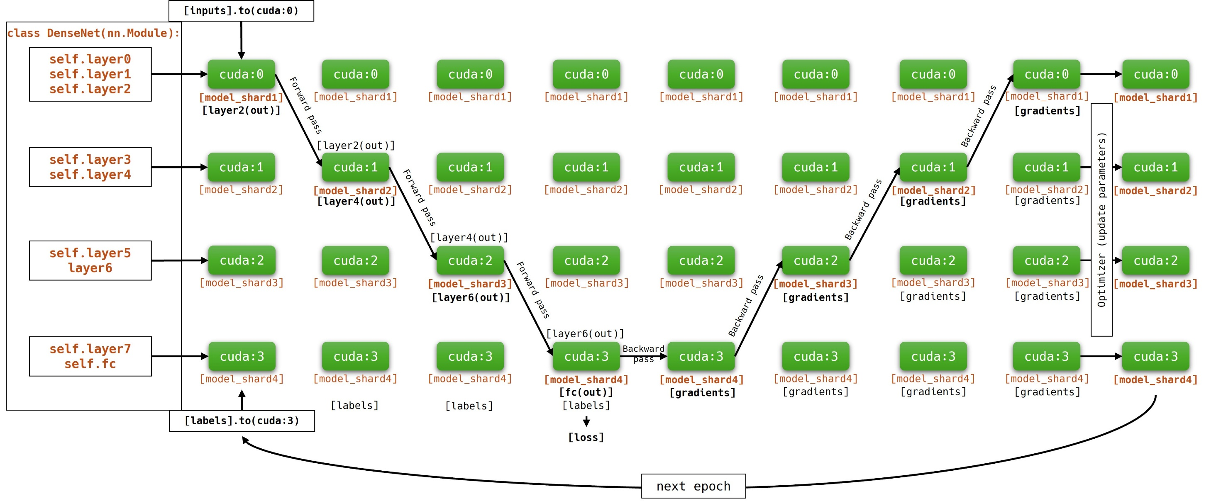
Layer-wise model parallelism

Slide 5
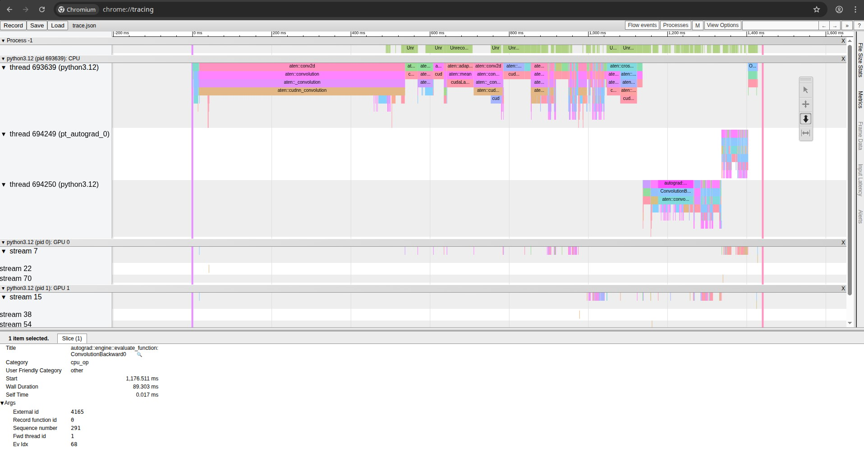
Tracing operations and tensors during training
ssh -L 16001:localhost:16001 youruser@login.Leonardo.cineca.it
tensorboard --logdir=/home/user/log/path --port 16001 --host localhost
(everyone has to use a unique port number)
Browser: localhost:16001

Slide 6
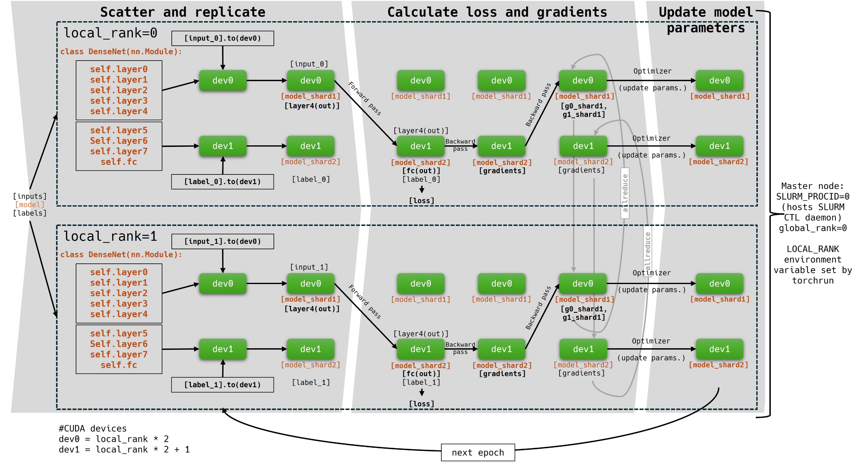
Layer-wise model parallelism + DDP

Slide 7
Basic model parallel techniques with Pytorch
Large amount of data | Too large model for 1 GPU | Both
No parallelism, infinite time | Layer-wise model parallel, or naïve model parallel | FSDP – Fully Sharded Data Parallel
DP – Data Parallel | TP - Tensor parallel | DDP + PP or TP
DDP – Distributed Data Parallel | PP - Pipeline parallel | + any other combination of methods

Slide 8
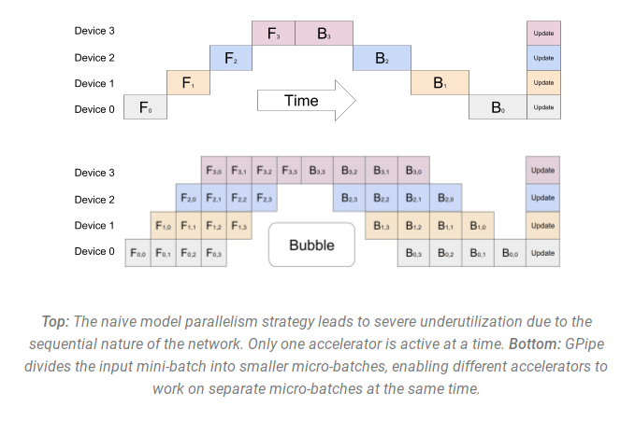
Pipeline Parallelism
https://research.google/blog/introducing-gpipe-an-open-source-library-for-efficiently-training-large-scale-neural-network-models/

Slide 9
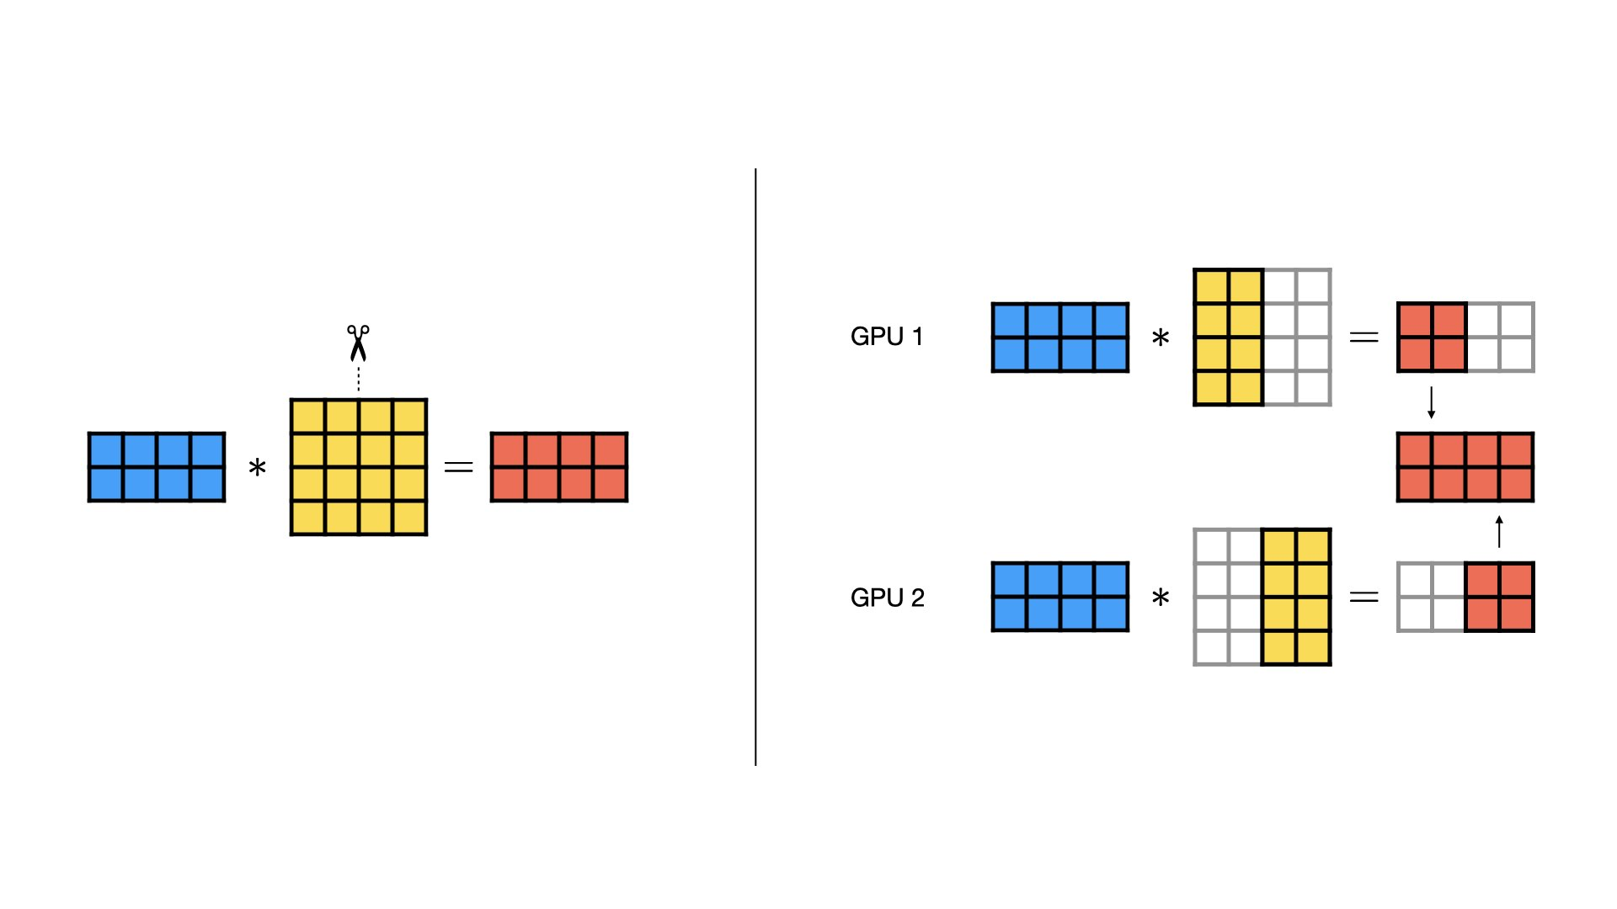
Tensor Parallelism in principle
https://lightning.ai/docs/pytorch/stable/advanced/model_parallel/tp.html

Slide 10
Thank you!

