Slide 1
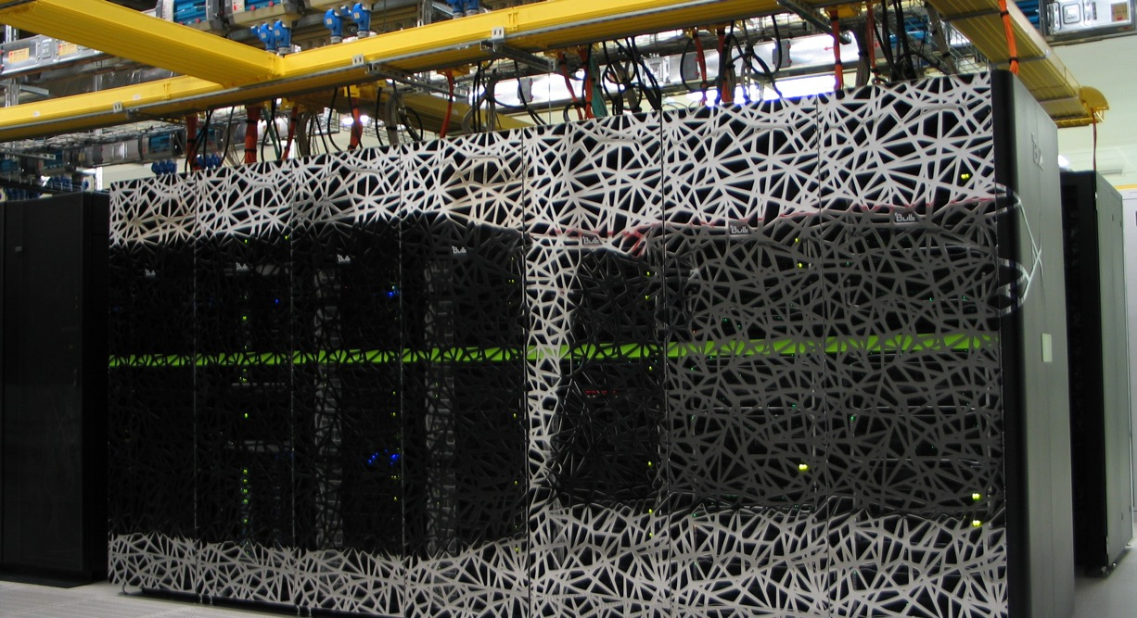
PyTorch Distributed data parallel
Caspar van Leeuwen
High Performance Machine Learning Consultant
SURF

Slide 2
Material
The material for this session (slides & exercise) can be obtained from GitHub:
git clone https://github.com/ENCCS/castiel-multi-gpu-ai

Slide 3
Goal
Understand…
What data-parallel training is
How to use PyTorch Distributed Data Parallel
(A little of ) what PyTorch DDP does ‘under the hood’

Slide 4
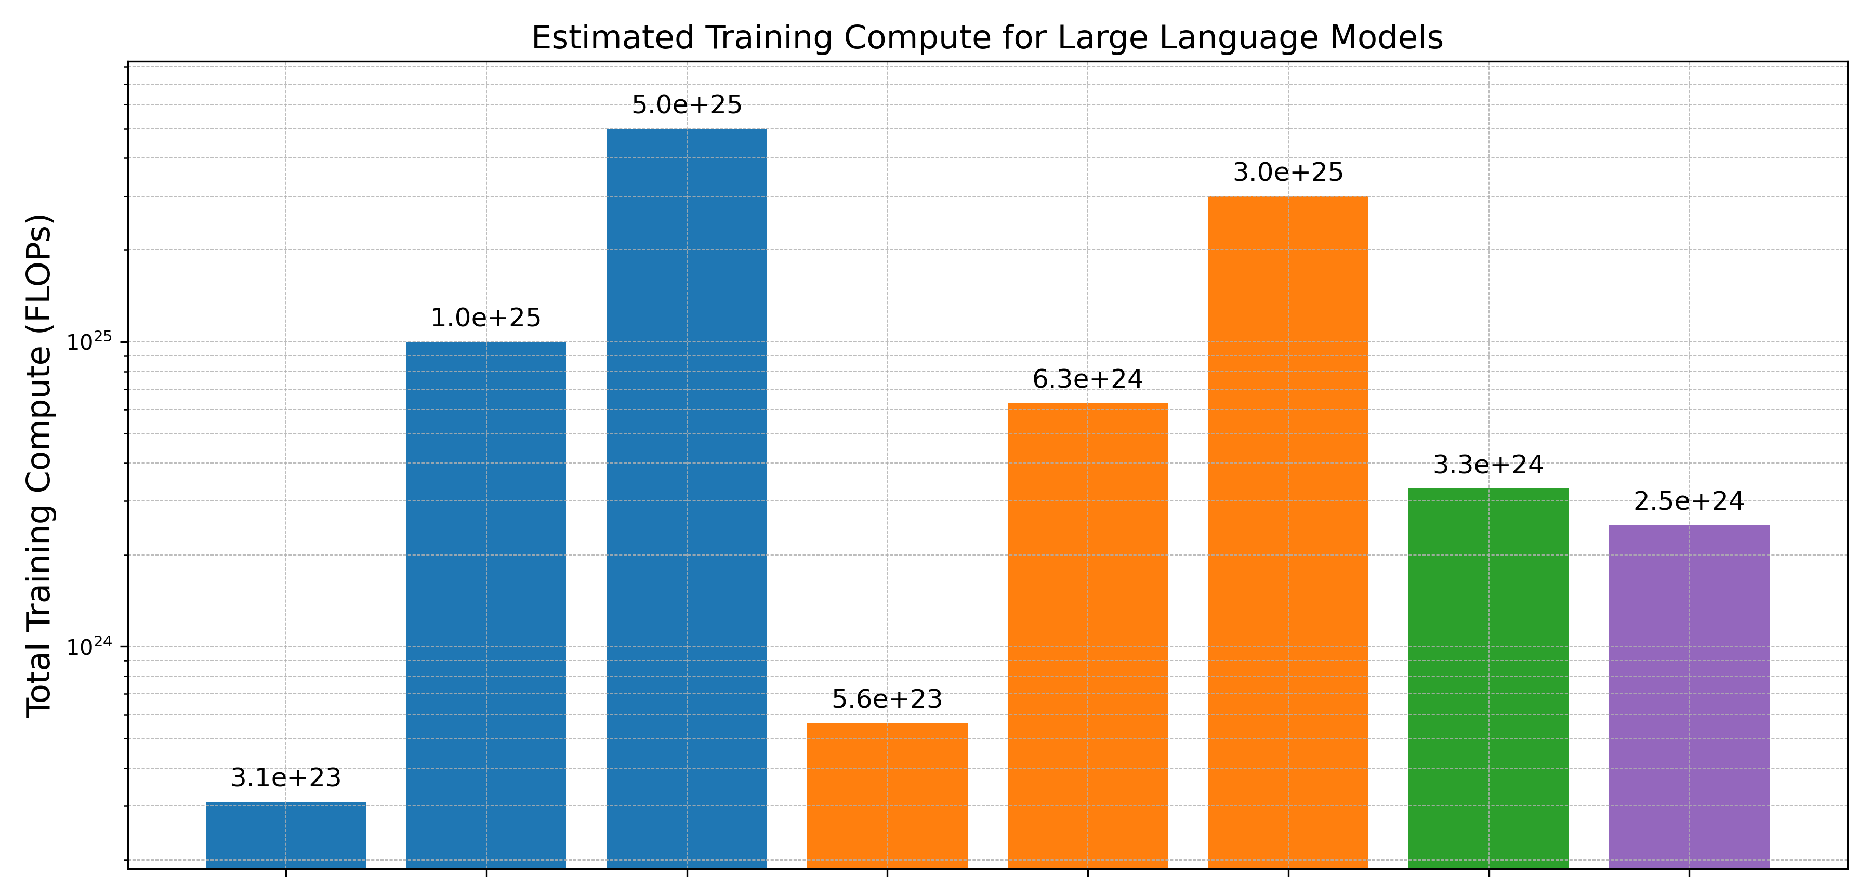
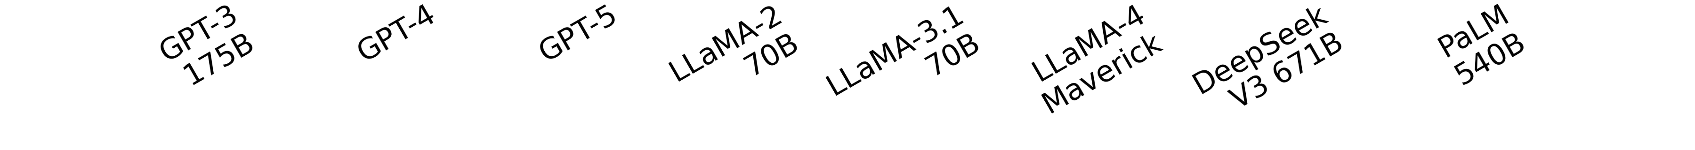
Parallelization: why?
5000 years @ 1 A100 GPU / 2000 years @ 1 H100 GPU
*
* very rough estimates, made by an LLM…
** Assuming pure FP16 Tensor Core operations @ theoretical throughput

Slide 5
Parallelization: why?
Faster trainings …
Enables learning on larger datasets
Enables improved accuracy through better hyperparemeter tuning
Enables larger, more complex models

Slide 6
But before we go parallel…
Optimize your serial code!
Make sure you exploit the hardware features of your GPU (e.g. reduced precision, tensor cores, etc)
Compile your models with torch.compile
Avoid unnecessary CPU-GPU transfers
Profile your code to identify bottlenecks (e.g. I/O)
Check out https://pytorch.org/tutorials/recipes/recipes/tuning_guide.html

Slide 7
Parallelization: when?
Computationally infeasible
Input size
Multiple GPUs
Single GPU
Model size

Slide 8
Parallelization: the basics
What is parallel computing?
Multiple processors or computers working on a single computational problem

Slide 9
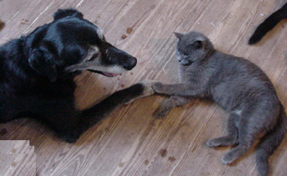

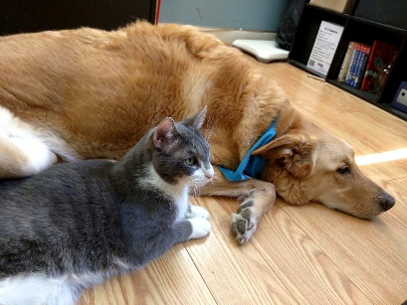

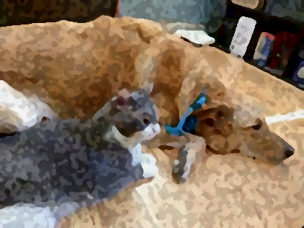
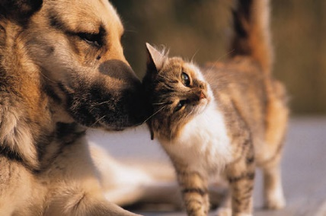
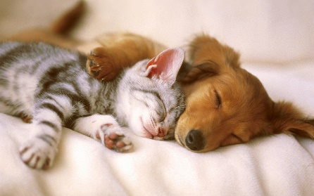

Parallelization: the basics
Serial computing
Data
Output
Apply filter()
Processor

Slide 10




Parallelization: the basics
Parallel computing
Data
Output
Apply filter()
Processor
Apply filter()
Processor
Apply filter()
Processor
Apply filter()
Processor

Slide 11
Parallelization: the basics
Benefits:
Solve computationally intensive problems (speedup)
Solve problems that don’t fit a single memory (multiple computers)
Requirements:
Problem should be divisible in smaller tasks
Considerations for problem decomposition
How can I limit the need for communication? (smaller overhead = bigger speedup)
How does my partitioning affect memory consumption?
How does partitioning affect my algorithm, e.g. convergence behavior?

Slide 12
Types of parallelization
Typically: PyTorch, TensorFlow, …, takes care of this
What types of parallelization exist?
Instruction level parallelism
Embarrassingly parallel
Data parallel
Model parallel
Hybrid data/model parallelism
Tensor parallel
Pipeline parallelism
Single instruction operating on e.g. entire vectors / matrices
E.g. hyperparameter grid search
Topic of this session ☺
Covered in upcoming sessions in this course

Slide 13



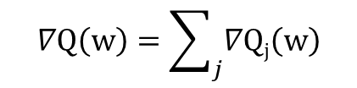
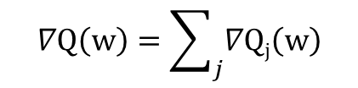

Data Parallelism
Train a single model, single set of hyperparameters, but faster
Split the data over multiple processors (CPUs/GPUs)
Each processor holds an identical copy of the model
Forward pass: calculated by each of the workers
Backward pass: gradients computed (per worker)
Communicate and aggregate gradients
Model update
NB: model is still identical, since initial model and update were identical!
$$∇Q\left(w\right)=\sum_{j}{∇Qj\left(w\right)}$$
$$w=w−η∇Q(w)$$
$$∇Q_{1}(w)$$
Processor 1
$$∇Q\left(w\right)=\sum_{j}{∇Qj\left(w\right)}$$
$$w=w−η∇Q(w)$$
$$∇Q_{2}(w)$$
Processor 2

Slide 14
Distributed Data Parallel
Pro tip:
- Overlap communication and computation (don’t waste compute cycles waiting for communication!)
- Most (distributed) DL frameworks already take care of this for you ☺ => so does PyTorch DDP!
A different view…
Time
Synchronization
barrier
Worker 1
N
N-1
…
1
Pro tip 2:
Make sure all workers are equally fast!
N
N-1
…
1
N
N-1
…
1
Forward pass
Worker 2
N
N-1
…
1
N
Backward pass,
compute gradient of layer N
N
Backward pass,
communicate gradient N
Wait

Slide 15
How does PyTorch aggregate gradients?
The AllReduce operation (with ‘sum’ as reduction operator) is defined as:
But this does not define how the operation should be implemented!
P0
A
B
C
D
P0
A+B+C+D
A+B+C+D
A+B+C+D
A+B+C+D
AllReduce
P1
P1
P2
P2
P3
P3

Slide 16
An AllReduce algorithm
Example: a (typically inefficient) AllReduce operation could implemented like this
P0
A
B
C
D
P0
A+B+C+D
A+B+C+D
A+B+C+D
A+B+C+D
P0
A+B+C+D
P1
P1
P2
P2
P3
P3

Slide 17
So: what algorithm does PyTorch use?
That is up to the communication backend! (https://discuss.pytorch.org/t/multiple-node-multiple-worker-allreduce/98869 )
There are four communication backends to PyTorch:
Gloo => Ring AllReduce
NCCL => Tree and Ring Allreduce implementions, automatically selected
MPI => Up to the MPI library
XCCL => Many options, default: topology-aware selection*
* http://intel.com/content/www/us/en/docs/oneccl/developer-guide-reference/2021-14/environment-variables.html

Slide 18
So: what communication backend should I use?
Rule of thumb (https://pytorch.org/docs/stable/distributed.html#backends)
Nvidia GPU host: NCCL
Intel GPU host: XCCL
CPU host with infiniband + IP over IB enabled: Gloo
CPU host with infiniband; no IP over IB: MPI (have to build PT from source!)
CPU host, no infiniband: Gloo

Slide 19
Why NCCL is the best backend for Nvidia GPUs
NCCL implements multiple algorithms for AllReduce
NCCL knows the connectivity between the GPUs involved (e.g. are the connected by NVLink, are they in the same node, etc)
  Try nvidia-smi topo -m
  DEMO: I’ll allocate an interactive job
  srun --partition=boost_usr_prod --account=tra26_castiel2 --time=10:00 --nodes=1 --ntasks-per-node=1 --gpus-per-node=4 --cpus-per-task=8 --pty /bin/bash
NCCL makes an informed choice on the best algorithm based on the connectivity

Slide 20
Intermezzo: why the PyTorch dispatcher is a blessing (and a curse)
Torch call stack is very complex! E.g.
You call Torch function
Which calls other Python (Torch) functions
Which call C++ (Torch) functions
Which call low level libraries, often hardware specific (MKL/MKL-DNN, CuBLAS/cuDNN, NCCL, …)
The blessing
The low level libraries usually do things in a very well-optimized way!
http://blog.ezyang.com/2020/09/lets-talk-about-the-pytorch-dispatcher/

Slide 21
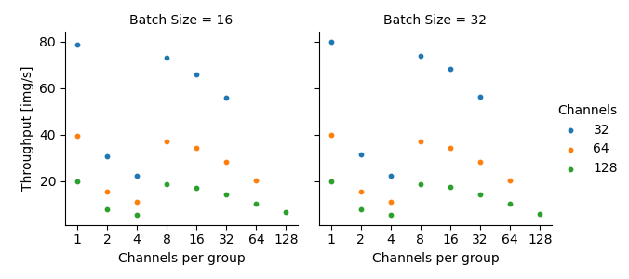
Intermezzo: why the PyTorch dispatcher is a blessing (and a curse)
The curse
High degree of abstraction makes it hard to predict for the programmer what will happen
Your choices matter! (but it is sometimes very hard to see how!)
Grouped 2D convolution on Intel CPUs with MKL
Uses optimized AVX512-based
algorithm
Uses generic matrix-multiply
algorithm
Uses optimized
AVX2/AVX512-based algorithm
https://medium.com/@casparvanleeuwen/why-efficientnet-is-not-very-computationally-efficient-505fc08087b9

Slide 22
DataParallel vs DistributedDataParallel
DataParallel
  Single process, multi-threaded
  Limited to single machine
  Typically slower than DistributedDataParallel due to Python GIL (Global Interpreter Lock)
  Cannot be combined with model parallel
DistributedDataParallel
  Multiple (possibly multi-threaded) processes
  Supports multiple machines
  Can be combined with model parallel
See also: https://pytorch.org/tutorials/intermediate/ddp_tutorial.html#comparison-between-dataparallel-and-distributeddataparallel

Slide 23
Questions so far?

Slide 24
How to go from regular PyTorch code to PyTorch with DDP
Step 1: Constructing the process group
Step 2: Constructing the DDP model
Step 3: Distributing input data
Step 4: Send data to correct GPU
Step 5: Alter saving model checkpoint (optional)
Step 6: Running the code: spawning multiple processes
See also: https://pytorch.org/tutorials/beginner/ddp_series_multigpu.html

Slide 25
Assumptions in this tutorial
We assume you are running on a SLURM cluster, and pass the --cpus-per-task and --ntasks-per-node options when scheduling your job
Each process in the DDP training is uniquely identified by its rank
We do pure DDP (i.e. we don’t combine with model parallelism). Thus, each rank uses 1 GPU
We will use the concept of local rank, a unique identifier of the process on that node. E.g. if you have global ranks 0-7 and launch 4 processes per node: global ranks 0, 1, 2, 3, 4, 5, 6, 7 will have local ranks 0, 1, 2, 3, 0, 1, 2, 3, respectively.
We want each local rank to use the GPU with the same ID as the local rank, i.e. local rank 0 will use gpu:0

Slide 26
Step 1a: Constructing the process group
Why: parallel launchers can launch multiple processes, but these processes need to know about each others existence!
How: by calling init_process_group, but we need to know the world_size and rank first. We can get those easily in a SLURM allocation!
We’ve chosen NCCL as backend, as per recommendation on https://pytorch.org/docs/stable/distributed.html#backends
N.B. There are multiple initialization methods for init_process_group, see https://pytorch.org/docs/stable/distributed.html#torch.distributed.init_process_group
def ddp_setup():
world_size = int(os.environ["SLURM_NTASKS"])
rank = int(os.environ["SLURM_PROCID"])
dist.init_process_group("nccl", rank=rank, world_size=world_size)
return rank

Slide 27
Step 1b: Constructing the process group
Call set_device before init_process_group to avoid hangs and/or multiple processes ending up on the default GPU (GPU:0)
Note that your code may work correctly without calling set_device, but it is recommended to avoid potential issues (see https://pytorch.org/tutorials/beginner/ddp_series_multigpu.html#constructing-the-process-group)
We need a local_rank to determine which GPU to set as device
def ddp_setup():
world_size = int(os.environ["SLURM_NTASKS"])
rank = int(os.environ["SLURM_PROCID"])
local_rank = int(os.environ["SLURM_LOCALID"])
torch.cuda.set_device(local_rank)
dist.init_process_group("nccl", rank=rank, world_size=world_size)
return rank, local_rank

Slide 28
Step 2: Constructing the DDP model
Why: after the backward pass has been done on a layer, the gradients should be aggregated between all ranks
How: by wrapping our existing (serial) model in the DDP class and telling it on which GPU this model should be kept. We can reuse the local_rank variable from earlier.
ddp_model = DDP(model, device_ids=local_rank)

Slide 29
Step 3a: Distributing input data
Why: we don’t want our N processes to do the same work N times, we want to divide our work into N smaller pieces – and have each process do one piece of work
How: by using the DistributedSampler
See https://pytorch.org/docs/stable/data.html?highlight=distributedsampler#torch.utils.data.distributed.DistributedSampler
train_loader = torch.utils.data.DataLoader(
dataset=…,
batch_size=…,
shuffle=False, # We don't shuffle
sampler=DistributedSampler(train_dataset), # Use the Distributed Sampler here.
)

Slide 30
Step 3b: Distributing input data
Every time we start new epoch, we have set a new seed for the distributed sampler (otherwise it would go through the samples in the same order every epoch)
See https://pytorch.org/docs/stable/data.html?highlight=distributedsampler#torch.utils.data.distributed.DistributedSampler
for epoch in range(0, max_epochs):
train_loader.sampler.set_epoch(epoch)
train(…) # Call actual training function that loops over batches

Slide 31
Step 4: Send data to correct GPU
Why: our input data needs to be sent to the GPU that is assigned to our (local) rank
How: by using .to(local_rank)
for batch_idx, (data, target) in enumerate(train_loader):
data, target = data.to(local_rank), target.to(local_rank)
…

Slide 32
Step 5: Alter saving model checkpoint (optional)
Why: the DDP model’s state_dict contains the original model as a module. Thus, all the original model’s parameters are prefixed with module.
  If you want to load this into another DDP-wrapped version of your model, that’s fine
  If you want to load this into an unwrapped version of your module, you’d have to strip the module. prefixes.
How: if you want to load into another DDP-wrapped version of your model, keep:
If you want to load into a serial version of your model, instead use:
torch.save(model.state_dict(), "mnist_cnn.pt")
torch.save(model.module.state_dict(), "mnist_cnn.pt")

Slide 33
Step 6a: Running the code: spawning multiple processes
Why: DDP is intended for multiple processes working together – so we need to start the code multiple times
How: using srun as a parallel launcher after setting MASTER_ADDR and MASTER_PORT
#!/bin/bash
#SBATCH --job-name=mnist-ddp --partition=gpu --time=10:00
#SBATCH --ntasks=8 --ntasks-per-node=4 --gpus-per-node=4 --cpus-per-task=18
# Pick a quasi-random port, and use the first node in the allocation as master node
export MASTER_PORT=$(expr 10000 + $(echo -n $SLURM_JOBID | tail -c 4))
master_addr=$(scontrol show hostnames "$SLURM_JOB_NODELIST" | head -n 1)
export MASTER_ADDR=$master_addr
srun python mnist_classify_ddp.py <script_arguments>

Slide 34
Step 6b: Running the code: spawning multiple processes
Why: DDP is intended for multiple processes working together – so we need to start the code multiple times
How: using torchrun as a parallel launcher
Where mnist_classify_ddp_torchrun.py has some small modifications compared to the original script…
Note the 2 tasks & 1 task per node: srun launches torchrun once per node, and torchrun itself then launches 4 processes
#!/bin/bash
#SBATCH --job-name=mnist-ddp --partition=gpu --time=10:00
#SBATCH --ntasks=2 --ntasks-per-node=1 --gpus-per-node=4 --cpus-per-task=18
head_node_ip=$(hostname --ip-address)
OMP_NUM_THREADS=18 srun torchrun --nproc_per_node=4 --nnodes 2 --rdzv_id 1234 --rdzv_backend c10d --rdzv_endpoint $head_node_ip:29500 mnist_classify_ddp_torchrun.py <script_arguments>

Slide 35
Step 6b: Running the code: spawning multiple processes
Where mnist_classify_ddp_torchrun.py has some small modifications compared to the original script:
N.B. we still return local_rank and rank from the environment because we use them elsewhere in the code, e.g. in our .to(local_rank) statements
def ddp_setup()
# These get set by torchrun, let's get them from the environment:
local_rank = int(os.environ["LOCAL_RANK"])
rank = int(os.environ["RANK"])
# no need to pass them explicitly anymore to the init_process_group
dist.init_process_group(backend="nccl")
return rank, local_rank

Slide 36
Step 6: Running the code: spawning multiple processes
You could even use things like mpirun, or other ways of spawning multiple processes, as long as you adapt your code accordingly so that it is able to determine the rank and local rank for the current process
So… which should I use? Depends on personal preference, needs, etc…
srun: less abstraction. Probably easier for your HPC site to help you. More clear and explicit what is happening.
torchrun: more abstraction, but also more functionality. Can automatically restart if single ranks fail (with srun, you’d have to manually submit a new job & restart from checkpoint). Probably easier for the Torch community to help you. See https://pytorch.org/tutorials/beginner/ddp_series_fault_tolerance.html
Word-of-warning: I saw a 5% (single node) – 25% (multinode) performance decrease when using torchrun on our mnist example code, for which I haven’t found a cause yet => one of the downsides of more abstraction…

Slide 37
Material
The material for this session (slides & exercise) can be obtained from GitHub:
git clone https://github.com/ENCCS/castiel-multi-gpu-ai

Slide 38
Exercise 1: run the serial MNIST classification code
You’ll find the serial code in mnist_classify.py
First, create an interactive allocation with 2 GPUs: salloc --partition=boost_usr_prod --account=tra26_castiel2 --time=10:00 --nodes=1 --ntasks-per-node=2 --gpus-per-node=2 --cpus-per-task=8 --reservation=<RESERVATION_NAME>
Load the software environment: module load profile/deeplrn && module load cineca-ai/4.3.0
Try to run the serial code: srun –n 1 python3 mnist_classify.py --batch-size 128 --epochs 5 --data-dir $FAST/data

Slide 39
Exercise 2: implement DDP on serial MNIST classification code
Once you have a successful serial run, try to go through the 6 steps to alter the code to make things run in parallel. You can run your modified script on 2 GPUs using: srun –n 2 python3 <my_DDP_script.py> --batch-size 128 --epochs 5 --data-dir $FAST/data
Hint: Don’t forget to set the MASTER_ADDR and MASTER_PORT!
Hint2: to accurately time the code, add a dist.barrier() before every time.time() invocation. WARNING: you’d never to this in production runs, as unnecessary barriers may increase your overall computation time – this is just so we can time this section of the code accurately!
Do you see any speedup? How much? Is it enough to justify using 2 times more resources?

Slide 40
Bonus Exercise 1: Try a scaling run on 1, 2, 4, and 8 GPUs
First, release your 2-GPU allocation from the previous exercise by running exit
Then, create a job script for your 2-GPU run. List the same arguments to SLURM in your #SBATCH statements, then load the module environment, then launch your 2-GPU python script with srun.
Submit your job script and verify that it completes successfully
Now, scale up: alter your job script so that it runs on 4 and 8 GPUs. Note: we fewer nodes than students! The more students release their 2-GPU interactive allocation, the faster these jobs will be scheduled…
Determine the strong scaling speedup and efficiency on 1, 2, 4 and 8 GPUs and create a scaling plot. See https://hpc-wiki.info/hpc/Scaling#Strong_Scaling and https://hpc-wiki.info/hpc/Scaling#Strong_Scaling_2

Slide 41
Bonus Exercises 2: Try to run with torchrun
Check https://pytorch.org/docs/stable/elastic/run.html for the arguments to torchrun
You can use head_node_ip=$(hostname --ip-address) to get the IP of the head node of your allocation, and use that as rdzv-endpoint
You will need to set OMP_NUM_THREADS, otherwise torchrun uses only 1 thread for each torchrun process
To start torchrun on multiple nodes, you’d need to wrap it in an srun statement. Hint: think about how many tasks per node you’d want srun to start and make sure to set that number through #SBATCH --ntasks-per-node
How much performance do you get? How does that compare to what you started with srun?

Slide 42
Bonus Exercises 3: Try setting different Reduction Algorithms
Try different reduction algorithms by setting NCCL_ALGO, see https://docs.nvidia.com/deeplearning/nccl/user-guide/docs/env.html#nccl-algo . Do you see any performance difference? Why (not)?

Slide 43
Recap
Step 1: Constructing the process group => Make sure processes can work together
Step 2: Constructing the DDP model => Make sure PyTorch automatically aggregates gradients before model update
Step 3: Distributing input data => Make sure each worker sees a different part of the data (i.e. does different work)
Step 4: Send data to correct GPU => Make sure our data goes to the same GPU as our model
Step 5: Alter saving model checkpoint (optional)
Step 6: Running the code: spawning multiple processes => If we want multiple processes to work together, we need to start multiple processes

Slide 44
Recap
Understand…
What data-parallel training is
How to use PyTorch Distributed Data Parallel
(A little of ) what PyTorch DDP does ‘under the hood’

Slide 45
Further reading
How to train LLMs at (very) large scale: https://huggingface.co/spaces/nanotron/ultrascale-playbook

