Slide 1

Information Diffusion in Social Networks
Kutuzova Tatiana
Vaganov Danila
Abubakirov Azat
Pankov Vasiliy
HPC Department
Saint-Petersburg, 2018

Slide 2

Main purposes
Implement a model of relations in online social networks
Implement a model of information diffusion in online social networks
Calibrate the models according to real data
Develop an integration of both models
2

Slide 3
Dataset description
Dataset was collected from VK social network
Community of Charity for seriously ill children
~294k followers and ~33.5m friends of followers
Considered network consists of ~33.8m nodes and ~80.6m edges
659 posts of community and it’s sharing topology was collected
3

Slide 4
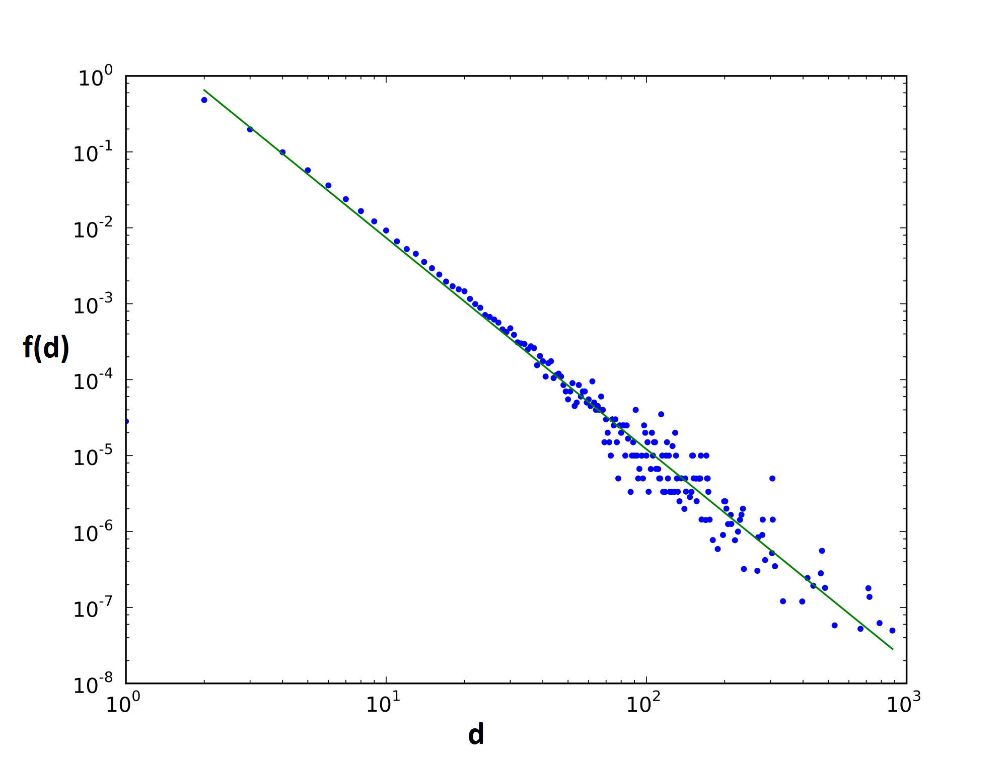
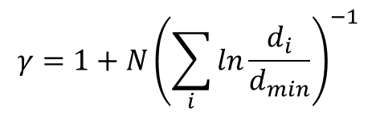

Degree distribution
Power law exponent
$$γ=1+N{\left(\sum_{i}{ln}\frac{d_{i}}{d_{min}}\right)}^{−1}$$
Power law
$$f\left(d\right)=d^{−γ}$$
d – degree of node
f(d) – fraction of node degree
4
Pósfai, M., et.al. (2015). Chapter 5: The Barabási-Albert Model. Network Science.

Slide 5
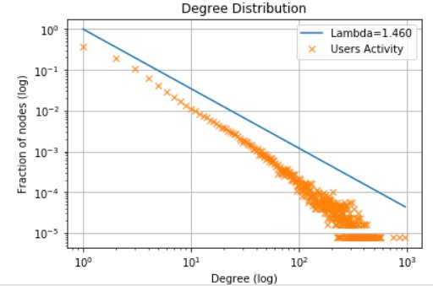
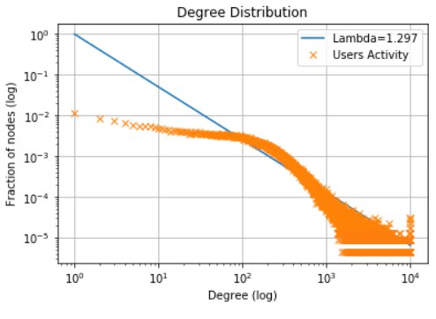
Dataset description
Degree distribution
Relations inside community Relations of subscribers and their friends
5

Slide 6
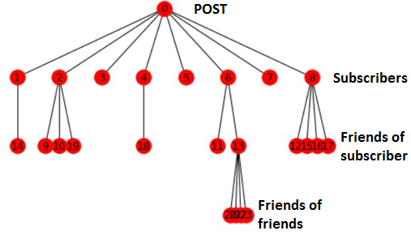
Cascade tree in dataset
659 cascades of information sharing were built for model calibration
212 cascades have 3 levels
Each connection means sharing (repost)
6

Slide 7
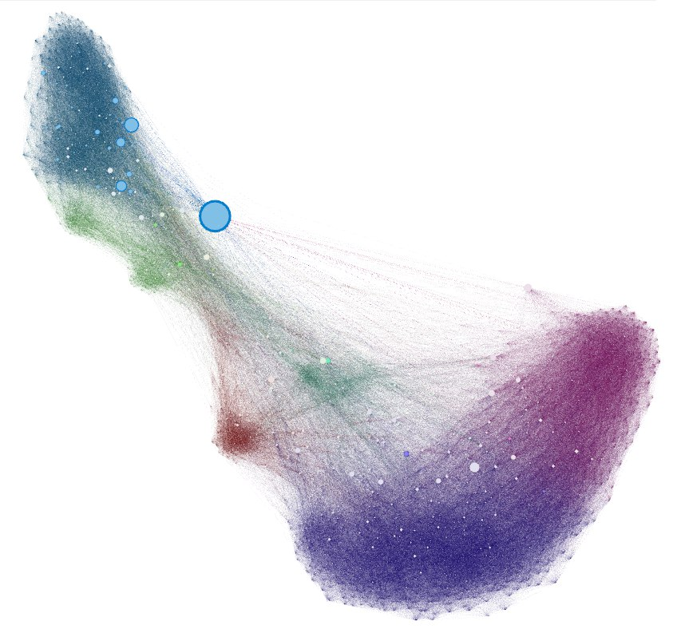
Network inside community
Graph contains only mostly connected nodes (10% of community)
Colors represents a modularity class
Size of nodes represents betweenness centrality
7

Slide 8
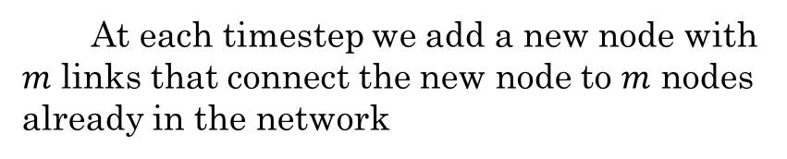
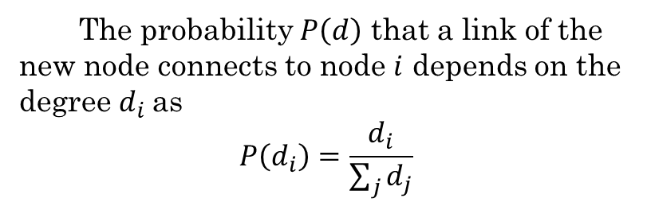
Barabási–Albert model
Barabási–Albert model can generate scale-free networks
At each timestep we add a new node with $m$ links that connect the new node to $m$ nodes already in the network
The probability $P\left(d\right)$ that a link of the new node connects to node $i$ depends on the degree $d_{i}$as
$$P\left(d_{i}\right)=\frac{d_{i}}{\sum_{j}{d_{j}}}$$
8
Pósfai, M., et.al. (2015). Chapter 5: The Barabási-Albert Model. Network Science.

Slide 9
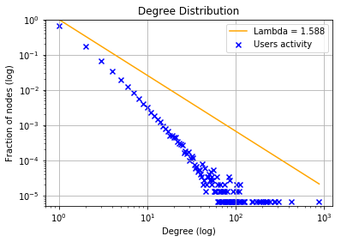
Degree distribution inside community
Real data
BA model
9

Slide 10
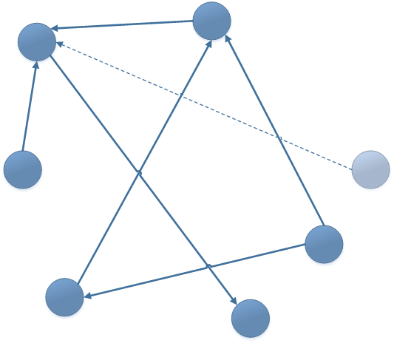
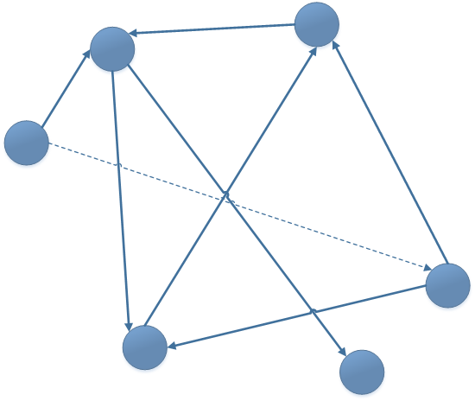
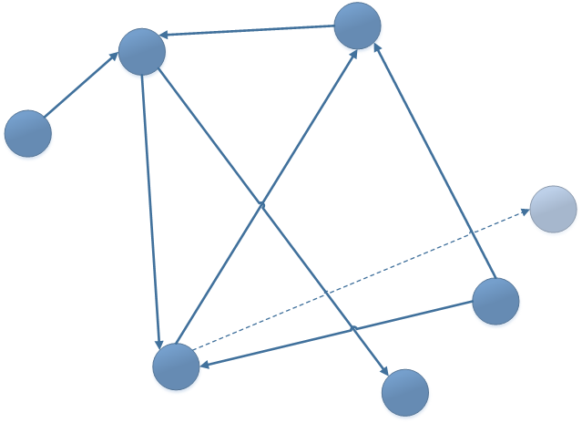
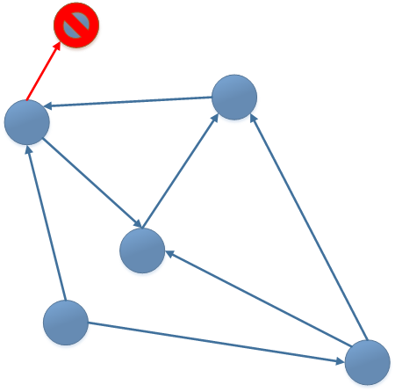
Growth process in the modified model
Modified model based on 4 probabilities
Our contribution
Node creation attaching an old node
Node creation as the target of an old node
Link creation between old nodes
Removing node and links
Dashed line – new link
Light blue node – new node
Blue node – old node
Red node/link– removed node/link
10
Aparicio, S., et. al (2015). A model for scale-free networks: Application to twitter.

Slide 11
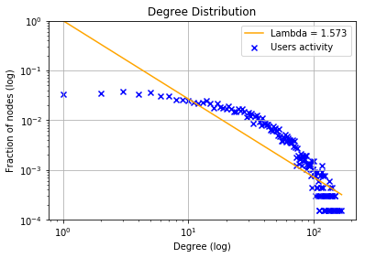
Degree distribution by subscribers and their friends
Real data
Model
11

Slide 12
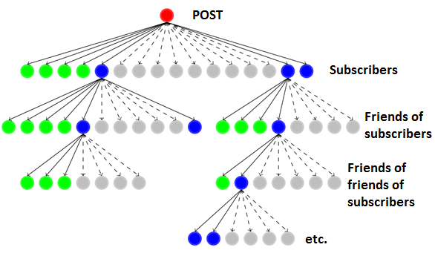
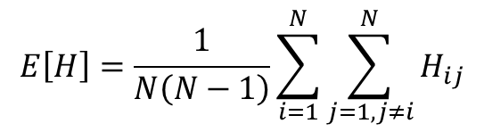
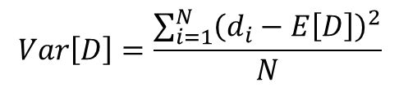
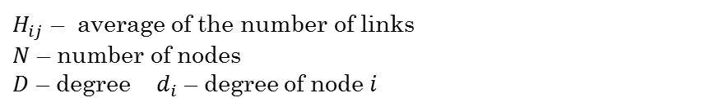
Information cascade tree
Basic idea of information diffusion model
Metrics for evaluation:
Average path length:
$$E\left[H\right]=\frac{1}{N\left(N−1\right)}\sum_{i=1}^{N}{\sum_{j=1, j≠i}^{N}{H_{ij}}}$$
Degree variance:
$$Var\left[D\right]=\frac{\sum_{i=1}^{N}{{\left(d_{i}−E\left[D\right]\right)}^{2}}}{N}$$
$H_{ij}$ – average of the number of links
$N$ – number of nodes
$D$ – degree $d_{i}$ – degree of node $i$
12
Liu, L., et.al (2017). Modeling of Information Diffusion on Social Networks with Applications to WeChat, 1–17.

Slide 13


Random Recursive Tree
Tree starts with the root with index = 1
The probability that new node will connect to a node with index = $i$ is proportional to the degree of this node of power 𝜃 :
RTT is defined by size N and scale parameter 𝜃
$$\frac{d_{i}^{θ}\left(t\right)}{\sum_{i=1}^{t}{d_{i}^{θ}\left(t\right)}}$$
13

Slide 14
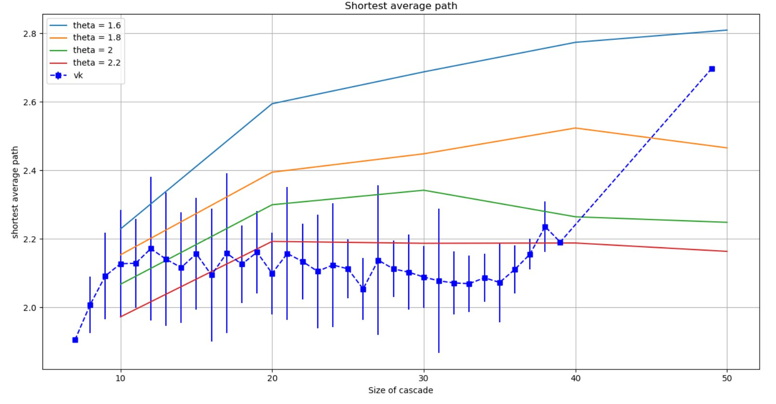
Shortest Average Path
14

Slide 15
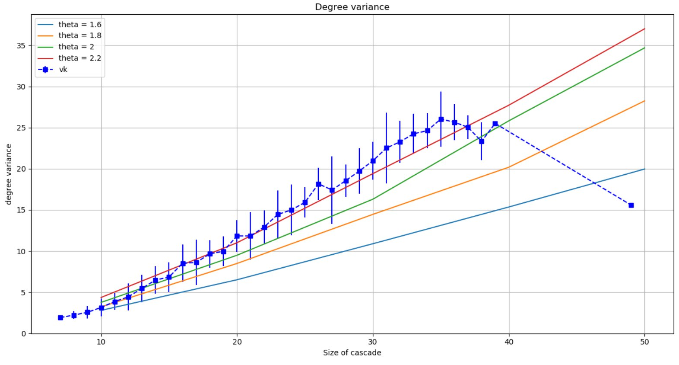
Degree Variance
15

Slide 16
Results and future work
Results:
Dataset was collected and analyzed
The existing model of relations in social networks was successfully implemented
The model of information diffusion was implemented
Models were calibrated
Future work:
Improve quality of data (more levels of sharing) for best calibration of the model
Integrate both of models
Extend the model of information diffusion by introducing new parameters
16

Slide 17
References
A. Guille, H. Hacid, C. Favre, D.A. Zighed: Information diffusion in online social networks: A survey.
A. Rudas, B. Toth, B. Valko: Random trees and general branching processes.
Aparicio, S., Villazón-Terrazas, J., & Álvarez, G. (2015). A model for scale-free networks: Application to twitter. Entropy, 17(8), 5848–5867.
Pósfai, M., Musella, G., Martino, M., Sinatra Acknowledgements, R., Morrison, S., Husseini, A., & Hoevel, P. (2015). Chapter 5: The Barabási-Albert Model. Network Science.
Liu, L., Qu, B., Chen, B., Hanjalic, A., & Wang, H. (2017). Modeling of Information Diffusion on Social Networks with Applications to WeChat, 1–17.
17

Slide 18

Thanks for your attention!
Kutuzova Tatiana
Vaganov Danila
Abubakirov Azat
Pankov Vasiliy
Saint-Petersburg, 2018

