Slide 1



DIGITAL EURO:
a statistical analysis of European citizens’ payment behavior, outlook and future developments.
Candidate:
Twinkle Gismondi

Slide 2



Overview
Introduction to the Digital Euro
Reason to Issue Digital Euro
Key Features
Research Questions
European Payments Landscape
Individual Characteristics
Cash Advantages
Conclusions

Slide 3

THE DIGITAL EURO
Global central banks are working to enhance the public money they supply, which is physical cash, by introducing a digital counterpart known as Central Bank Digital Currency (CBDC).
The European Central Bank aims to address this need by introducing the “Digital Euro” within the European market.
Reasons to issue it:
01
DECREASING CASH USAGE:
Evolve with people’s preferences.
Not a substitute to cash.
02
SUPPORT FINANCIAL INCLUSION:
Universally accepted.
Ensure privacy.
Free to use for everyone.
03
SUPPORT MONETARY SOVEREIGNTY:
More competitive and resilient to non-European providers.
Foundation for innovation.
04
LOWER PAYMENT COSTS:
Instant payments across EU.
Improving payment efficiency.
Online and offline features.

Slide 4
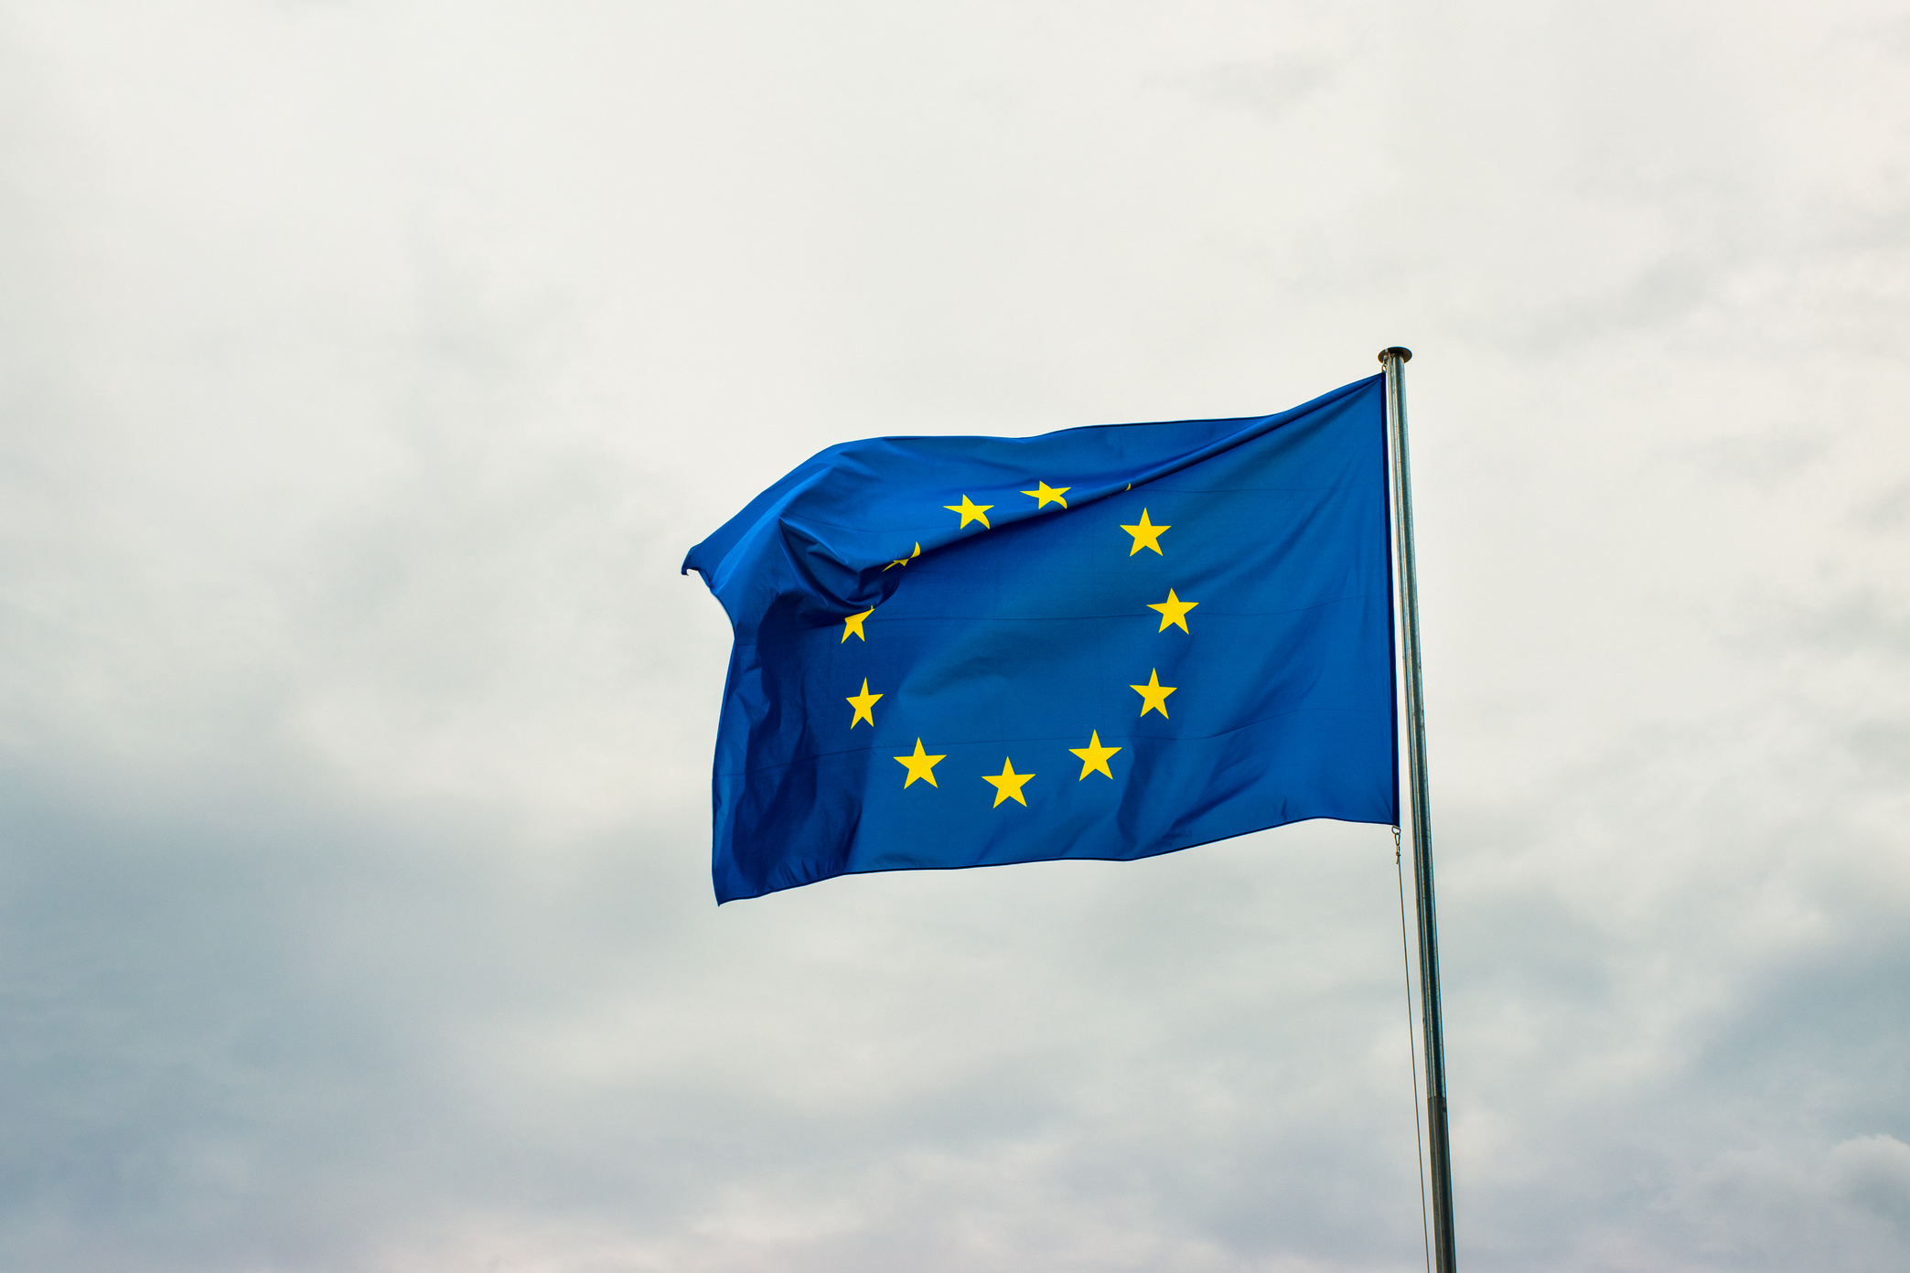
EUROPEAN LANDSCAPE
How do cultural attitudes towards cash and digital payments vary across European countries?

Slide 5
PAYMENT METHODS- Analysis on SPACE Survey 2022
Heading towards digitalized payments.
Physical cash is still representing an important element - high variability between countries.
We can notice the high variability between countries.
70.9%
58.9%
23.8%
ITALY: Payment with cash
Average EU panel
FINLAND: Payment with cash
71.6%
of cash is non obligated one.

Slide 6
Usage of Cash in the different Point of Sales
Estimating the % cash in the different points of sales we notice that:
There is high variability between points of sales ( Services 58%; Supermarket 84%).
Fixed the point of sales, remains high variability between countries.
Italy always has a higher use of cash than Finland.
Restaurants: notice how the % cash changes going from Italy to Finland.
EXAMPLE : RESTAURANT
78,5%
61.4%
17,1%
ITALY
Average EU panel
FINLAND

Slide 7

INDIVIDUAL
CHARACTERISTICS
What demographic factors influence Europeans’ preferences for cash versus digital payments?

Slide 8
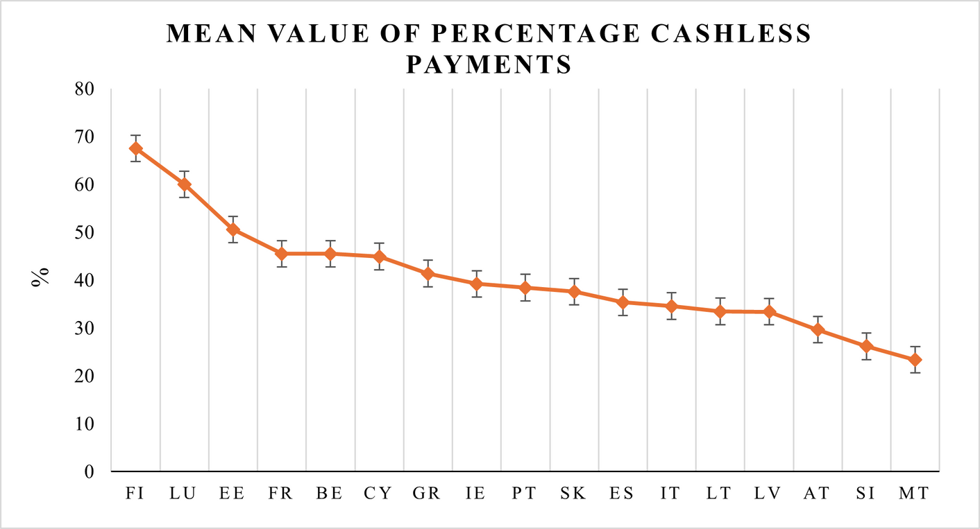
What are the potential responsible variables for this gap?
Countries’ attitude to pay voluntary cashless.
The countries are sorted from the one with the highest mean value to the one with the lowest.
The more the intervals are overlapped, the less they are significant.

Slide 9
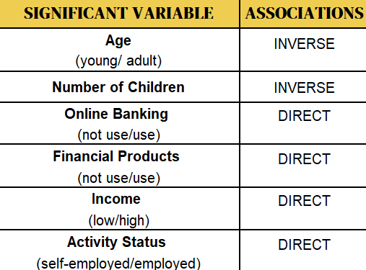
DEPENDENCE ANALYSIS OF NO CASH PAYMENT
Overall Model including the 8 countries:
How % No cash depends on Gender, Age, Education, Dependent Children, Online Banking, Financial Products, Income, and Activity Status.
We used the Beta regression model to estimate the relationship between the dependent variable and several factors.
Countries where the model is useful: Finland (FI), Slovakia (SK), Spain (ES), Italy (IT), Greece (GR), Ireland (IE), Latvia (LV), and Slovenia (SI).
The influence of the significant factors varies as the country is considered.
Gender and Education are not significant.

Slide 10

CASH ADVANTAGES
OVER DIGITAL PAYMENTS
What are the reasons that still drive European consumers to prefer cash over cashless payment?

Slide 11
Cash advantages -
Europe
The graph is ordered from the most relevant preference reason to the lowest.
Privacy and Awareness of Spending were revealed to be the major concerns related to cash usage.
Countries, where they spend more cash (Italy), consider privacy as one of many reasons by which they justify their use. In countries where %no cash is high (Finland), privacy becomes the main reason.

Slide 12
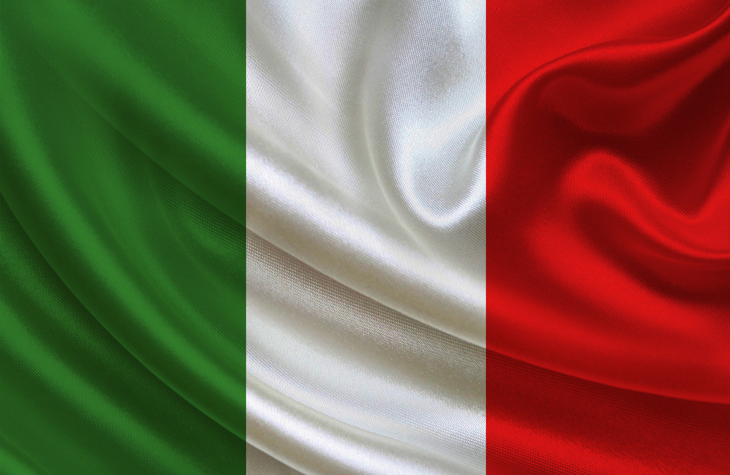
ITALIAN
LANDSCAPE
What incentives could be implemented to encourage Italian citizens to adopt the Digital Euro?

Slide 13


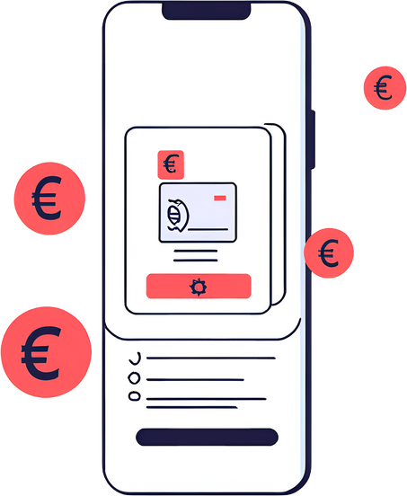

Cash advantages -
Italy
Privacy is not considered as one of the main reasons to pay with cash.
Awareness of spending is the most important factor, followed by Acceptance.

Slide 14
ITALIAN CASE STUDY
Age’s classes | % Population by Age | Margin
18-24 | 9% | 38,5%
25-29 | 6% | 37,9%
30-34 | 7% | 38%
35-39 | 7% | 37,6%
40-44 | 8% | 36,9%
45-49 | 7% | 37,7%
50-54 | 10% | 38%
55-59 | 10% | 37,3%
60-64 | 7% | 37,9%
65-69 | 8% | 39,1%
70-74 | 7% | 41,4%
>75 | 15% | 45%
Italians holding financial products are more likely to make cashless payments.
As income rises, there is a growing trend towards preferring non-cash payment methods.
Tendency of adult people to use cashless methods.
Incentives are to be provided for both youth and adults.

Slide 15
CONCLUSIONS
01
The Digital Euro’s success relies on a balanced approach to privacy, accessibility, and innovation.
02
The accessibility of the tool for European citizens will depend on the peculiar characteristics of the citizens we saw.
03
We have seen heterogeneity of no cash payments, so there will be a different implementation process for the countries within the EU.
04
2025: The regulation of the Digital Euro will be finalized, and the ECB’s Governing Council will decide whether to take a step forward.

Slide 16
Thank you
for your
attention!

