Slide 1
Handling the Client Request: Form Data
Core Servlets & JSP book: www.coreservlets.com
More Servlets & JSP book: www.moreservlets.com
Servlet and JSP Training Courses: courses.coreservlets.com

Slide 2
Agenda
Mengapa form data penting
Memproses form data di servlets
Membaca individual request parameters
Membaca all request parameters
Real-life servlets: handling malformed data
Filtering HTML-specific characters
Form Data

Slide 3
The Role of Form Data
Example URL at online travel agent
  http://host/path?user=Marty+Hall&origin=bwi&dest=lax
  Nama Url dari pembuat HTML;
  Nilai datang dari end user
Parsing form (query) data in traditional CGI
  Membaca data satu arah (QUERY_STRING) untuk GET requests, standard input untuk POST requests
  Gunakan ampersands (&), lalu pisahkan nama parameter dengan nilai parameter dengan tanda =.
  URL decode values (e.g., "%7E" becomes "~")
Form Data

Slide 4
HTTP Request-method
Protokol HTTP mendefinisikan struktur request/response antara client dan server. Yaitu:
  bagaimana client menyusun request untuk dikirimkan kepada server.
  bagaimana server menyusun response untuk diserahkan kepada client.
Class HttpServlet memakai protokol HTTP untuk menangani permintaan service dari client.
Ada tujuh method yang didefinisikan dalam spesifikasi HTTP, yaitu GET, POST, HEAD, PUT, DELETE, TRACE dan OPTIONS. (http://www.ietf.org/rfc/rfc2068.txt).
  Dua method yang banyak dipakai dalam aplikasi web adalah GET dan POST.

Slide 5
Method GET
tipikal pemakaian metoda GET untuk menjalankan (mengirimkan request kepada) servlet
  http://localhost:8084/FirstServlet/HelloServlet
Metoda GET tidak selalu dijalankan memakai URL dari dalam address-bar.
  dapat memakai form (tag <form>) untuk mengirimkan (submit) sebuah request GET.
Informasi tambahan berupa parameter dapat disertakan dalam request GET. Misalnya:
  http://localhost:8084/FirstServlet/HelloServlet?UserName=Gus Soes
Parameter disertakan setelah karakter '?'.
Setiap parameter terdiri dari pasangan name-value.
Value diletakkan setelah karakter '='.

Slide 6
Method POST
POST dipakai untuk menyertakan message-body dalam request.
POST umumnya dikirimkan melalui sebuah form (tag <form>).
  Misalnya, dalam sebuah halaman buku tamu (guest-book), ada berbagai isian seperti nama, alamat, e-mail, pesan dan sebagainya.
  Semua teks isian ini dapat dikirimkan memakai metoda POST sebagai message-body.
Contoh:
<form action="MyServlet" method="POST">
<p>Name: <input type="text" name="UserName" size="36"></p>
<p>E-mail: <input type="text" name="Email" size="36"></p>
<p>Message: <br>
<TEXTAREA name="Msg" rows=7 cols=50></TEXTAREA>
</p>
<p>Press Submit to send data.
<input type="submit" name="Submit" value="Submit">
<input type="reset" value="Reset">
</p>
</form>

Slide 7
Creating Form Data:
HTML Forms
<!DOCTYPE HTML PUBLIC "-//W3C//DTD HTML 4.0 Transitional//EN">
<HTML>
<HEAD><TITLE>A Sample Form Using GET</TITLE></HEAD>
<BODY BGCOLOR="#FDF5E6">
<H2 ALIGN="CENTER">A Sample Form Using GET</H2>
<FORM ACTION="http://localhost:8088/SomeProgram">
<CENTER>
First name:
<INPUT TYPE="TEXT" NAME="firstName" VALUE="Joe"><BR>
Last name:
<INPUT TYPE="TEXT" NAME="lastName" VALUE="Hacker"><P>
<INPUT TYPE="SUBMIT"> <!-- Press this to submit form -->
</CENTER>
</FORM>
</BODY></HTML>
See CSAJSP Chapter 16 for details on forms
Form Data

Slide 8
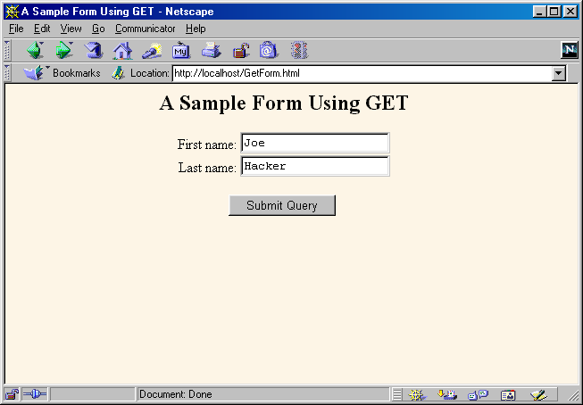
HTML Form: Initial Result
Form Data

Slide 9
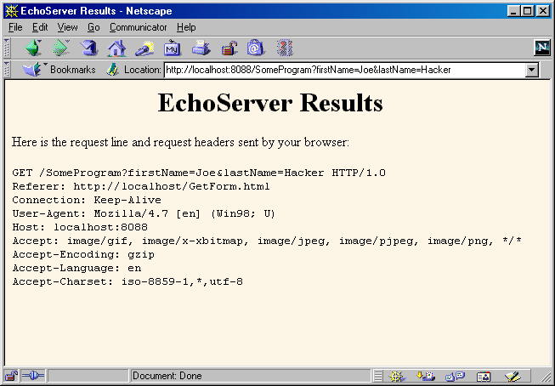
HTML Form: Submission Result
(Data Sent to EchoServer)
Form Data

Slide 10
Sending POST Data
<!DOCTYPE HTML PUBLIC "-//W3C//DTD HTML 4.0 Transitional//EN">
<HTML>
<HEAD><TITLE>A Sample Form Using POST</TITLE></HEAD>
<BODY BGCOLOR="#FDF5E6">
<H2 ALIGN="CENTER">A Sample Form Using POST</H2>
<FORM ACTION="http://localhost:8088/SomeProgram"
METHOD="POST">
<CENTER>
First name:
<INPUT TYPE="TEXT" NAME="firstName" VALUE="Joe"><BR>
Last name:
<INPUT TYPE="TEXT" NAME="lastName" VALUE="Hacker"><P>
<INPUT TYPE="SUBMIT">
</CENTER>
</FORM>
</BODY></HTML>
Form Data

Slide 11
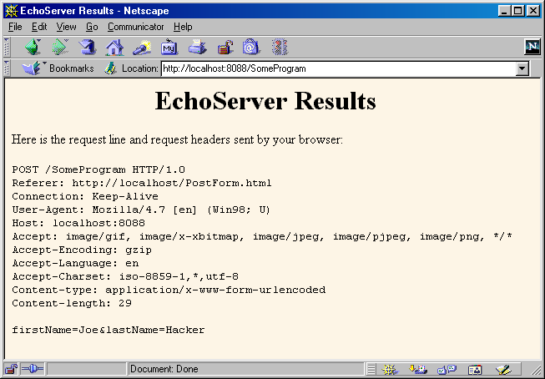
Sending POST Data
Form Data

Slide 12
GET Method VS POST Method
Jika menggunakan GET, maka data ditambahkan pada akhir dari URL setelah tanda (?). Get merupakan method default.
Jika menggunakan POST, data dikirimkan pada baris terpisah.
Keuntungan menggunakan method GET :
  method sederhana
  Servlet dapat digunakan untuk testing dan debugging tanpa membuat form.
Kelemahan GET :
  Pada beberapa browser, ada keterbatasan jumlah data.
  Beberapa browser memperlihatkan alamat URL, sehingga tidak sesuai untuk data yang rahasia.
Form Data

Slide 13
Reading Form Data In Servlets
request.getParameter("name")
  Returns URL-decoded value of first occurrence of name in query string
  Works identically for GET and POST requests
  Returns null if no such parameter is in query
request.getParameterValues("name")
  Returns an array of the URL-decoded values of all occurrences of name in query string
  Returns a one-element array if param not repeated
  Returns null if no such parameter is in query
request.getParameterNames()
  Returns Enumeration of request params
Form Data

Slide 14
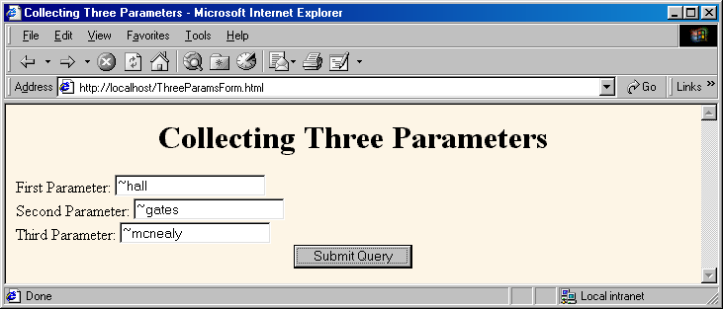
An HTML Form With Three Parameters
<FORM ACTION="/servlet/coreservlets.ThreeParams">
First Parameter: <INPUT TYPE="TEXT" NAME="param1"><BR>
Second Parameter: <INPUT TYPE="TEXT" NAME="param2"><BR>
Third Parameter: <INPUT TYPE="TEXT" NAME="param3"><BR>
<CENTER><INPUT TYPE="SUBMIT"></CENTER>
</FORM>
Form Data

Slide 15
Reading the Three Parameters
public class ThreeParams extends HttpServlet {
public void doGet(HttpServletRequest request,
HttpServletResponse response)
throws ServletException, IOException {
response.setContentType("text/html");
PrintWriter out = response.getWriter();
String title = "Reading Three Request Parameters";
out.println(ServletUtilities.headWithTitle(title) +
"<BODY BGCOLOR=\"#FDF5E6\">\n" +
"<H1 ALIGN=CENTER>" + title + "</H1>\n" +
"<UL>\n" +
" <LI><B>param1</B>: "
+ request.getParameter("param1") + "\n" +
" <LI><B>param2</B>: "
+ request.getParameter("param2") + "\n" +
" <LI><B>param3</B>: "
+ request.getParameter("param3") + "\n" +
"</UL>\n" +
"</BODY></HTML>"); }}
Form Data

Slide 16
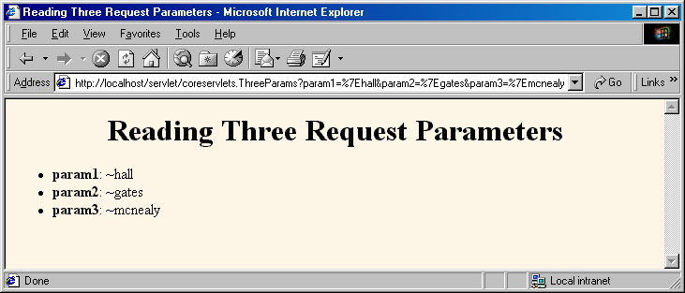
Reading Three Parameters:
Result
Form Data

Slide 17
Reading All Parameters
public class ShowParameters extends HttpServlet {
public void doGet(HttpServletRequest request,
HttpServletResponse response)
throws ServletException, IOException {
response.setContentType("text/html");
PrintWriter out = response.getWriter();
String title = "Reading All Request Parameters";
out.println(ServletUtilities.headWithTitle(title) +
"<BODY BGCOLOR=\"#FDF5E6\">\n" +
"<H1 ALIGN=CENTER>" + title + "</H1>\n" +
"<TABLE BORDER=1 ALIGN=CENTER>\n" +
"<TR BGCOLOR=\"#FFAD00\">\n" +
"<TH>Parameter Name<TH>Parameter Value(s)");
Form Data

Slide 18
Reading All Parameters (Continued)
Enumeration paramNames = request.getParameterNames();
while(paramNames.hasMoreElements()) {
String paramName = (String)paramNames.nextElement();
out.print("<TR><TD>" + paramName + "\n<TD>");
String[] paramValues =
request.getParameterValues(paramName);
if (paramValues.length == 1) {
String paramValue = paramValues[0];
if (paramValue.length() == 0)
out.println("<I>No Value</I>");
else
out.println(paramValue);
Form Data

Slide 19
Reading All Parameters (Continued)
} else {
out.println("<UL>");
for(int i=0; i<paramValues.length; i++) {
out.println("<LI>" + paramValues[i]);
}
out.println("</UL>");
}
}
out.println("</TABLE>\n</BODY></HTML>");
}
public void doPost(HttpServletRequest request,
HttpServletResponse response)
throws ServletException, IOException {
doGet(request, response);
}
}
Form Data

Slide 20
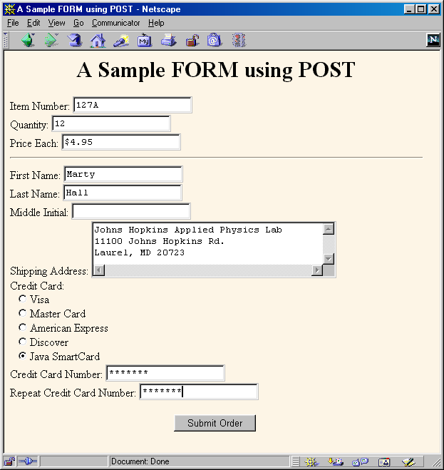
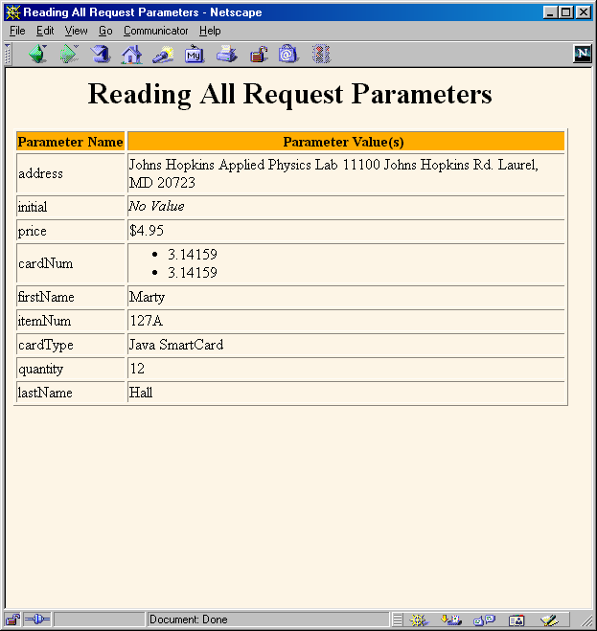
Result of ShowParameters Servlet
  Note that order of parameters in Enumeration does not match order they appeared in Web page
Form Data

Slide 21
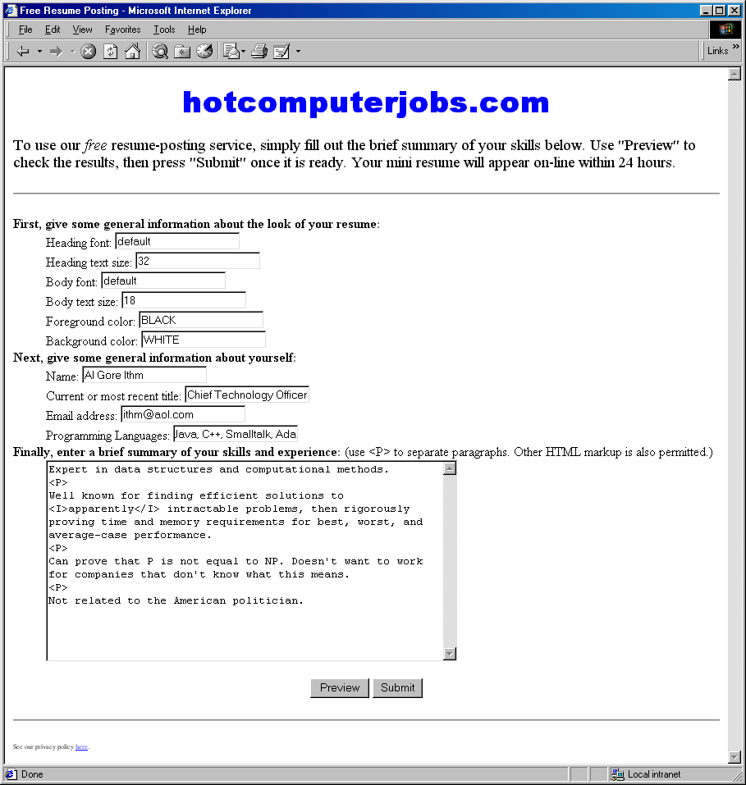
Posting Service: Front End
Gathers resumé
formatting and
content
information
Form Data

Slide 22
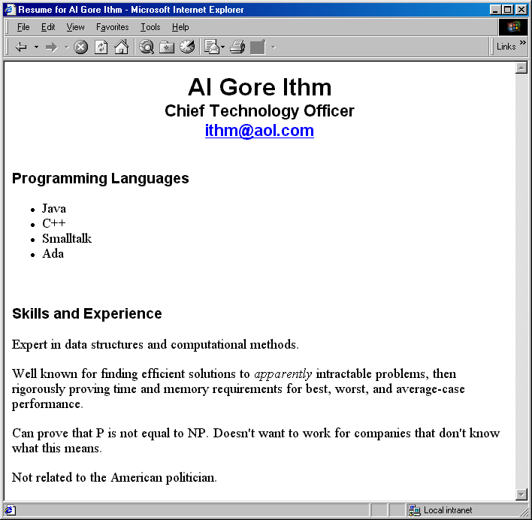
Posting Service: Back End
Previews
result
or stores
resumé
in database
Form Data

Slide 23
Point: Check for Missing Data
Textfield was not in HTML form at all
  request.getParameter returns null
Textfield was empty when form was submitted
  Request.getParameter returns an empty String
Example Check
String value = request.getParameter("someName");
if ((value != null) && (!value.equals("")) {
…
}
Form Data

Slide 24
Posting Service: Servlet Code
private void showPreview(HttpServletRequest request,
PrintWriter out) {
String headingFont = request.getParameter("headingFont");
headingFont = replaceIfMissingOrDefault(headingFont, "");
...
String name = request.getParameter("name");
name = replaceIfMissing(name, "Lou Zer");
String title = request.getParameter("title");
title = replaceIfMissing(title, "Loser");
String languages = request.getParameter("languages");
languages = replaceIfMissing(languages, "<I>None</I>");
String languageList = makeList(languages);
String skills = request.getParameter("skills");
skills = replaceIfMissing(skills, "Not many, obviously.");
...
}
Point: always explicitly handle
missing or malformed query data
Form Data

Slide 25
Filtering Strings for HTML-Specific Characters
You cannot safely insert arbitrary strings into servlet output
  < and > can cause problems anywhere
  & and " can cause problems inside of HTML attributes
You sometimes cannot manually translate
  The string is derived from a program excerpt or another source where it is already in some standard format
  The string is derived from HTML form data
Failing to filter special characters from form data makes you vulnerable to cross-site scripting attack
  http://www.cert.org/advisories/CA-2000-02.html
  http://www.microsoft.com/technet/security/crssite.asp
Form Data

Slide 26
Filtering Code (ServletUtilities.java)
public static String filter(String input) {
StringBuffer filtered = new StringBuffer(input.length());
char c;
for(int i=0; i<input.length(); i++) {
c = input.charAt(i);
if (c == '<') {
filtered.append("&lt;");
} else if (c == '>') {
filtered.append("&gt;");
} else if (c == '"') {
filtered.append("&quot;");
} else if (c == '&') {
filtered.append("&amp;");
} else {
filtered.append(c);
}
}
return(filtered.toString());
}
Form Data

Slide 27
Servlet That Fails to Filter
public class BadCodeServlet extends HttpServlet {
private String codeFragment =
"if (a<b) {\n" +
" doThis();\n" +
"} else {\n" +
" doThat();\n" +
"}\n";
public String getCodeFragment() {
return(codeFragment);
}
Form Data

Slide 28
Servlet That Fails to Filter (Continued)
public void doGet(HttpServletRequest request,
HttpServletResponse response)
throws ServletException, IOException {
response.setContentType("text/html");
PrintWriter out = response.getWriter();
String title = "The Java 'if' Statement";
out.println(ServletUtilities.headWithTitle(title) +
"<BODY>\n" +
"<H1>" + title + "</H1>\n" +
"<PRE>\n" +
getCodeFragment() +
"</PRE>\n" +
"Note that you <I>must</I> use curly braces\n" +
"when the 'if' or 'else' clauses contain\n" +
"more than one expression.\n" +
"</BODY></HTML>");
}
Form Data

Slide 29
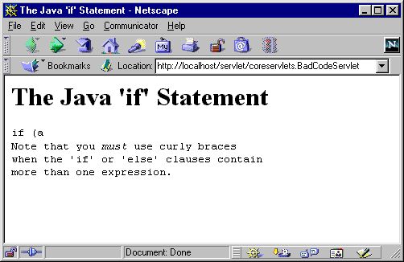
Servlet That Fails to Filter (Result)
Form Data

Slide 30
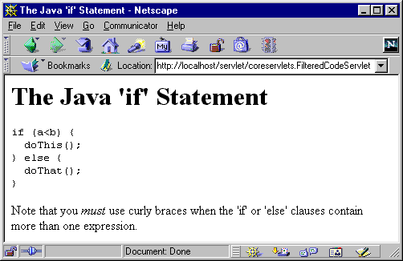
Servlet That Properly Filters
public class FilteredCodeServlet extends BadCodeServlet {
public String getCodeFragment() {
return(ServletUtilities.filter(super.getCodeFragment()));
}
}
Form Data

Slide 31
Summary
Query data comes from HTML forms as URL-encoded name/value pairs
Servlets read data by calling request.getParameter("name")
  Results in value as entered into form, not as sent over network. I.e. not URL-encoded.
Always check for missing or
malformed data
  Missing: null or empty string
  Special case: query data that contains special HTML characters
    Need to be filtered if query data will be placed into resultant HTML page
Form Data

Slide 32
Questions?
Core Servlets & JSP book: www.coreservlets.com
More Servlets & JSP book: www.moreservlets.com
Servlet and JSP Training Courses: courses.coreservlets.com

