Slide 1
Welcome!
MAJESCONET
Tour

Slide 2
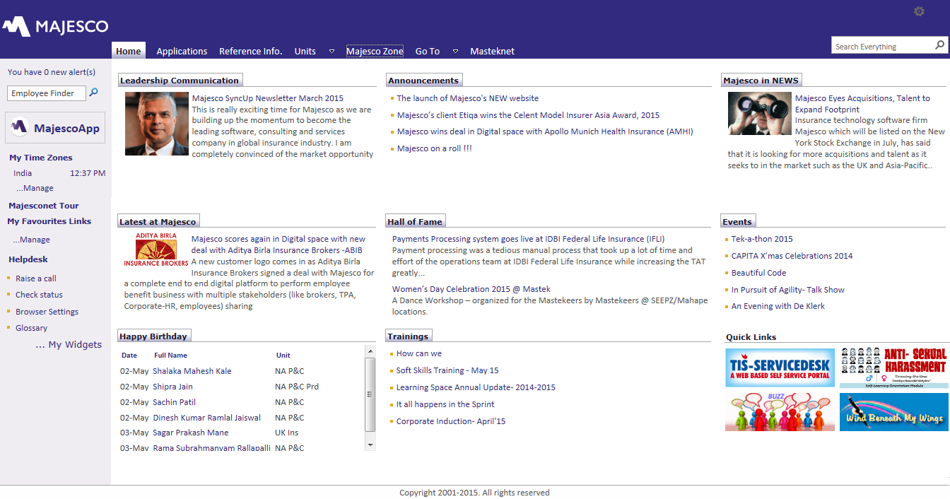
The Home Page
Navigation Bar
Search Box
News
Hall Of Fame
Dashboard
Events
Trainings
Birthday List
Quick Links

Slide 3
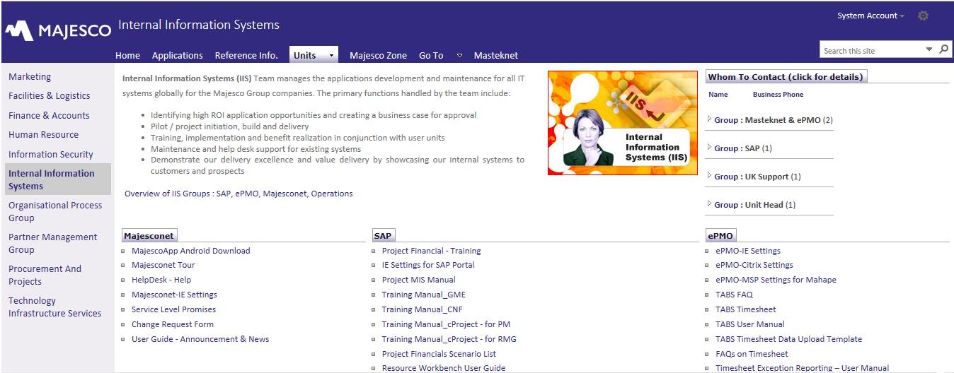
Multiple ways to navigate
Top Navigation bar
available at all times
Use Menu bar to browse
within the sections

Slide 4
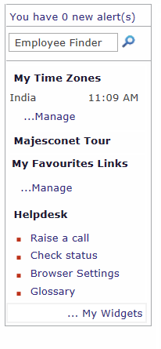
Dashboard
Check alerts regularly!
Quickly search a person by name
Contact Masteknet Helpdesk

Slide 5
Organization of Information
Access the major sections from the top navigation bar.
Applications
Access the Employee Self-service Applications menu grouped by function
Units
Information pertaining to a specific unit such as Corporate Function and the reference information like whom to contact, forms, procedures etc.
Majesco Zone
Information pertaining to the Majesco Group as a whole
Go to
Information pertaining to SAP and OPG portal as a whole
Masteknet
Access the Masteknet portal

Slide 6
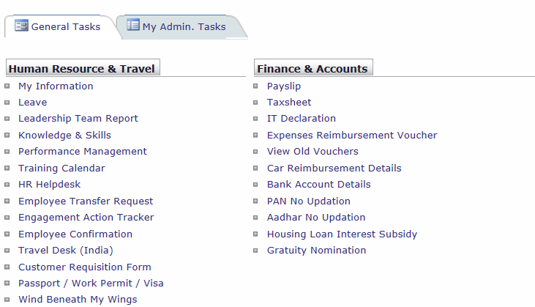
Applications
Employee Self-Service
Applications Menu
The tasks (applications) are
grouped as per the corporate
function providing the service.
Click on the menu option to
carry out a task or request a service.
Administrative menu options are available under the “Admin Tasks” tab.

Slide 7
Individual Unit section
Each Corporate Function
has a dedicated section.
This section provides the basic information about the unit and its services.
Whom to contact in the unit
Reference information
Applications / tasks menu
Policies & Procedures
The section may have sub-sections or pages. Please browse through the section using Menu bar on the left side.

Slide 8
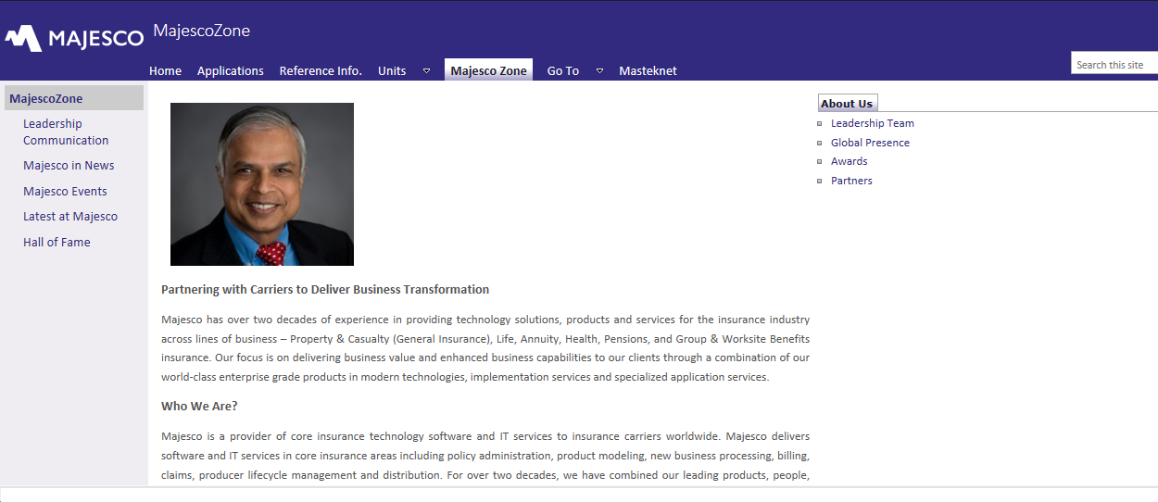
Majesco Zone
The whole is greater than sum of parts!
This section provides the basic information about the Mastek Group on a global scale.
The vision and culture
Leadership profile
History & Fast fact
Org chart & global presence
The section has many sub-sections or pages. Please browse through the section using Menu bar on the left side.

Slide 9
How to get further help???
Its easier than you think.
Go to the Dashboard and try any of these ways –
Look in the Glossary
Check browser settings, if needed
Raise a query on Helpdesk
You can also log a call by sending email to iishelpdesk@mastek.com
Thank you!
IIS Team

