Slide 1

WAPT
A load testing solution for web applications
This presentation should be viewed as a Slide Show. Choose “Slide Show” from the PowerPoint menu and click the “From Beginning” button on the toolbar.
© 2016 SoftLogica Inc.

Slide 2

Load testing basics
If your web application is to be used by multiple people simultaneously, you need to load test it before going to production.
Functional tests are not sufficient, because the application behavior may be significantly different under the load.
A performance problem limiting the application capacity may be related to any component: from web server to third party web services. That is why it is important to create realistic load tests with carefully emulated user sessions. This is the only way to fully test the backend performance.
www.LoadTestingTool.com

Slide 3






Testing types and goals
Each test may have a more specific purpose, which will define its type.
Performance: measures average response time, error rate, number of transactions per second, etc.
Capacity: finds maximum number of users that can work with the application concurrently.
Stress: checks the ability to return to normal operation after experiencing exceptionally high load.
Volume: checks the ability to work with high volumes of data.
Endurance: checks the ability to stay loaded for a long time without performance degradation.
Regression: ensures that each new version meets the performance criteria.
www.LoadTestingTool.com

Slide 4
Load testing tools
There is a wide range of tools and online services that let you run all types of load tests.
Despite so many options, we believe that WAPT is the right choice for a number of reasons:
Ease of use
Emulation accuracy
Set of features and supported technologies
Scalability for large tests
Load generation performance
Level of technical support
Let’s see how we achieve excellence in each of these points…
www.LoadTestingTool.com

Slide 5

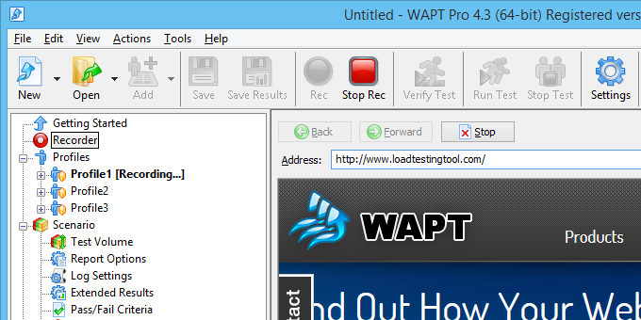
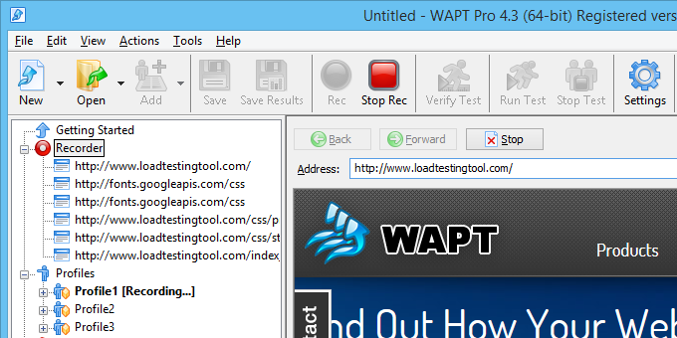
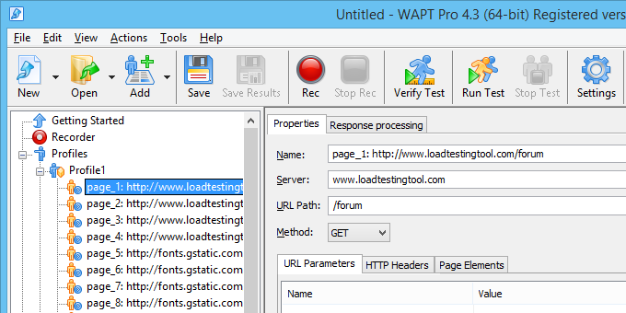
WAPT
You can design tests as easy as using a browser. Just navigate through the web site to record a user session. WAPT will replay it with thousands virtual users when running the test.
No scripting is necessary.
No programming background is required.
The efficiency of your work is our priority.
www.LoadTestingTool.com

Slide 6
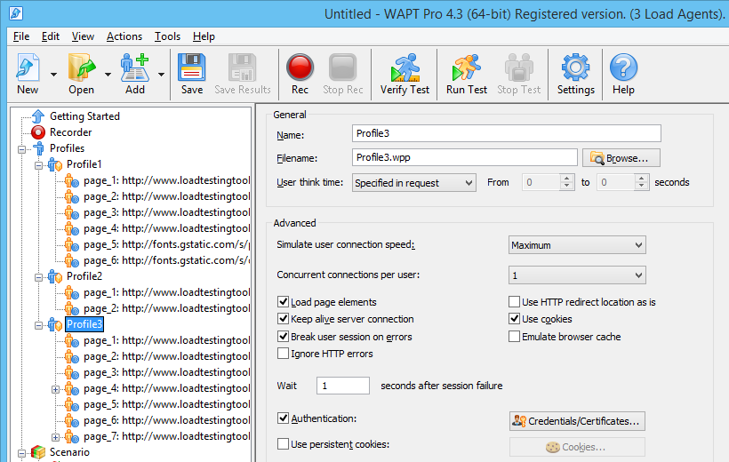
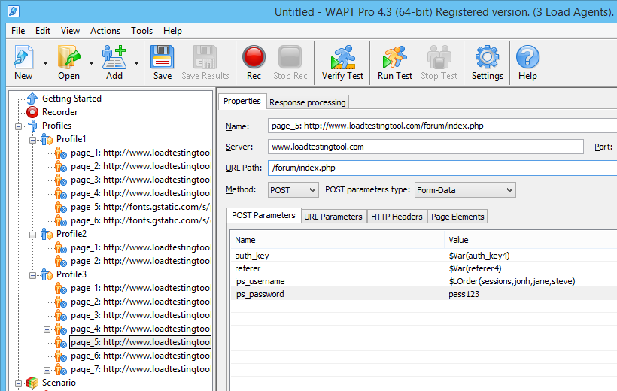
WAPT
Each session is recorded to a virtual user profile as a sequence of HTTP requests. You can browse profiles in the left view.
In the same view you can select a request and edit its parameters, headers, page elements and other properties.
www.LoadTestingTool.com

Slide 7
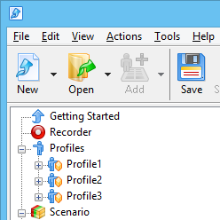
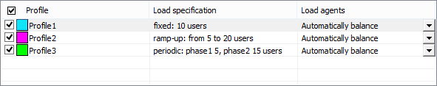
WAPT
The test may include different profiles to emulate different types of users.
The load is flexibly specified separately for each profile.
www.LoadTestingTool.com

Slide 8
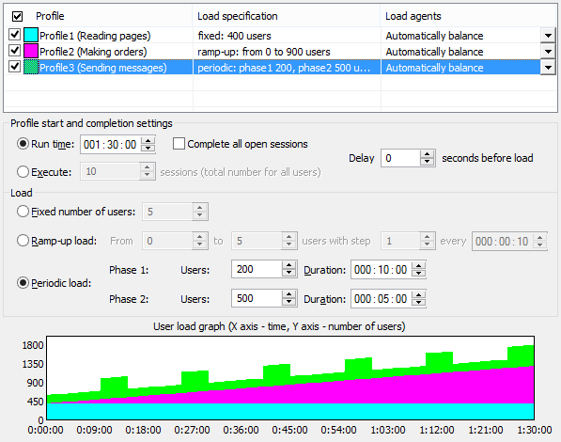
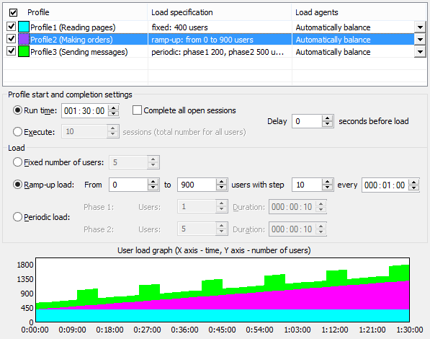
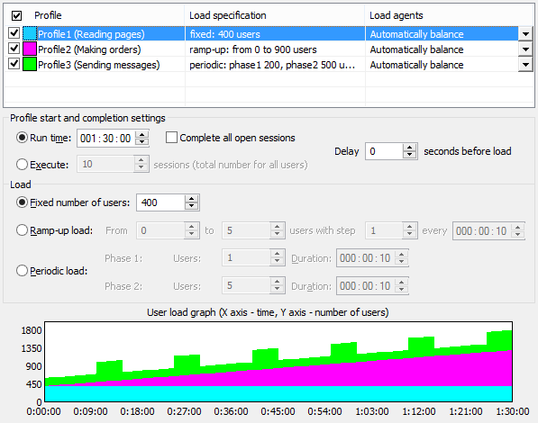
WAPT
Depending on the type of load the number of virtual users can change throughout the test.
It can be constant (Profile1)…
Growing (Profile2)…
Or periodic (Profile3).
www.LoadTestingTool.com

Slide 9
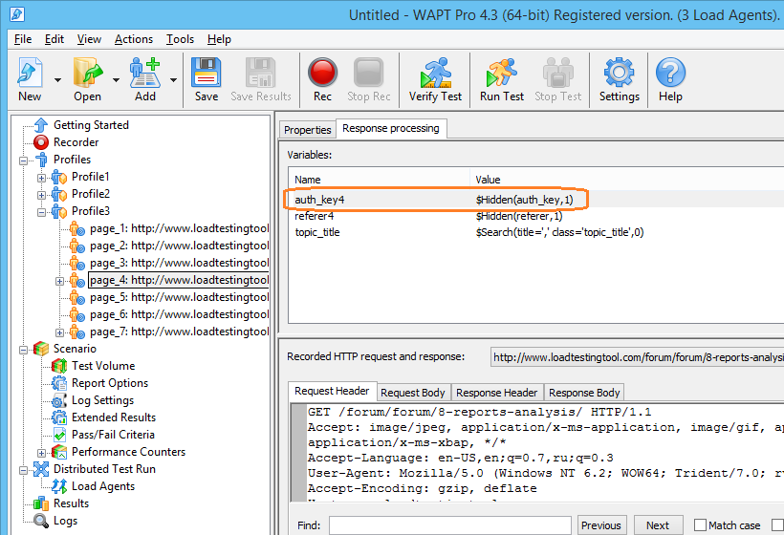
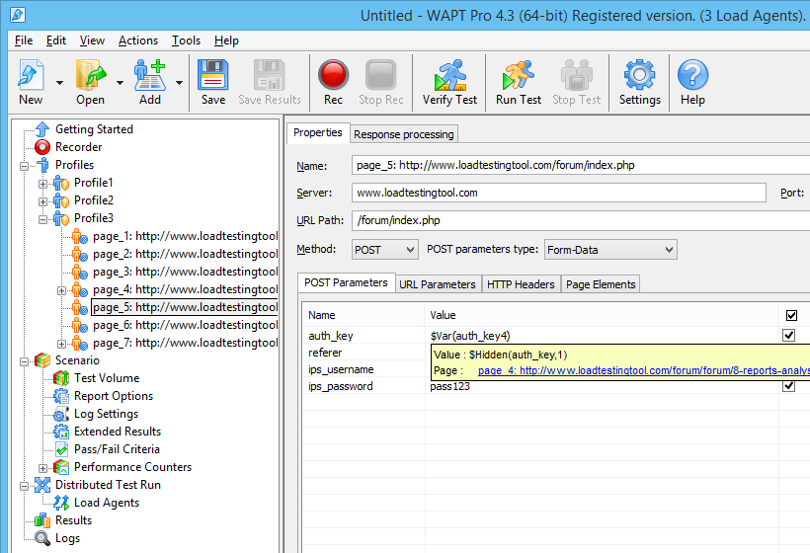
WAPT
Automatic handling of cookies and standard session-specific values will produce correct emulation of each user session.
www.LoadTestingTool.com

Slide 10
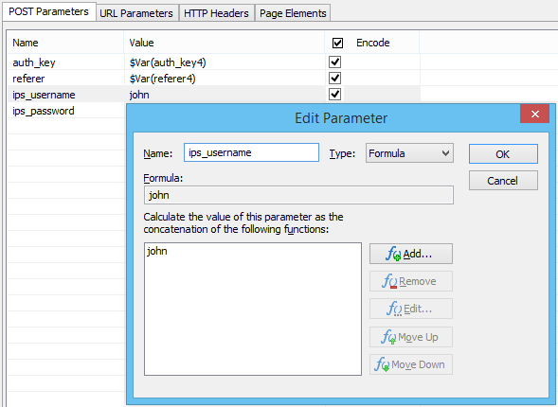
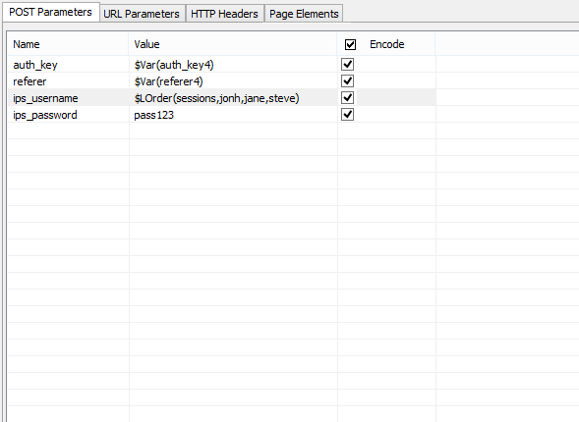
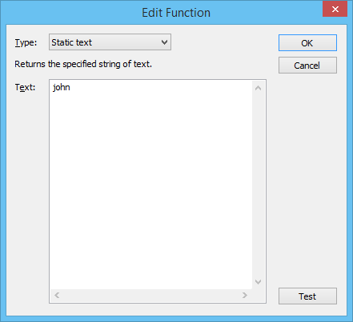
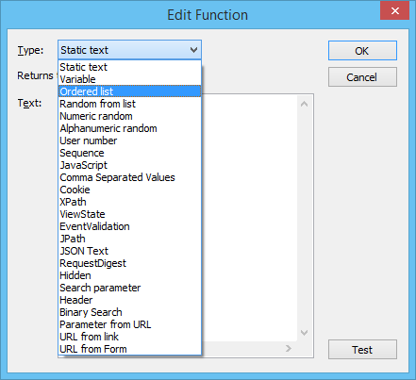
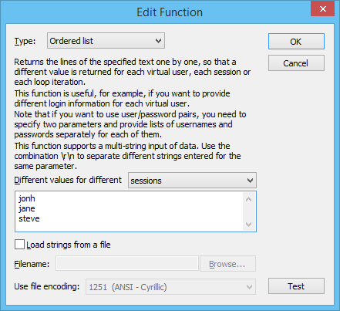
WAPT
With couple clicks you can create data-driven tests by specifying different names, passwords and input data for different users.
www.LoadTestingTool.com

Slide 11
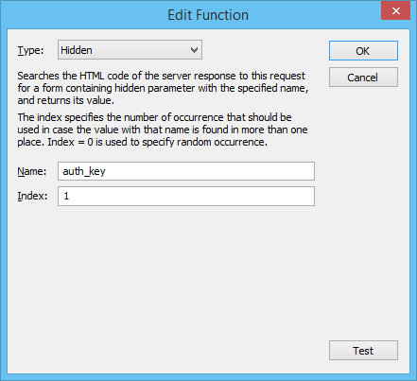
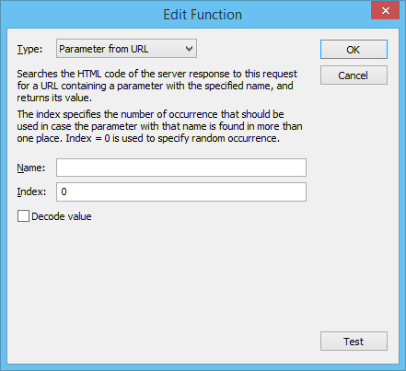
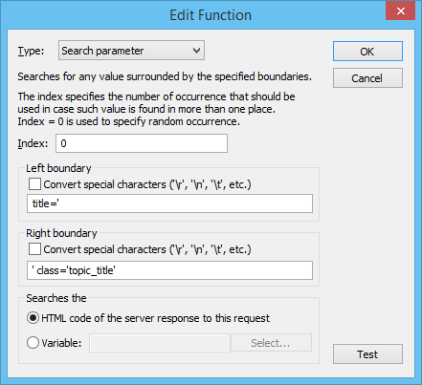
WAPT
Any session-specific values in the test can be parameterized with help of the special WAPT functions.
You can extract values from server responses to variables and reuse them in subsequent requests.
www.LoadTestingTool.com

Slide 12
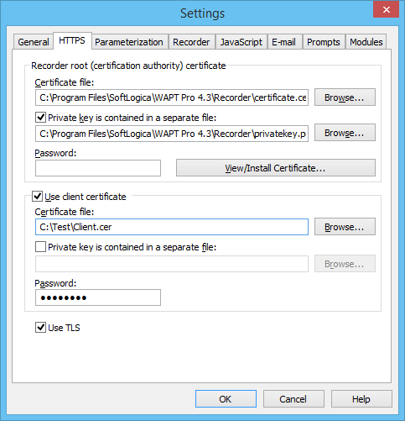
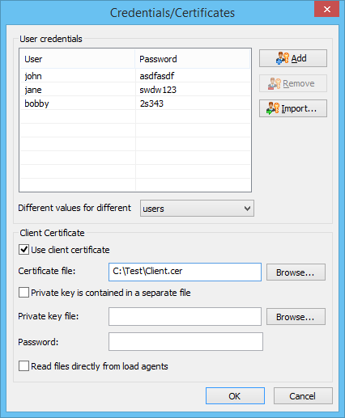
WAPT
You can test secure HTTPs pages and web sites requiring all types of authentication and client certificates.
www.LoadTestingTool.com

Slide 13
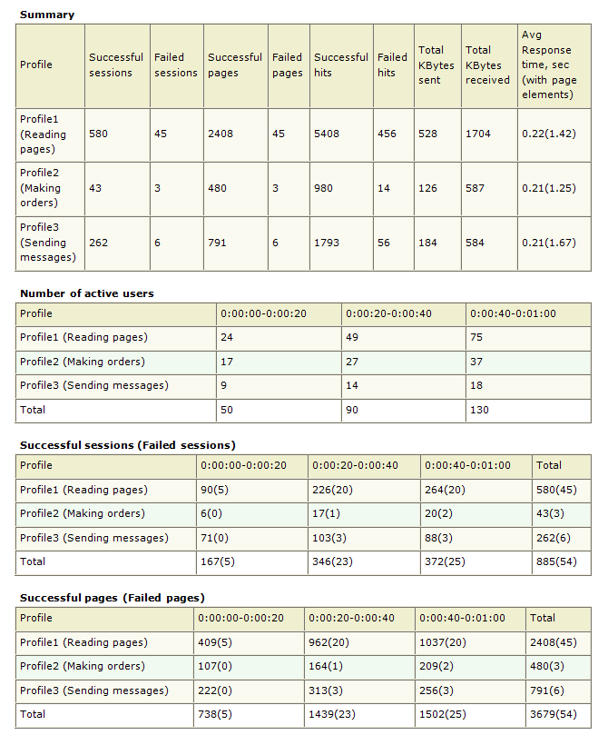
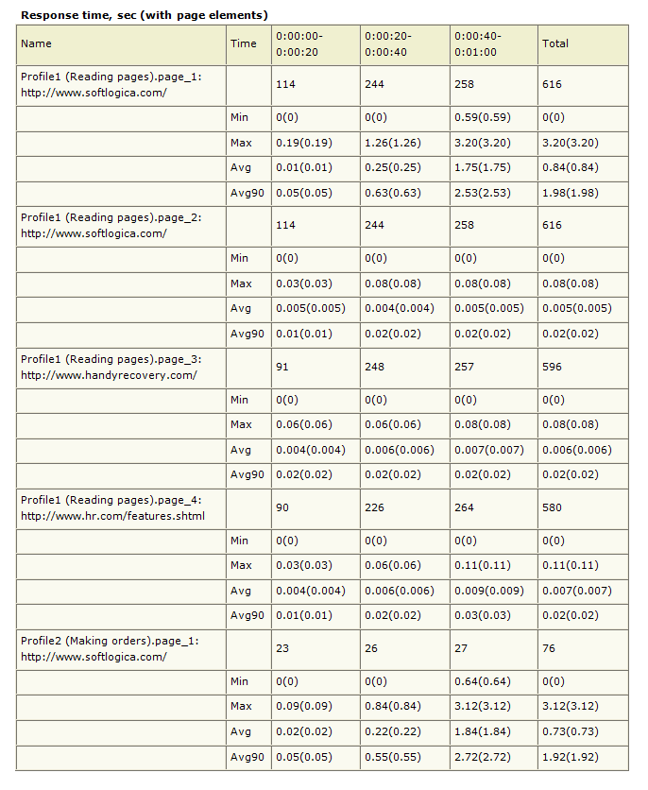
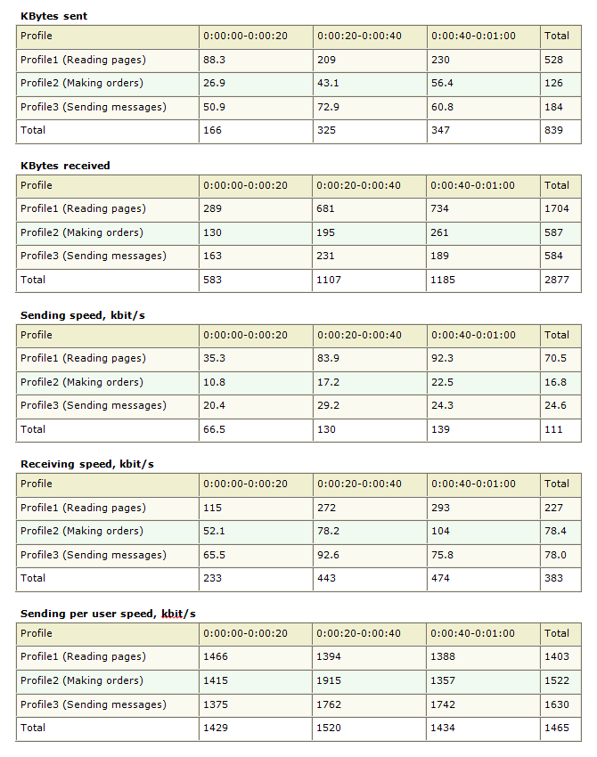
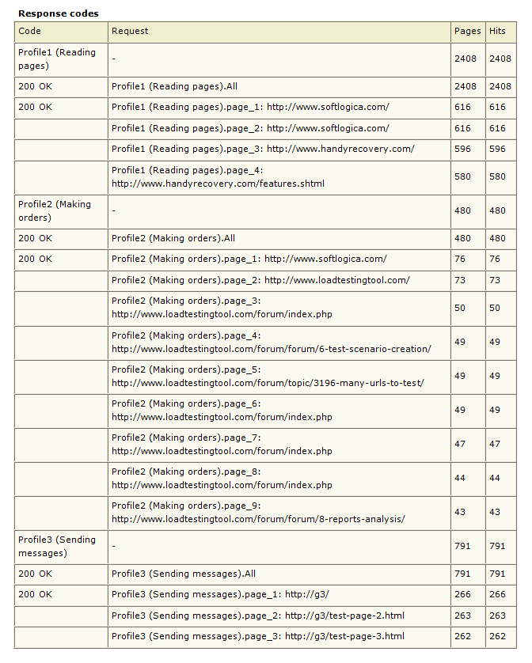
WAPT
Test report contains comprehensive information on the system performance: response times, throughput parameters, bandwidth usage, errors rates, and over 20 other tables with data.
www.LoadTestingTool.com

Slide 14
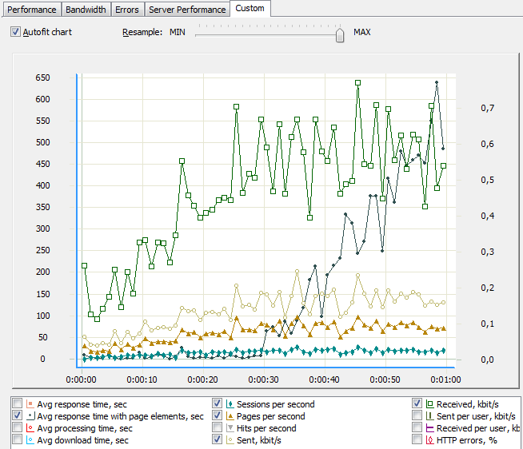
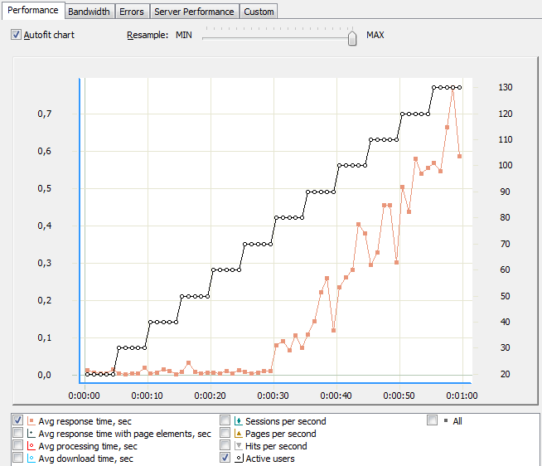
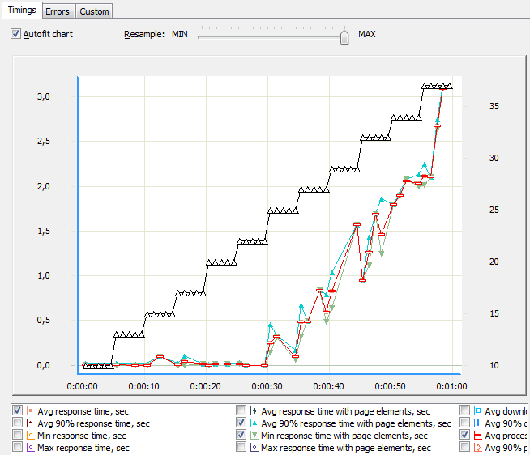
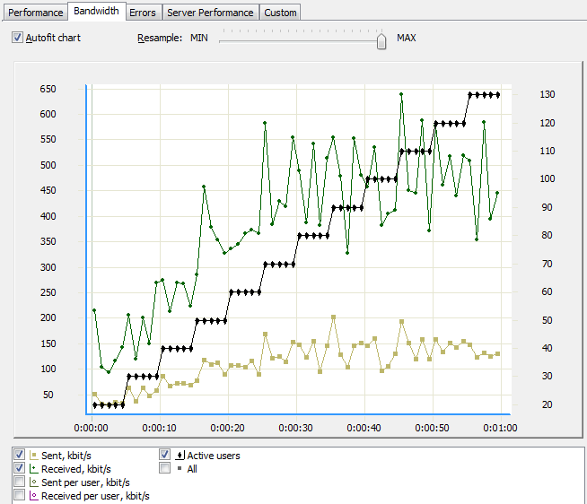
WAPT
You are not limited to viewing report tables with numbers. WAPT also provides test results in form of charts updating at runtime.
You can analyze the dependence of any performance parameters from the created load.
www.LoadTestingTool.com

Slide 15
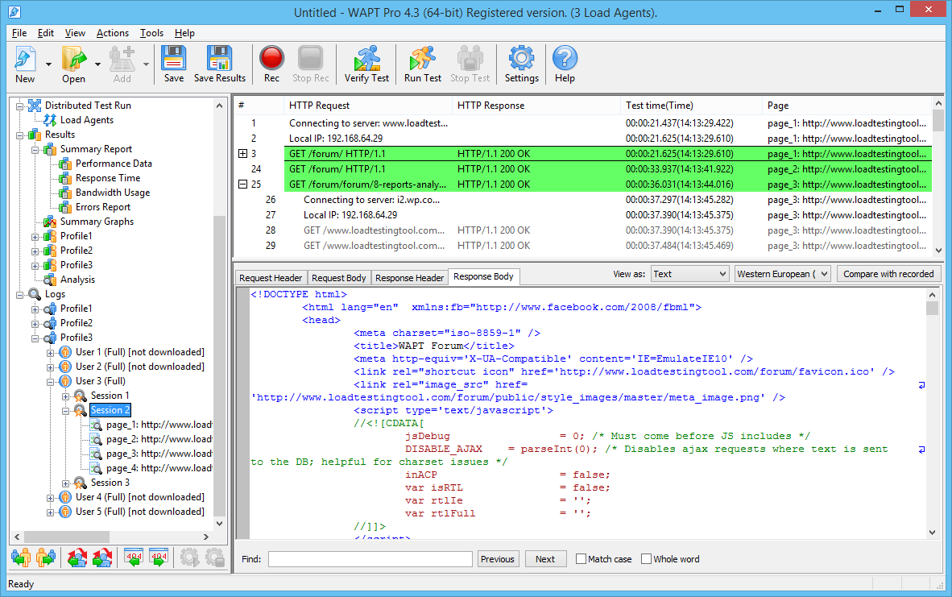
WAPT
The information on each HTTP request produced in the test can be logged. This lets you fully analyze the conditions of any errors.
WAPT lets you browse logs in a special viewer, where you can easily navigate between users, sessions and reported errors.
www.LoadTestingTool.com

Slide 16

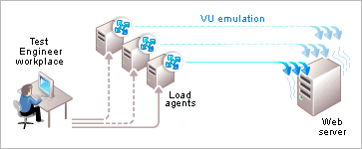
WAPT Pro
To address the need for a more powerful, flexible and feature-rich testing tool with additional integration capabilities, we offer the professional version of our product. Due to the distributed architecture, it can use several systems for load generation.
www.LoadTestingTool.com

Slide 17
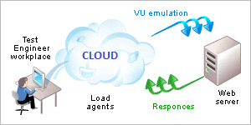
WAPT Pro
WAPT Pro consists of the workplace component and multiple load agents that can be installed in different network locations.
You can switch load agents and change the test load on the fly.
www.LoadTestingTool.com

Slide 18
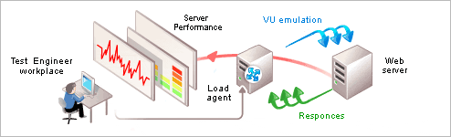
WAPT Pro
Your web application may include multiple components, such as load balancers, web servers, application servers, databases, etc.
When applying a load test to such a complex system, the classical black-box approach will not always work. It is often required to monitor the behavior of each system component under load.
WAPT Pro can use WMI and SNMP interfaces to collect the performance counters values directly from one or more servers. It can also monitor database performance for MS SQL, Oracle and MySQL.
www.LoadTestingTool.com

Slide 19
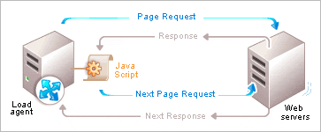
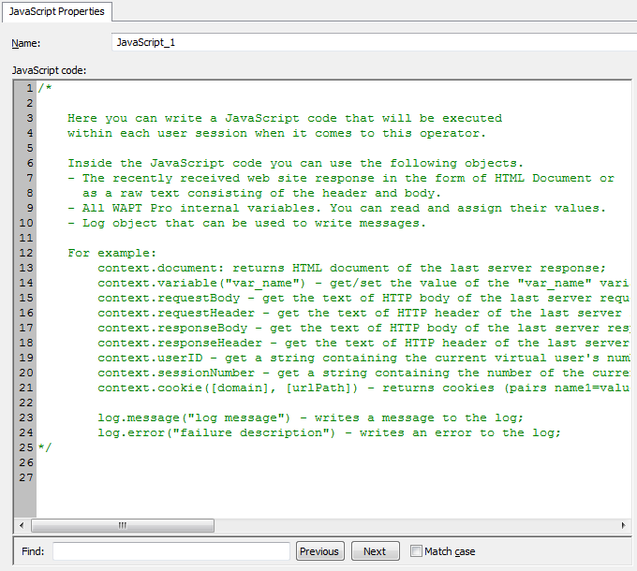
WAPT Pro
If your web application uses a complex client-server communication scheme, it is not always possible to extract all session-specific values from server responses with help of simple functions.
In WAPT Pro you can use JavaScript code to calculate such values. The code will be executed inside each user session.
www.LoadTestingTool.com

Slide 20
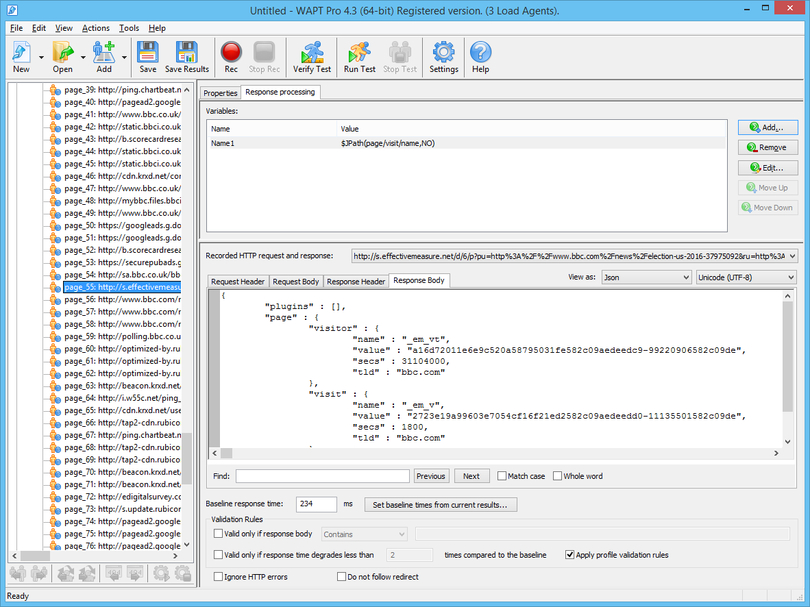
WAPT Extension Modules
Web applications created with help of modern frameworks often use complex data structures to pass information between the client and the server.
To provide better support for this, we offer a number of extension modules for WAPT and WAPT Pro products.
Each module adds features related to a certain technology:
Support for binary data formats;
Visual representation of embedded structures;
Automatic parameterization of protocol-specific data.
www.LoadTestingTool.com

Slide 21







WAPT Extension Modules
The following modules are currently available:
Module for ASP.NET testing
Module for Adobe® Flash® testing
Module for JSON format
Module for Silverlight testing
Module for GWT testing
Module for binary formats
Module for SharePoint testing
www.LoadTestingTool.com

Slide 22

x64 Load Engine
If you need to run a high capacity test with over 5,000 virtual users, you have an option to use a special 64 bit load generation utility. It is capable of emulating over 10,000 users with help of a single system.
x64 Load Engine works with WAPT Pro and replaces a regular load agent.
You can attach as many engines as you need to generate higher load.
www.LoadTestingTool.com

Slide 23


WAPT Cloud
If you need to run a one-time test and do not want to purchase permanent product licenses, WAPT Cloud is the best choice for you. Available at $5 per hour, it will let you use the full functionality of WAPT Pro and all extension modules.
You will not need to choose any components and install them. The product is ready-to-use as a preconfigured system image. You can connect to it with Remote Desktop and run your tests.
To create greater test load you can use additional Cloud Engines of different capacity.
All products are currently available on the Amazon Web Services Marketplace.
www.LoadTestingTool.com

Slide 24



Support and Services
We do not simply sell software licenses. We see the communication with each of our customers as a process that starts before we make a sale and may develop into any type of collaboration.
We provide free technical support on the product functionality and general load testing practices. It is fast and efficient, because we believe that this is what you actually pay for when you purchase our products.
In addition, we provide consulting services, so you have an option to fully outsource your load testing tasks to us.
www.LoadTestingTool.com

Slide 25




WAPT resources on the Web
Product documentation: from Quick Start Guide on the main WAPT features to the complete online help.
Demo video on the product usage with step by step instructions.
The “On Load Testing” blog: industry news, best practices, product announcements and more.
Online forum: ask questions and share your experience with other WAPT users.
www.LoadTestingTool.com

Slide 26



WAPT Customers
Thousands organizations from all around the world have already chosen our products.
Our customers range:
from financial to educational and government institutions;
from IT service providers to energy companies;
from small private businesses to international corporations.
Our mission is to address the needs of each of our clients and offer quality products and services at competitive prices.
www.LoadTestingTool.com

Slide 27
Contact us
You can download the latest versions of our products from our web site: http://www.loadtestingtool.com
If you have any questions on our products or services, please contact us at support@loadtestingtool.com
© 2016 SoftLogica Inc.
901 N Pitt str Suite 325, Alexandria, VA, 22314, United States

