Slide 1
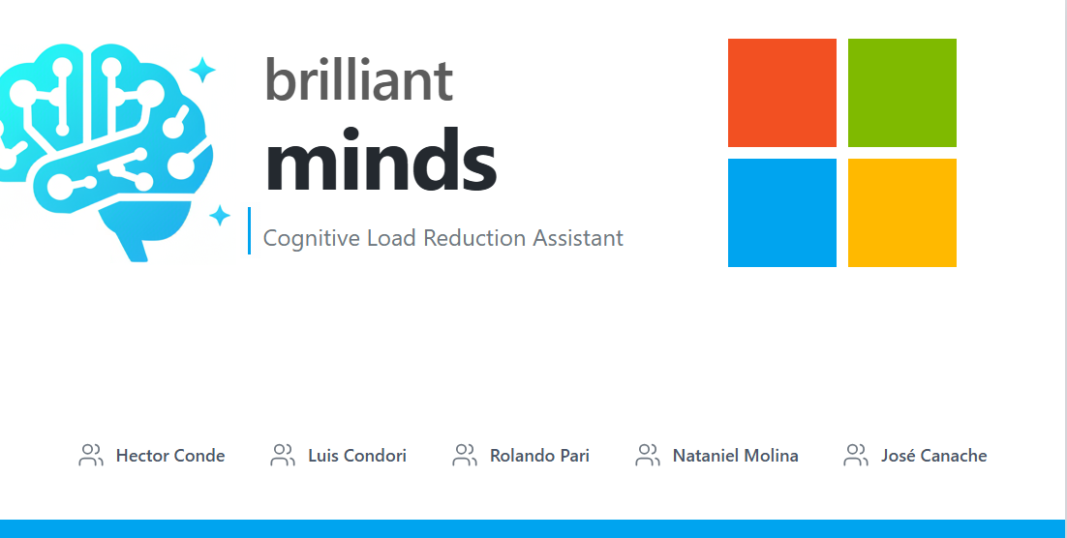
Microsoft Innovation Challenge March 2026

Slide 2
BRILLIANT MINDS
Brilliant Minds is a Cognitive Load Reduction Assistant.
AI-powered learning initiative.
Designed to support neurodiverse learners to build cognitive resilience.
Promotes inclusion and equal opportunities in education.
Focused on advancing STEAM subjects (Science, Technology, Engineering, Arts, Mathematics).
Supports collaboration between students, teachers, and parents.
Vision: To empower the next generation to learn anytime, anywhere, without limits.
Mission: Use Responsible AI and Microsoft technologies to provide personalized, inclusive, and flexible learning experiences.
Microsoft Azure AI Foundry
Microsoft Agent Framework
Microsoft Azure Document Intelligence
Microsoft Azure Cosmos DB
Microsoft Azure Blob Storage
Microsoft Azure AI Search
Large Language Models
Compliance with Responsible AI principles
Python.
FastAPI.
Nextjs

Slide 3
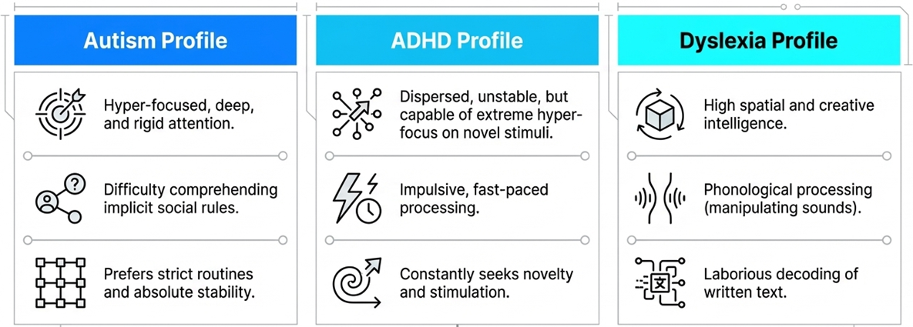
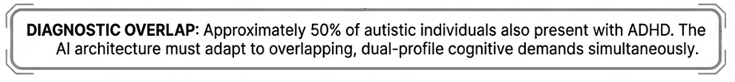
PROBLEM DESCRIPTION

Slide 4
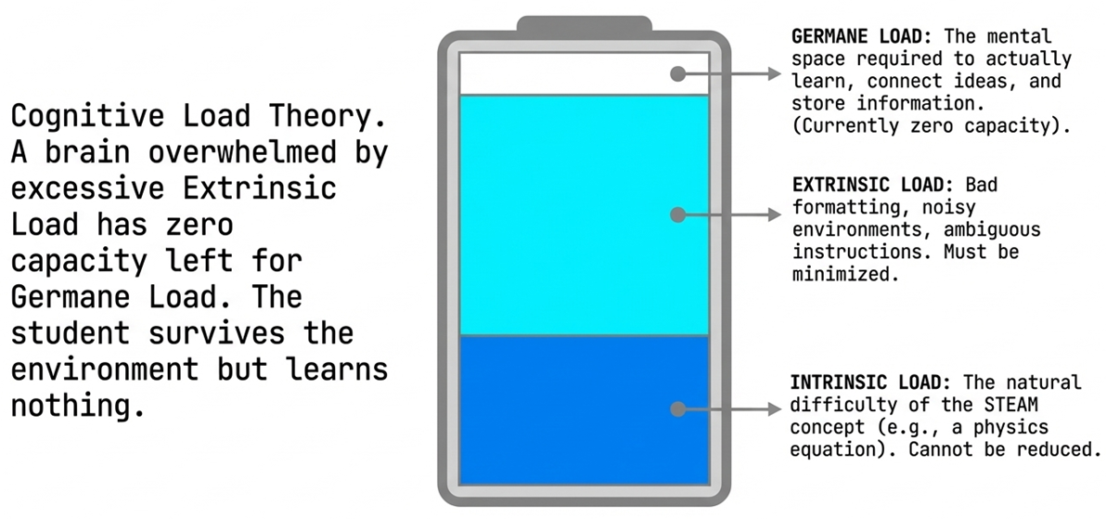
PROBLEM DESCRIPTION

Slide 5
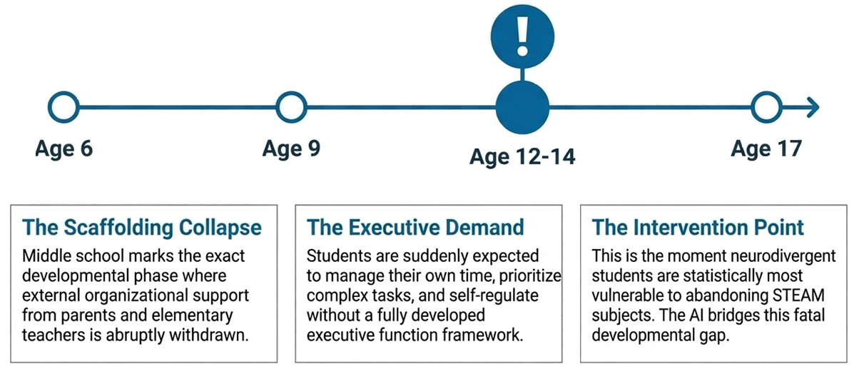
PROBLEM DESCRIPTION

Slide 6
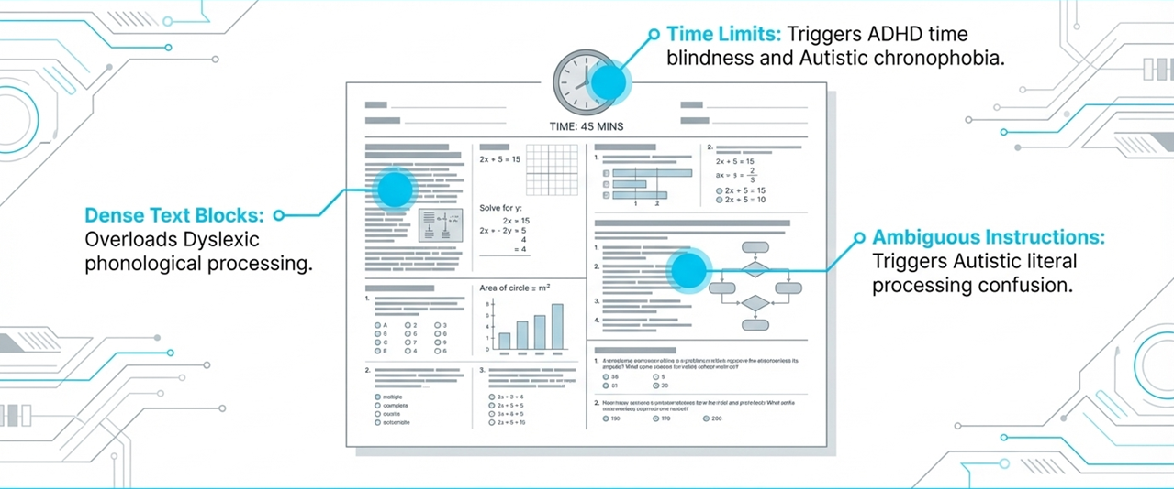
PROBLEM DESCRIPTION

Slide 7
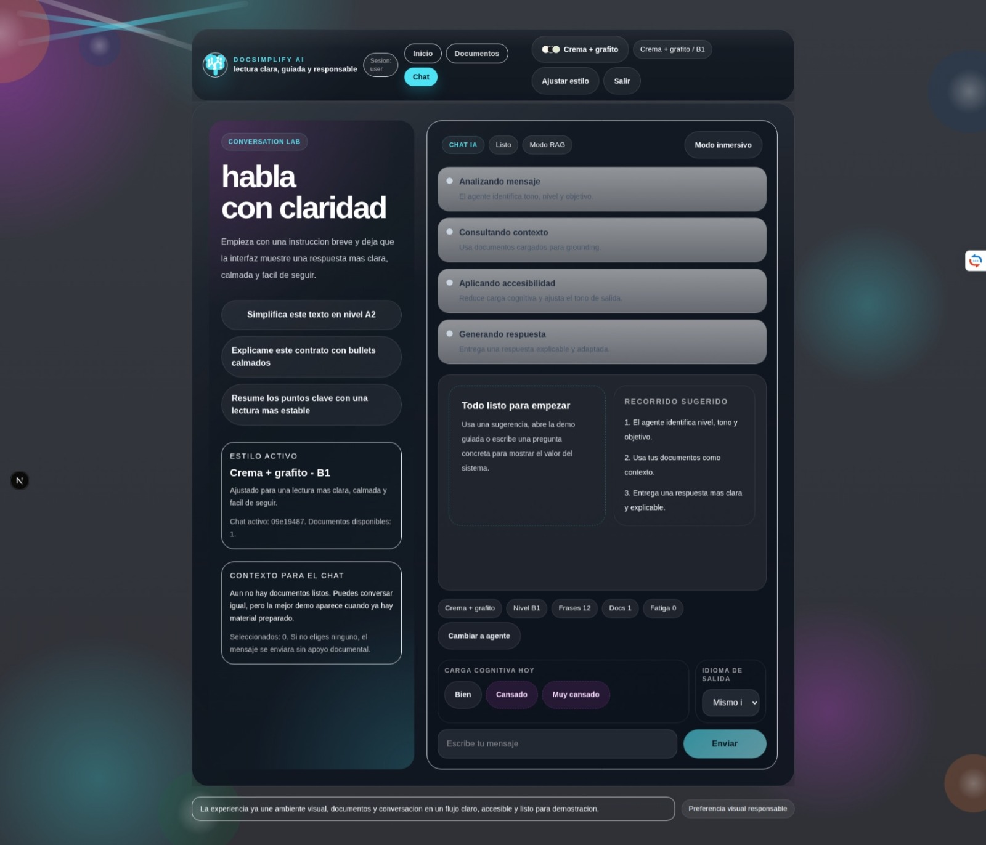
USER INTERFACE FUNCIONALITY

Slide 8
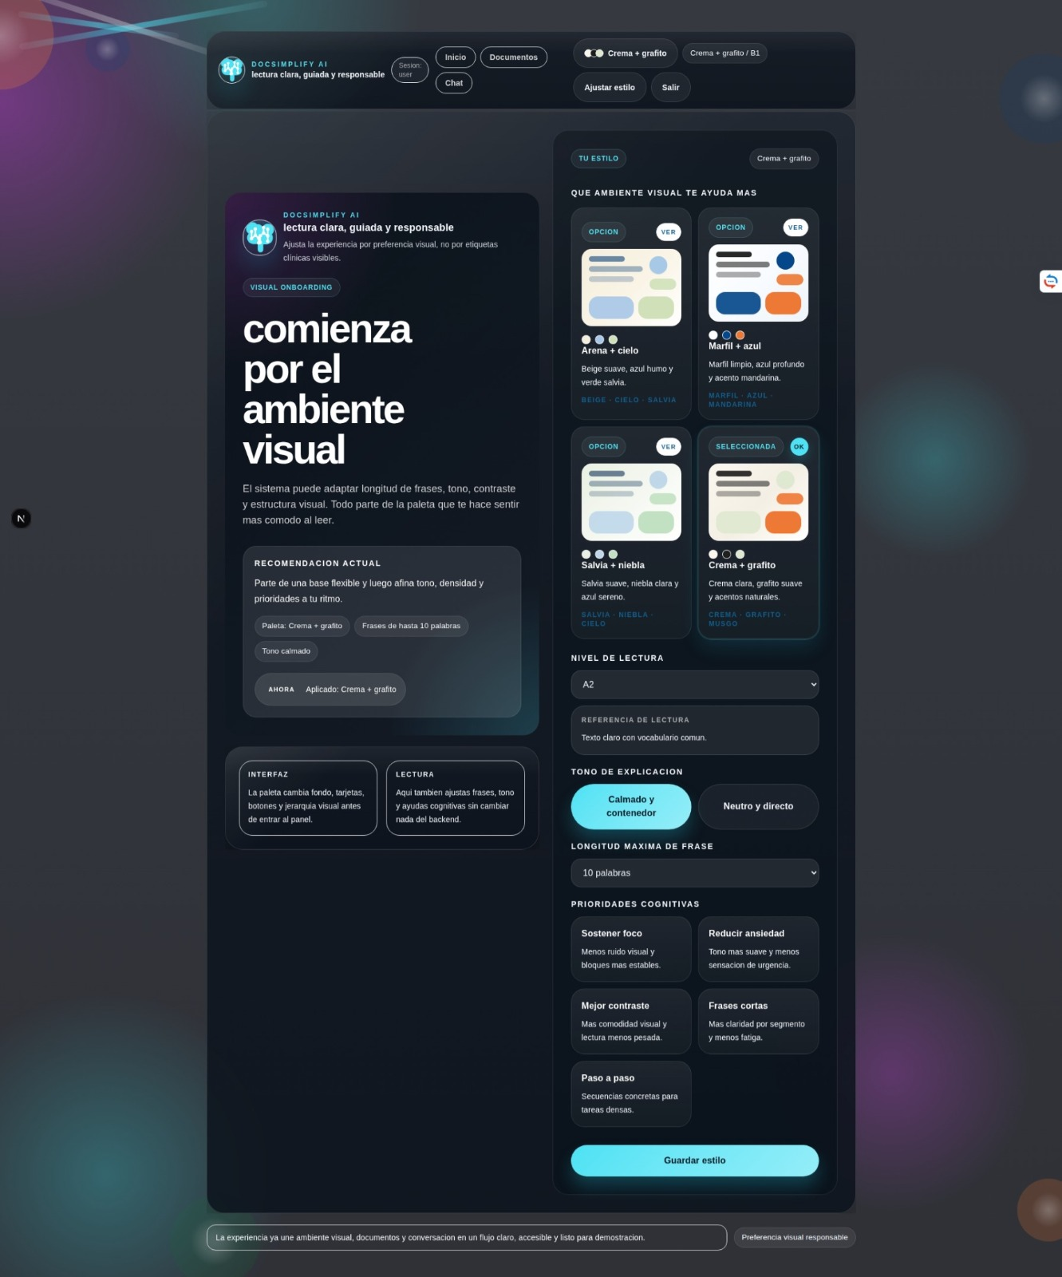
USER INTERFACE FUNCIONALITY

Slide 9
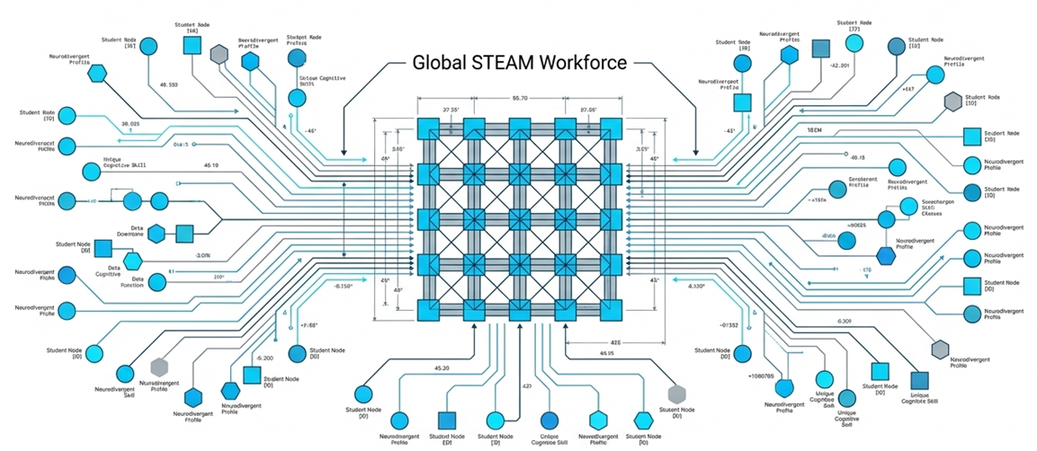

Slide 10
Microsoft Innovation Challenge March 2026

