Slide 1

INFINITYHEX
GAMES
Publishing & Localization Catalogue
SELECTED PORTFOLIO • 2026
Original tabletop publishing and Chinese-language localization for distinctive games from around the world.
2026

Slide 2
About InfinityHex
ORIGINAL DEVELOPMENT
We’re a team of passionate board game enthusiasts.
Founded in 2013, we began with murder mystery games and expanded into board game design in 2018.
In-house game design and publishing experience from concept through delivery.
Our work covers the full publishing cycle, including game design, localization, crowdfunding, production coordination, fulfillment, and long-term retail support.
Our mission is to craft great games and bring them to players worldwide.
LOCALIZATION
Chinese-language adaptation for narrative, strategy, campaign, and thematic games.
MARKET LAUNCH
Crowdfunding-led launches supported by community building and retail distribution.
INFINITYHEX GAMES
02

Slide 3
Our Publishing Portfolio
A growing catalogue spanning delivered releases, projects in production, and signed upcoming campaigns.
PUBLISHED & DELIVERED
CROWDFUNDED / IN PRODUCTION
SIGNED / UPCOMING CAMPAIGNS
5 titles
5 titles
2 titles
Games successfully crowdfunded, produced, and delivered.
Campaigns completed and currently moving through production.
Localization agreements signed, with campaigns still ahead.
Plus original titles in active development.
PORTFOLIO OVERVIEW
03

Slide 4
01
Published & Delivered
Projects that have completed crowdfunding, production, and fulfillment.
This section includes both localized international titles and InfinityHex original publishing.
PUBLISHED & DELIVERED
04

Slide 5
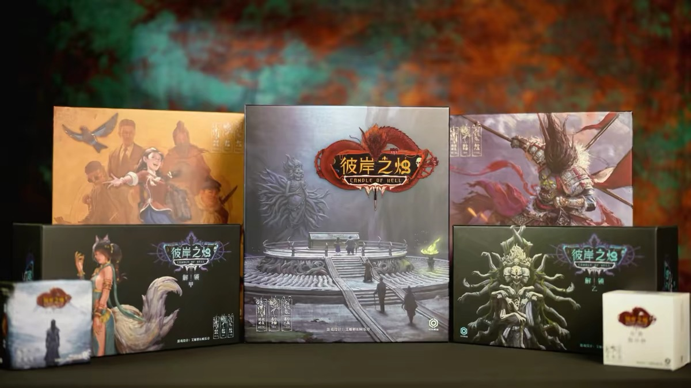
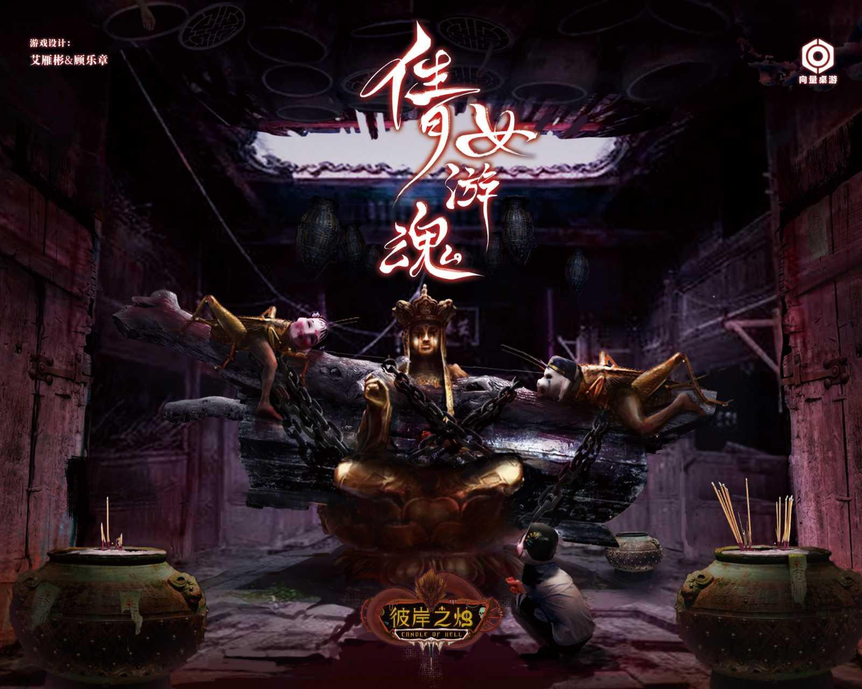
Original Game Development
InfinityHex was founded around original tabletop design, and we continue to develop our own games alongside our localization portfolio.
Netherworld Candle
倩女游魂
Designed by CEO Andy Eyre
Successfully crowdfunded, produced, and delivered.
In development • Designed by Andy Eyre
ORIGINAL DEVELOPMENT
05

Slide 6
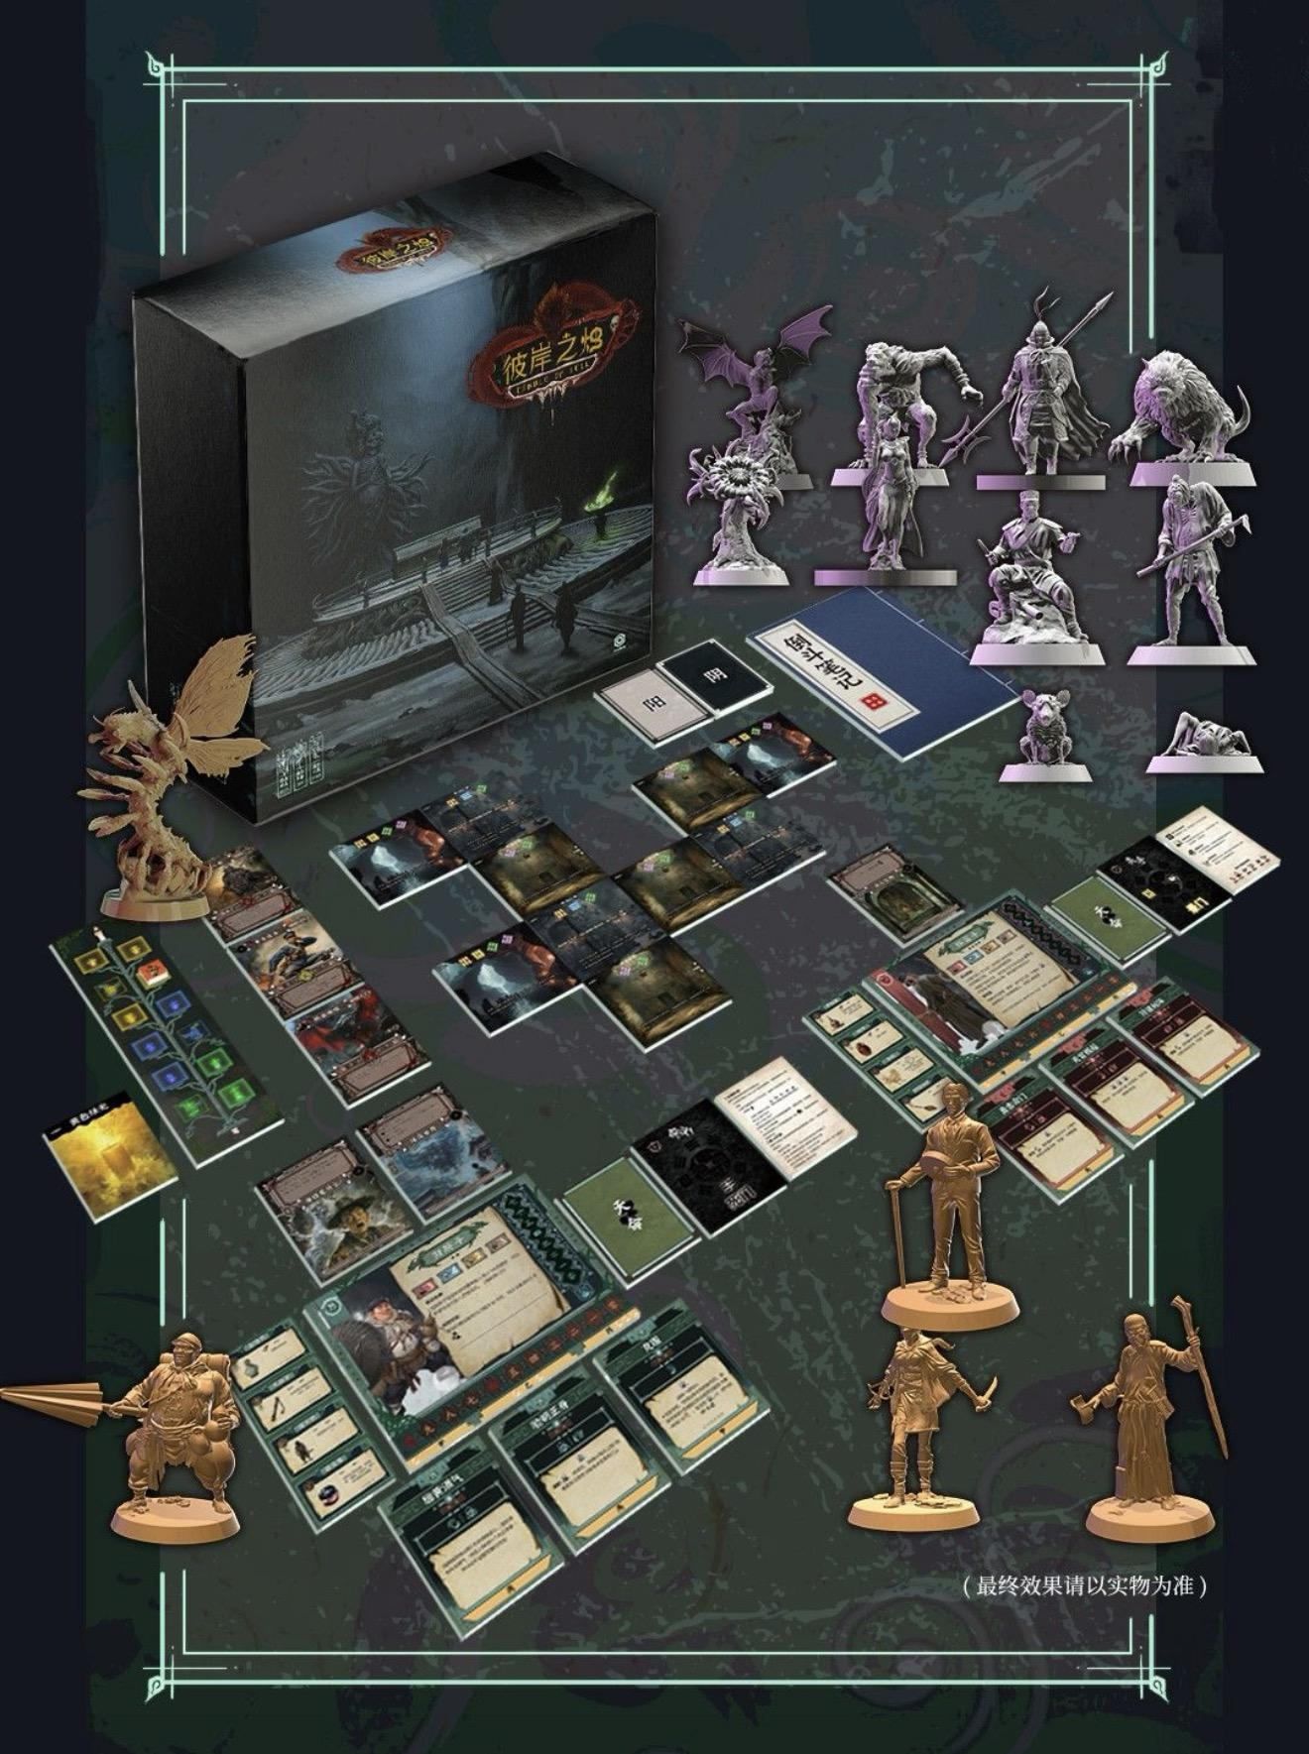
PUBLISHED & DELIVERED
INFINITYHEX ORIGINAL
Netherworld Candle
ORIGINAL THEMATIC BOARD GAME
An InfinityHex original designed by CEO Andy Eyre. Successfully crowdfunded, produced, and delivered.
Netherworld Candle is a cooperative, story-driven campaign adventure set in late 19th-century China, combining historical events, ancient mythology, supernatural horror, exploration, puzzle-solving, tactical combat, and a branching narrative.
InfinityHex Games
Chinese publishing / localization portfolio
PUBLISHED & DELIVERED
06

Slide 7
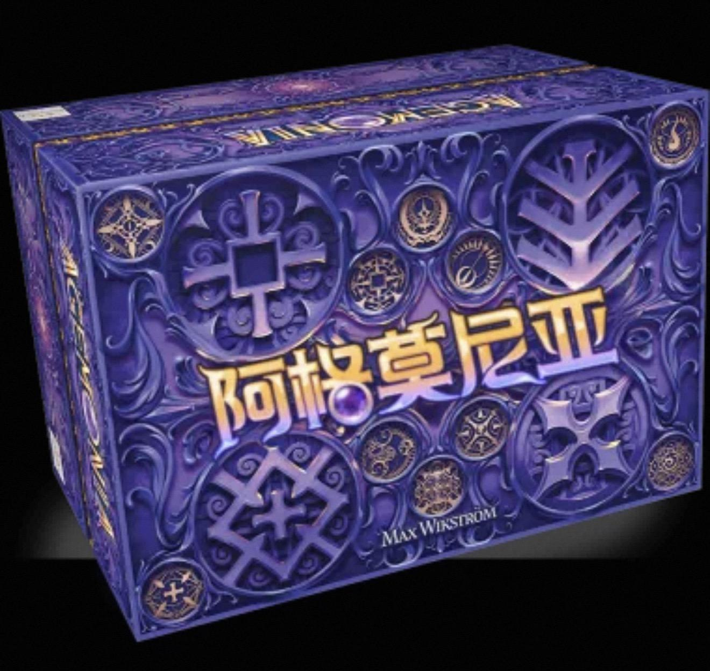
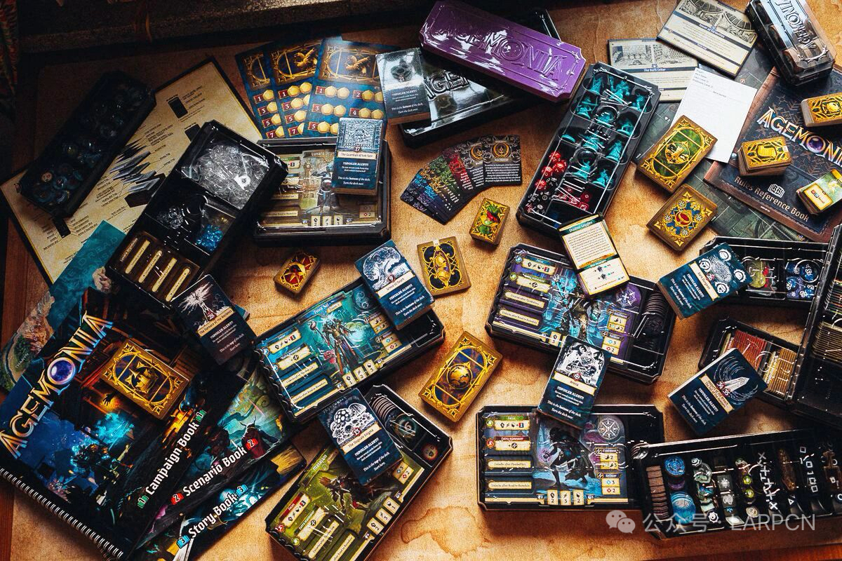
PUBLISHED & DELIVERED
LOCALIZED TITLE
Agemonia
COOPERATIVE NARRATIVE CAMPAIGN GAME
A cooperative, story-driven fantasy campaign game combining tactical scenarios, exploration, character development, and a branching narrative.
InfinityHex Games
Chinese publishing / localization portfolio
PUBLISHED & DELIVERED
07

Slide 8
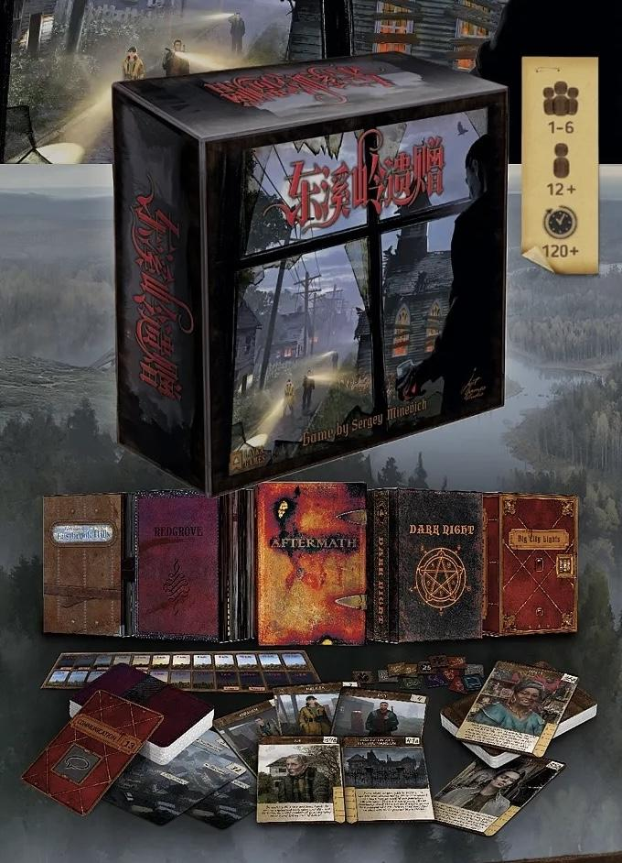
PUBLISHED & DELIVERED
LOCALIZED TITLE
Legacy of Eastbrook Hills
NARRATIVE DETECTIVE GAME
A cooperative dark detective and narrative game in which players investigate supernatural mysteries in a decaying mining town across five connected episodes.
InfinityHex Games
Chinese publishing / localization portfolio
PUBLISHED & DELIVERED
08

Slide 9
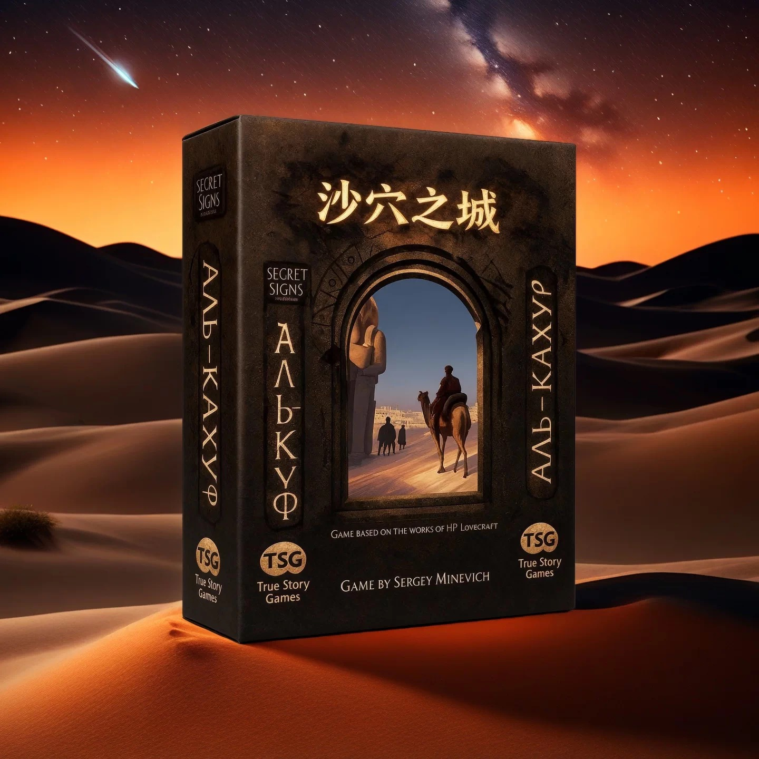
PUBLISHED & DELIVERED
LOCALIZED TITLE
Al-Kahuf
NARRATIVE DETECTIVE GAME
An investigation-focused narrative game centered on mystery solving, discovery, and piecing together a larger story.
InfinityHex Games
Chinese publishing / localization portfolio
PUBLISHED & DELIVERED
09

Slide 10
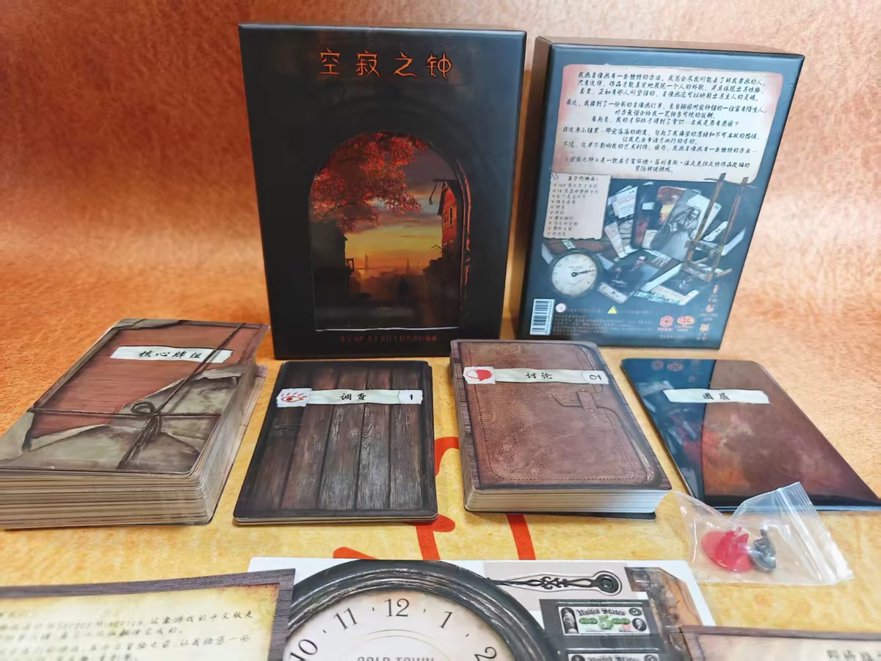
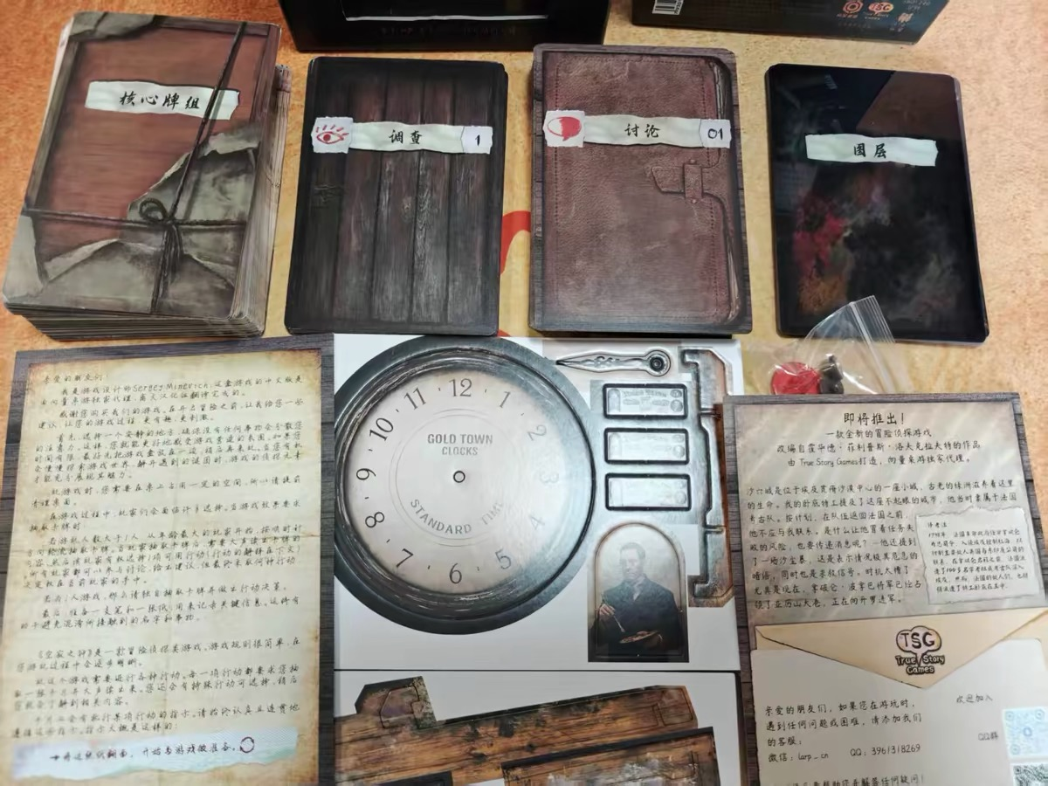
PUBLISHED & DELIVERED
LOCALIZED TITLE
Quiet Bell
LOVECRAFTIAN ADVENTURE DETECTIVE GAME
A Lovecraftian adventure detective game featuring an interactive branching narrative, nonlinear character interactions, and a unique transparent-card investigation mechanic.
InfinityHex Games
Chinese publishing / localization portfolio
PUBLISHED & DELIVERED
10

Slide 11
02
Upcoming
Projects already secured for the InfinityHex portfolio and moving toward future release.
Crowdfunded / In Production
Signed / Upcoming Campaigns
5 titles
2 titles
UPCOMING
11

Slide 12
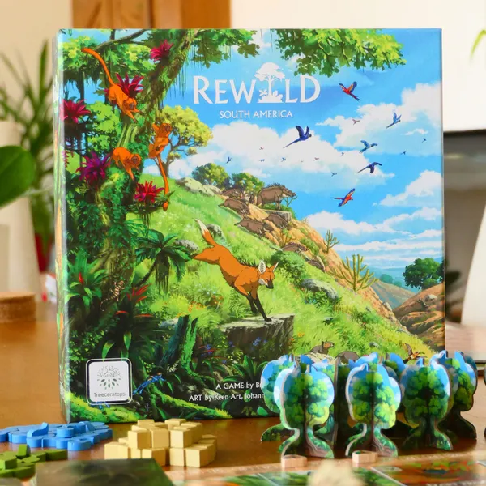
CROWDFUNDED / IN PRODUCTION
Rewild: South America
ENGINE-BUILDING STRATEGY GAME
A card-driven strategy game focused on restoring and developing the diverse ecosystems of South America.
InfinityHex Games
Upcoming Chinese publishing / localization
UPCOMING • IN PRODUCTION
12

Slide 13
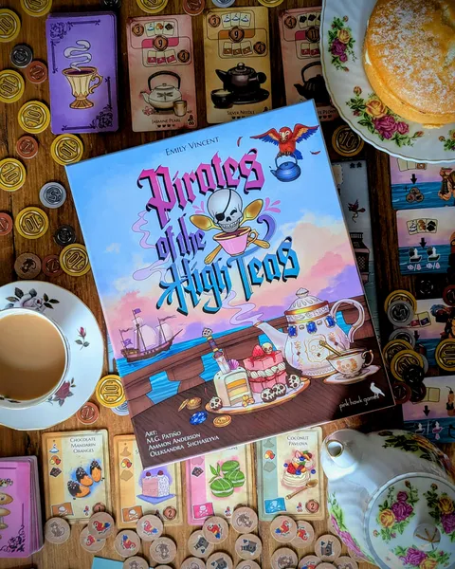
CROWDFUNDED / IN PRODUCTION
Pirates of the High Teas
WHIMSICAL STRATEGY GAME
A playful strategy game of pirate tea parties, smuggling, pastries, and food fights in a highly distinctive setting.
InfinityHex Games
Upcoming Chinese publishing / localization
UPCOMING • IN PRODUCTION
13

Slide 14
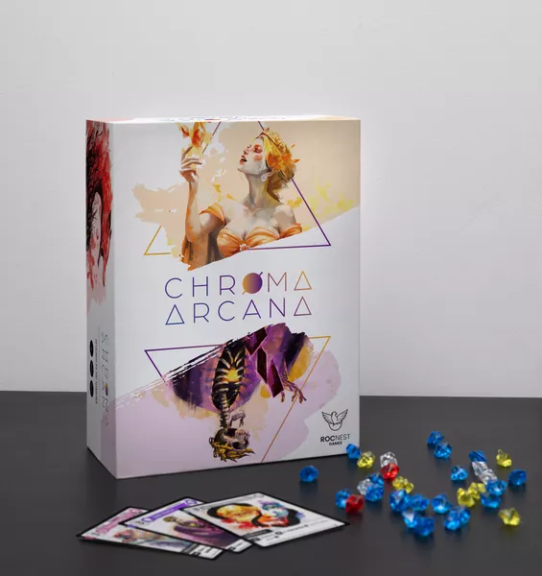
CROWDFUNDED / IN PRODUCTION
Chroma Arcana
TACTICAL FANTASY CARD GAME
A fantasy card game centered on dueling mages, with competitive battles and cooperative challenges against powerful enemies.
InfinityHex Games
Upcoming Chinese publishing / localization
UPCOMING • IN PRODUCTION
14

Slide 15
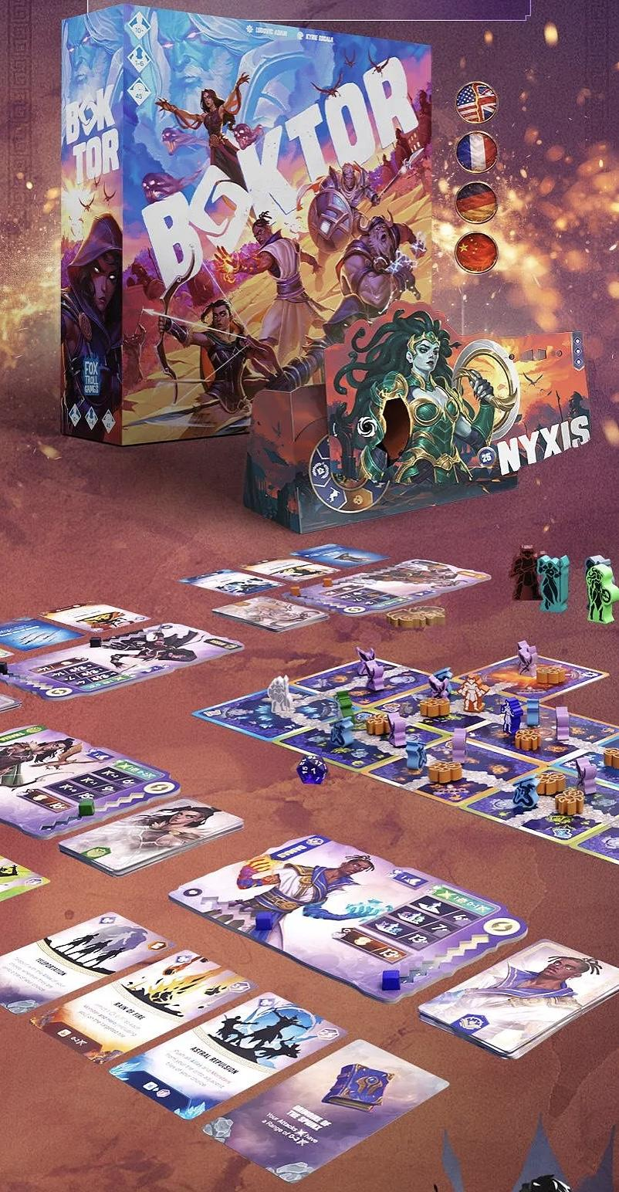
CROWDFUNDED / IN PRODUCTION
Boktor
FANTASY ADVENTURE GAME
A fantasy adventure title built around exploration, encounters, and character-driven play in a distinctive world.
InfinityHex Games
Upcoming Chinese publishing / localization
UPCOMING • IN PRODUCTION
15

Slide 16
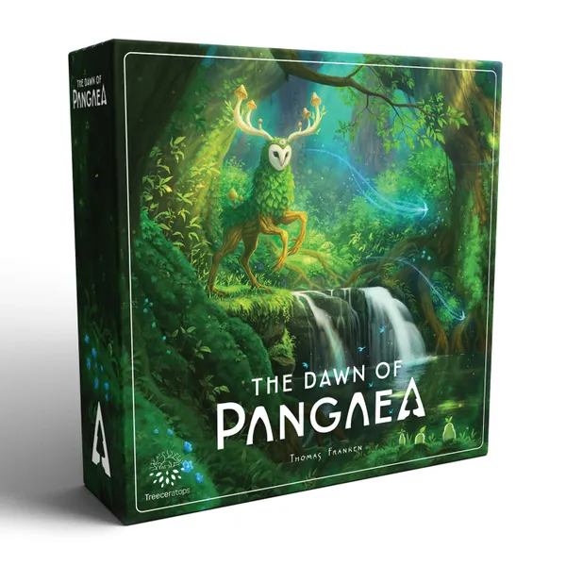
CROWDFUNDED / IN PRODUCTION
The Dawn of Pangaea
TILE-LAYING & ENGINE-BUILDING STRATEGY GAME
A strategic game about shaping Pangaea’s landscapes and ecosystems through tile placement and engine building.
InfinityHex Games
Upcoming Chinese publishing / localization
UPCOMING • IN PRODUCTION
16

Slide 17
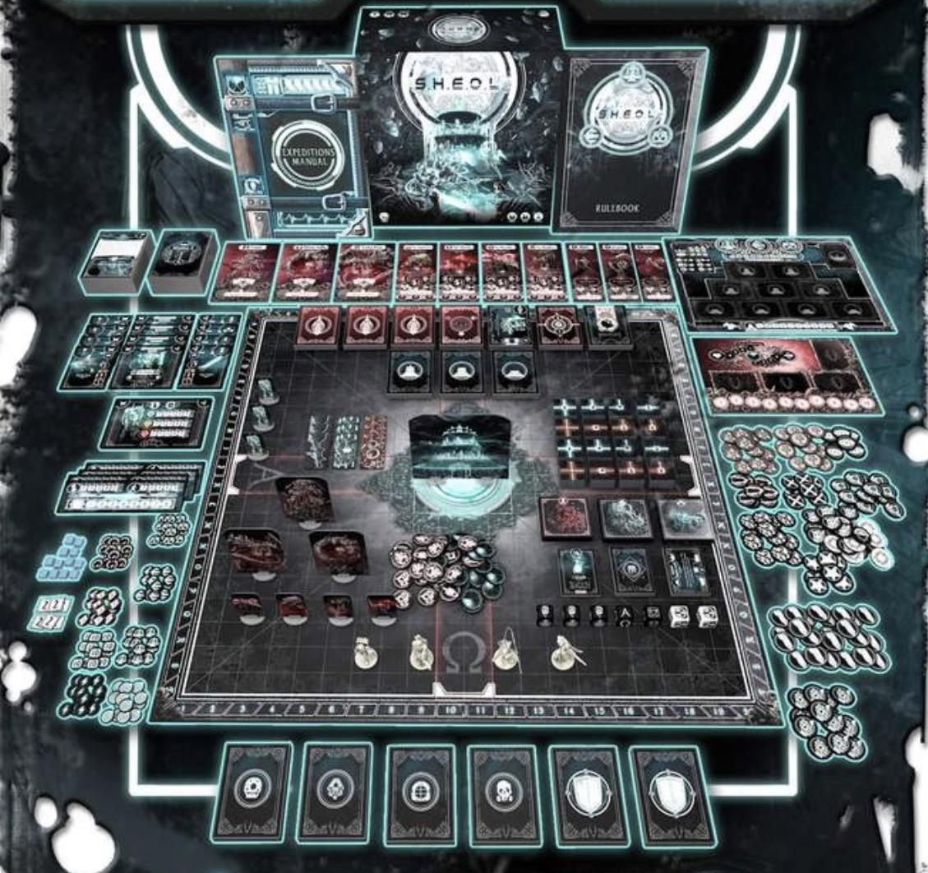
SIGNED / UPCOMING CAMPAIGN
S.H.E.O.L. 2.0
COOPERATIVE SCI-FI CAMPAIGN GAME
A dark science-fiction campaign experience built around tactical combat, exploration, progression, and humanity’s fight for survival.
Localization agreement signed
Campaign and release to follow
UPCOMING • SIGNED
17

Slide 18
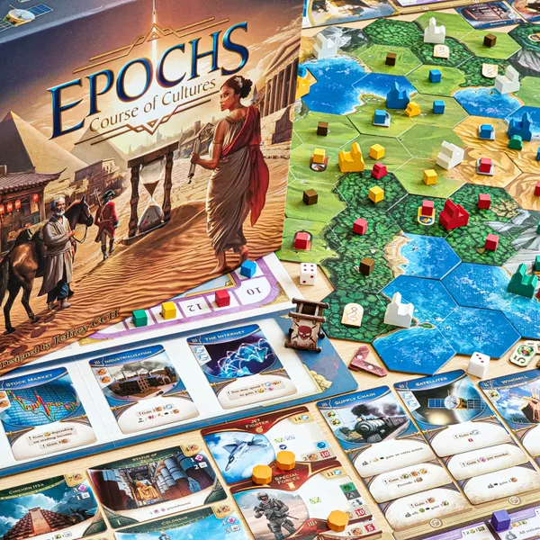
SIGNED / UPCOMING CAMPAIGN
Epochs: Course of Cultures
CIVILIZATION STRATEGY GAME
A civilization strategy game spanning multiple eras through expansion, research, trade, government, warfare, and technological development.
Localization agreement signed
Campaign and release to follow
UPCOMING • SIGNED
18

Slide 19
From Selection to Delivery
Our publishing workflow is built to support international partners throughout the full localization lifecycle.
01
02
03
04
05
›
›
›
›
TITLE
SELECTION
LOCALIZATION
& EDITING
CROWDFUNDING
LAUNCH
PRODUCTION
COORDINATION
FULFILLMENT
& RETAIL
A portfolio built through both original publishing experience and international partnerships.
PUBLISHING WORKFLOW
19

Slide 20
Let’s work together.
CONTACT
We are interested in distinctive tabletop games with strong themes, thoughtful design, and the potential to connect with Chinese-speaking players.
Nana Wang
Business Representative
InfinityHex Games
Email: nana.wang@infinityhex.com
Web: www.infinityhex.com
Publishing & Localization Catalogue 2026
CONTACT
20

