Slide 2


http://info.cern.ch/hypertext/WWW/TheProject.html

Slide 3

01
JavaScript refresher
Academy of
Digital Industries

Slide 4

რა არის ჯავასკრიპტი
JavaScript was initially created to “make web pages alive”.
The programs in this language are called scripts. They can be written right in a web page’s HTML and run automatically as the page loads.
Scripts are provided and executed as plain text. They don’t need special preparation or compilation to run.
In this aspect, JavaScript is very different from another language called Java.

Slide 5


JS Engine
Today, JavaScript can execute not only in the browser, but also on the server, or actually on any device that has a special program called the JavaScript engine.
V8 – in Chrome, Opera and Edge.
SpiderMonkey – in Firefox.
…There are other codenames like “Chakra” for IE, “JavaScriptCore”, “Nitro” and “SquirrelFish” for Safari, etc.

Slide 6
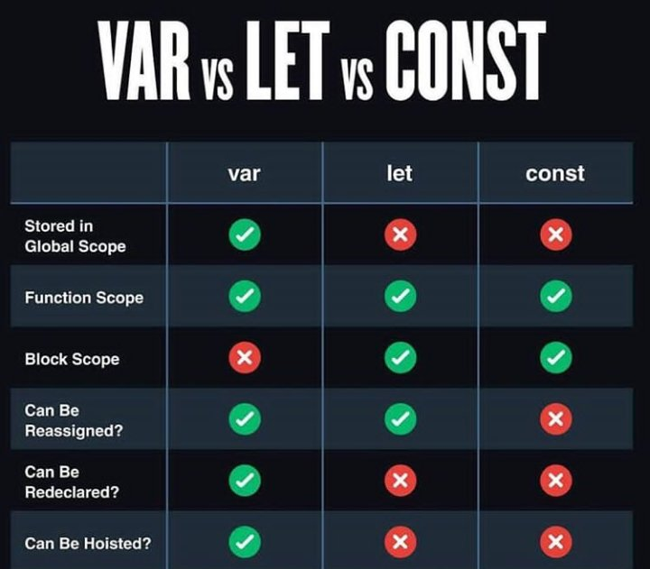
05
Difference between Var, let and const
Academy of
Digital Industries
Var is defined on window object but let and const don’t

Slide 7
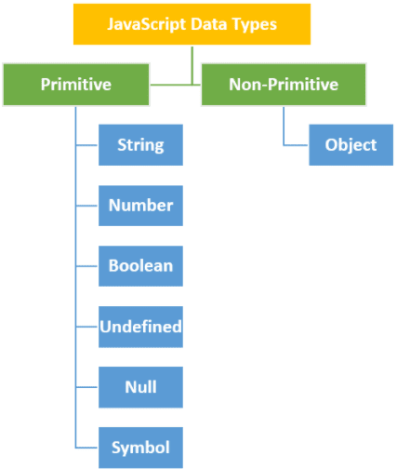
Data types
03
Academy of
Digital Industries

Slide 8
Compare two values
03
Academy of
Digital Industries
=== — strict equality (triple equals)
== — loose equality (double equals)
Object.is()
Number.isNan()

Slide 9
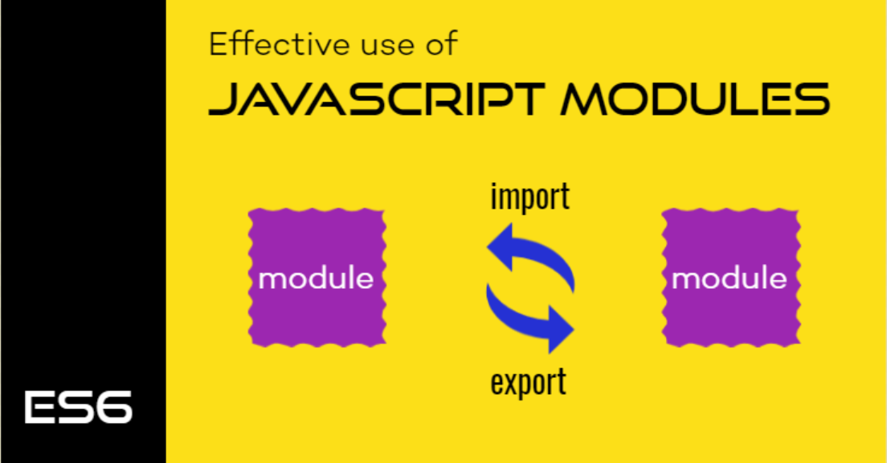
JavaScript import / export
03
Academy of
Digital Industries

Slide 10
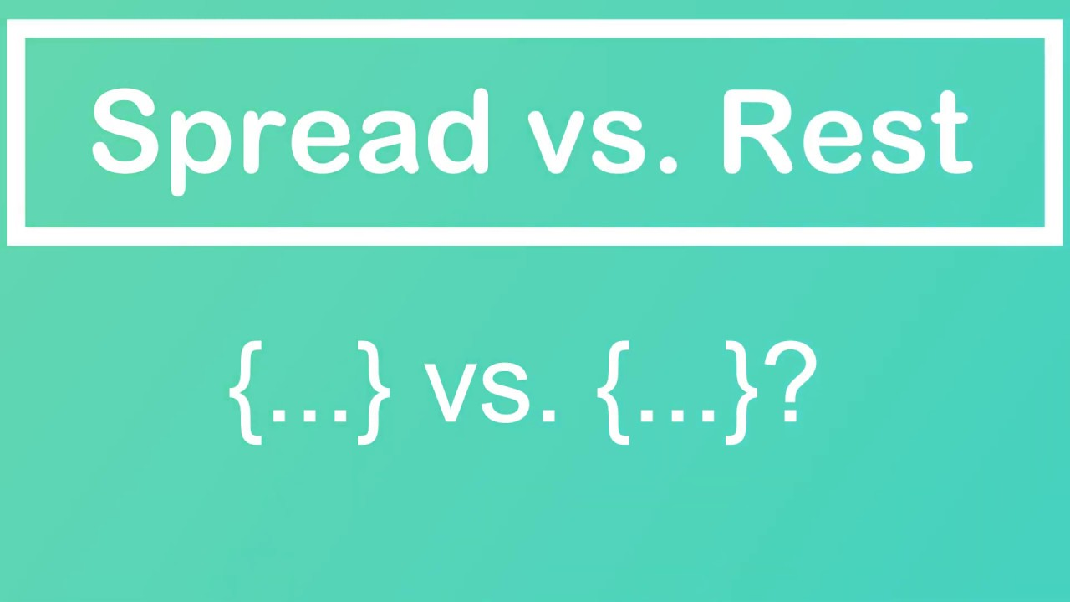
JavaScript spread & rest
03
Academy of
Digital Industries

Slide 11
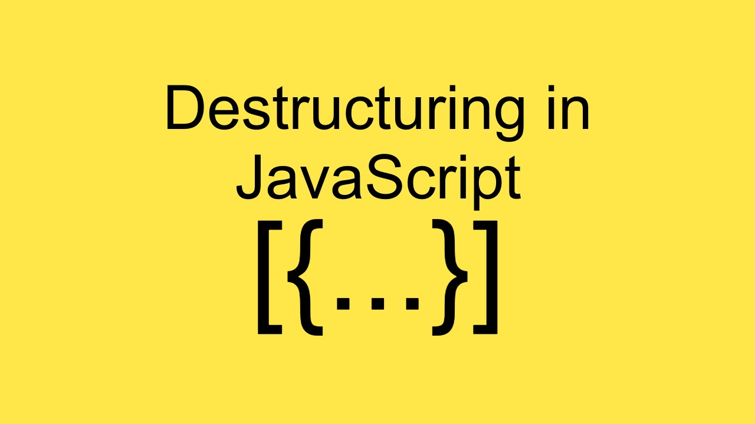
JavaScript Destructuring
03
Academy of
Digital Industries

Slide 12

Template Strings
03
Academy of
Digital Industries

Slide 13
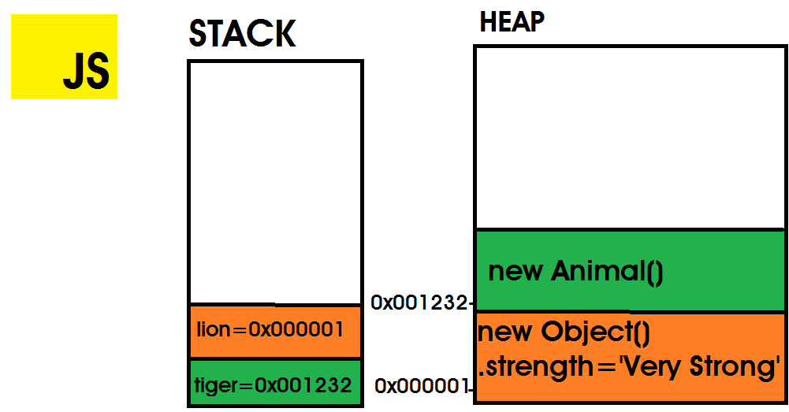
07
Reference Values
Academy of
Digital Industries
Reference Value: JavaScript provides three types of Reference values that include Array, Object, and Function. The size of a reference value is dynamic therefore It is stored on Heap.

Slide 14
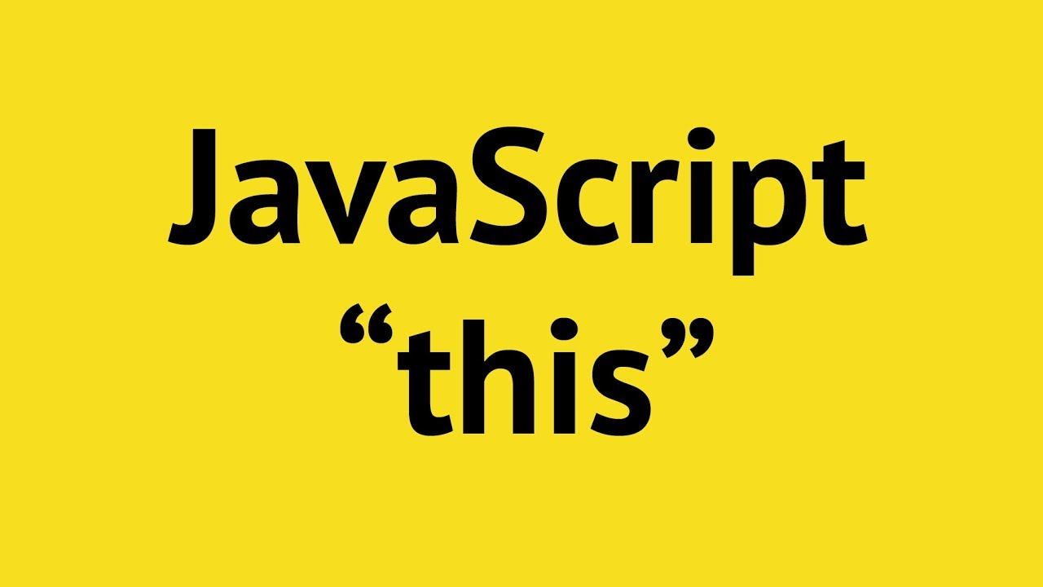
05
Academy of
Digital Industries
JavaScript this Keyword
In JavaScript, the this keyword refers to an object. Which object depends on how this is being invoked (used or called).
The this keyword refers to different objects depending on how it is used:

Slide 15
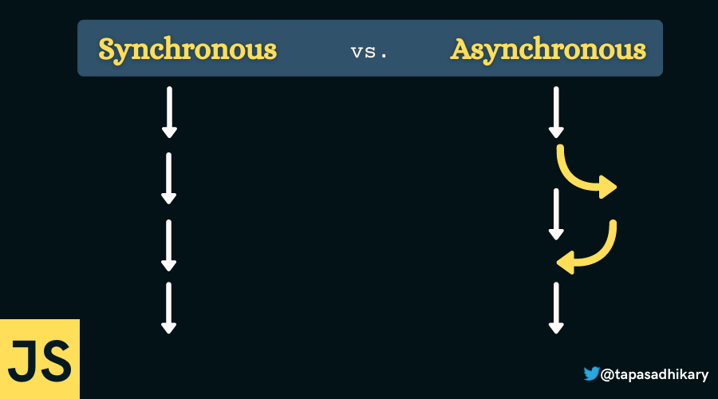
05
JavaScript is a synchronous, blocking, single-threaded language
Academy of
Digital Industries
To make async programming possible, JavaScript alone is not enough. We also need the web browser.
Browser JavaScript execution flow, as well as in Node.js, is based on an event loop.
Understanding how the event loop works is important for optimizations, and sometimes for the right architecture.

Slide 16
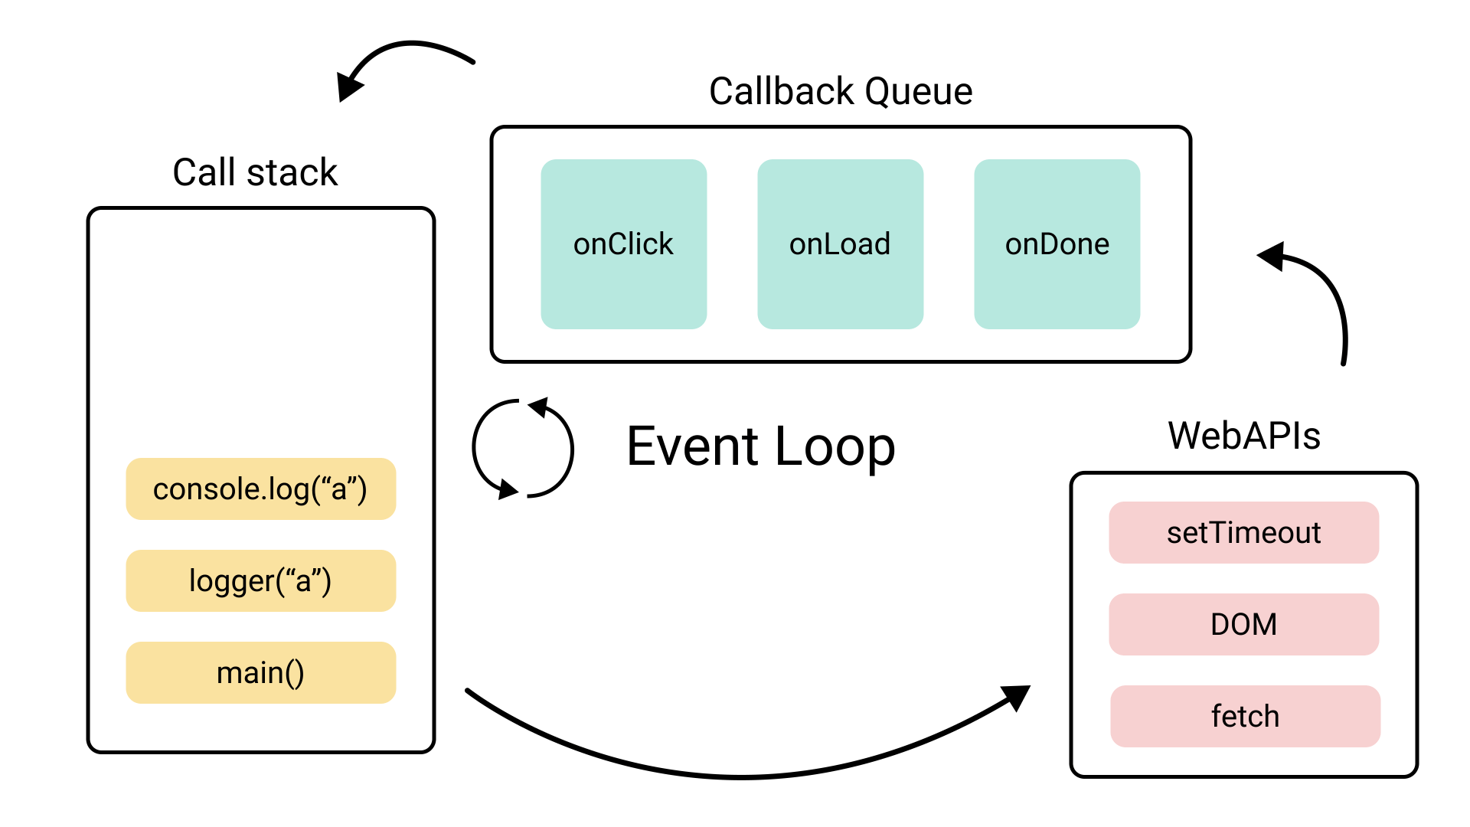
05
Event loop
Academy of
Digital Industries
Browser JavaScript execution flow, as well as in Node.js, is based on an event loop.
Understanding how the event loop works is important for optimizations, and sometimes for the right architecture. The event loop concept is very simple. There’s an endless loop, where the JavaScript engine waits for tasks, executes them and then sleeps, waiting for more tasks.

Slide 17
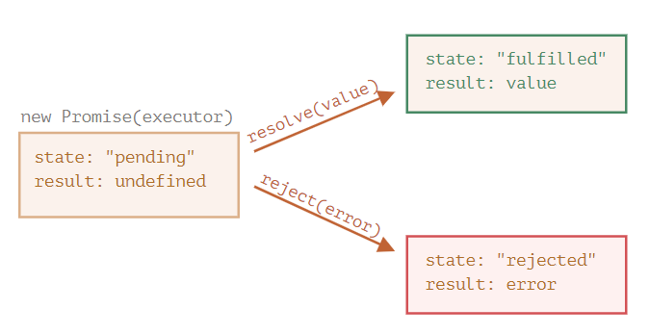
05
Promise
Academy of
Digital Industries
The Promise object represents an asynchronous operation's eventual completion (or failure) and its resulting value.
pending: initial state, neither fulfilled nor rejected.
fulfilled: meaning that the operation was completed successfully.
rejected: meaning that the operation failed.

Slide 18
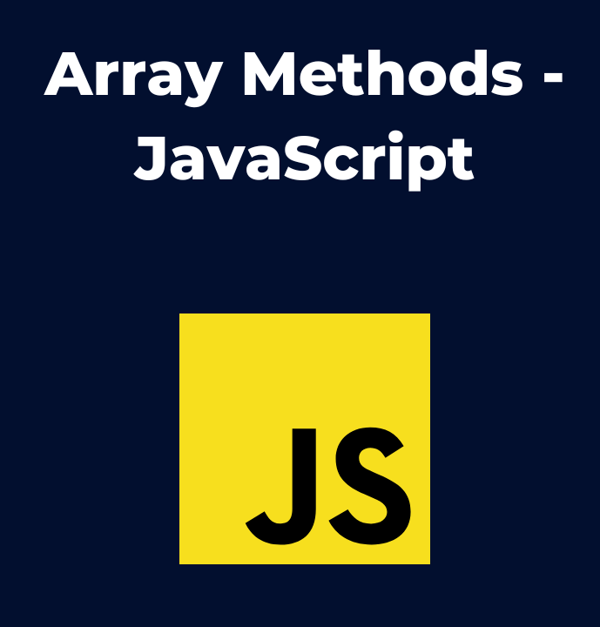
Array methods
03
Academy of
Digital Industries

