Slide 2


Slide 3
Git Cheat Sheet
Initializing a repository
git init
Staging files
git add file1.js # Stages a single file
git add file1.js file2.js # Stages multiple files
git add *.js # Stages with a pattern
git add . # Stages the current directory and all its content
Viewing the status
git status # Full status
Committing the staged files
git commit -m “Message” # Commits with a one-line message git commit # Opens the default editor to type a long message

Slide 4
Git Cheat Sheet
See all branch
Git branch # shows all branch
Create new branch
Git branch <branchName> # creates new branch
change branch
Git switch # change the branch
Update branch
Git pull # updates branch
Add remote origin
git remote add origin <repoLink> # adds remote origin\
Push the code
git push origin <master> # push the code
git push –u origin <master> # The -u option automatically sets that repo as the upstream repo for you.

Slide 5

05
What is React JS
Academy of
Digital Industries
React is a declarative, efficient, and flexible JavaScript library for building user interfaces or UI components. It lets you compose complex UIs from small and isolated pieces of code called “components”.

Slide 6
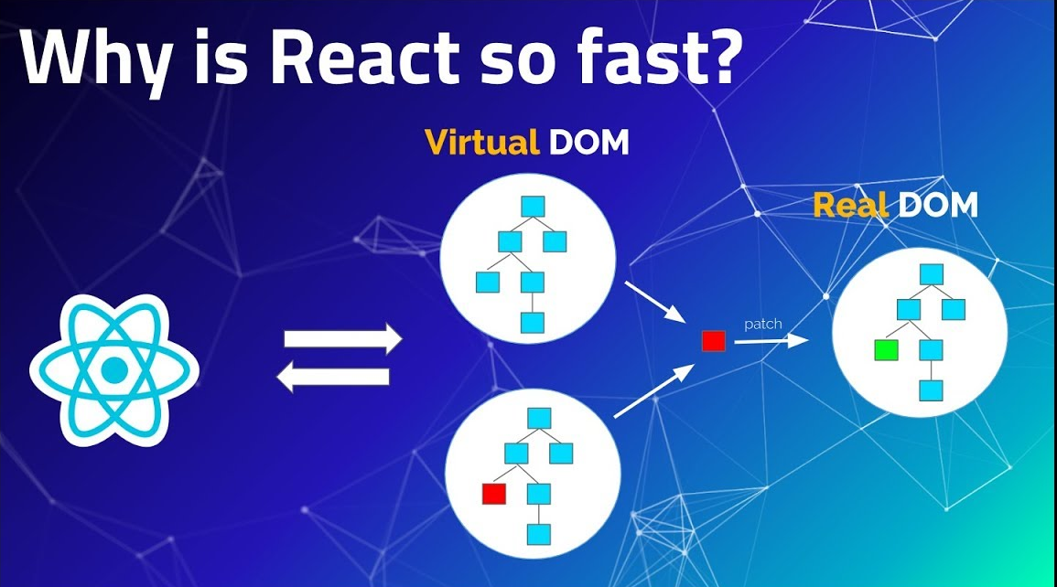
05
Why you should use React
Academy of
Digital Industries
React makes it painless to create interactive UIs. Design simple views for each state in your application, and React will efficiently update and render just the right components when your data changes. Declarative views make your code more predictable and easier to debug.

Slide 7



05
Who uses React?
Academy of
Digital Industries

Slide 8
05
How to start using React
Academy of
Digital Industries
<script src = "https://unpkg.com/react@17.0.2/umd/react.production.min.js"></script>
<script src = "https://unpkg.com/react-dom@17.0.2/umd/react-dom.production.min.js"></script>
const element = React.createElement( 'h1', {className: 'greeting'}, 'Hello, world!' );

Slide 9
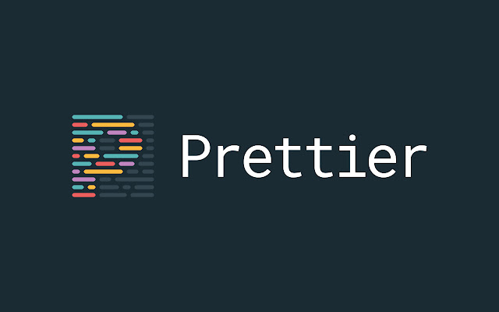
05
BUILD tools
Academy of
Digital Industries

Slide 10
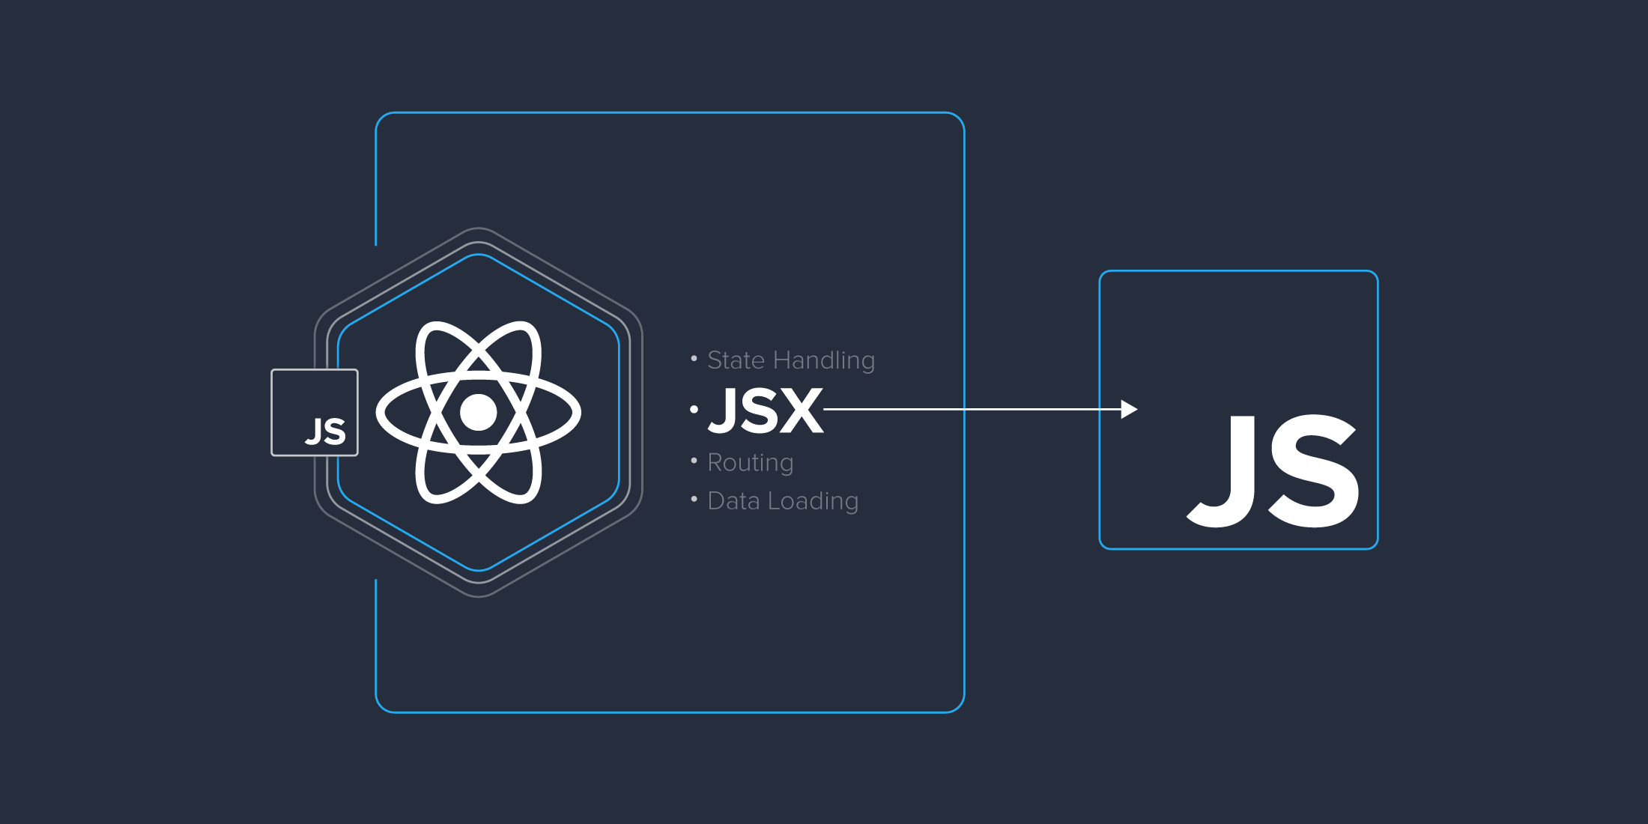

05
JSX & Babel
Academy of
Digital Industries

