Slide 2
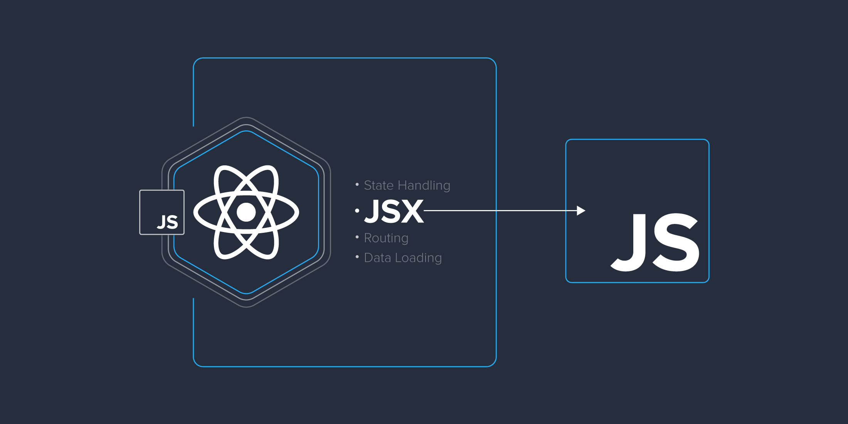

05
JSX & Babel
Academy of
Digital Industries

