Slide 2

05
What is ESLint
Academy of
Digital Industries

Slide 3

05
React hooks
Academy of
Digital Industries
React Hooks are simple JavaScript functions that we can use to isolate the reusable part from a functional component. Hooks can be stateful and can manage side effects. React provides a bunch of standard in-built hooks

Slide 4
05
Rules of Hooks
Academy of
Digital Industries
Hooks are a new addition in React 16.8. They let you use state and other React features without writing a class.
https://reactjs.org/docs/hooks-rules.html#explanation
1 . Only Call Hooks at the Top Level
2. Only Call Hooks from React Functions
Don’t call Hooks inside loops, conditions, or nested functions. Instead, always use Hooks at the top level of your React function, before any early returns
Don’t call Hooks from regular JavaScript functions. Instead, you can:

Slide 5
05
React hooks list
Academy of
Digital Industries
1. useState - to Create State Variables
2. useEffect - to Perform Side Effects
3. useRef - to Reference React Elements
4. useCallback - Prevents Callbacks from Being Recreated
5. useMemo - Can Improve Expensive Operations
6. useContext - Helps Us Avoid Prop Drilling
7. useReducer - is (Another) Powerful State Management Tool

Slide 6
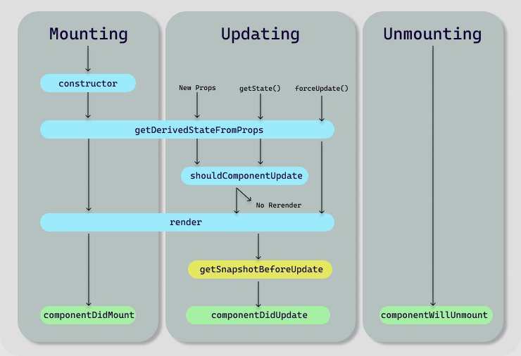
05
React Components lifecycle
Academy of
Digital Industries

Slide 7
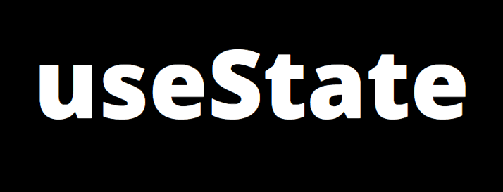
05
useState hook
Academy of
Digital Industries
The React useState Hook allows us to track state in a function component.
State generally refers to data or properties that need to be tracking in an application.

Slide 8

05
useEffect hook
Academy of
Digital Industries
If the component makes calculations that don't target the output value, then these calculations are named side-effects

Slide 9
05
Academy of
Digital Industries

Slide 10
05
Academy of
Digital Industries

