Slide 2

05
Academy of
Digital Industries
React allows you to write maintainable and performant code by using the concept of components. Components allow you to focus on describing the UI you want, rather than focusing on the details of how the UI actually gets inserted in the page

Slide 3
05
Academy of
How does really work
Digital Industries
React components
React elements
Component instances

Slide 4
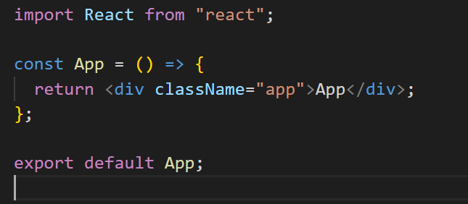
05
Academy of
React component
Digital Industries
=>

Slide 5
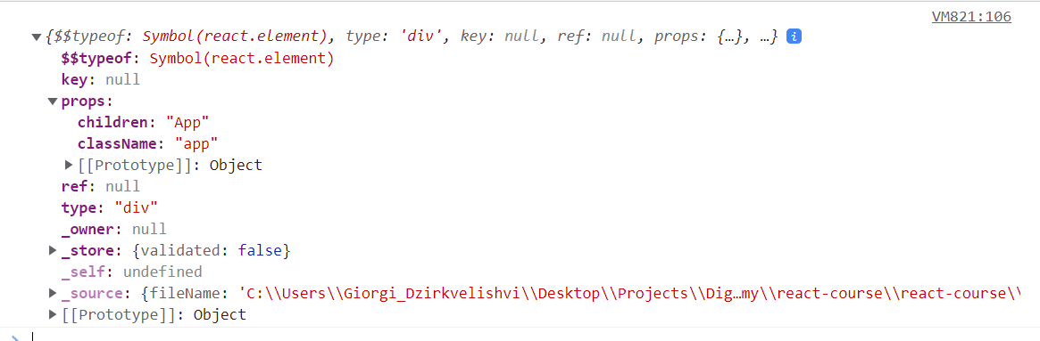
05
Academy of
React element
Digital Industries

Slide 6
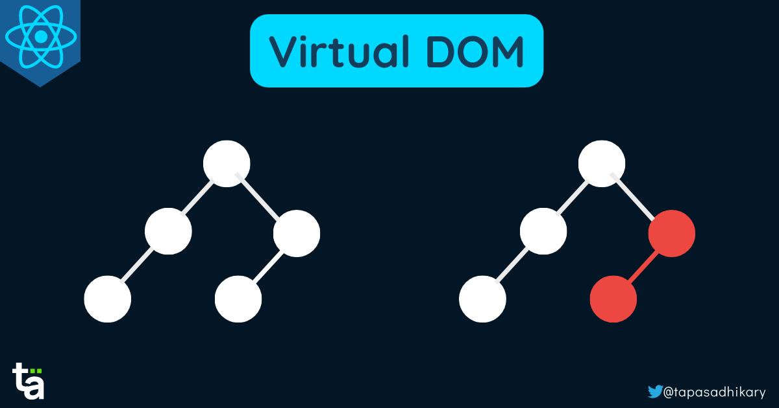
05
Academy of
Reconciliation
Digital Industries
All React does is create a tree of elements
This is very fast because React elements are just plain Javascript objects

Slide 7
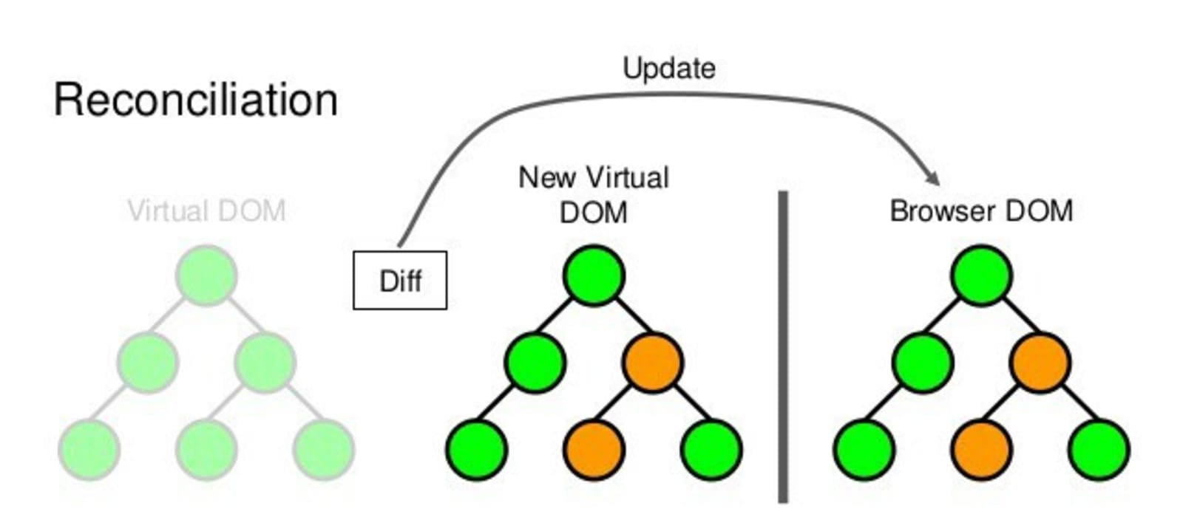
05
Academy of
Digital Industries

Slide 8
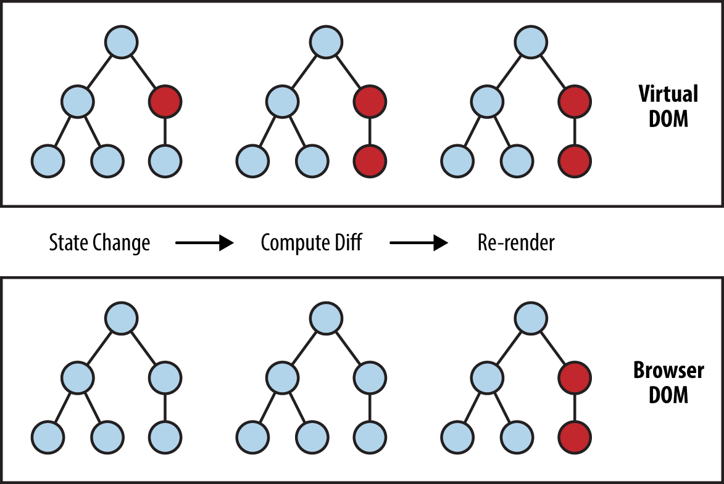
05
What if the tree of elements changes?
Academy of
Digital Industries

Slide 9
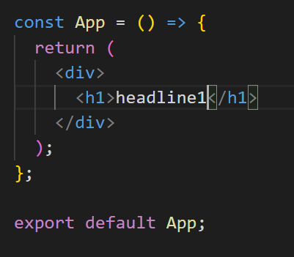
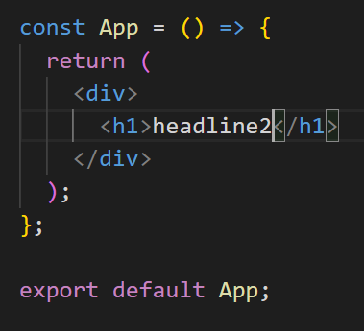
05
Diffing algorithm operations
Academy of
Digital Industries
=>

Slide 10
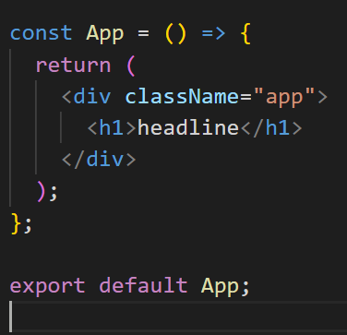
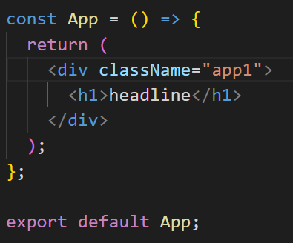
05
Example 2
Academy of
Digital Industries
=>

Slide 11
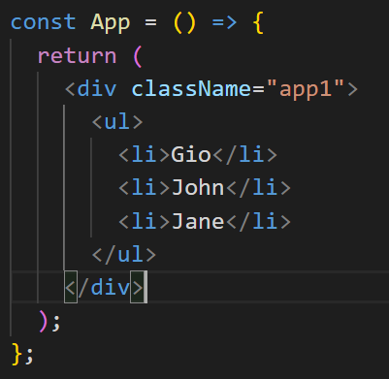
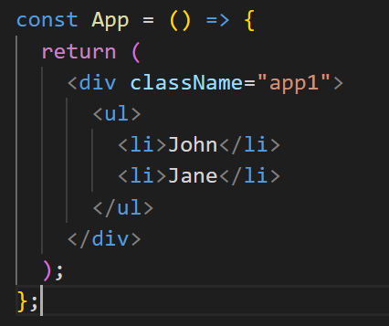
05
Example 3
Academy of
Digital Industries
=>

Slide 12
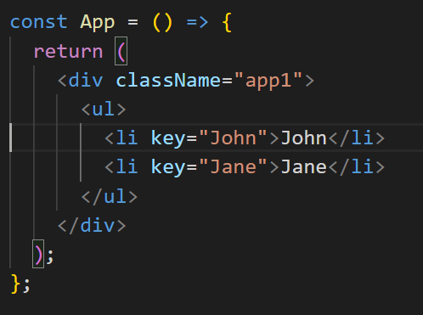
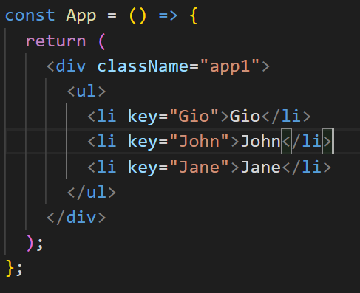
05
Example 3 (with keys)
Academy of
Digital Industries
=>

Slide 13
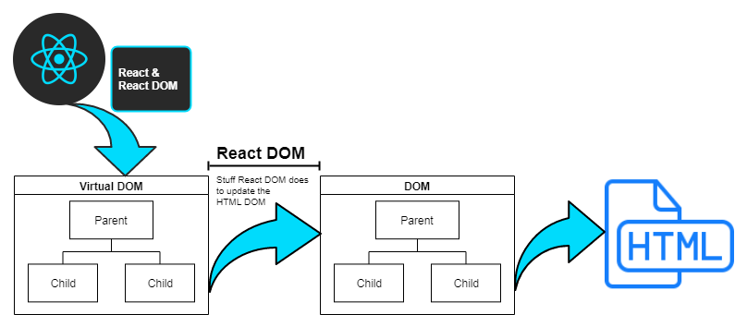
05
Rendering
Academy of
Digital Industries
React on its own is just a library that allows us to define components, elements and It does the diffing algorithm

Slide 14
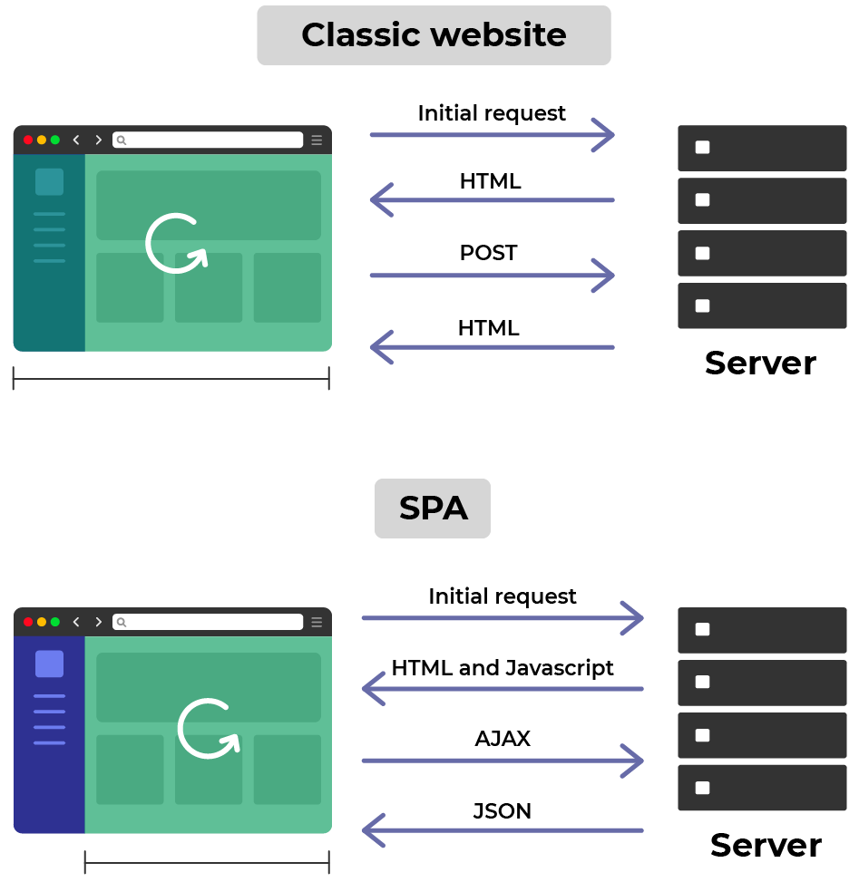
What is SPA(single page application)
05
Academy of
Digital Industries
A single-page application (SPA) is a web application or website that interacts with the user by dynamically rewriting the current web page with new data from the web server, instead of the default method of a web browser loading entire new pages.

Slide 15
05
React Router
Academy of
Digital Industries

Slide 16
05
Academy of
Digital Industries

Slide 17
05
Academy of
Digital Industries

