Slide 2

05
How to style in React
Academy of

Slide 3
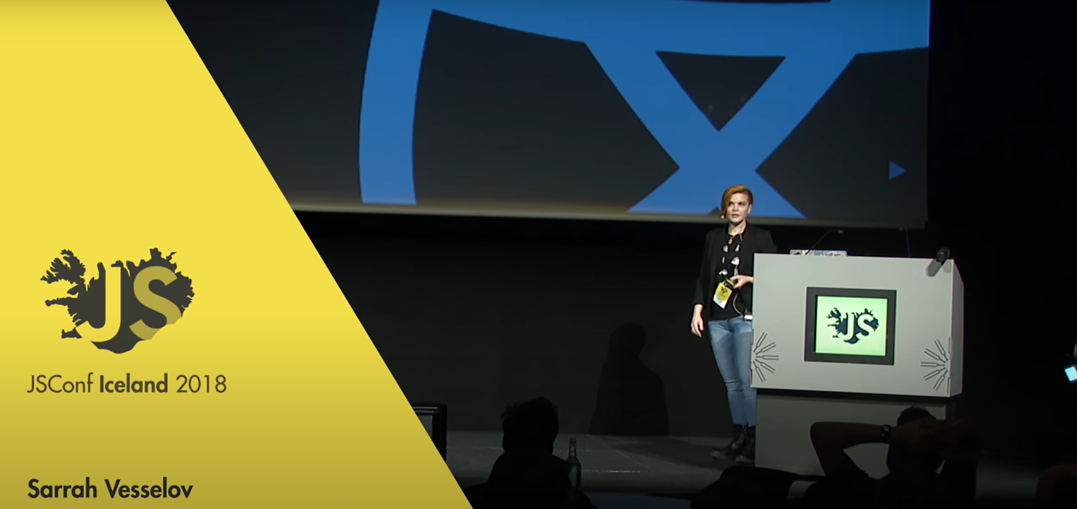
05
Sarrah Vesselov: How to style in React and not lose friends | JSConf Iceland 2018
Academy of

Slide 4

05
React Simple Design Patterns You Should Know
Academy of

Slide 5
Container and Presentational Components
The first pattern we’ll look at is separating the container and presentational components. This pattern is about separating data management concerns and UI rendering. Container components are responsible for managing the data and state of the application, while presentational components are responsible for rendering the UI.

Slide 6
HOC
A Higher-Order Component (HOC) is a pattern that allows you to reuse component logic. HOCs are a way to share standard functionality among multiple components.

Slide 7
Custom hooks
A custom hook is a special JavaScript function whose name starts with 'use' and can be used to call other hooks

Slide 8
Modal
Another nice feature of React is something called a Portal. You can think of the portal as a separate mount point (the actual DOM node which your app is put into) for your React app.

