Slide 2

05
Academy of
Redux && Redux toolkit
Digital Industries

Slide 3
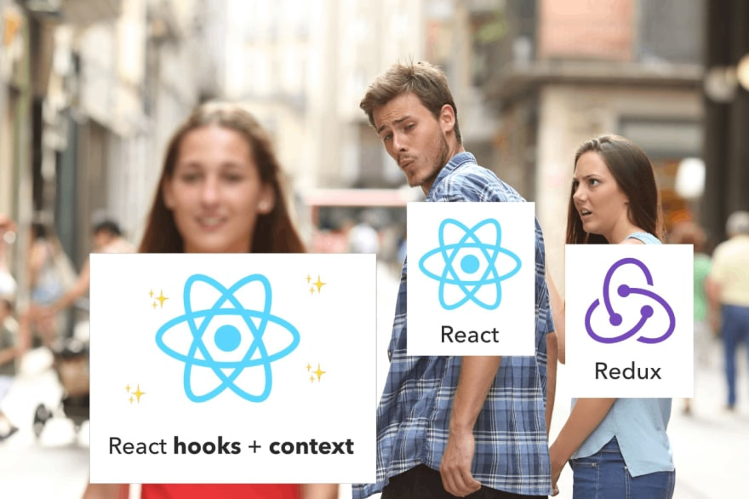
05
Academy of
Digital Industries

Slide 4
05
Academy of
Digital Industries

Slide 5
05
Academy of
Digital Industries

Slide 6
05
Academy of
Digital Industries

Slide 7
05
Academy of
Digital Industries

