Slide 1
Agentic AI for Earth
on Amazon Bedrock AgentCore
Presenter name
9 November 2026
Notes:
Point to land: The agent does the work; a person decides.
Say: Hello, and thanks for coming. I’m [Presenter name], and this is Agentic AI for Earth. In the next half hour you’ll see four short acts on a live stage, each with its own agent on Amazon Bedrock AgentCore. Each agent works through a question over real Earth observation data: it chains tools, reads the imagery, does the sums and drafts the answer. Then a person decides what happens next. Watch for where the agent’s work stops and ours begins.
Transition: First, why this matters.

Slide 2
Why this matters
More Earth observation data than people can read
The agent does the reading and the legwork
A person makes the call
Notes:
Point to land: There is more Earth data than people can read, so the agent reads and a person decides.
Say: Here’s the problem. Satellites photograph the whole planet again every few days, from dozens of missions, and most of it is never looked at closely by a person. The bottleneck isn’t the data, it’s people’s time to read it. So we hand the reading and the legwork to an agent: it finds the right data, looks at it, measures, and shows its evidence. A person makes the call.
Transition: Here are the four places we’ll see that.

Slide 3
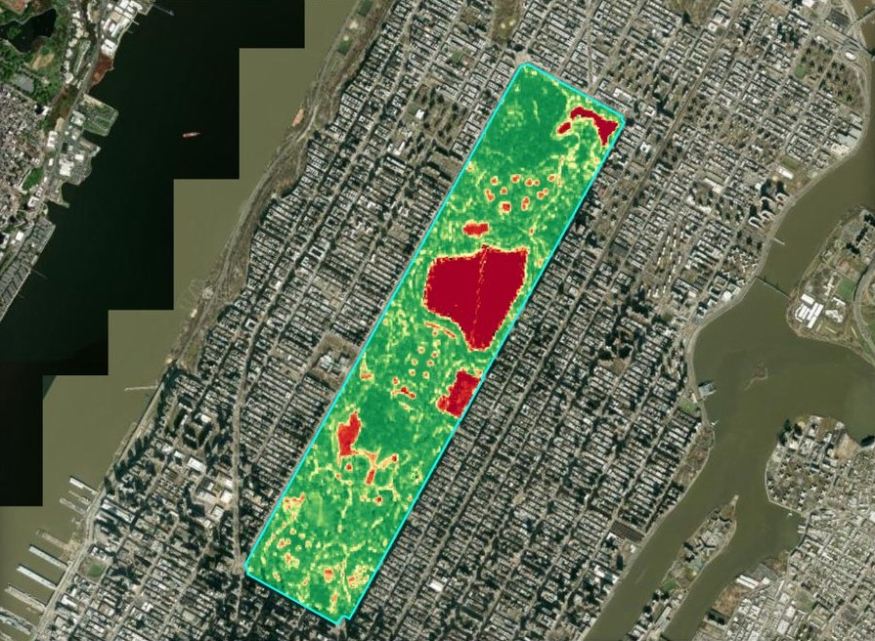
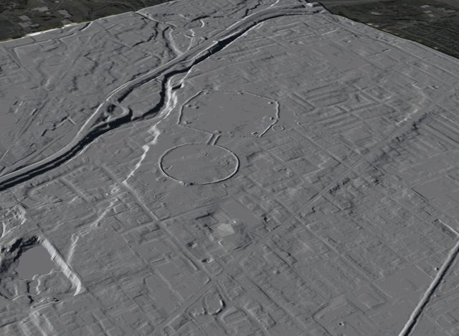
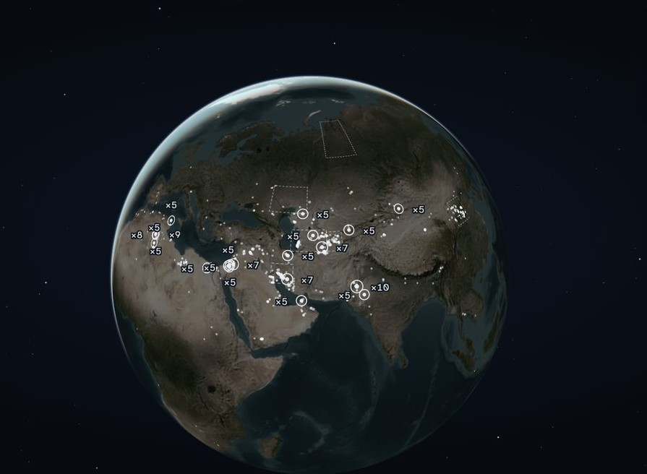
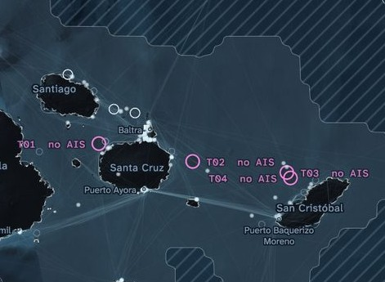
Four acts, one map
1
2
3
4
Earth Analyst
AI Archaeologist
Methane Hunter
Dark Vessels
Reads imagery, finds similar places
LiDAR of known, public sites
From satellite tip to draft brief
Spots silent ships, plans the patrol
Notes:
Point to land: Four different jobs, one platform.
Say: First, the Earth Analyst fetches a Sentinel-2 scene, looks at it, then measures plant health or finds similar places. Second, the AI Archaeologist reads LiDAR of earthworks already on the public record, and only those. Third, the Methane Hunter follows a satellite tip to a methane site, checks ground records and drafts a brief for an analyst. Last, Dark Vessels compares a radar pass over the Galápagos with ship broadcasts, called AIS, and checks where those broadcasts can be heard. A target that isn’t broadcasting there becomes a reason for a patrol to look. The agent predicts where to look next, and the officer decides whether to send one.
Transition: Let’s start with the Earth Analyst.

Slide 4
What you just saw
The agents chose their tools,
looked before they measured, and showed their reasons
The agent does the legwork and drafts;
the analyst or officer decides
One platform: each agent is its own runtime
on Amazon Bedrock AgentCore
[Your call to action]
Notes:
Point to land: Four acts, one pattern: the agent does the legwork and drafts; a person decides.
Say: Four acts, one pattern. The Earth Analyst looked at a scene before it measured, and turned down a cloudy one. The AI Archaeologist looked at the LiDAR of each site like the Octagon and judged whether its walls still show. Methane Watch followed a satellite tip, checked it with a sharper instrument and an independent catalogue, and told us what it could not confirm. Dark Vessels chose its radar pass, checked whether a silence could mean anything there, predicted where to look and drafted a patrol; the officer decided whether it goes. Not every step was the model choosing live: some of the data was prepared ahead of time, and I’ve pointed out which. Each agent is its own runtime on Amazon Bedrock AgentCore, on one shared map. The agent does the legwork and drafts; a person decides. [Your call to action]
Transition: Here’s how it’s built.

Slide 5
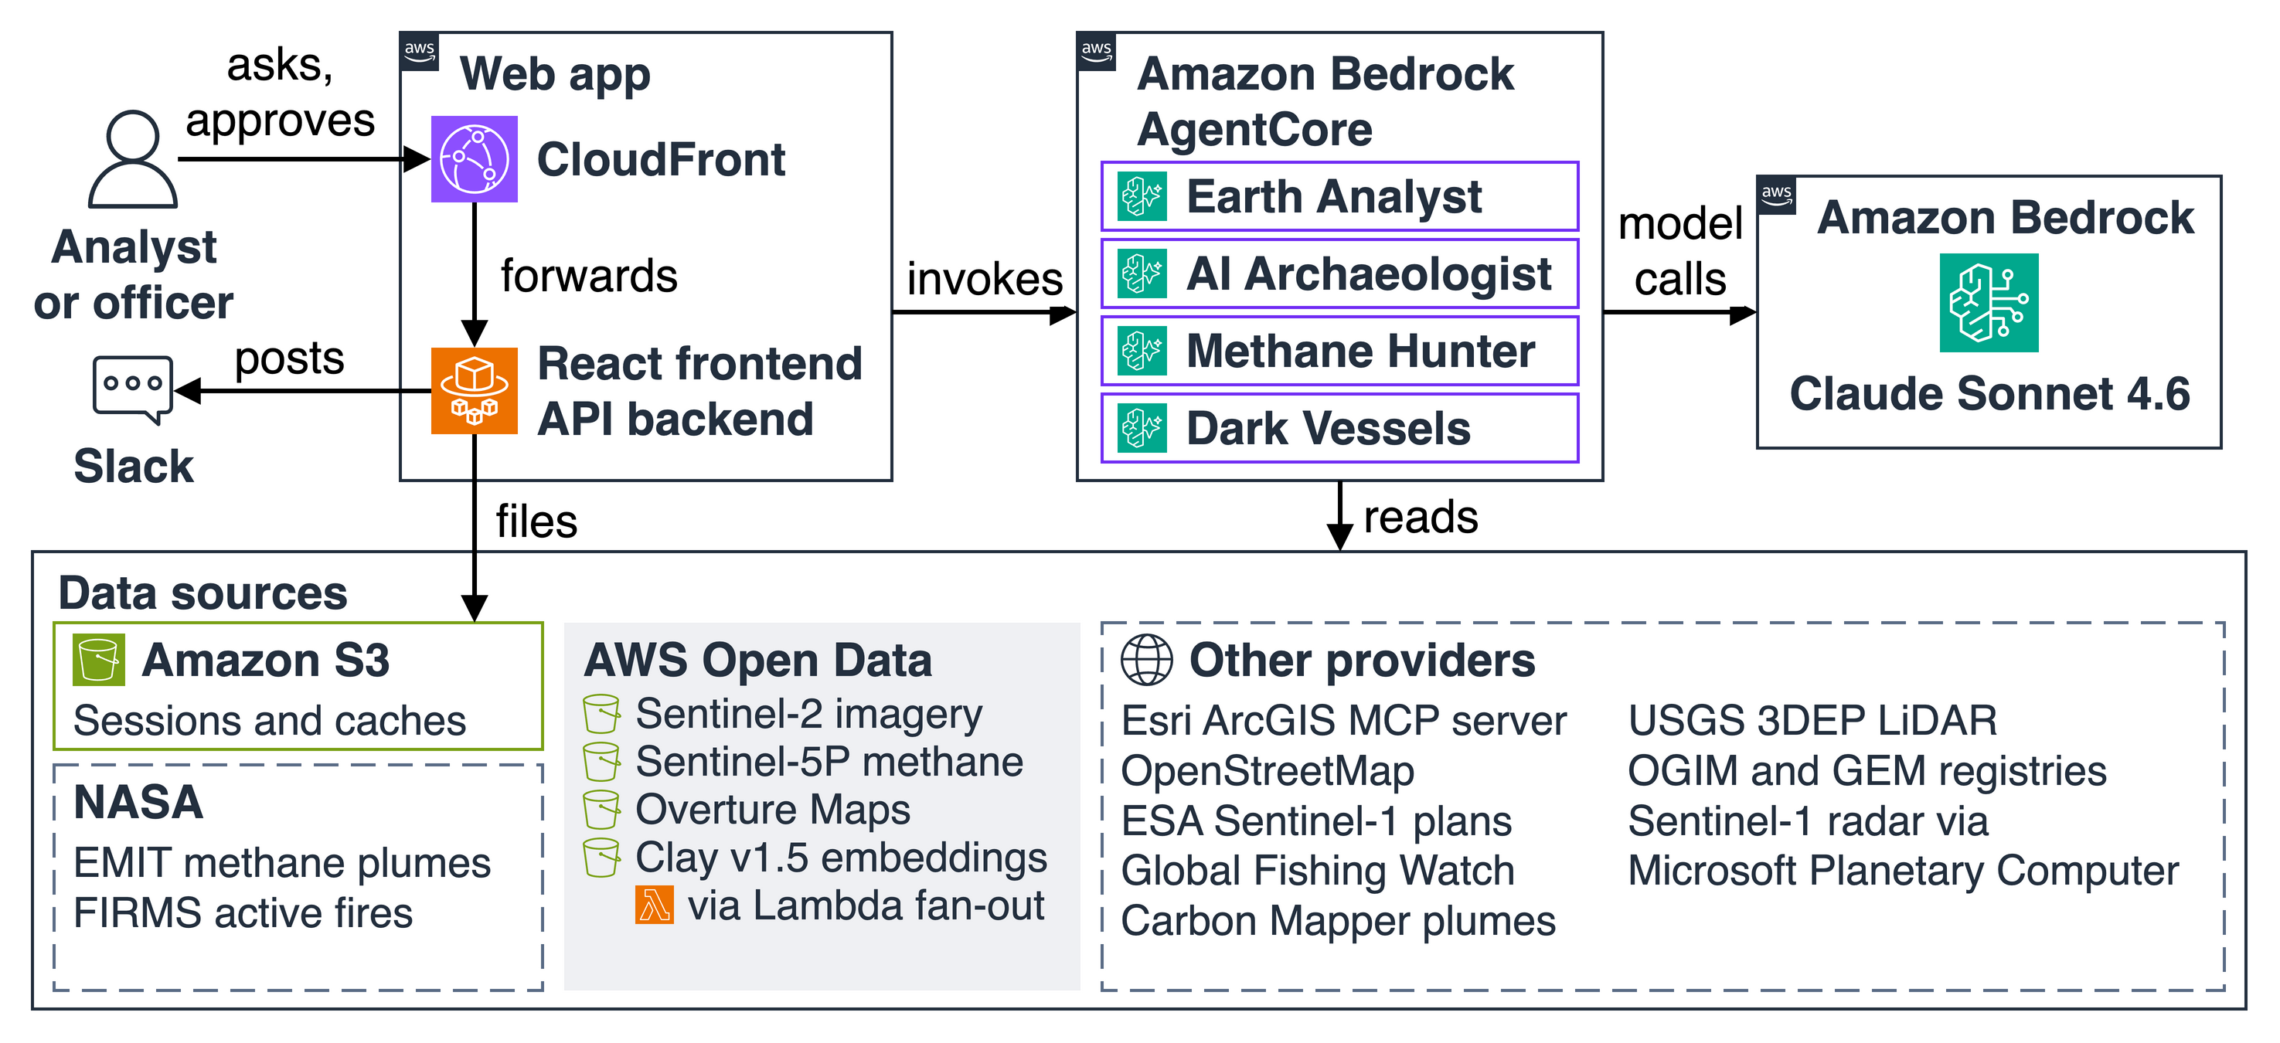
How it’s built
Notes:
Point to land: Four agents share one model; the analyst or officer decides.
Say: Left to right. The analyst or officer asks in the web app, a React frontend and API backend on AWS Fargate behind Amazon CloudFront. It goes to one of four Strands agents, each on its own AgentCore runtime. Claude Sonnet 4.6 on Amazon Bedrock is the model the agents use. Along the bottom, the data sources: Sentinel-2 imagery, Sentinel-5P methane, Overture Maps and Clay embeddings from AWS Open Data; NASA’s EMIT plumes and FIRMS fires; Esri’s ArcGIS MCP server, OpenStreetMap, ESA’s Sentinel-1 plans, Sentinel-1 radar from Microsoft Planetary Computer, Global Fishing Watch, USGS LiDAR, the OGIM and GEM registries, Carbon Mapper’s public plume catalogue, and our own S3 bucket. Nothing is filed until the analyst or officer approves; then it goes to S3 and Slack.
Transition: Happy to take questions.

Slide 6
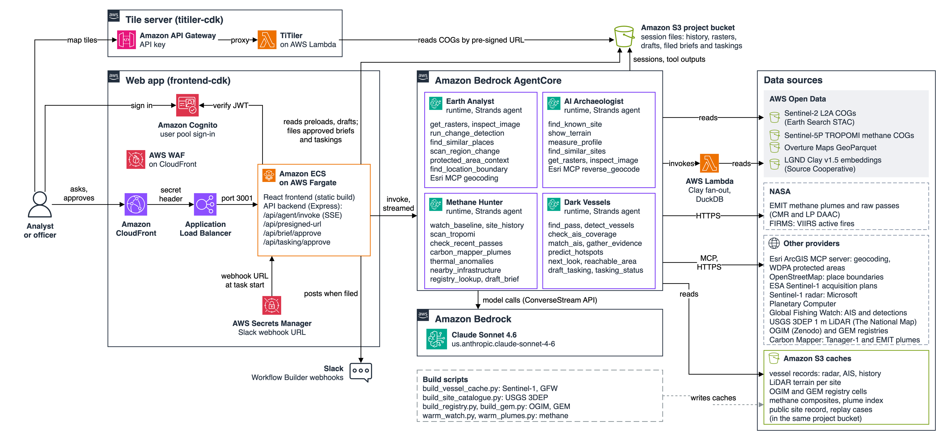
Backup: the architecture in detail
Notes:
Point to land: Backup for technical questions; every box on it comes from the code.
Say: Only if someone asks how it works. Walk it left to right, as on the earlier slide, then answer from the lines below.
If asked about sign-in and traffic: Amazon Cognito user pool, with users added by an admin only. The browser signs in and the backend checks the token on every API call. Requests go through CloudFront with AWS WAF, then an Application Load Balancer that only accepts CloudFront’s secret header, then one container image on ECS Fargate that serves the React frontend and the Express API backend.
If asked about the agents: Four AgentCore runtimes, one per agent, each a Strands agent with its own tools. The backend calls InvokeAgentRuntime and streams each step back as server-sent events. All four call one model, Claude Sonnet 4.6 on Amazon Bedrock, through the US cross-Region inference profile; that is why it sits in its own box. Conversation history is kept in S3, not in AgentCore Memory.
If asked about data: The agents read Sentinel-2 from AWS Open Data, the Clay embeddings through a Lambda fan-out with DuckDB, Esri’s ArcGIS MCP server, OpenStreetMap and ESA’s Sentinel-1 plans when asked. The methane data, Sentinel-5P from AWS Open Data with NASA EMIT and FIRMS and Carbon Mapper’s public plumes (the Tanager-1 satellite and EMIT, from data.carbonmapper.org, credited on the stage), is warmed into S3 the day before and on the day, and fetched only if something is missing. The radar and AIS from Microsoft Planetary Computer and Global Fishing Watch, the USGS 3DEP LiDAR and the OGIM and GEM registries are built into S3 by scripts before the show, so the agents never call those providers during it.
If asked about decisions: Nothing is filed until the analyst or the officer clicks. The backend writes the record to S3 and posts to Slack; the brief’s Slack webhook URL comes from Secrets Manager.
If asked about tracing: The web app’s logs and Container Insights go to Amazon CloudWatch. Agent traces aren’t on this diagram because they weren’t confirmed for the deployed runtimes, so don’t promise a trace view.
Transition: Back to your questions.

