Slide 1
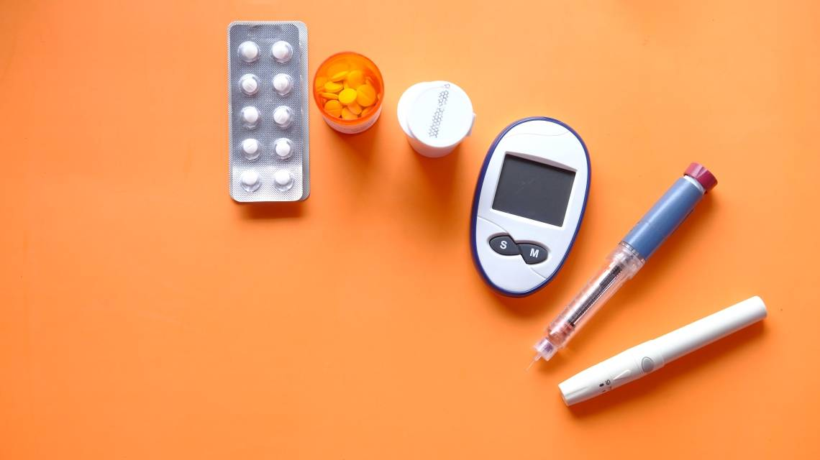
PYTHON FOR DATA ANALYSIS Diabetes in 130-US hospitals
Alexandre BARRAT
Théo JAOUDET

Slide 2




SUMMARY
Presentation of the subject and the dataset
First analysis of the data
Deeper analysis on specific criterias
Machine learning

Slide 3


Presentation of the subject and the dataset
Diabetes in 130-US hospitals between 1999 and 2008
Polish Companies Bankruptcy

Slide 4
Presentation of the subject and the dataset
Diabetes in 130-US hospitals between 1999 and 2008
Inpatient encounter (a hospital admission)
Diabetic encounter (any kind of diabetes)
The length of stay was at least 1 day and at most 14 days
Laboratory tests were performed during the encounter
Medications were administered during the encounter

Slide 5
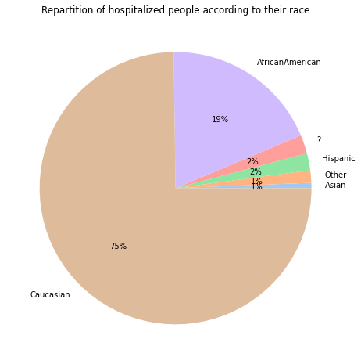
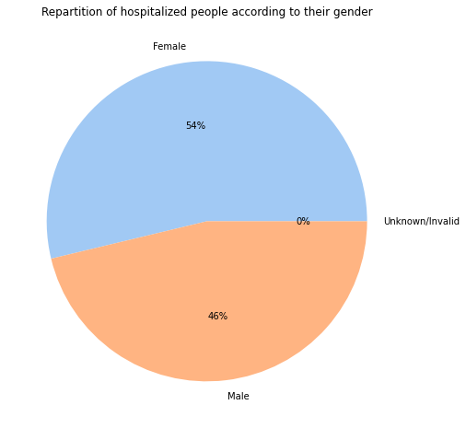
First analysis of the data

Slide 6
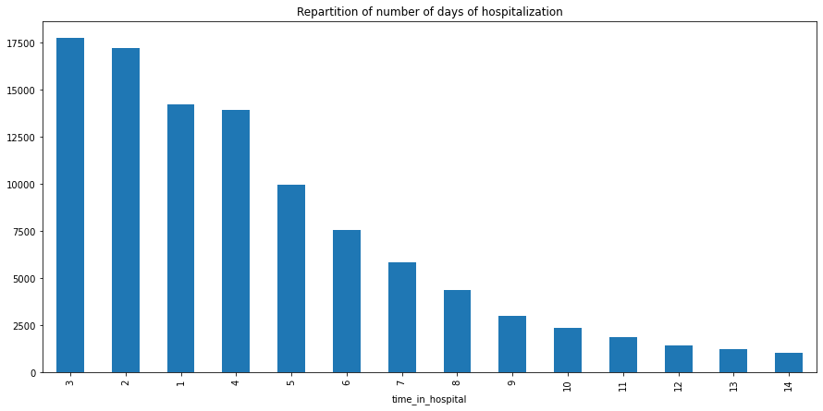
First analysis of the data

Slide 7
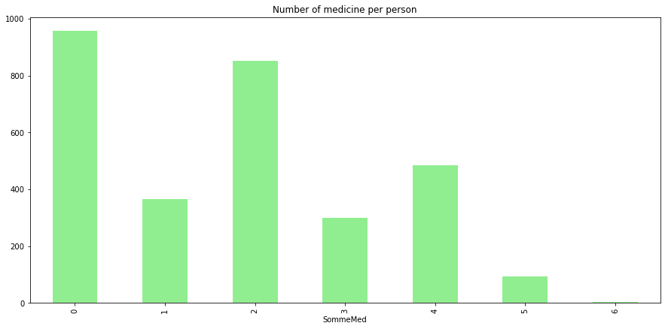
First analysis of the data

Slide 8
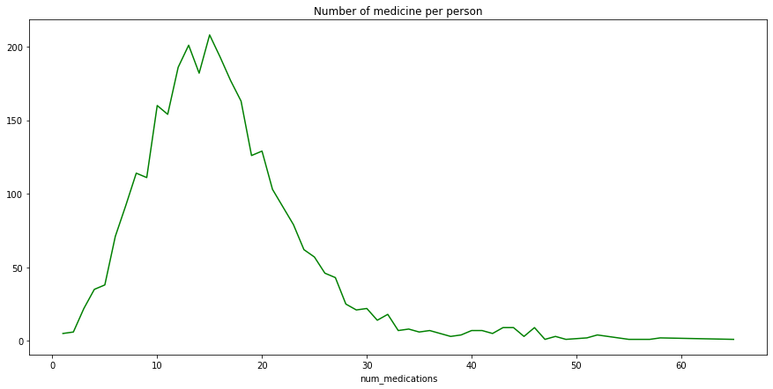
First analysis of the data

Slide 9
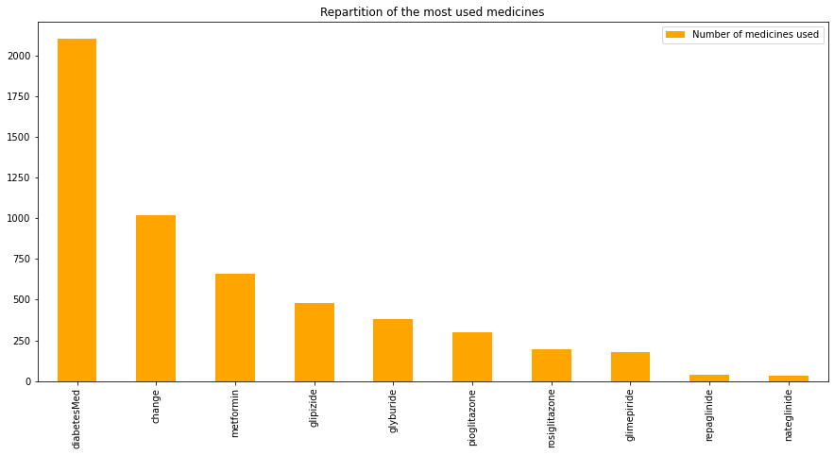
First analysis of the data

Slide 10
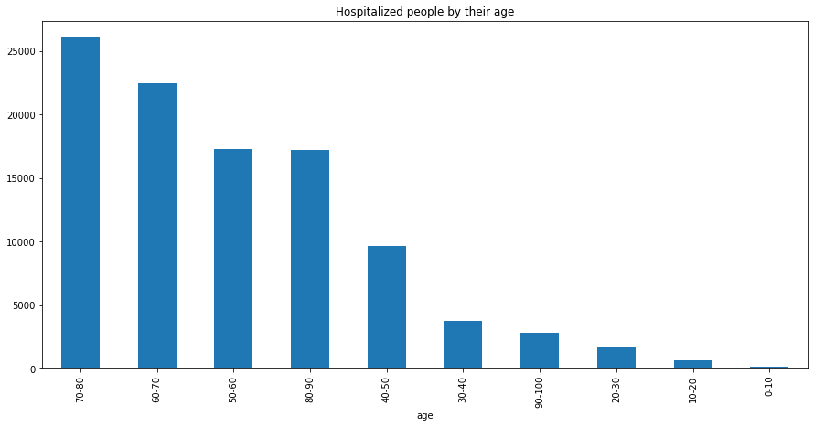
First analysis of the data

Slide 11
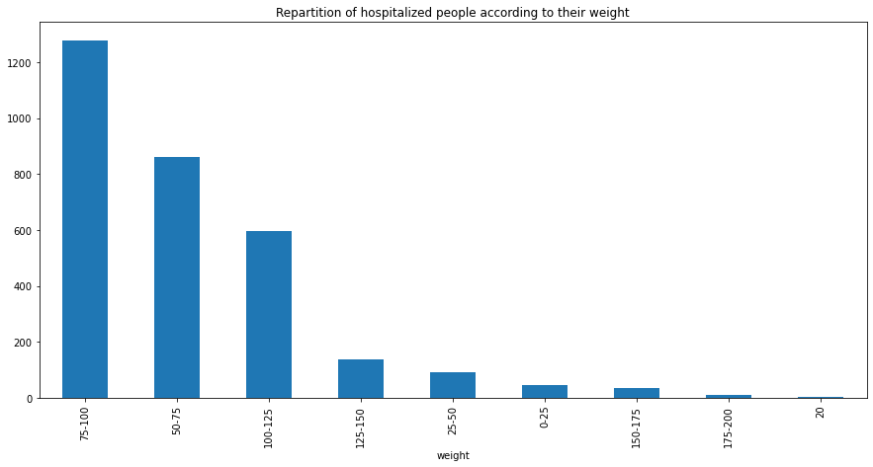
First analysis of the data

Slide 12
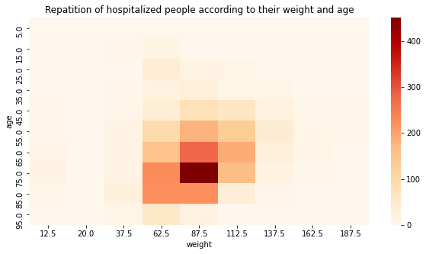
Deeper analysis on specific criterias

Slide 13
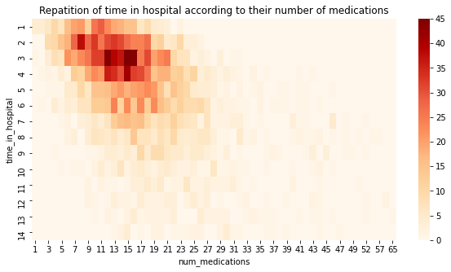
Deeper analysis on specific criterias

Slide 14
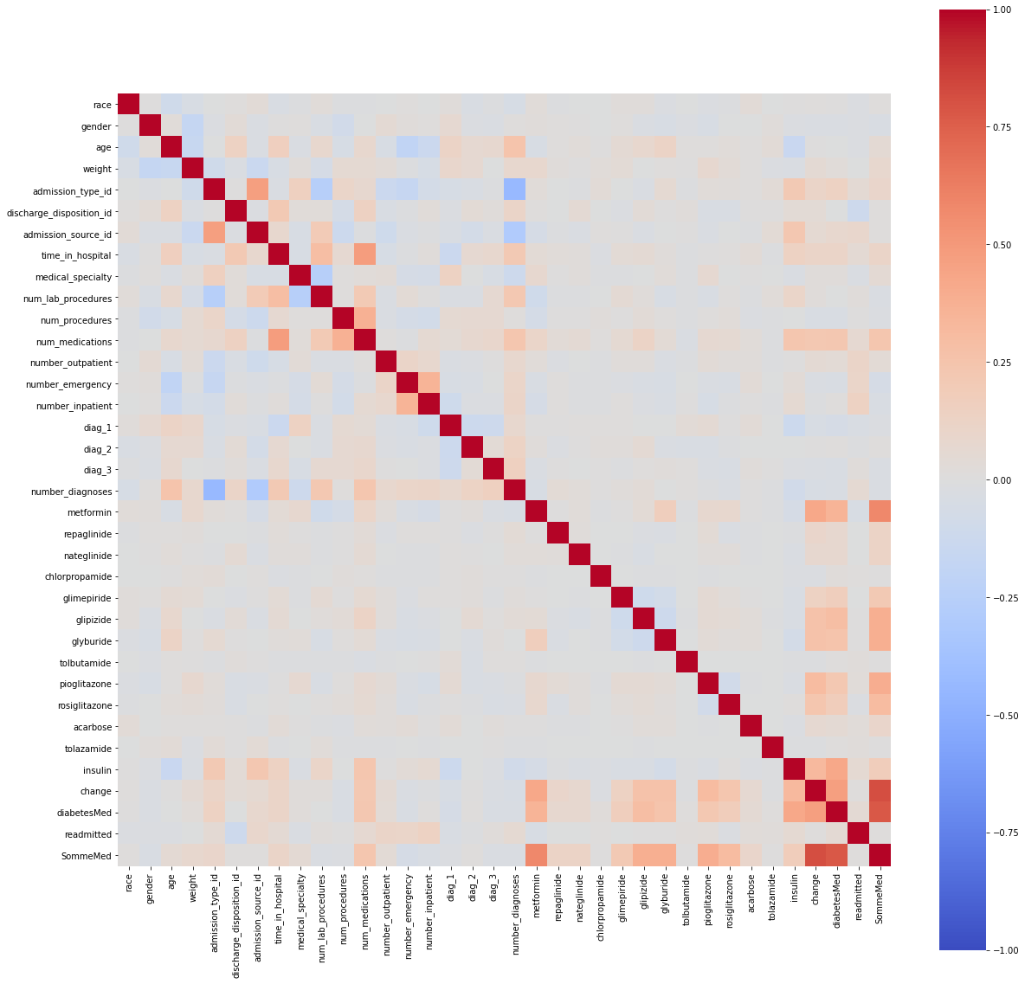
Correlation Matrix

Slide 15
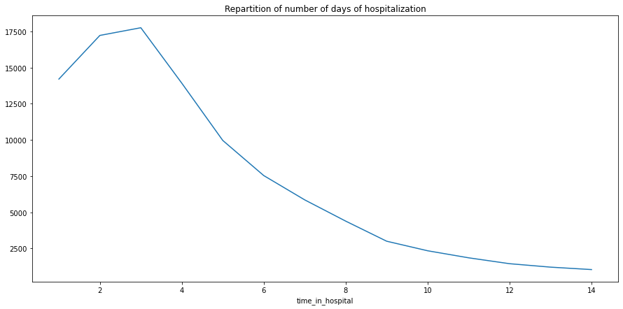
Machine Learning
Which variable are we going to study ?

Slide 16
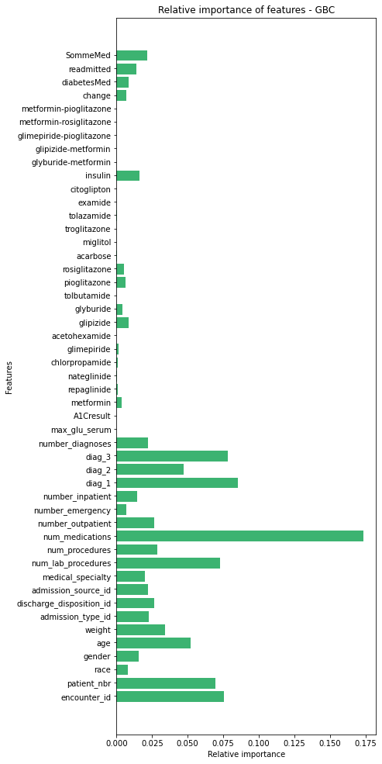

Slide 17
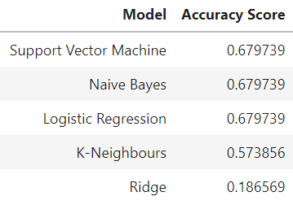
Machine Learning
Best models

Slide 18

Machine Learning
Best model
With

Slide 19
Conclusion
Important correlation between number of meds and time of hospital
Optimisation of the rooms distribution
Better stay for the patient
Prioritazing some kind of patients that are more fragile
Other variables could be useful : number of meds, number of lab procedures or the type of medicines used

Slide 20
Thank you for your attention !

