Slide 1
Chapter 2
Circuit Elements
Taken from PowerPoint Slides for 172212
with slight modifications

Slide 2
Chapter Objectives
To provide a concept of linear models
To study various active and passive circuit elements
  Resistors
  Independent and dependent sources
  Ideal voltmeters and ammeters
  Transducers
  Switches

Slide 3
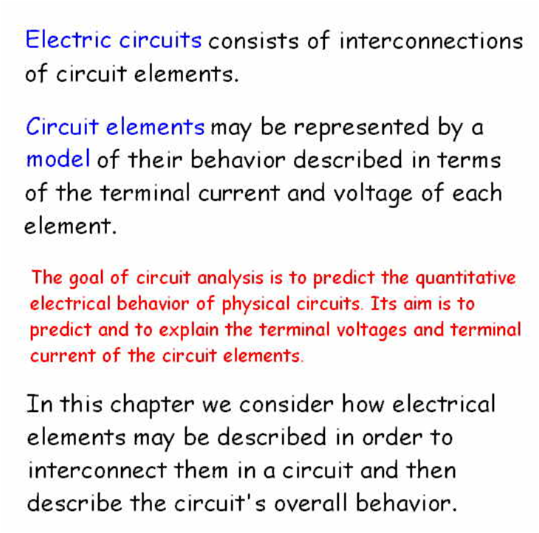

Slide 4
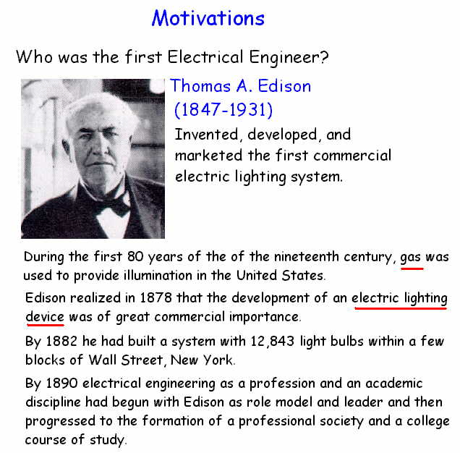

Slide 5
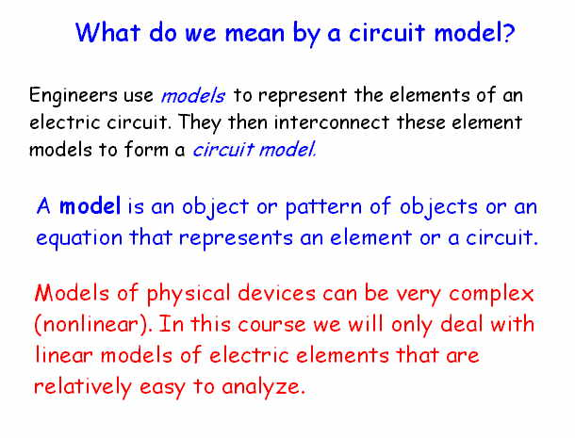

Slide 6
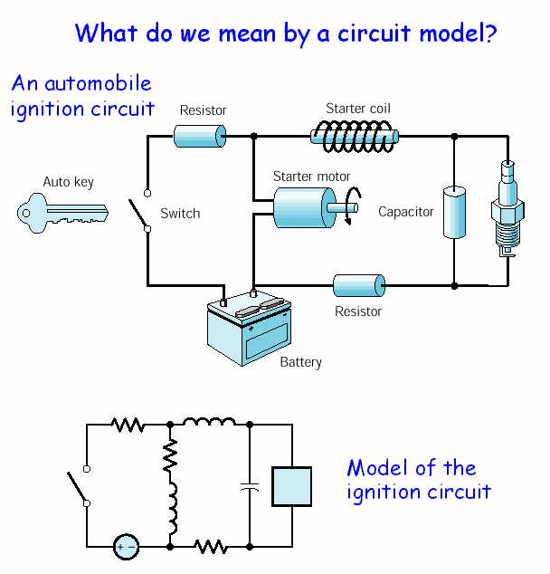

Slide 7
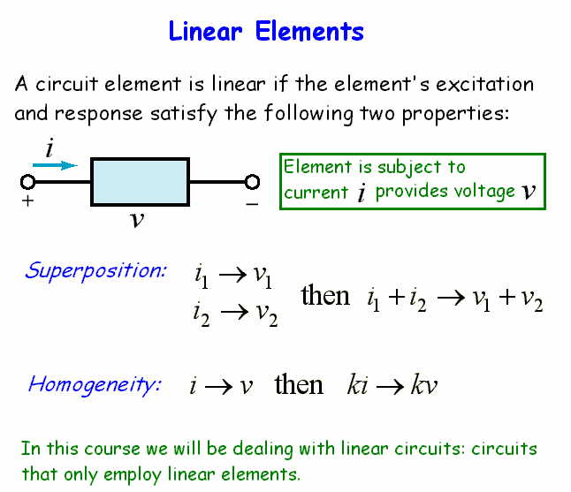

Slide 8
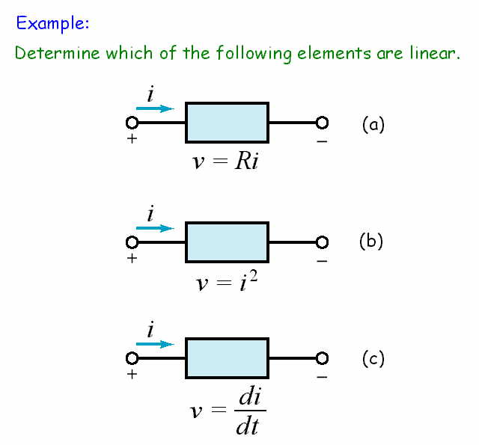

Slide 9
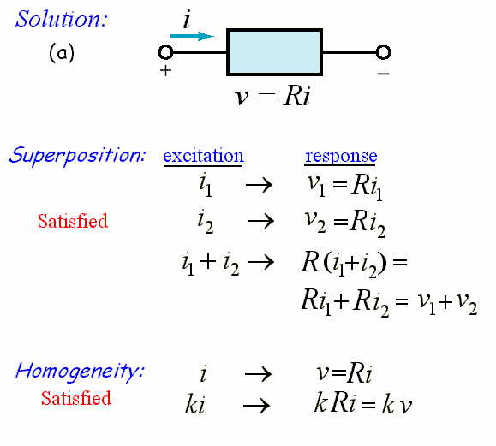

Slide 10
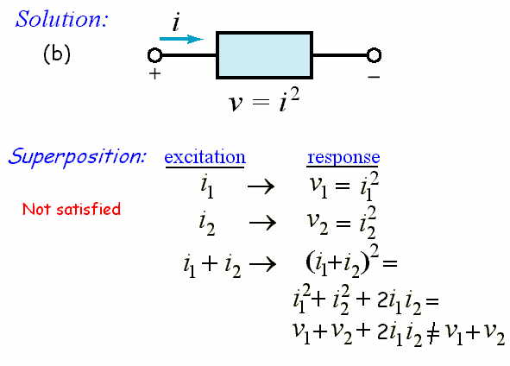

Slide 11
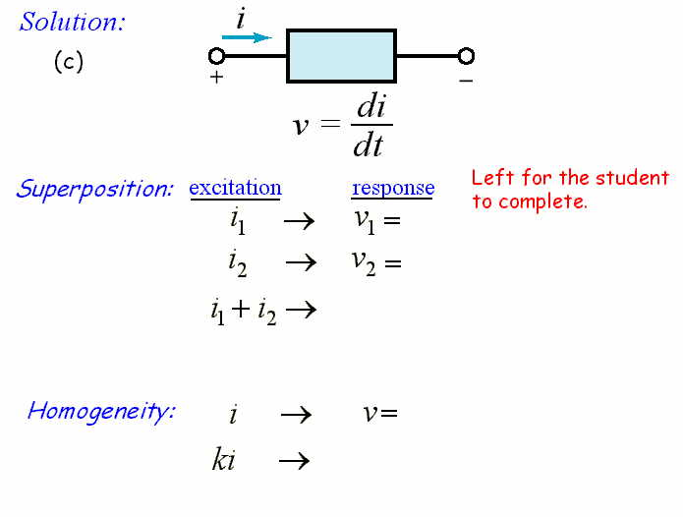

Slide 12
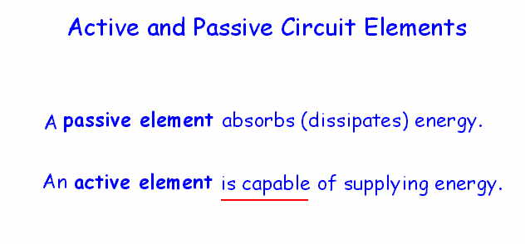

Slide 13
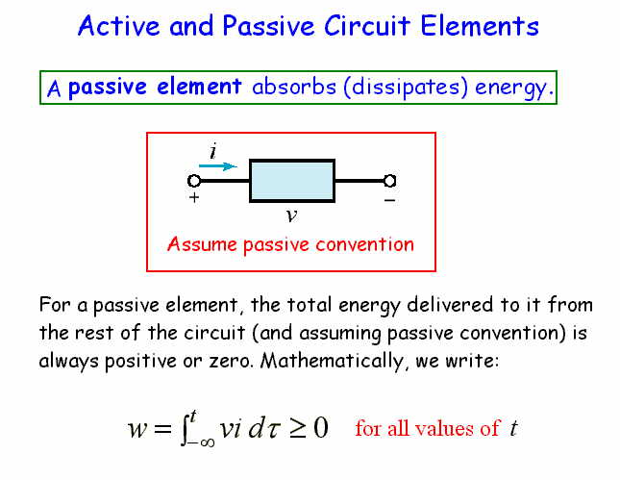

Slide 14
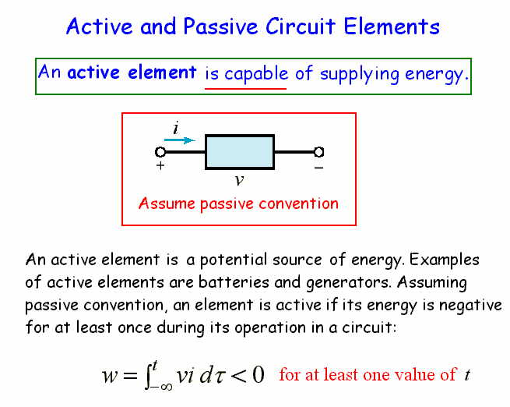

Slide 15
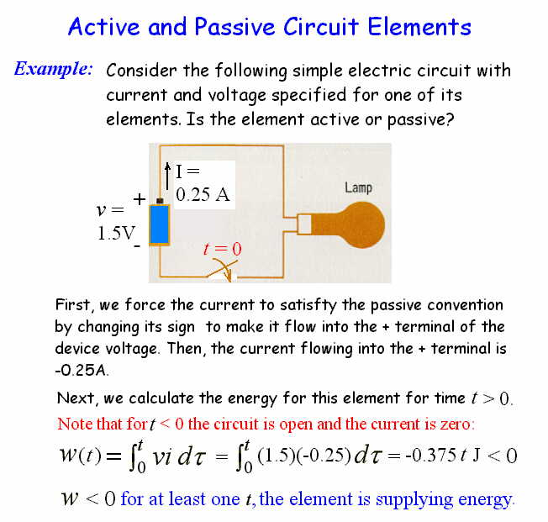

Slide 16
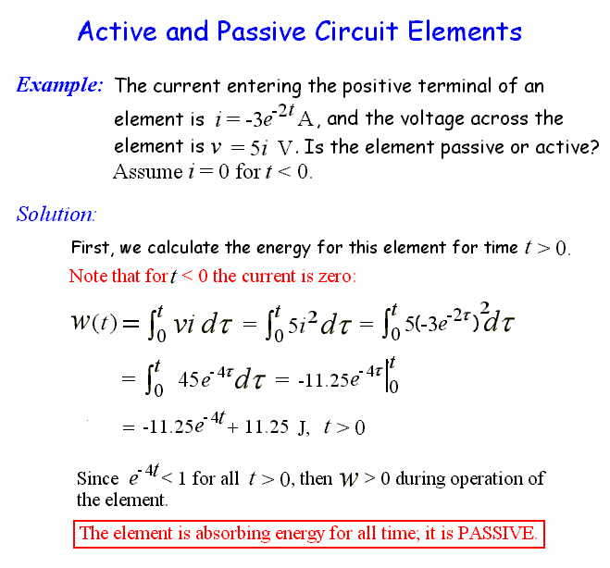

Slide 17
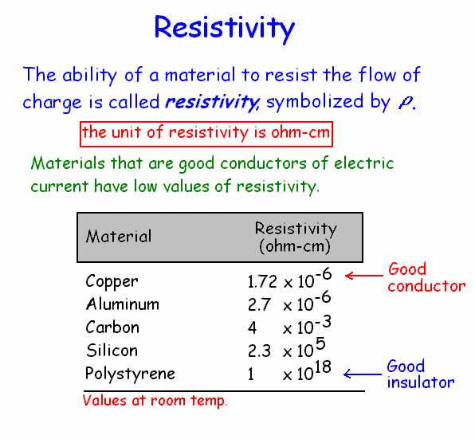

Slide 18
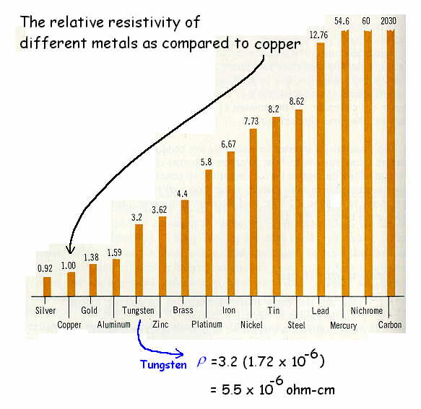

Slide 19
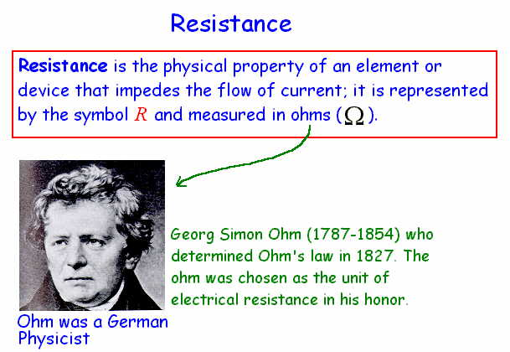

Slide 20
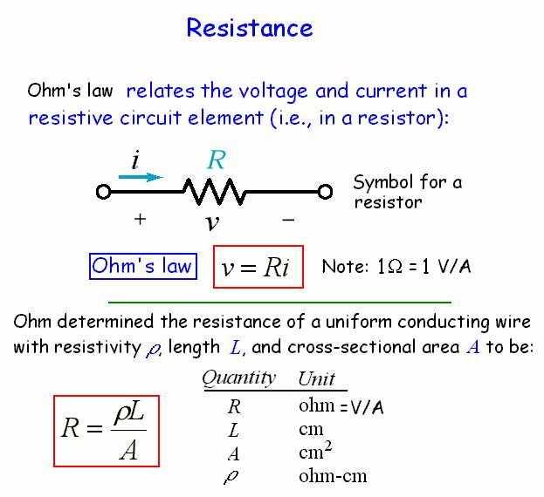

Slide 21
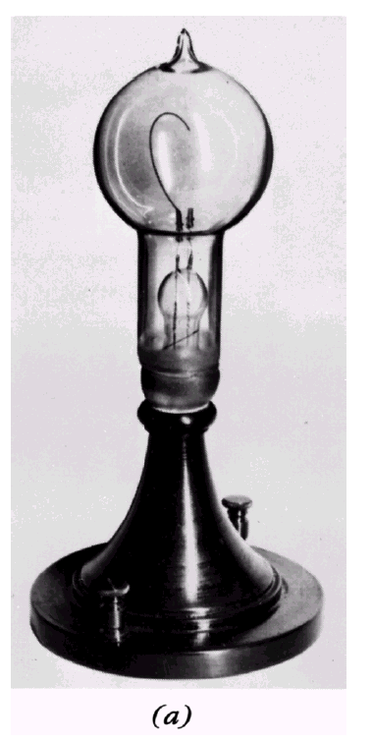
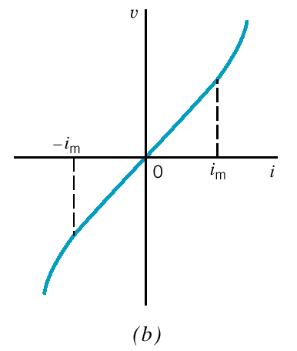
Figure 2.3-3
(a) An incandescent lamp. (b) Voltage–current relationship for an incandescent lamp. The lamp is linear within the range −i_{m} < i < i_{m}.
i-v characteristic

Slide 22
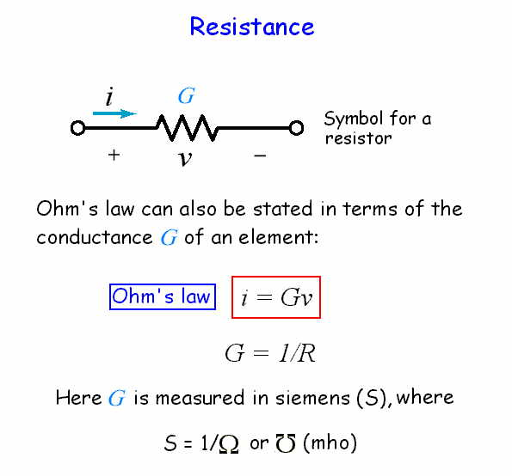

Slide 23
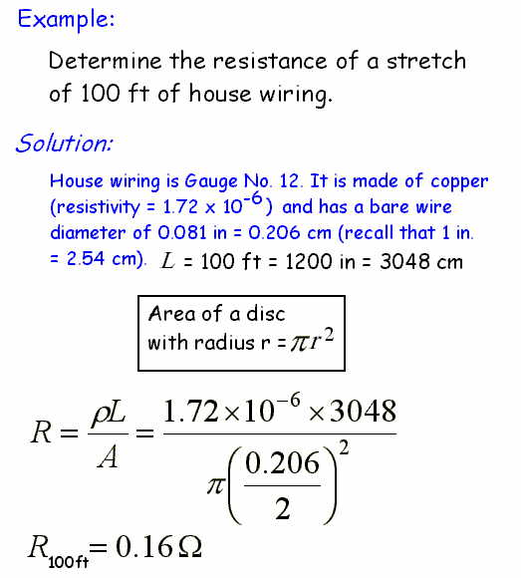

Slide 24
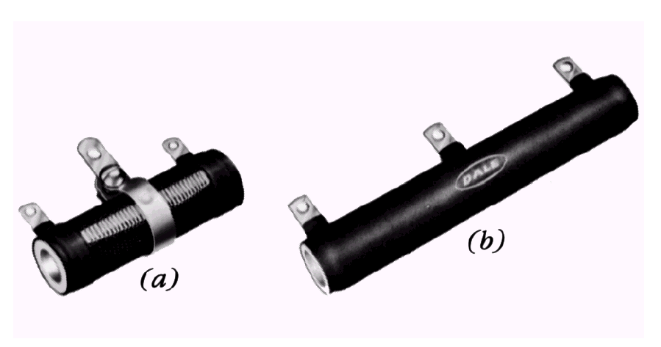
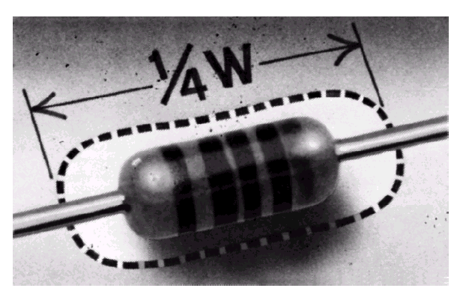
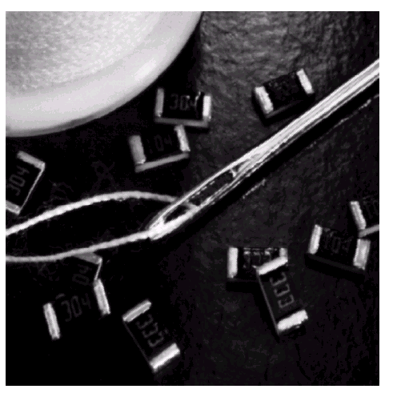
Wirewound resistor
A 1/4-watt
metal film resistor
Different types of
resistors
Small thick-film resistor chips

Slide 25
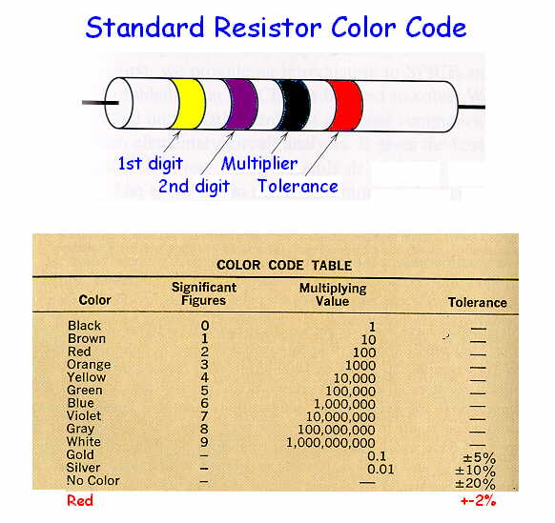

Slide 26
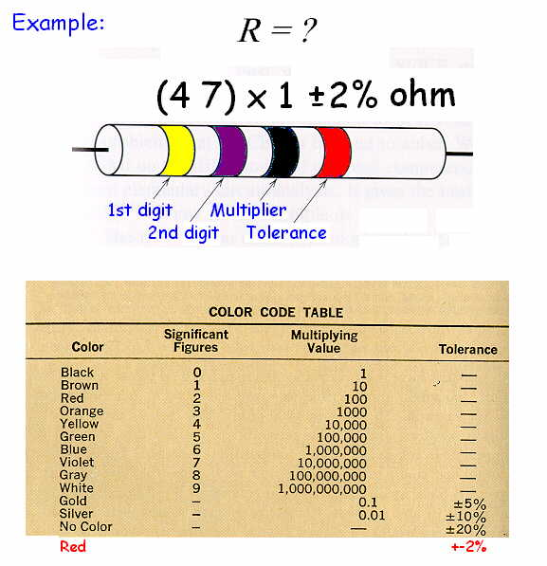

Slide 27
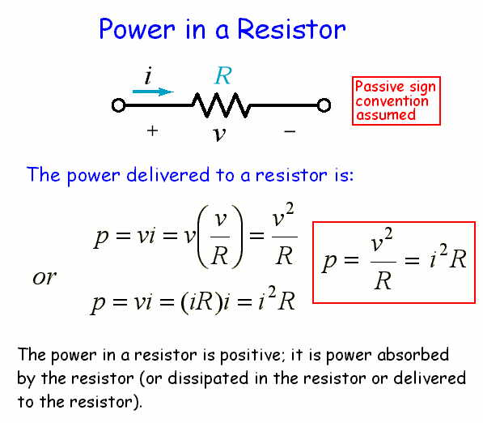

Slide 28
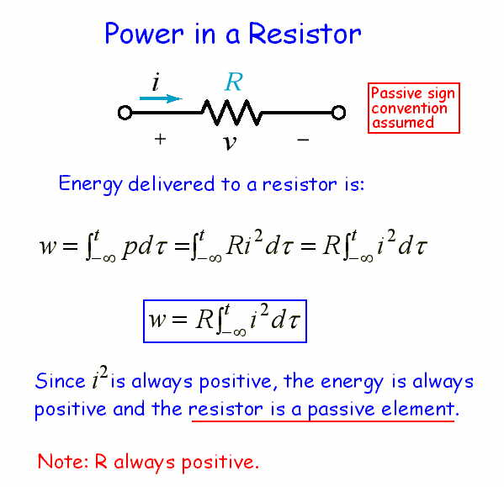

Slide 29
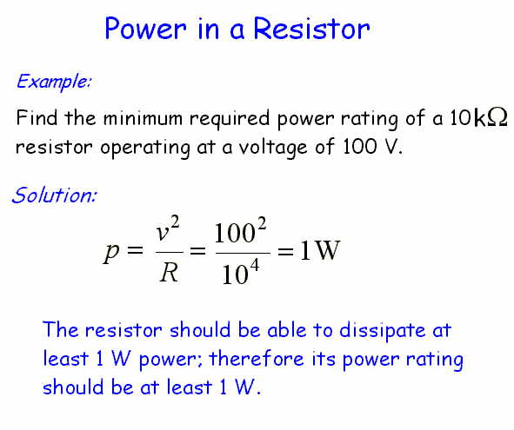

Slide 30
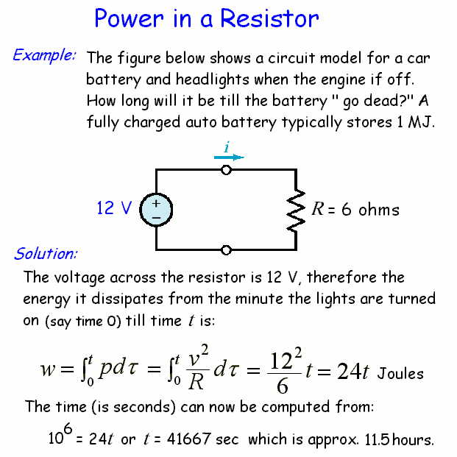

Slide 31
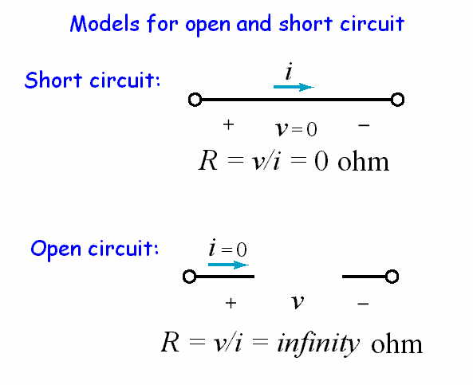

Slide 32
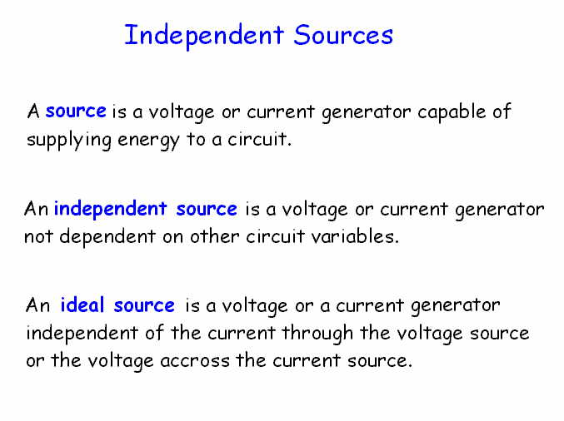

Slide 33
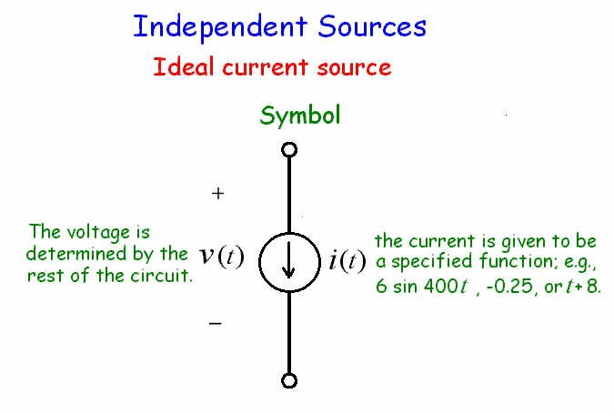

Slide 34
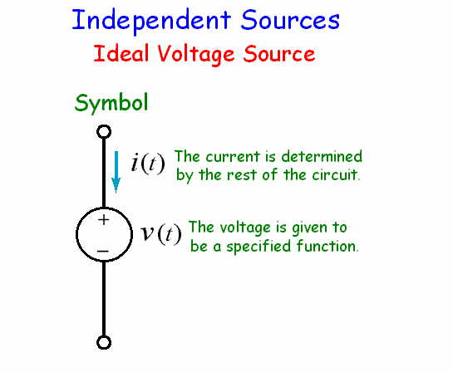

Slide 35
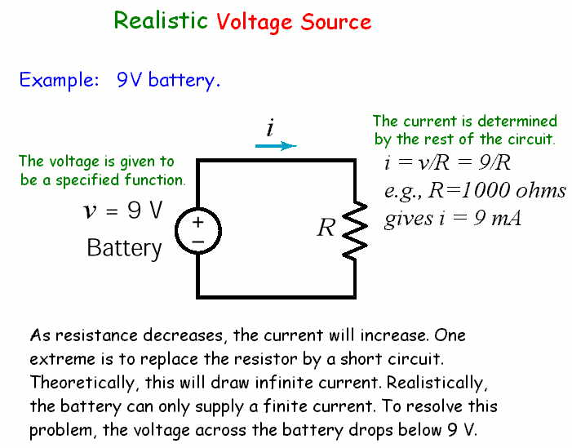

Slide 36
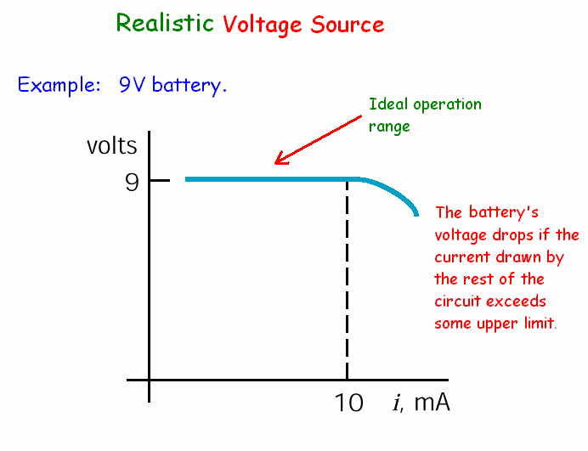

Slide 37
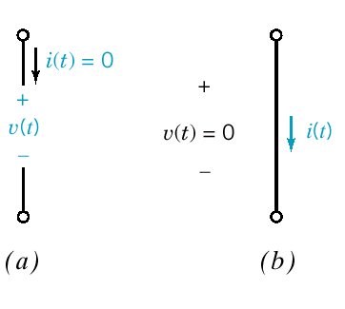
Figure 2.6-3
(a) Open circuit. (b) Short circuit.
Ideal current source
i(t) = 0
Ideal voltage source
v(t) = 0

Slide 38
Models for Open & Short Circuits
Type of circuit | Resistor | Source
Open circuit | Infinity Ohms | 0A current source
Short circuit | 0 Ohm | 0V voltage source

Slide 39
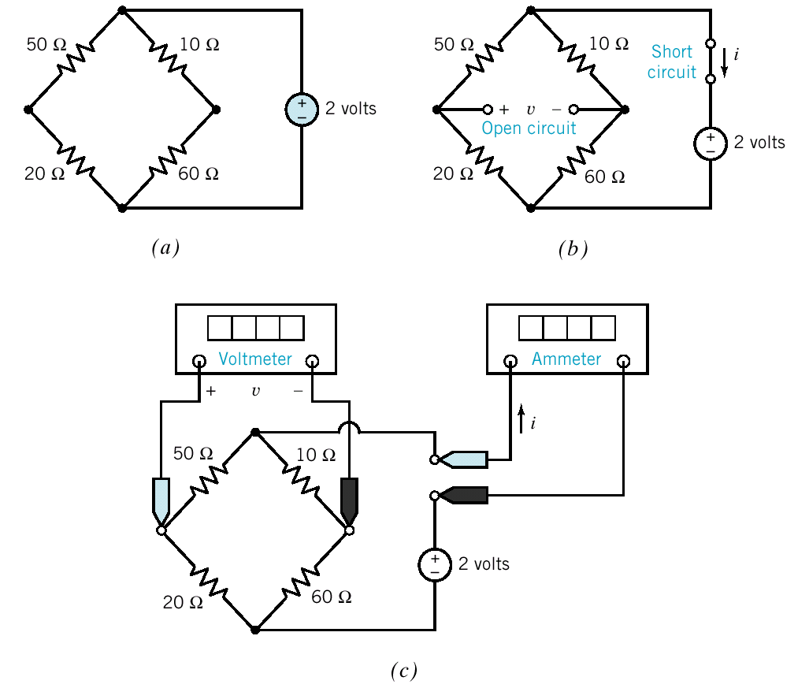
Figure 2.7-3
(a) An example circuit,
(b) plus an open circuit and a short circuit.
(c) The open circuit is replaced by a voltmeter, and the short circuit is replaced by an ammeter. All resistance are in ohms.

Slide 40
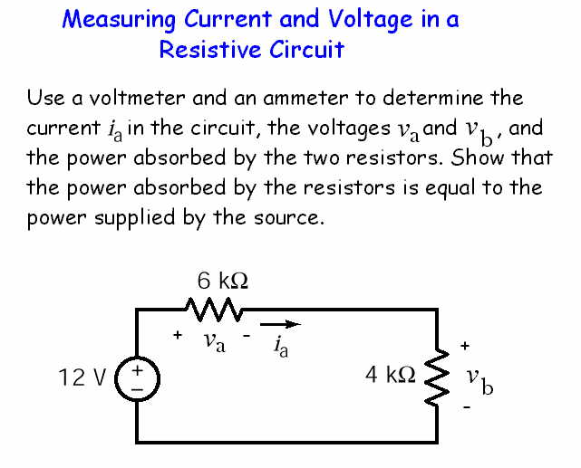

Slide 41
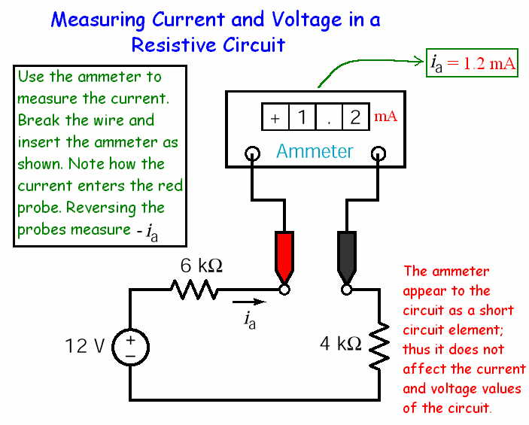

Slide 42
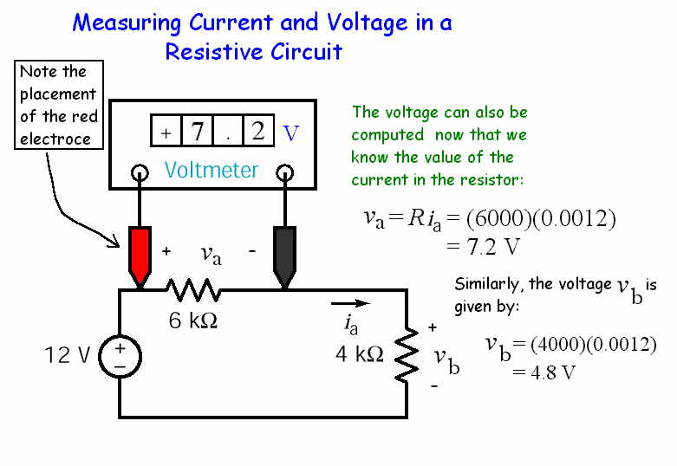

Slide 43
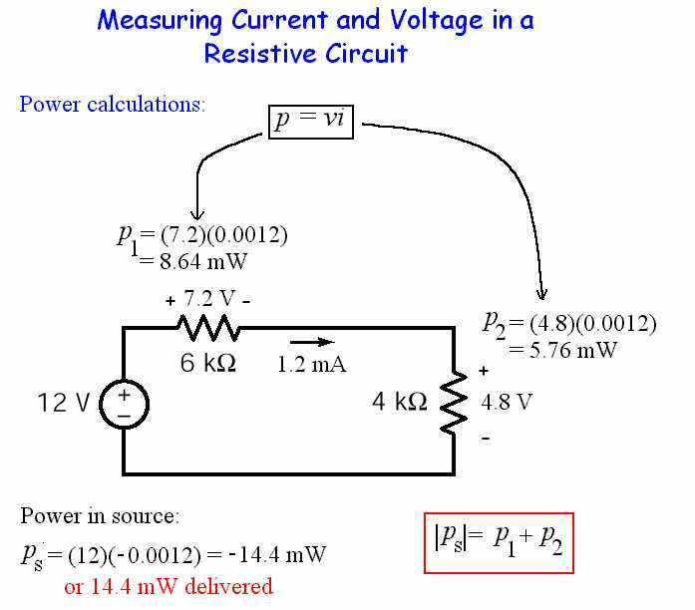

Slide 44
Formulas for Resistive Circuits

Slide 45
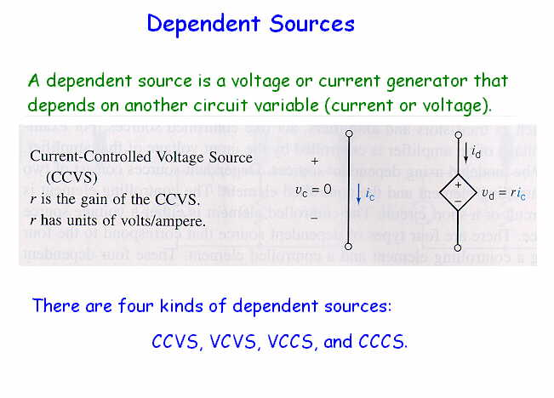

Slide 46
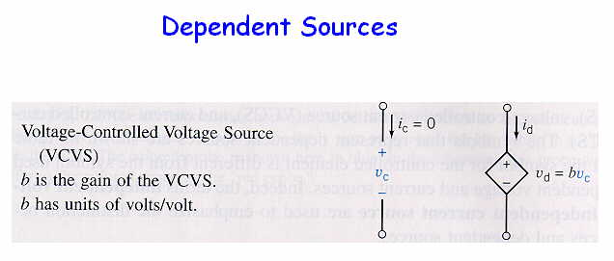

Slide 47
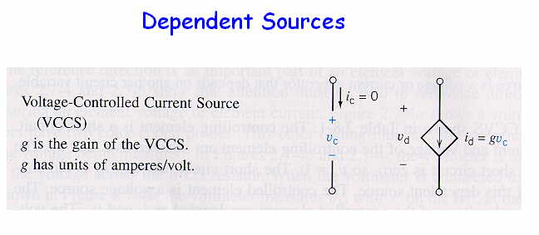

Slide 48
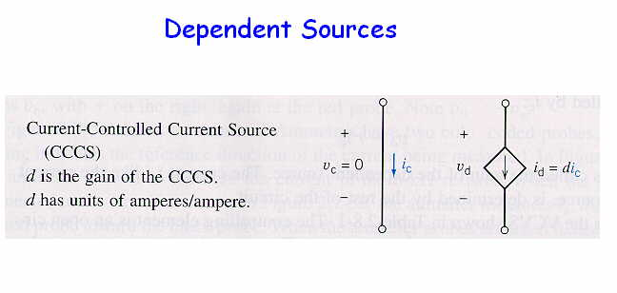

Slide 49
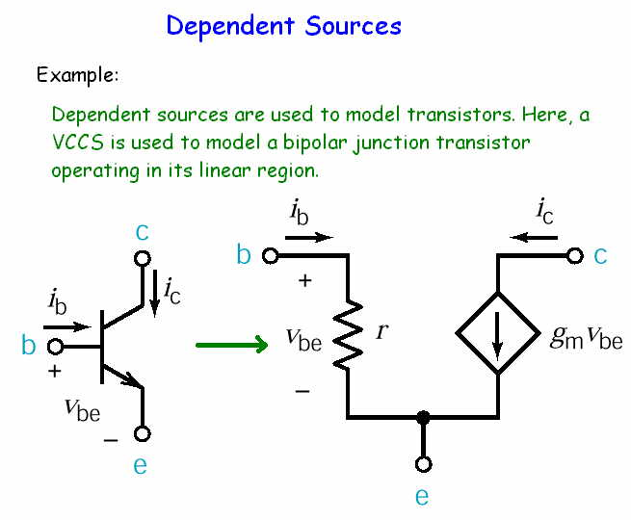

Slide 50
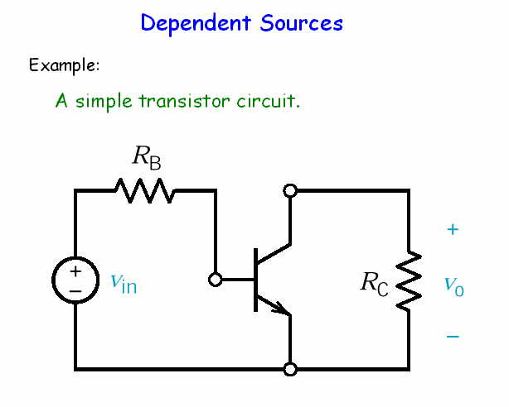

Slide 51
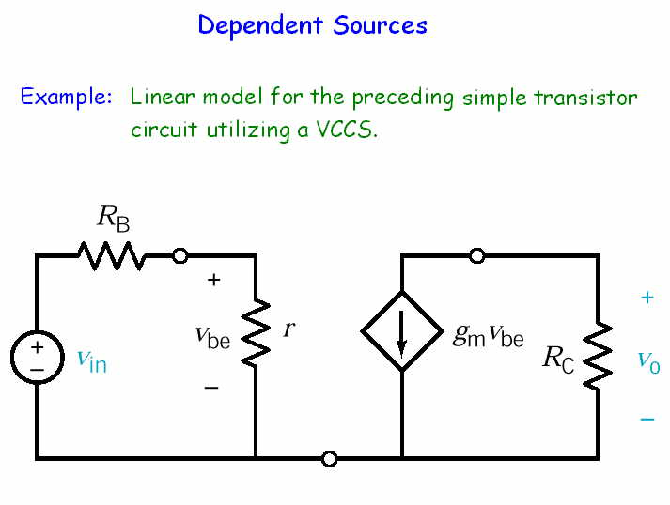

Slide 52


Slide 53


Slide 54

Other circuit simulators
PSPICE (SPICE = Simulation Program with Integrated Circuits Emphasis)
TINA (Toolkit for Interactive Network Analysis)
Etc.

Slide 55


Transducers: devices that convert
physical quantities to electrical quantities
Figure 2.9-1
(a) The symbol and (b) a model for the potentiometer.

Slide 56

Figure 2.9-2
(a) A circuit containing a potentiometer.
(b) An equivalent circuit containing a model of the potentiometer.

Slide 57
Other Transducers
Temperature sensor
Pressure sensor
Photo sensor
Displacement sensor
Etc.

Slide 58


Slide 59


Slide 60


Slide 61


Slide 62
Summary
First electrical engineer
Linear model
Active & passive circuit elements
Resistors
Independent sources
Dependent sources
Transducers
Switches

